Slide 1
Text Mining and Search
Agazzi Ruben 844736
Cominetti Fabrizio 882737

Slide 2
Project Details
00

Slide 3
Project Details
Tasks to be accomplished:
Text Classification
Text Clustering

Slide 4
Dataset
01

Slide 5
Dataset
The dataset used for the project is the IMDB Reviews dataset

Slide 6
Data Exploration
During this phase we observed that the dataset is composed by 50000 reviews, half positive and half negative.
The dataset is composed by training and test dataset, each with 25000 reviews

Slide 7
Classification The goal of the classification task is to distinguish between negative and positive reviews.
02

Slide 8
TEXT CLASSIFICATION
01
03
02
04
PROCESSING
CLASSIFICATION
Tokenization, stopwords, num, punct removal, lemmatization, case folding
Training of classifiers on the two obtained representations
TEXT REPRESENTATION
EVALUATION
Tf-Idf and Bag-of-Words
Performance evaluation of the classifiers

Slide 9
ALTERNATIVE
TEXT PROCESSING
During this phase, we made the following operations:
All the text was transformed in lowercase
Number removal
Punctuation removal
Stop words removal
Extra space removal
Tokenization, using nltk’s word tokenizer
Lemmatization, using wordnet lemmatizer

Slide 10
ALTERNATIVE
TEXT REPRESENTATION
In order to train the classifiers, we needed to get a numerical representation of the text. We choose the following text representations:
Bag-of-Words: we considered uni-grams, bi-grams, and tri-grams. The final vectorized text is composed of 10000 features;
Tf-Idf: we considered uni-grams, bi-grams, and tri-grams, and the final vectorized text is composed by 10000 features.

Slide 11
ALTERNATIVE
TEXT CLASSIFICATION
We chose to train three different classifiers:
Support Vector Machine (SVM)
Multi-Layer Perceptron (MLP)
Logistic Regression (LR)

Slide 12
ALTERNATIVE
Support Vector Machine
We trained a Support Vector Machine on both Bag-of-Words and Tf-Idf text representation.
After a process of trial and error, we used the SVM provided by the scikit-learn library (Linear SVC) with C parameter, which is a regularization parameter, equal to 0.001.
Class | Precision | Recall | F1-Measure
Negative | 0.87 | 0.86 | 0.87
Positive | 0.86 | 0.87 | 0.87
Accuracy |  |  | 0.87
Class | Precision | Recall | F1-Measure
Negative | 0.82 | 0.79 | 0.80
Positive | 0.79 | 0.83 | 0.81
Accuracy |  |  | 0.81
Trained using Bag of Words
Trained using Tf-Idf

Slide 13
ALTERNATIVE
Multi Layer Perceptron
We trained a Multi-Layer Perceptron on both Bag-of-Words and Tf-Idf text representation.
The network architecture is composed by 3 fully-connected layers with ReLU activation, the layers have 128, 64 and 32 neurons; and an output layer with sigmoid activation function with 1 neuron. We chose binary cross-entropy as loss function and adam as optimizer.
Class | Precision | Recall | F1-Measure
Negative | 0.87 | 0.79 | 0.83
Positive | 0.81 | 0.88 | 0.84
Accuracy |  |  | 0.83
Class | Precision | Recall | F1-Measure
Negative | 0.85 | 0.81 | 0.83
Positive | 0.82 | 0.86 | 0.84
Accuracy |  |  | 0.83
Trained using Bag of Words
Trained using Tf-Idf

Slide 14
ALTERNATIVE
Logistic Regression
We finally trained a Logistic Regression classifier on both Bag-of-Words and Tf-Idf text representation.
After a process of trial and error we choose the l2 norm as penalty, a C (regularization parameter) with a value of 1 and we specified a limit of 500 iterations for the training.
Class | Precision | Recall | F1-Measure
Negative | 0.85 | 0.87 | 0.86
Positive | 0.87 | 0.84 | 0.85
Accuracy |  |  | 0.86
Class | Precision | Recall | F1-Measure
Negative | 0.87 | 0.87 | 0.87
Positive | 0.87 | 0.87 | 0.87
Accuracy |  |  | 0.87
Trained using Bag of Words
Trained using Tf-Idf

Slide 15
ALTERNATIVE
EVALUATION
After seeing the classification results, we can state that all the three models performs very well, with all the values of accuracy higher than 80% in the binary classification task.
In particular, the best models, in terms of accuracy, are the Logistic Regression trained on Tf-Idf weights and the Support Vector Machine trained on Bag-of-Words.

Slide 16
Clustering The goal of the clustering task is to group together similar reviews.
03

Slide 17
CLUSTERING
01
03
02
04
PROCESSING
CLUSTERING
Tokenization, stopwords, num, punct removal, lemmatization, case folding
Find clusters using obtained text representation
TEXT REPRESENTATION
EVALUATION
Tf-Idf weights and dimensionality reduction
Performance evaluation of the clustering algorithms

Slide 18
ALTERNATIVE
PROCESSING
During this phase, we made the following operations:
All the text is transformed in lowercase
Number removal
Punctuation removal
Stop words removal
Extra space removal
Tokenization, using nltk’s word tokenizer
Lemmatization, using wordnet lemmatizer

Slide 19
ALTERNATIVE
TEXT REPRESENTATION
In order to perform the clustering steps, we needed to get a numerical representation of the text.
The next steps were followed to obtain the desired text representation:
Tf-Idf: we considered uni-grams and bi-grams, and the final vectorized text is composed by 10000 features;
SVD: we performed Singular Value Decomposition in order to obtain shorter and denser vectors that represent text. After SVD was performed, all vectors had a length of 200.

Slide 20
ALTERNATIVE
TEXT CLUSTERING
We used the following clustering algorithms:
DBSCAN: a partitional, partial and exclusive clustering algorithm. It creates clusters selecting dense regions of points. It is not needed to specify the number of clusters;
K-Means: a partitional, total and exclusive clustering algorithm. It assigns points to clusters based on their Euclidean distance. It is needed to specify the number of clusters.

Slide 21
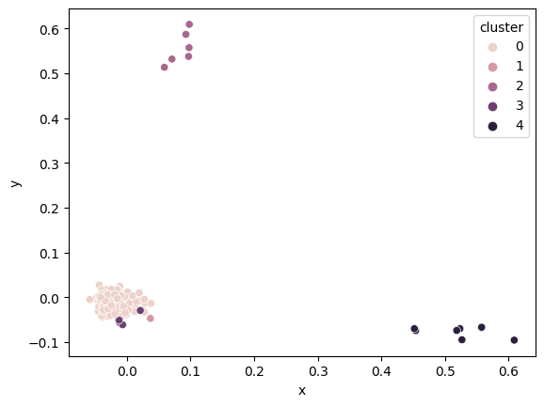
ALTERNATIVE
DBSCAN
We performed text clustering using the DBSCAN algorithm. In particular, we set the
Minimum distance between two points that are in the same cluster equal to 0.225 and we set the minimum number of elements per cluster equal to 5.
5 clusters were found, and 247 reviews were assigned to a cluster.
Silhouette coefficient = 0.391
Plot of the clusters (points not assigned to any clusters are omitted)

Slide 22
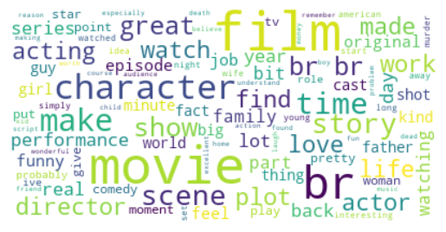
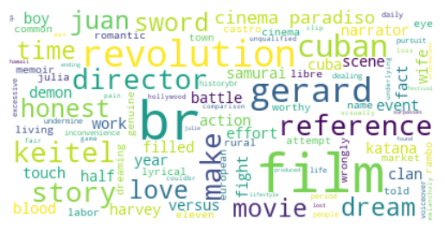
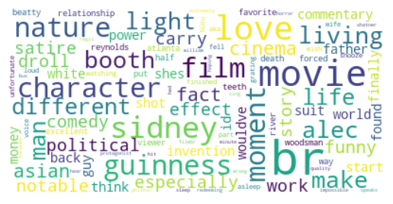
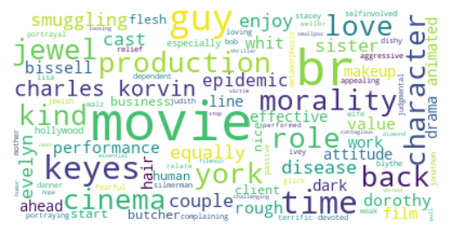
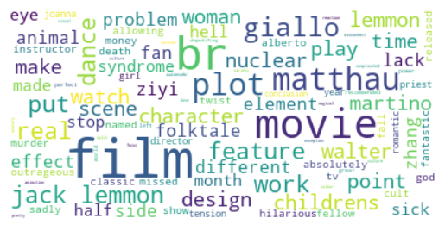
DBSCAN Clusters WordClouds
ALTERNATIVE

Slide 23
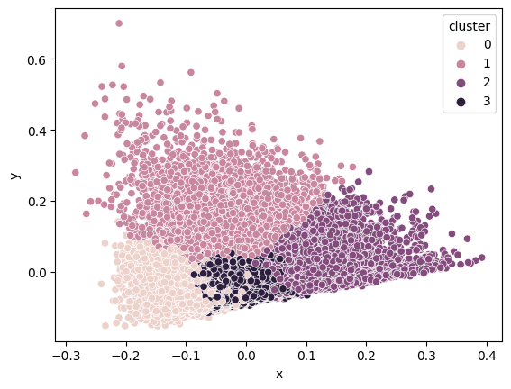
ALTERNATIVE
K-Means
We performed text clustering using the K-Means algorithm. In particular, we set the number of clusters equal to 4. The silhouette measure was equal to 0.17
Silhouette coefficient = 0.017
Plot of the clusters

Slide 24
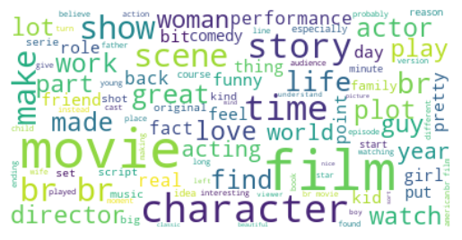
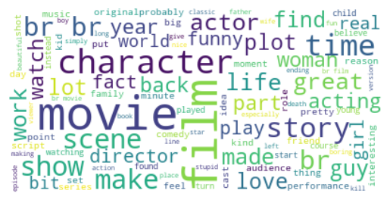
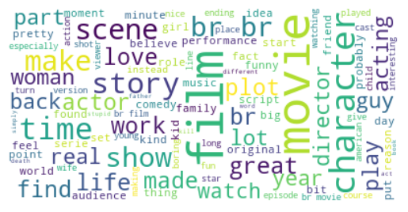
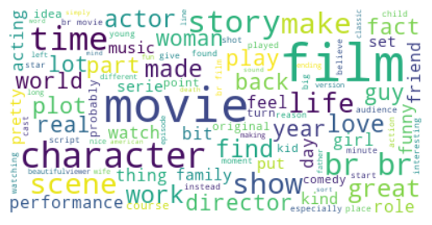
K-Means Clusters WordClouds
ALTERNATIVE

Slide 25
ALTERNATIVE
EVALUATION
As we can see from the average Silhouette measure, the clustering algorithm that performs “better” is the DBSCAN, even though only 300 reviews out of 50000 are assigned to a cluster. In the other hand, the k-means algorithm have a lower average Silhouette but all the reviews are assigned to a cluster.

Slide 26
ALTERNATIVE
CONCLUSIONS
We can be satisfied with what we obtained from the text classification phase, with all three algorithms achieving a good accuracy value.
Regarding text clustering, the Silhouette coefficient values obtained by the algorithms are not equally satisfactory.
Possible future developments could include different algorithms and different text representation techniques.

Slide 27
THANK YOU!

