Slide 1
Text Mining Project
Agazzi Ruben 844736
Cominetti Fabrizio xxxxxx

Slide 2
Project details
02

Slide 3
Project details
The project is divided in two tasks:
Text classification
Text clustering

Slide 4
Dataset
01

Slide 5
Dataset
The dataset used for the project is the «IMDB Reviews» dataset(Kaggle link)

Slide 6
Data exploration
During this phase we observed that the dataset is composed by 50000 reviews, half positive and half negative.
The dataset is composed by training and test dataset, both with 25000 reviews

Slide 7
Classification
03

Slide 8
Classification task
The goal of the classification task is to distinguish between negative and positive reviews.

Slide 9
CLASSIFICATION
01
03
02
04
PREPROCESSING
CLASSIFICATION
Text pre-processing: tokenization, stop words removal, lemmatization, etc.
Training of some classifiers on the two obtained representations
TEXT REPRESENTATION
EVALUATION
Text representation using TF-IDF and Bag of Words
Performance evaluation of the classifiers

Slide 10
ALTERNATIVE
PREPROCESSING
During the preprocessing phase we made the following operations:
All the text is transformed in lowercase
Number removal
Punctuation removal
Stop words removal
Tokenization, using nltk’s word tokenizer
Lemmatization, using wordnet lemmatizer

Slide 11
ALTERNATIVE
TEXT REPRESENTATION
In order to train the classifiers we need to get a numerical representation of the text.
We choose the following text representations:
Bag of Words: we considered uni-grams and bi-grams, and the final vectorized text is composed of 25000 features.
TF-IDF: we considered uni-grams and bi-grams, and the final vectorized text is composed by 25000 features.

Slide 12
ALTERNATIVE
CLASSIFICATION
For the classification part we choose 3 different classifiers to train:
Support Vector Machine
Multi-Layer Perceptron
Logistic Regression

Slide 13
ALTERNATIVE
Support Vector Machine
We trained a Support Vector Machine on both TF-IDF and Bag of Words representation.
After a process of trial and error we used the svm provided by the scikit-learn library(Linear SVC) with C parameter, which is a regularization parameter, equal to 0.001.
Class | Precision | Recall | F1-Measure
Negative | 0.87 | 0.86 | 0.87
Positive | 0.86 | 0.87 | 0.87
Accuracy |  |  | 0.87
Class | Precision | Recall | F1-Measure
Negative | 0.82 | 0.78 | 0.80
Positive | 0.79 | 0.83 | 0.81
Accuracy |  |  | 0.81
Trained using Bag of Words
Trained using TF-IDF

Slide 14
ALTERNATIVE
Multi Layer Perceptron
We trained a Multi Layer Perceptron.
The network architecture is composed by 3 Fully connected layers with ReLU activation, the layers have 128, 64 and 32 neurons; and an output layer with sigmoid activation function with 1 neuron.
We choose binary cross-entropy as loss function and adam as optimizer.
Class | Precision | Recall | F1-Measure
Negative | 0.85 | 0.82 | 0.84
Positive | 0.84 | 0.86 | 0.84
Accuracy |  |  | 0.84
Class | Precision | Recall | F1-Measure
Negative | 0.85 | 0.81 | 0.83
Positive | 0.82 | 0.85 | 0.84
Accuracy |  |  | 0.83
Trained using Bag of Words
Trained using TF-IDF

Slide 15
ALTERNATIVE
Logistic regression
We finally trained a logistic regression classifier.
After a process of trial and error we choose the l2 norm as penalty, as C (regularization parameter) a value of 1 and we specified a limit of 500 iterations for the training.
Class | Precision | Recall | F1-Measure
Negative | 0.85 | 0.87 | 0.86
Positive | 0.86 | 0.84 | 0.85
Accuracy |  |  | 0.85
Class | Precision | Recall | F1-Measure
Negative | 0.87 | 0.87 | 0.87
Positive | 0.87 | 0.87 | 0.87
Accuracy |  |  | 0.87
Trained using Bag of Words
Trained using TF-IDF

Slide 16
ALTERNATIVE
CLASSIFICATION EVALUATION
After seeing the classification results we can say that all the three models performs very well, with all accuracies around 80% in the binary classification task. In particular, the best models, in terms of accuracy, are the Logistic Regression trained on TF-IDF dataset and the SVM trained on the Bag of Word dataset.

Slide 17
Clustering
04

Slide 18
Clustering task
The goal of the clustering task is to group together similar reviews.

Slide 19
CLUSTERING
01
03
02
04
PREPROCESSING
CLUSTERING
Text pre-processing: tokenization, stop words removal, lemmatization, etc.
Find clusters using obtained text representation
TEXT REPRESENTATION
EVALUATION
Text representation using TF-IDF and dimensionality reduction
Performance evaluation of the clustering algorithms

Slide 20
ALTERNATIVE
PREPROCESSING
During the preprocessing phase we made the following operations:
All the text is transformed in lowercase
Number removal
Punctuation removal
Stop words removal
Tokenization, using nltk’s word tokenizer
Lemmatization, using wordnet lemmatizer

Slide 21
ALTERNATIVE
TEXT REPRESENTATION
In order to perform the clustering step, we need to get a numerical representation of the text.
We followed the following steps to perform text representation:
TF-IDF: we considered uni-grams and bi-grams, and the final vectorized text is composed by 25000 features.
SVD: we performed SVD in order to obtain shorter and denser vectors that represent text. After SVD all vectors have a length of 200.

Slide 22
ALTERNATIVE
CLUSTERING
We used the following clustering algorithms to perform this step:
DBSCAN: is a partitional, partial and exclusive clustering algorithm. It creates clusters selecting dense regions of points. It is not needed to specify the number of clusters
K-Means: is a partitional, total and exclusive clustering algorithm. It assigns points to clusters based on their Euclidean distance. It is needed to specify the number of clusters.

Slide 23
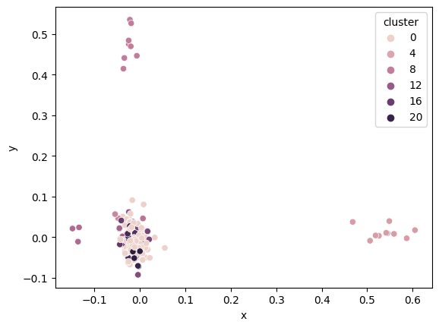
ALTERNATIVE
DBscan
We performed the first clustering using the Dbscan algorithm. In particular, we set the
Minimum distance between two points that are in the same cluster equal to 0.25 and we set the minimum number of elements per cluster equal to 3.
There were 6 clusters found, 342 reviews were assigned to a cluster. The average silhouette measure was equal to 0.24
Plot of the reviews of the clusters (points not assigned to any clusters are omitted).

Slide 24
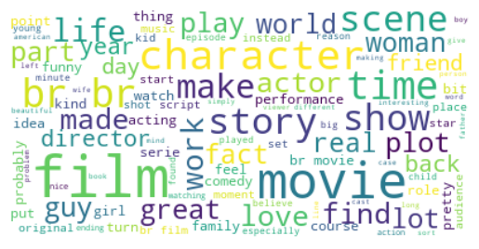
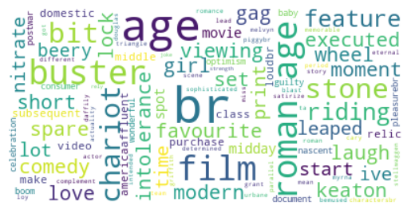
Dbscan Clusters Word Clouds
ALTERNATIVE

Slide 25
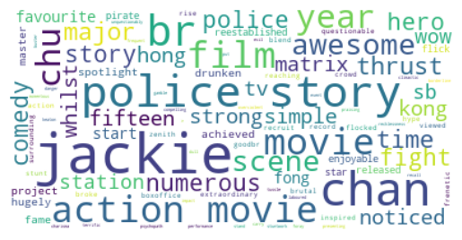
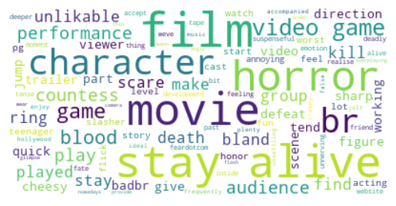
Dbscan Clusters Word Clouds
ALTERNATIVE

Slide 26
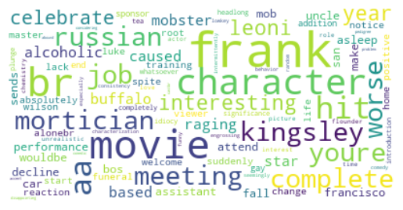
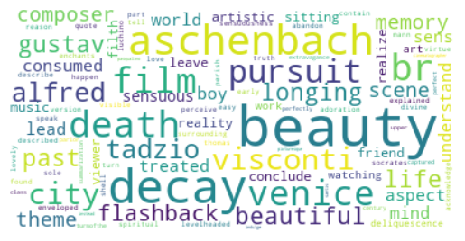
Dbscan Clusters Word Clouds
ALTERNATIVE

Slide 27
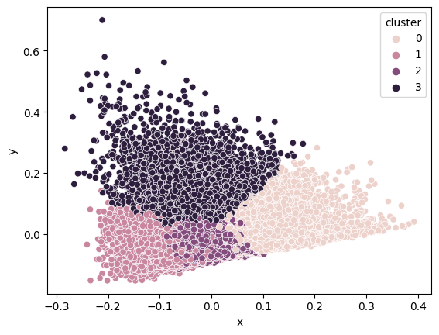
ALTERNATIVE
K-Means
We performed the second clustering using the K-Means algorithm. In particular, we set the
Number of clusters equal to 4. The silhouette measure was equal to 0.17
The average silhouette measure was equal to 0.24
Plot of the clusters of the reviews.

Slide 28
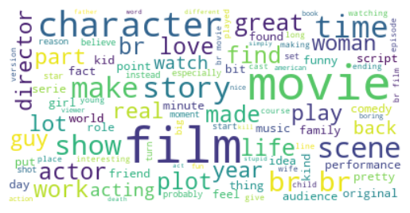
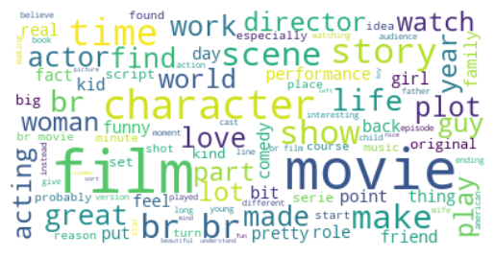
K-Means Clusters Word Clouds
ALTERNATIVE

Slide 29
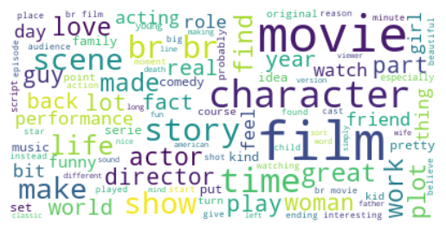
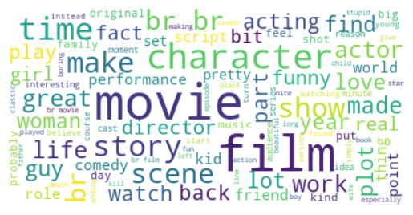
K-Means Clusters Word Clouds
ALTERNATIVE

Slide 30
ALTERNATIVE
CONCLUSIONI CLUSTERING
As we can see from the average silhouette measure, the algorithm that performs “better” is the DBSCAN, even though only 300 reviews out of 50000 are assigned to a cluster. In the other hand the k-means algorithm have a lower average silhouette but all the reviews are assigned to a cluster.

Slide 31
ALTERNATIVE
CONCLUSIONS
We are very satisfied with the classification task; all the classifiers achieved good values of accuracy.
The clustering task the results, measured with the average silhouette measure, are not too high, maybe an improvement could be made for the text representation, for example using embeddings like GloVe or word2vec.

Slide 32
THANK YOU!

