Slide 1

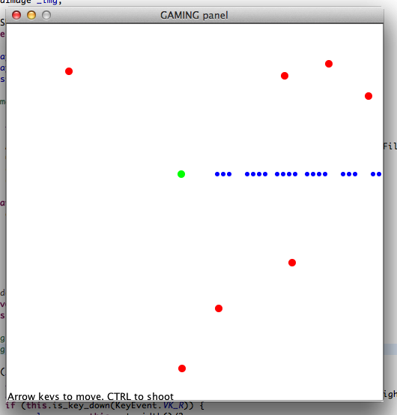
Let's make a shooter game
Object-oriented design with gamepanel
+
Misc gamepanel stuff

Slide 2
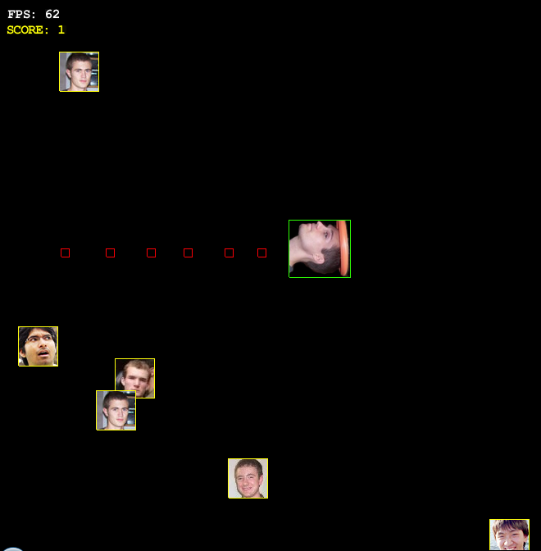
Outline:
You shoot bullets from the last direction you moved. Keep track of direction (as an enum), keep track of bullets (as a list of bullet objects). Remove the bullets if they're offscreen.
There are enemies on the screen (keep track of them as a list of enemy objects). Spawn enemies every once in a while. They'll move at the player (make some dumb AI).
If a bullet hits an enemy, remove both.
If an enemy hits the player, game over.
(Use intersecting circles for hit detection!)
Demo:
http://spotcos.com/misc/martygame.html

Slide 3
Designing a bullet class:
public class Bullet {
public int _x, _y, _vx, _vy;
public Bullet(int x, int y, int vx, int vy) {
_x = x;
_y = y;
_vx = vx;
_vy = vy;
}
public void update(ShooterGame game) {
_x += _vx;
_y += _vy;
game._g.setColor(Color.blue);
game._g.fillOval(this._x-3, this._y-3, 6, 6);
}
}
Every bullet will keep track of it's position and velocity. It'll also “know” how to draw itself as well.
We'll keep a list of these. Then, every (game) update cycle, we'll call update on every bullet.
for (int i_bullet = 0; i_bullet < _player_bullets.size(); i_bullet++) {
Bullet itr_bullet = _player_bullets.get(i_bullet);
itr_bullet.update(this);
}

Slide 4
Designing a bullet class:
If the bullet is offscreen, remove it from the list.
This'll break though, why?
for (int i_bullet = 0; i_bullet < _player_bullets.size(); i_bullet++) {
Bullet itr_bullet = _player_bullets.get(i_bullet);
itr_bullet.update(this);
if (!this.point_on_screen(itr_bullet._x, itr_bullet._y)) {
_player_bullets.remove(itr_bullet);
}
}
And how do we fix this?
(Hint: think backwards!)

Slide 5
How to Make Bullet
Keep track of your last movement direction (I recommend an enum like this)
public enum Side {
LEFT, RIGHT, UP, DOWN
}
Then just modify the movement code from last time:
if (this.is_key_down(KEY_UP)) {
_player_y-=3;
_last_facing = Side.UP;
}
if (this.is_key_down(KEY_DOWN)) {
_player_y+=3;
_last_facing = Side.DOWN;
}
if (this.is_key_down(KEY_LEFT)) {
_player_x-=3;
_last_facing = Side.LEFT;
}
if (this.is_key_down(KEY_RIGHT)) {
_player_x+=3;
_last_facing = Side.RIGHT;
}

Slide 6
How to Make Bullet
Keep track of your last movement direction (I recommend an enum like this)
public enum Side {
LEFT, RIGHT, UP, DOWN
}
Then just modify the movement code from last time:
if (this.is_key_down(KEY_UP)) {
_player_y-=3;
_last_facing = Side.UP;
}
if (this.is_key_down(KEY_DOWN)) {
_player_y+=3;
_last_facing = Side.DOWN;
}
if (this.is_key_down(KEY_LEFT)) {
_player_x-=3;
_last_facing = Side.LEFT;
}
if (this.is_key_down(KEY_RIGHT)) {
_player_x+=3;
_last_facing = Side.RIGHT;
}

Slide 7
How to Make Bullet
When you press the “shoot” button, add a bullet to the list.
(Decide it's velocity based on your last facing)
if (this.is_key_down(KeyEvent.VK_SPACE)) {
int bvx = 0, bvy = 0;
if (_last_facing == Side.LEFT) {
bvx = -8;
} else if (_last_facing == Side.RIGHT) {
bvx = 8;
}
if (_last_facing == Side.UP) {
bvy = -8;
} else if (_last_facing == Side.DOWN) {
bvy = 8;
}
Bullet neu = new Bullet(_player_x, _player_y, bvx, bvy);
_player_bullets.add(neu);
}

Slide 8
Making an enemy class
Do something similar to what was just done with the bullet
public class Enemy {
public int _x, _y;
public Enemy(int x, int y) {
_x = x;
_y = y;
}
public void update(ShooterGame game) {
//We'll put enemy AI in here later!
game._g.setColor(Color.red);
game._g.fillOval(_x-5, _y-5, 10, 10);
}
}
And update them similarly in every update cycle.

Slide 9
Enemies die when you kill them
For every enemy, loop through all the bullets.
If the enemy and the bullet are colliding, remove both.
for (int i_enemy = _enemies.size()-1; i_enemy >= 0; i_enemy--) {
Enemy itr_enemy = _enemies.get(i_enemy);
itr_enemy.update(this);
boolean do_remove = false;
for (int i_bullet = _player_bullets.size()-1; i_bullet >= 0; i_bullet--) {
Bullet itr_bullet = _player_bullets.get(i_bullet);
if (is_collide(itr_enemy._x, itr_enemy._y, itr_bullet._x, itr_bullet._y, 5 + 3)) {
_player_bullets.remove(itr_bullet);
do_remove = true;
break;
}
}
if (do_remove) {
_enemies.remove(itr_enemy);
continue;
}
}
Do the enemy-player collision here, too!

Slide 10
The simplest enemy AI possible:
public void update(ShooterGame game) {
if (rand.nextInt(2)==0) {
if (_x > game._player_x) {
_x-=2;
} else {
_x+=2;
}
} else {
if (_y > game._player_y) {
_y-=2;
} else {
_y+=2;
}
}
//...
This could be improved...

Slide 11
Misc GamePanel Stuff
Want to draw an image?
BufferedImage _img = ImageIO.read(new File("doge.jpeg"));
...
_g.drawImage(_img, 0, 0, 100, 100, null);
Want to play a sound?
AudioInputStream audioInputStream = AudioSystem.getAudioInputStream(new File("goober.wav"));
Clip clip = AudioSystem.getClip();
clip.open(audioInputStream);
clip.start();
(This only supports .wav files)
Want to set the font?
_g.setFont(new Font("Comic Sans MS", Font.BOLD, 45));
(Due to an odd quirk in DrawingPanel, you gotta do this in the update cycle. Thanks, Marty. )

Slide 12
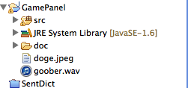
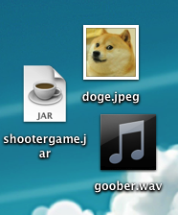
Resource Files
Include the resource files you're loading in the root directory of your eclipse project.
← Like this
If running standalone JAR, include them in the same folder as the JAR.
← Like this
There's also a way to embed the file INTO the JAR, but it's pretty ridiculous.

Slide 13
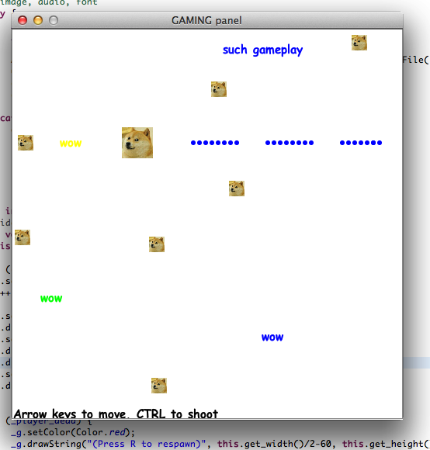
Activity:
Add SOME sort of feature or spin onto the game in 30 minutes.
wow
such creative
group acitiviyt
maknig the gmae
https://gist.github.com/spotco/8452705

