Slide 1

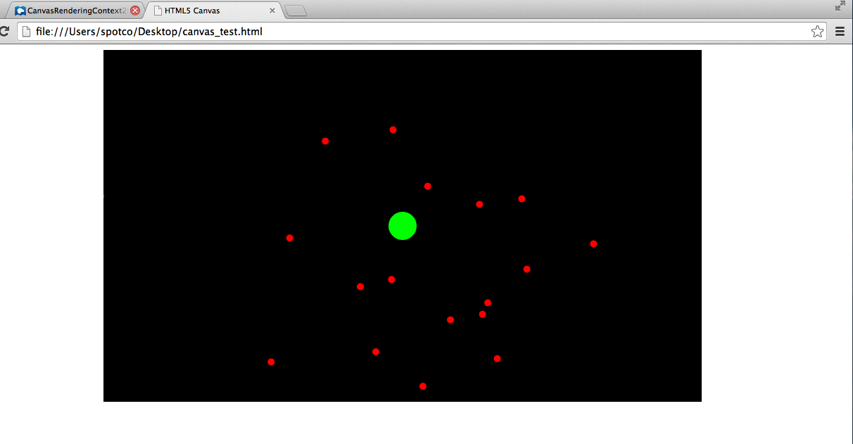
HTML5 Canvas – Let's make a physics simulator!

Slide 2
We'll be doing everything in “HTML5 Canvas” now.
(It's very similar to the GamePanel setup, and all the same ideas still apply).
Pros:
It's much easier to share your games (just open a website on your browser!)
HTML5 Canvas's Context2D is slightly more powerful than java's Graphics
Javascript may be faster to get stuff done with (takes less writing)
Chrome dev tools are really good
Not java
Cons:
New language, javascript, which may be harder to do stuff in
Most errors will come at runtime
Javascript kinda sucks in its own ways
Performance is kinda iffy

Slide 3
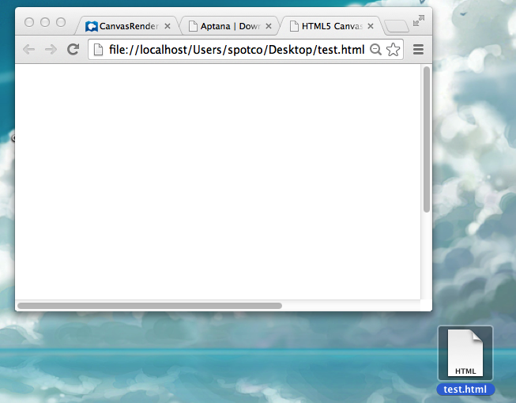
Basic setup
<!DOCTYPE html><html>
<head>
<title>HTML5 Canvas</title>
<script>
//code goes here
</script>
</head>
<body><canvas id="game" width="850px" height="500px" style="margin:auto;display:block;"></canvas></body>
</html>
It won't look like too much

Slide 4
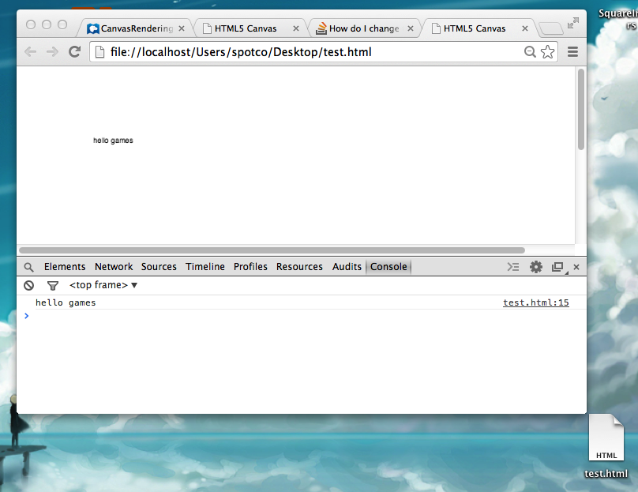
<!DOCTYPE html><html>
<head>
<title>HTML5 Canvas</title>
<script>
var _g;
var _canvas;
window.onload = function() {
_canvas = document.getElementById("game");
_g = _canvas.getContext("2d");
_g.fillText("hello games",100,100);
console.log("hello games");
}
</script>
</head>
<body><canvas id="game" width="850px" height="500px" style="margin:auto;display:block;"></canvas></body>
</html>
“Hello Game”
Prints a message to the console (in chrome dev tools)
Draws a message to the screen

Slide 5
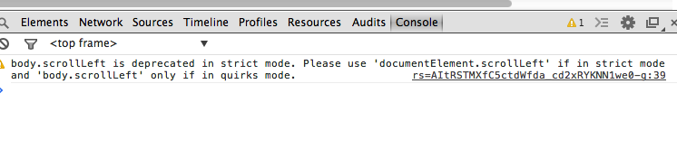
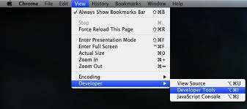
Javascript in 5 slides
var x = 5;
var y = "games"
console.log(y);
for (var i = 0; i < 10; i++) {
console.log(i+" video games");
}
function games(v) {
console.log("where da "+ v +" games at");
}
games("vidheo");
Declare all variables with “var”
No types (that you need to declare)
“console.log” instead of println
For/while/if look the same as java
Functions look pretty similar to java
Functions call similar to java
Console.log prints to the console

Slide 6
Javascript in 5 slides
Do all you initialization code in this “window.onload” function
Make arrays like this
Add to arrays with push
Looping through them is still the same as java
Remove elements from arrays with
array.splice(INDEX,HOW_MANY)
window.onload = function() {
var array = [1,2,3];
array.push(4);
for (var i = 0; i < array.length; i++) {
console.log(array[i]);
}
array.splice(0,1);
console.log(array); //this will print [2,3,4]
}

Slide 7
Javascript in 5 slides
You make hashmap-dictionary-objects like this
You'll use this instead of classes in javascript
You can do object-oriented programming with these
window.onload = function() {
var obj = {};
obj["games"] = 0;
var obj2 = {};
obj2.games = 0;
var obj3 = {
games: 0
};
//obj, obj2 and obj3 are all the same
var obj4 = {
games: 0,
print_games:function(){
console.log(this.games)
}
};
obj4.print_games();
}

Slide 8
Javascript in 5 slides
window.onload = function() {
setInterval(update,20); //update every 20ms
}
function update() {
console.log("update");
}
Here's the update cycle.
Note, in javascript, you can pass around functions like parameters.
Ex:
function update() { console.log("update");}
function caller(f) {
f();
}
caller(update);

Slide 9
Javascript in 5 slides
Here's keyboard/mouse input:
function get_canvas_cursor_position(canvas, evt) {
var rect = canvas.getBoundingClientRect();
return {
x: evt.clientX - rect.left,
y: evt.clientY - rect.top
};
}
window.onload = function() {
_canvas.addEventListener('mousedown',mouse_down);
_canvas.addEventListener('mouseup',mouse_up);
_canvas.addEventListener('mousemove',mouse_move);
window.addEventListener('keydown', key_down);
window.addEventListener('keyup',function(e) {
console.log(e.keyCode);
});
}
function mouse_down(e){
var mouse_pos = get_canvas_cursor_position(_canvas,e);
console.log(mouse_pos.x,mouse_pos.y)
}
function mouse_up(e) {var mouse_pos = get_canvas_cursor_position(_canvas,e);}
function mouse_move(e) { var mouse_pos = get_canvas_cursor_position(_canvas,e);}
function key_down(e) { console.log(e.keyCode) }
(You can either do it separate function or inline style)

Slide 10
var _canvas;
var _g;
window.onload = function() {
_canvas = document.getElementById("game");
_g = _canvas.getContext("2d");
_g.fillText("hello games",100,100);
}
The “_g” object is a “CanvasRenderingContext2D” object
Here's how to
-clear the screen
-draw a filled rectangle
-filled circle with the _g object
Note the fillStyle needs to be a CSS string
_g.clearRect(0,0,WID,HEI);
_g.fillStyle = "rgb(255,0,0)";
_g.fillRect(X,Y,WID,HEI);
_g.fillStyle = "rgb(0,255,0)";
_g.beginPath();
_g.arc(X,Y,RADIUS,STARTING_ANGLE,ENDING ANGLE);
//_g.arc(X,Y,RADIUS,0,Math.PI*2);
_g.closePath();
_g.fill();
https://developer.mozilla.org/en-US/docs/Web/API/CanvasRenderingContext2D

Slide 11
Let's make this “game”:
Big green planet in the center
Small red planets “orbit” around it

Slide 12
var _gameobjs = [];
function make_object(x,y) {
var rtv = {};
rtv.x = x;
rtv.y = y;
rtv.vx = Math.random()*5-2.5;
rtv.vy = Math.random()*20-10;
return rtv;
}
//...
_gameobjs.push(make_object(100,100));
Insights:
Make an array to store your “planet objects”
Make a method that makes a
“planet” object, with x,y,vx and vy fields.
//...
for(var i_obj = 0; i_obj < _gameobjs.length; i_obj++) {
var itr_obj = _gameobjs[i_obj];
itr_obj.x += itr_obj.vx;
itr_obj.y += itr_obj.vy;
_g.fillStyle = COLOR.RED;
_g.beginPath();
_g.arc(itr_obj.x,itr_obj.y,5,0,Math.PI*2);
_g.closePath();
_g.fill();
}
Loop through your game objects in your update cycle
Draw every object, as well as applying its vx and vy

Slide 13
Orbital Gravity
var intensity = 1/distance_to_gravity_center(itr_obj.x,itr_obj.y) * 100;
var delta = {x:get_gravity_center().x-itr_obj.x, y:get_gravity_center().y-itr_obj.y};
var delta_len = Math.sqrt(Math.pow(delta.x,2)+Math.pow(delta.y,2));
var normalized_delta = {x:delta.x/delta_len,y:delta.y/delta_len};
itr_obj.vx += normalized_delta.x*intensity;
itr_obj.vy += normalized_delta.y*intensity;
Calculate the distance from the object to your gravity center.
Force is inversely proportional to distance (100 is just a number that looked fine)
Calculate the object's difference (delta) x and y to the gravity center.
Normalize this as a 2d vector (divide both x and y by the vector length)
Apply changes to object's vx and vy in the direction of the difference, scaled by intensity

Slide 14
Activity: How would you make this into a game?
https://gist.github.com/spotco/8586743

