Slide 1

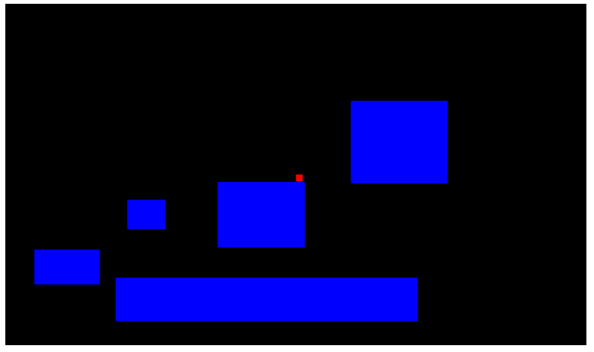
Making a simple platformer with physics
Using stuff from last time (loading levels, player-following camera)

Slide 2
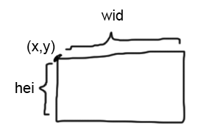
The core: rect-rect hit detection
We have two rectangles defined by {x,y,wid,hei}.
How can you tell if they're intersecting?

Slide 3
The core: rect-rect hit detection
//given two objects with fields {x,y,wid,hei}, returns if the two rectangles are touching
function hitrect_touch(a,b) {
if (a.wid == 0 || a.hei == 0 || b.wid == 0 || b.hei == 0) return false;
var r1x1 = a.x;
var r1x2 = a.x + a.wid;
var r1y1 = a.y;
var r1y2 = a.y + a.hei;
var r2x1 = b.x;
var r2x2 = b.x + b.wid;
var r2y1 = b.y;
var r2y2 = b.y + b.hei;
return !(r1x1 > r2x2 || r2x1 > r1x2 || r1y1 > r2y2 || r2y1 > r1y2);
}
hitrect_touch({x:0,y:0,wid:100,hei:100},{x:10,y:10,wid:50,hei:50}) //true
hitrect_touch({x:0,y:0,wid:100,hei:100},{x:-10,y:-10,wid:5,hei:5}) //false

Slide 4
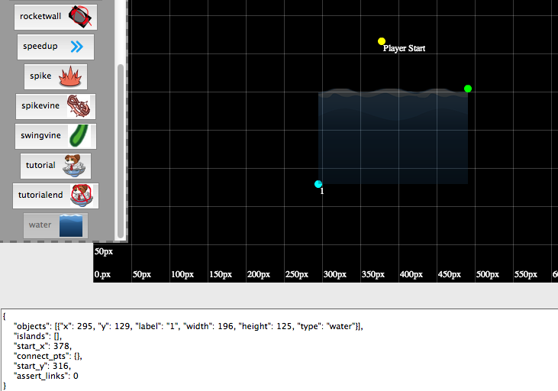
Setting up our world
Generate our worlds using the same “SpeedyPups” tool,
http://spotcos.com/gogodoggy/editor.html
{
"objects": [
{"x": 295, "y": 129, "label": "1", "width": 196, "height": 125, "type": "water"}
],
"islands": [],
"start_x": 378,
"connect_pts": {},
"start_y": 316,
"assert_links": 0
}
*w+click to set player spawn position,
*Select water then click+escape to drop a green point. q+click to the bottom-left of the green point to make a square
Since the y coords in the editor are flipped, load like this:
_player.x = LEVEL.start_x;
_player.y = -LEVEL.start_y;
for (var i_obj = 0; i_obj < LEVEL.objects.length; i_obj++) {
var itr_obj = LEVEL.objects[i_obj];
_gameobjs.push({
x : itr_obj.x,
y : -itr_obj.y-itr_obj.height,
wid : itr_obj.width,
hei : itr_obj.height
});
}

Slide 5
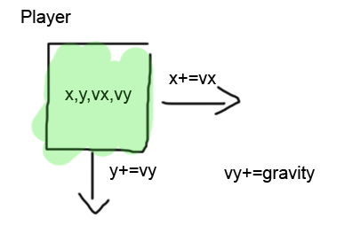
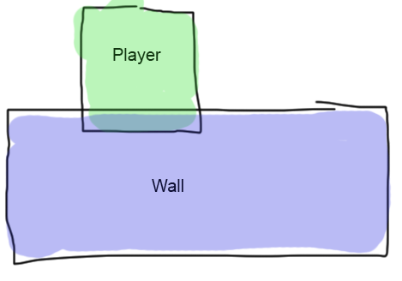
Platformer (the concept)
Have a player with x,y,vx,vy fields.
On update,
Update x by vx
Update y by vy
Update vy by gravity (constant)
If the player intersects a wall (using the rect-rect intersection)...
(it gets a little hairy from here)

Slide 6
Platformer logic: in the air
We want to be able to know if we're on the ground
(only can jump when on the ground)
Use this global variable:
var _on_ground = false;
And in our update, two conditions:
function update()
if (_on_ground) {
//...
} else {
_player.vy += GRAVITY;
_player.x += _player.vx;
_player.y += _player.vy;
for (wall in all_walls) {
if (hitrect_touch(player,wall)) {
//...
}
}
}

Slide 7
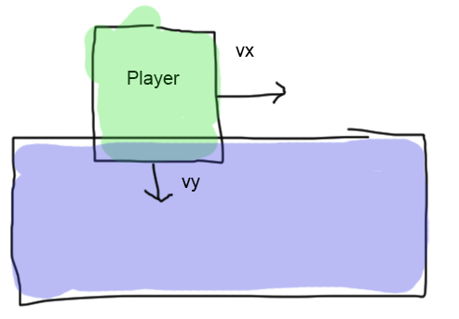
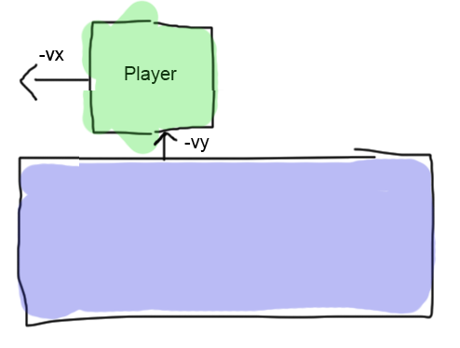
Platformer logic: in the air
If the player is colliding with a wall, move him out in the reverse direction (-vx,-vy)
Until he's no longer colliding.
if (hitrect_touch(_player,itr_obj)) {
while (hitrect_touch(_player,itr_obj)) {
_player.x -= signum(_player.vx);
_player.y -= signum(_player.vy);
}
//...
}
Note signum is: number != 0 ? (number < 0 ? -1 : 1) : 0;
(We want to move him out in increments of 1)

Slide 8
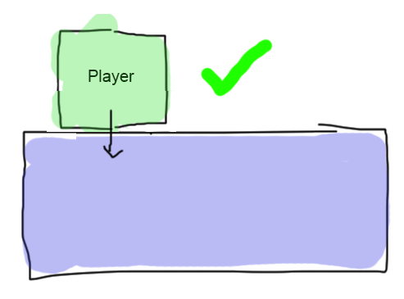
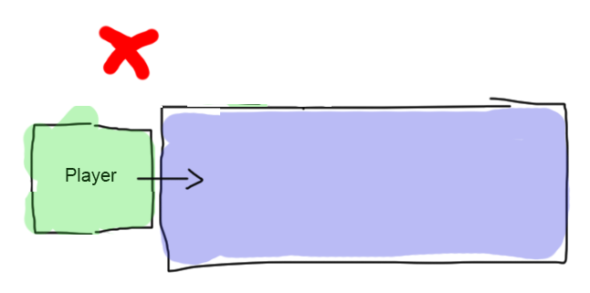
Platformer logic: in the air
If the player is directly above the wall (that he just moved out of), we're on the ground.
Enter ground mode.
_player.y += 1;
if (hitrect_touch(_player,itr_obj)) {
_on_ground = true;
}
_player.y -= 1;

Slide 9
Platformer logic: on the ground
function update()
if (_on_ground) {
_player.x += _player.vx;
_player.vy = 0;
_player.y += 1; //test if under the player is a wall
var did_hit = false;
for (var i_obj = 0; i_obj < _gameobjs.length; i_obj++) {
var itr_obj = _gameobjs[i_obj];
if (hitrect_touch(_player,itr_obj)) {
did_hit = true;
break;
}
}
if (!did_hit) { //if there wasn't a wall, not on the ground anymore
_on_ground = false;
}
_player.y -= 1; //unset the test
} else {
//...
}
-Move the player in the x direction (but not in y)
-If there is NOT a wall underneath the player (test in the same way as before),
You're in the air now

Slide 10
Misc
if (KEYS_DOWN[KEYBOARD.RIGHT]) {
_player.vx = 10;
} else if (KEYS_DOWN[KEYBOARD.LEFT]) {
_player.vx = -10;
} else {
_player.vx *= 0.3;
if (_player.vx < 0.1) _player.vx = 0;
}
To get the most “natural” movement, add a friction slowdown when no keys are pressed (as opposed to immediately stopping)
Add this to jump
(what would happen if we didn't put in the change to air mode?)
if (KEYS_DOWN[KEYBOARD.SPACE] && _on_ground) {
_player.vy = -15;
_on_ground = false;
}

Slide 11
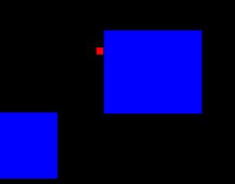
Some (unsolved) problems
You can climb up walls (bug or feature?)
If you land while moving fast (in the x direction), you'll get a little glitch-hiccup. Why is this?
Are there any conditions that could cause this physics engine to infinite loop? (There are)
How well do you think this engine works if the walls move around? (surprisingly well, though a couple of edge cases)

Slide 12
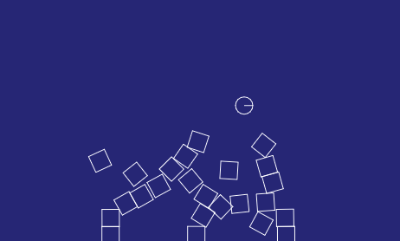
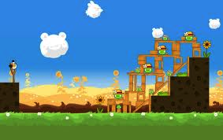
Further resources
Want more complicated physics interactions (without having to code them yourself?)
http://box2d-js.sourceforge.net/index2.html
(this is what angry birds uses)

