Slide 1
Intro To Unity

Slide 2
Before We Start… Download It!
https://unity3d.com/unity/download

Slide 3
Why Use Unity?
Very beginner friendly
Exports to all major platforms (Desktop, iOS, Android, Web, PS 3/2/Vita, Xbox 360/One, and Wii-U)
No royalties
Three scripting languages to choose from – C#, UnityScript, and Boo

Slide 4
Creating Our First Project

Slide 5
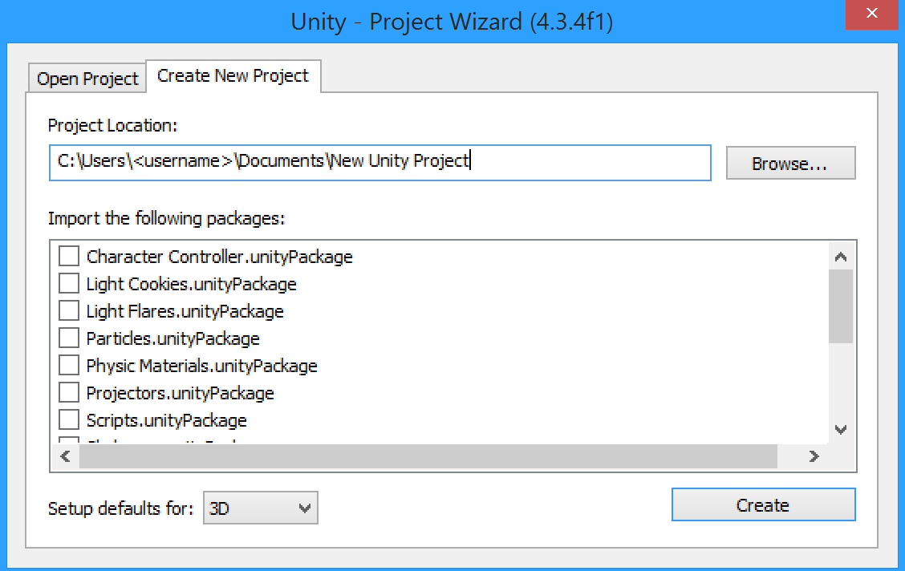
After Opening Unity…

Slide 6
Intro To The Editor

Slide 7
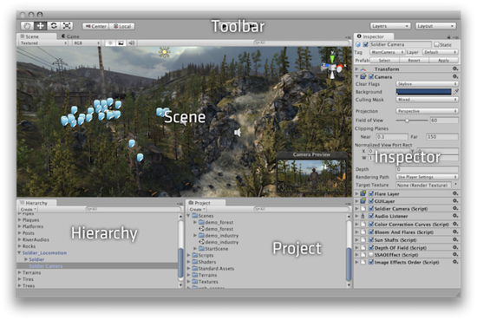
What’s In The Editor?

Slide 8
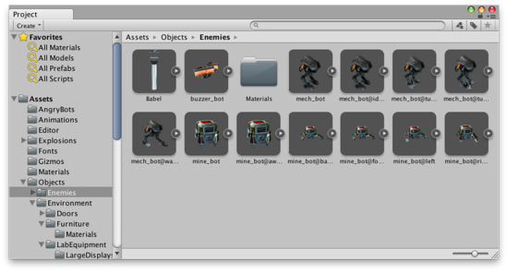
Project Browser
A place to manage and view all of your assets (e.g. scripts, models)

Slide 9
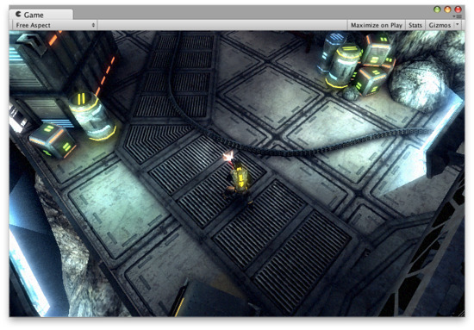
Game View
The view that’s rendered from the camera(s) in your game, representative of what the final game will look and play like

Slide 10
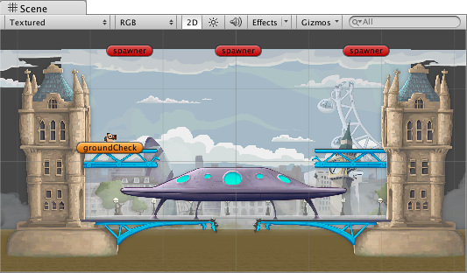
Scene View
The interactive sandbox where you can move and manipulate objects in your scene

Slide 11
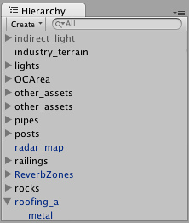
Hierarchy View
Contains a list of all the objects currently in scene

Slide 12
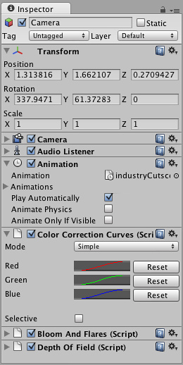
Inspector View
Displays and allows for editing of information about the selected game object

Slide 13
Let’s Start On Our Demo Game

Slide 14
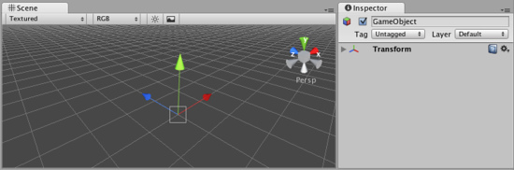
The Basics of Unity
GameObject – A container for components, does nothing by itself
Every object in the game scene, visible or not, is contained within a GameObject
Component – Attached to GameObjects to give functionality/behavior (e.g. light, colliders, scripts)

Slide 15
What Is Our Demo?
You control a sphere on a platform
Enemy sphere randomly spawn
Dodge the enemy sphere or else you’ll die!

Slide 16
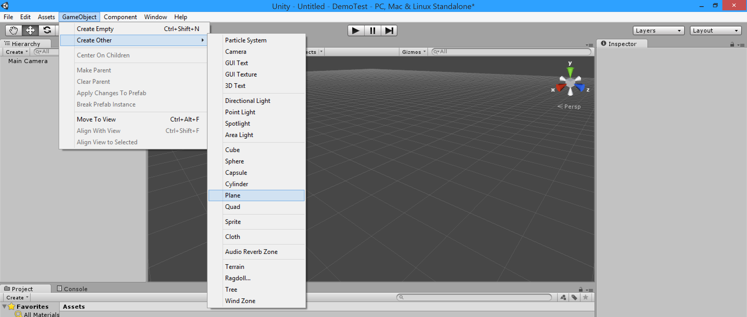
Let’s Create Our Large Platform…
GameObject > Create Other > Plane

Slide 17
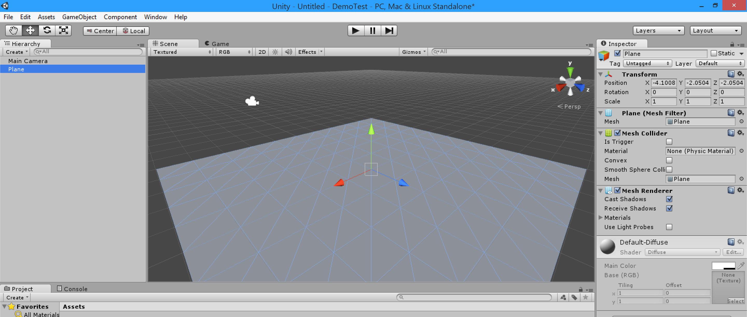
Our Platform!
Change the plane’s position to the origin (0, 0, 0)

Slide 18
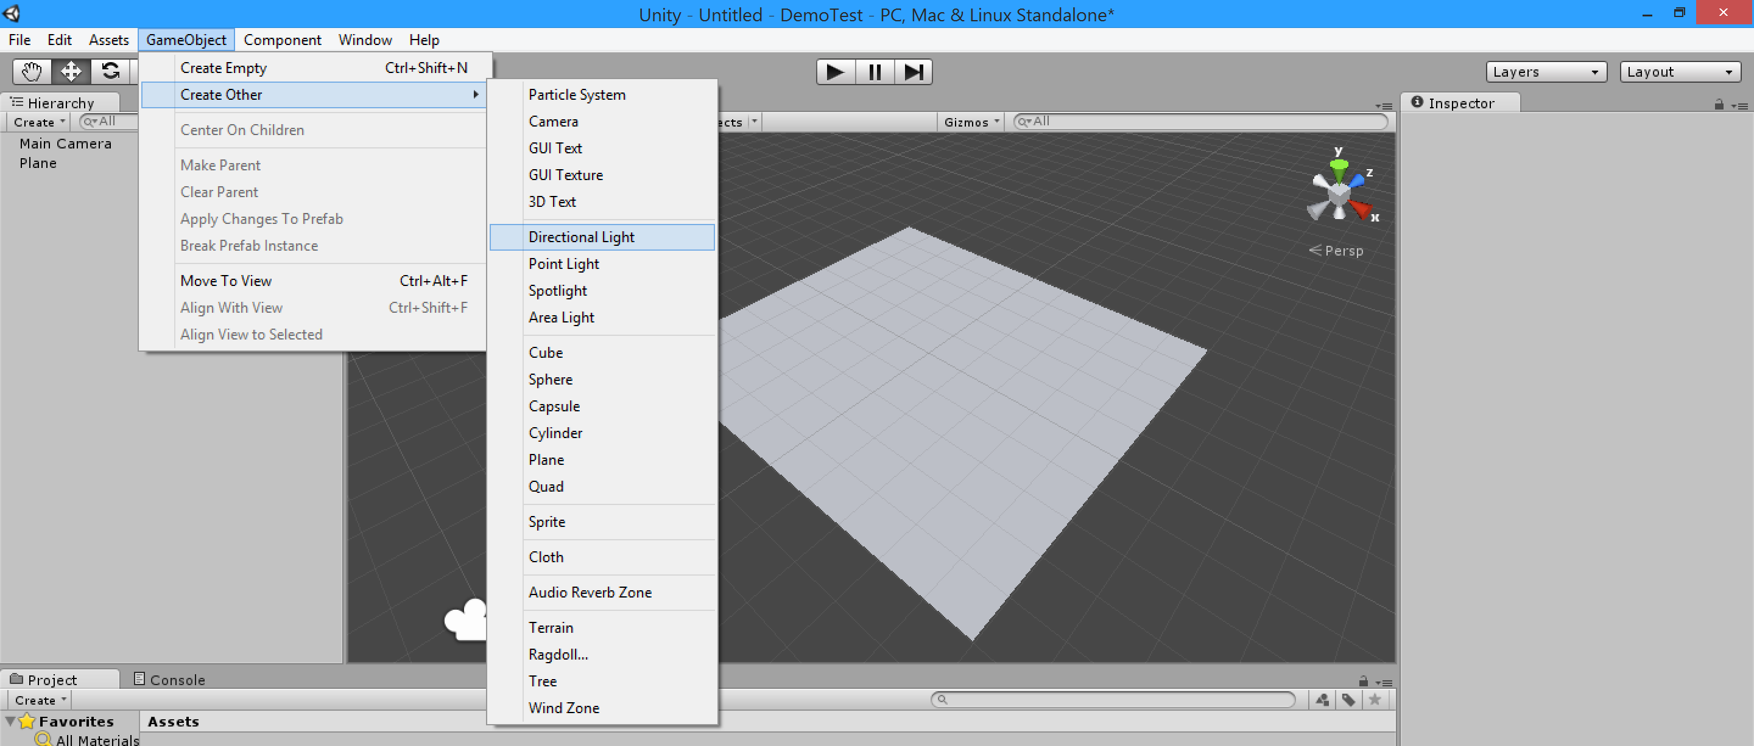
Let’s Create A (Directional) Light
A directional light is a light source that shines light in one direction infinitely far away (like the sun).
GameObject > Create Other > Directional Light

Slide 19
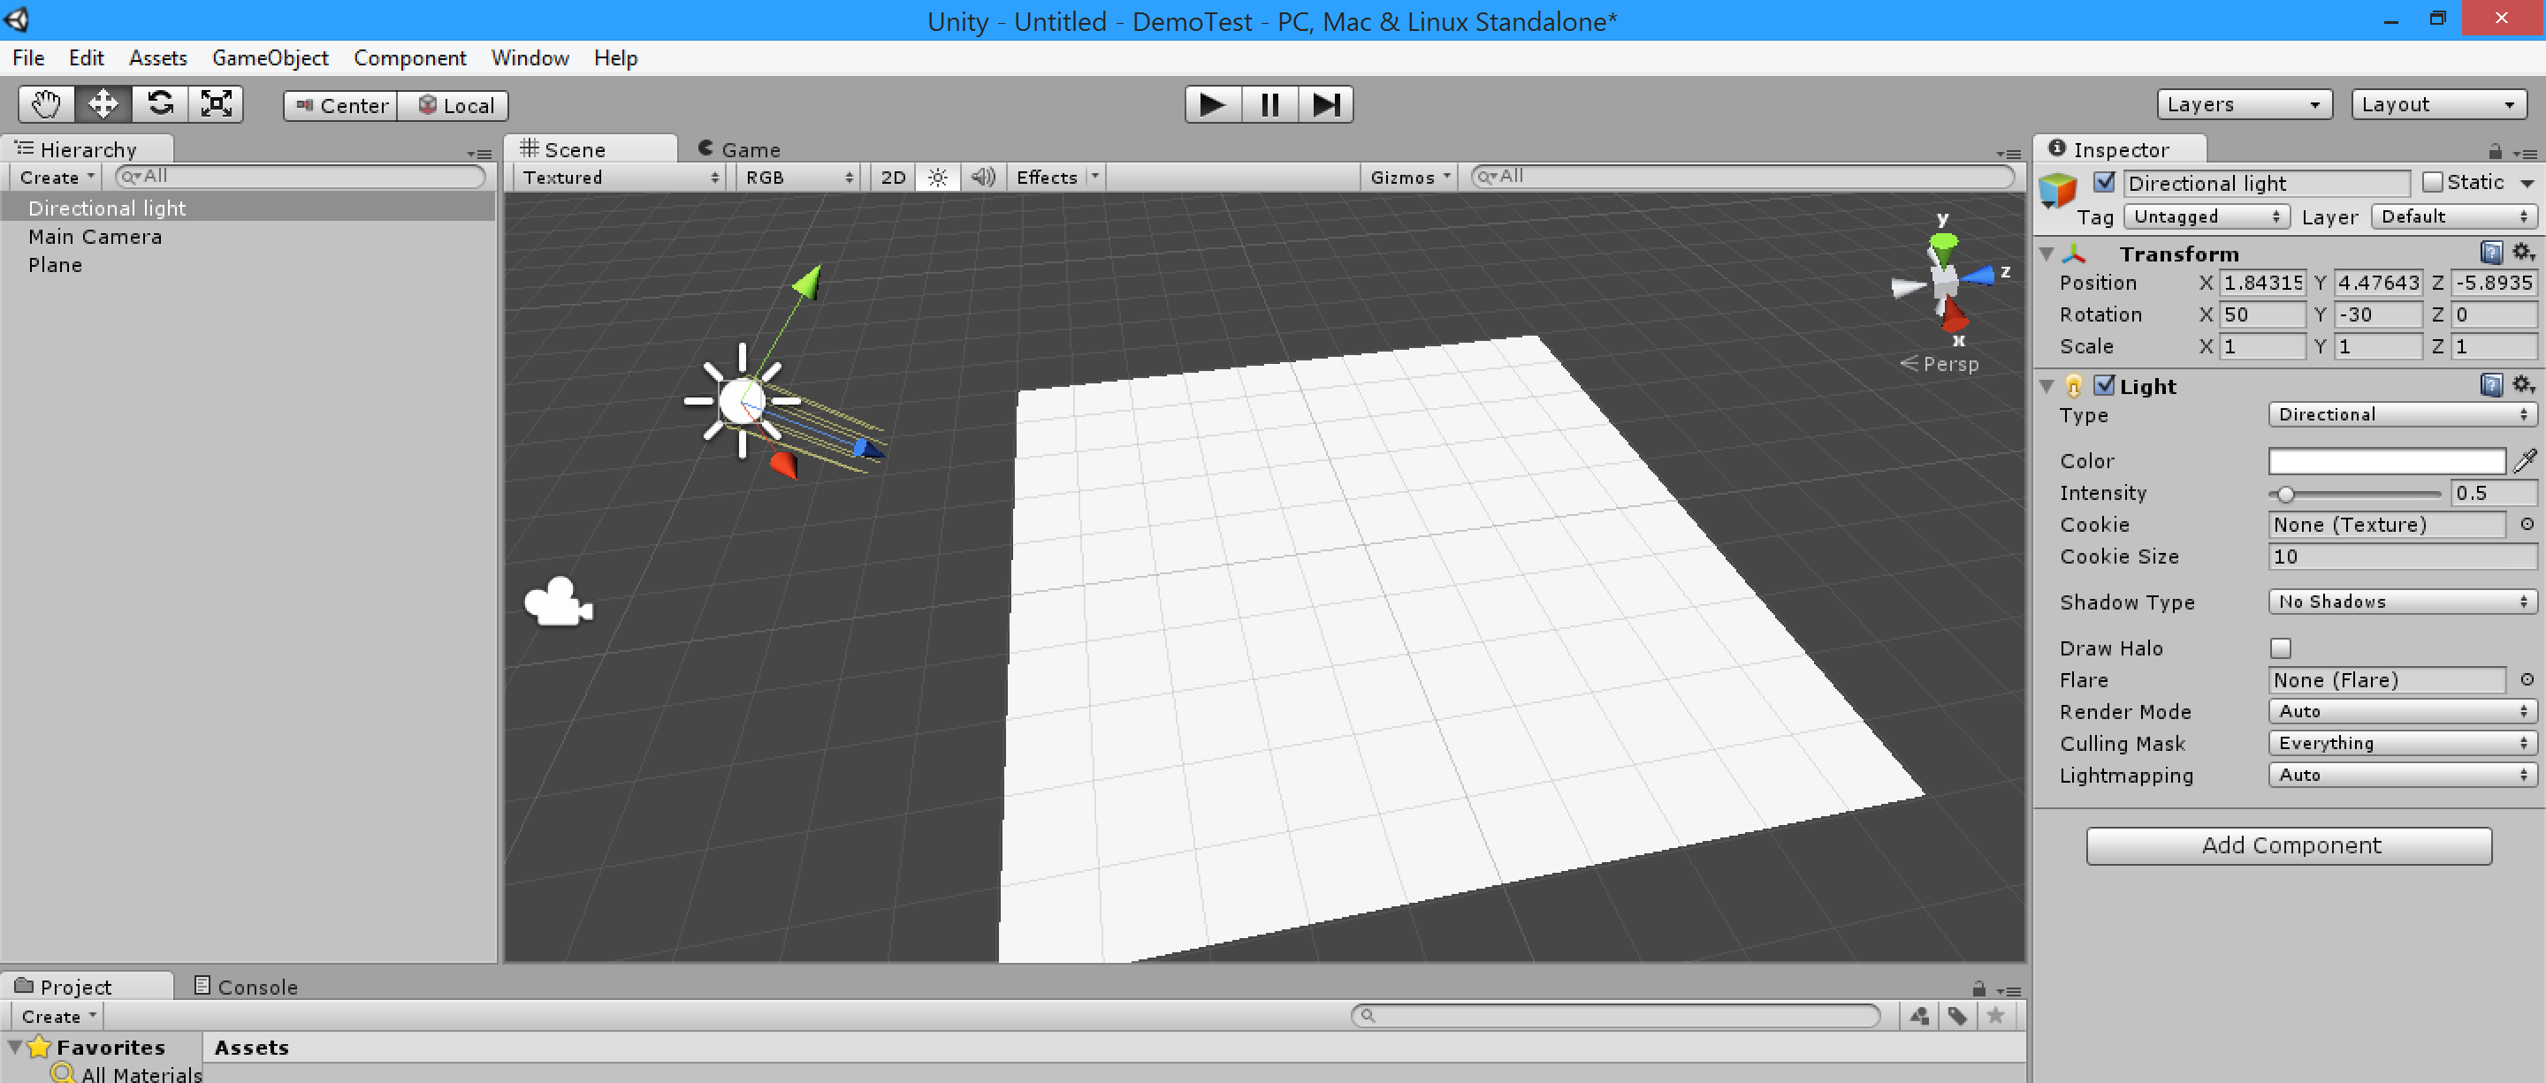
Much Brighter!
Position and rotate is wherever you’d like,
It should probably face the platform though!

Slide 20
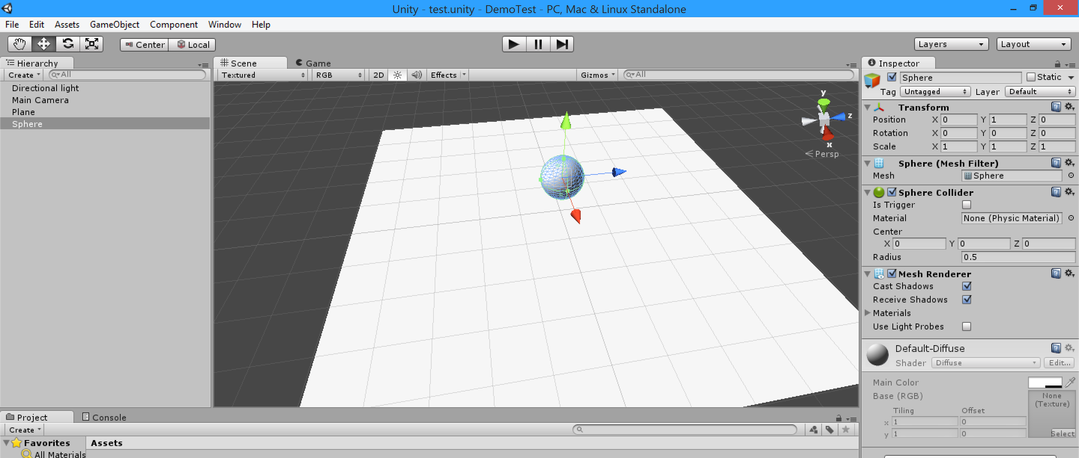
Let’s Create A Sphere
We’ll create our base sphere, so let’s create one via GameObjects > Create Other > Sphere

Slide 21
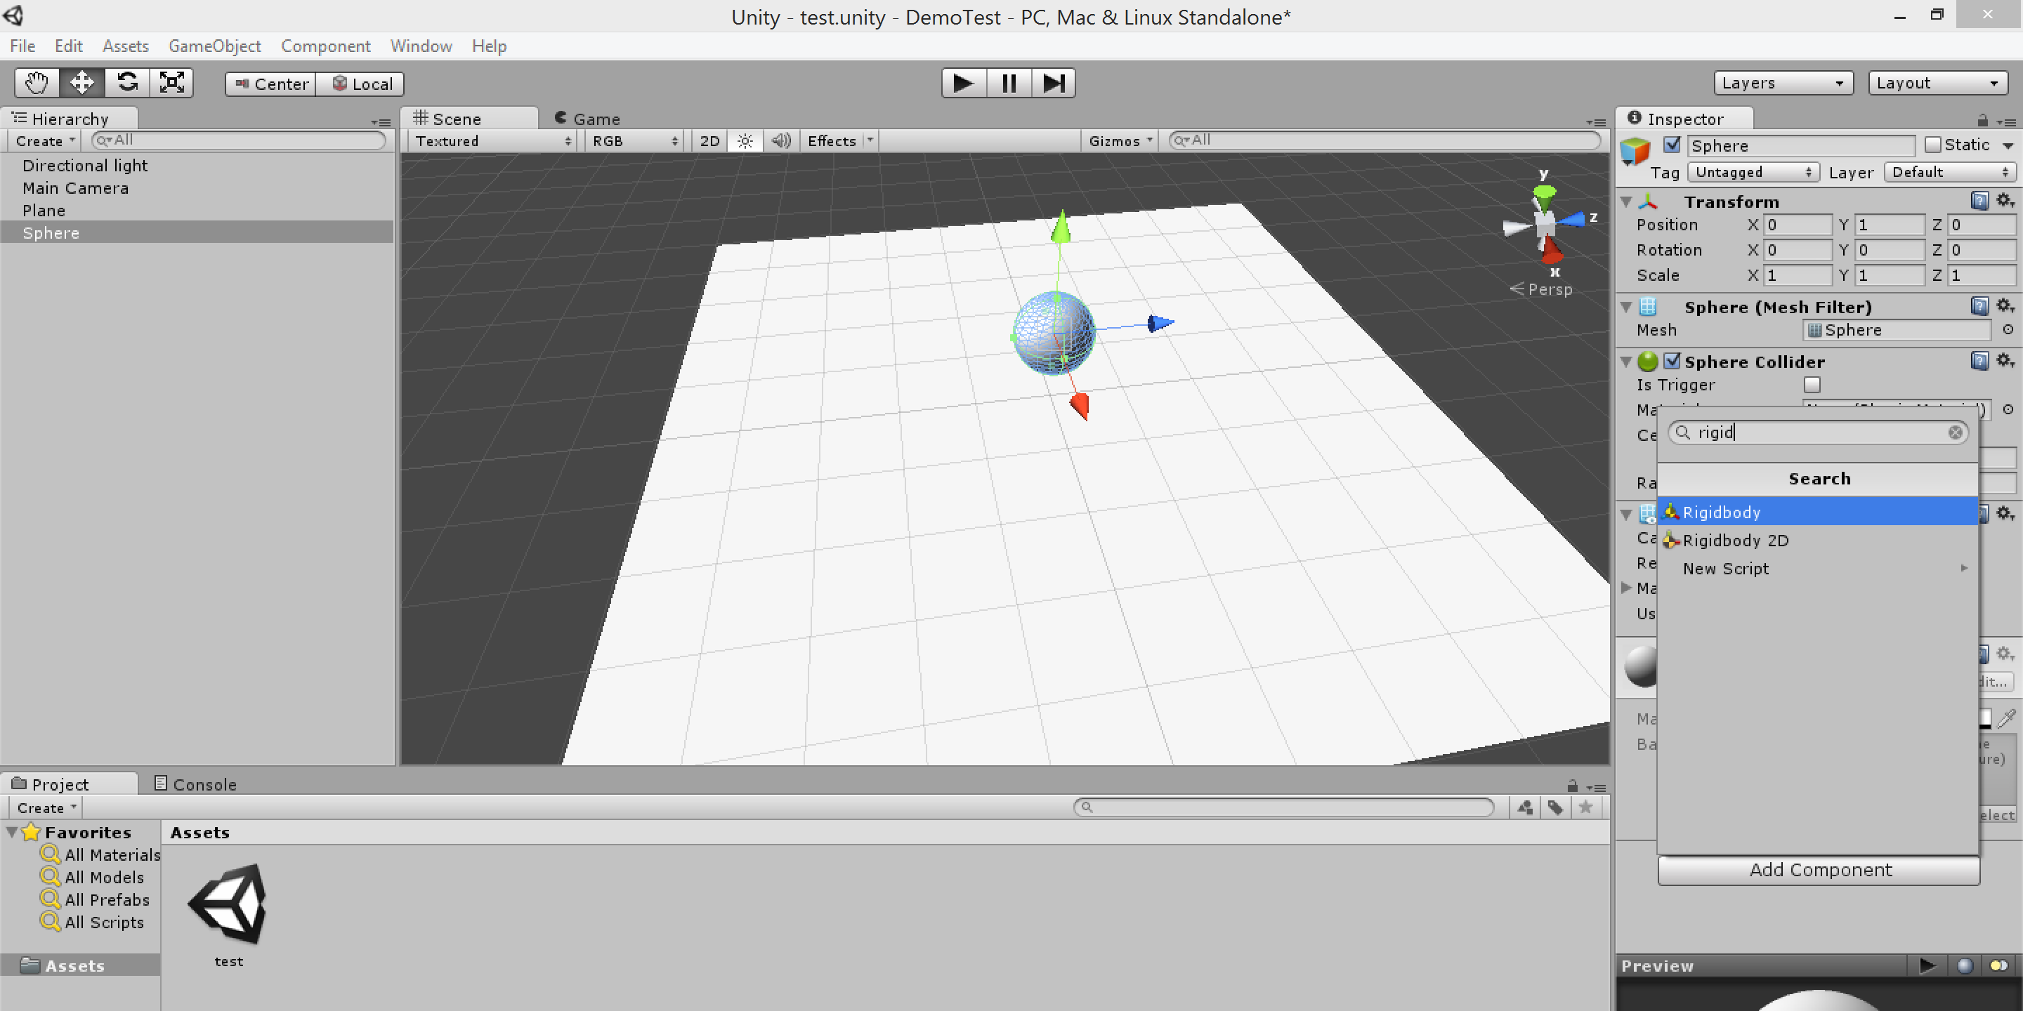
Let’s Make Our Sphere Have Physics
We’ll need to add a rigid body component for our sphere so that it will behave like a rigid body
Select the sphere and click “Add Component” in the inspector window, then search for “rigidbody” and select the RigidBody component to attached

Slide 22
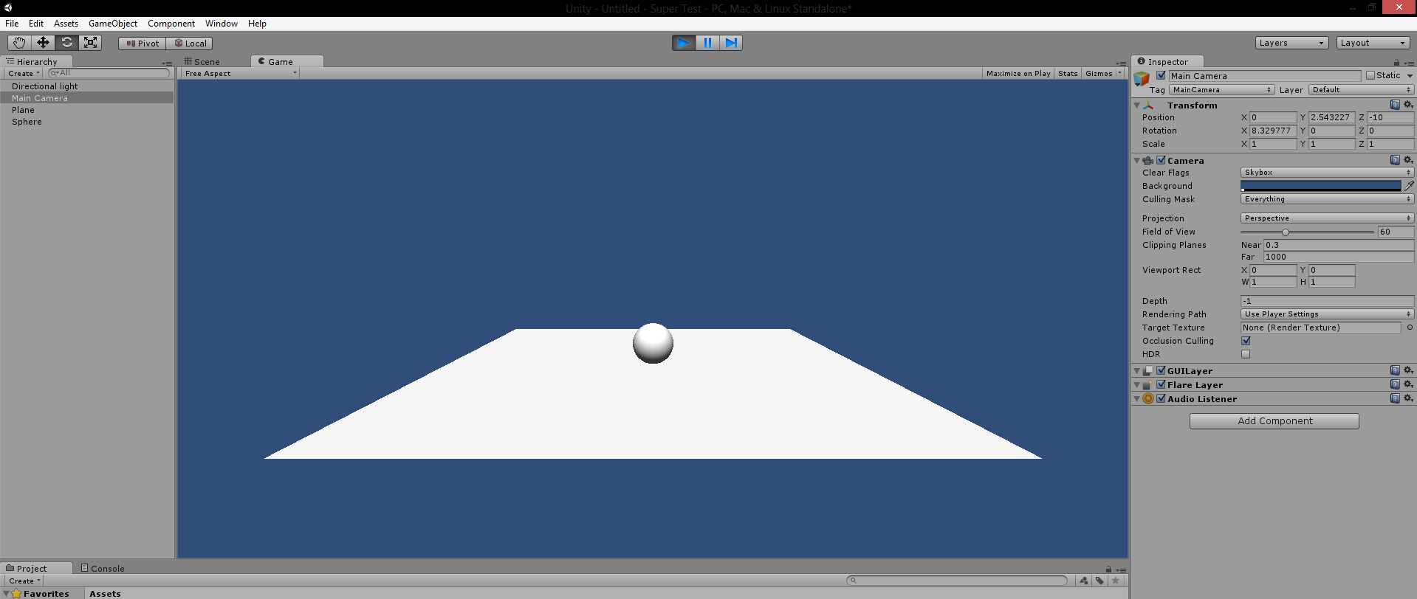
Let’s Do A Test
Move the camera in the scene so that it is facing the platform
Hit the play button at the top
The ball should drop and it should look something like this….
Now let’s start scripting to our ball some controls

Slide 23
Scripting

Slide 24
What Languages?
C#, UnityScript (Javascript), and Boo (Python-like syntax)
We’ll be using C#

Slide 25
Monobehavior
All scripts attached to game objects as components (i.e. scripts that give behaviors) must inherit from the base class Monobehavior.
Scripts created in Unity will come with some boilerplate code that will inherit Monobehavior

Slide 26
Monobehavior (continued)
What does Monobehavior give me?
transform
transform.position – the world position of the game object (Vector3)
transform.rotation – the rotation of the game object (Quaternion)
Transform.eulerAngles – the rotation of the game object (Vector3)
transform.scale – the scale of the game object (Vector3)
Start()
Called only once during the scripts lifetime (use this for initialization)
Update()
Called every time the game updates (once per frame)

Slide 27
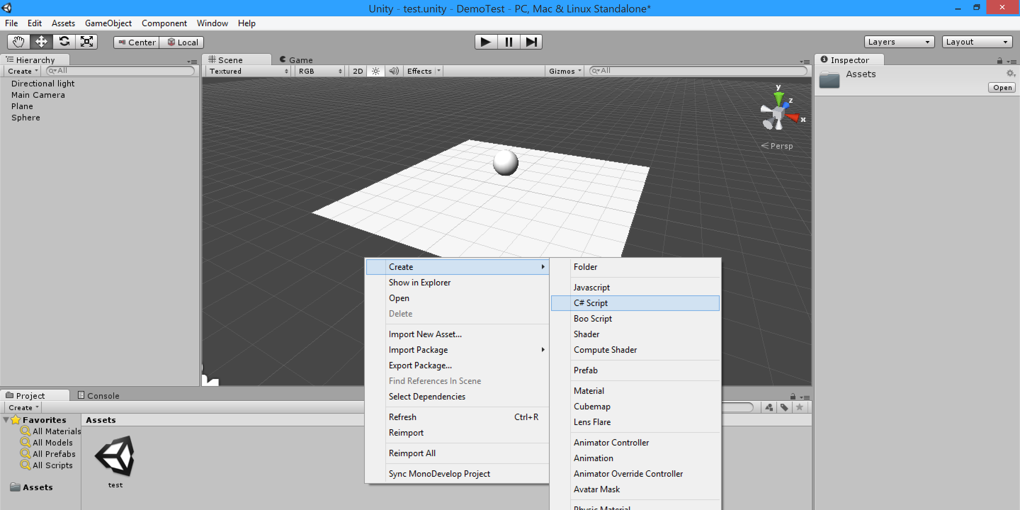
Let’s Create Our First Script
Right click in the project area and go to Create > C# Script

Slide 28
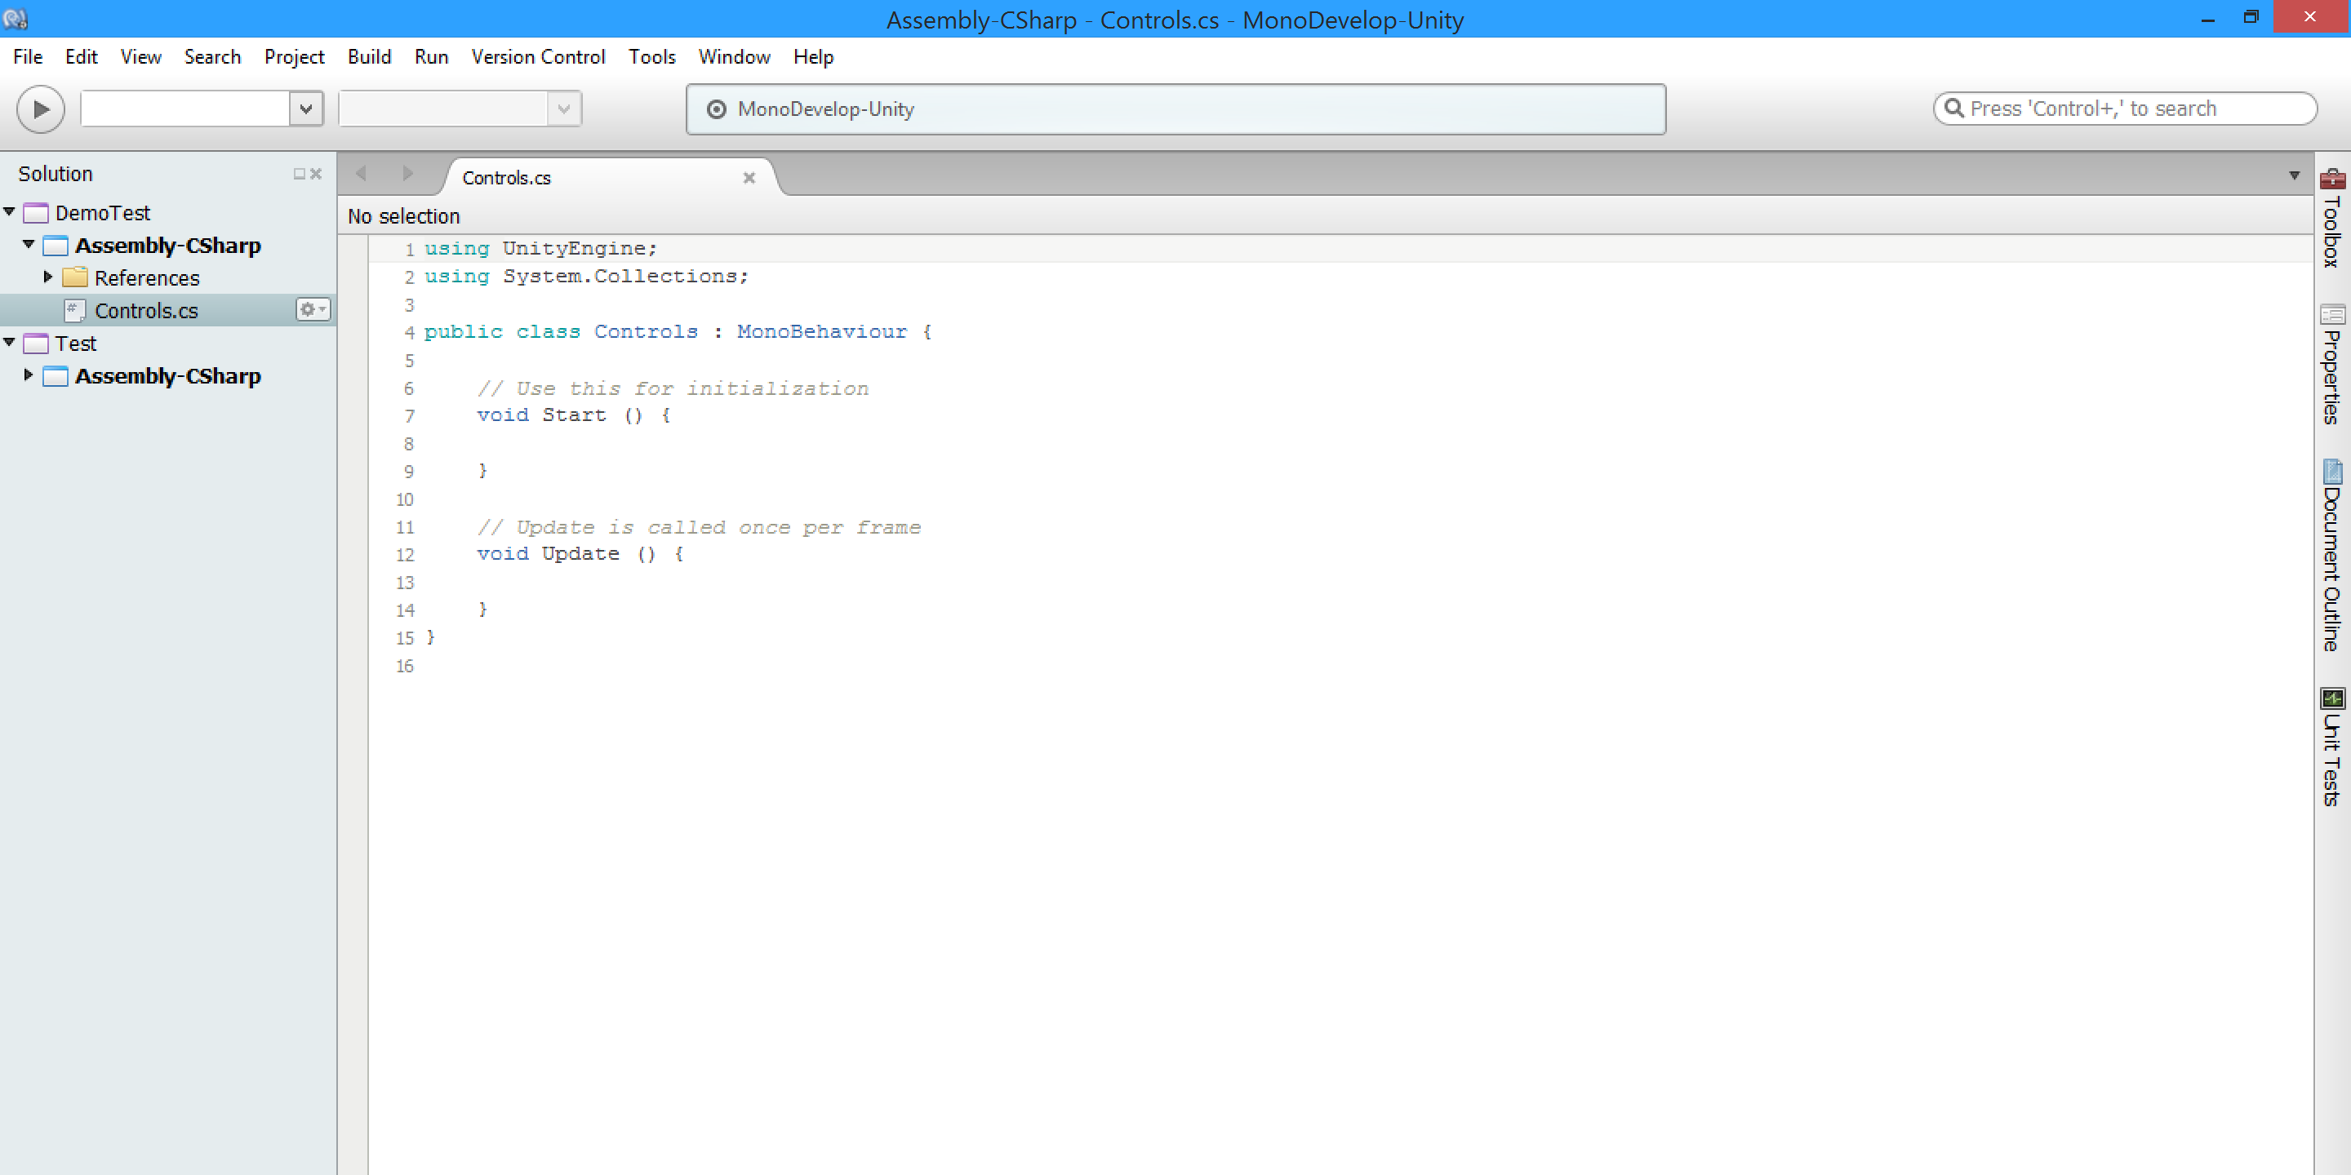
Our New Script

Slide 29
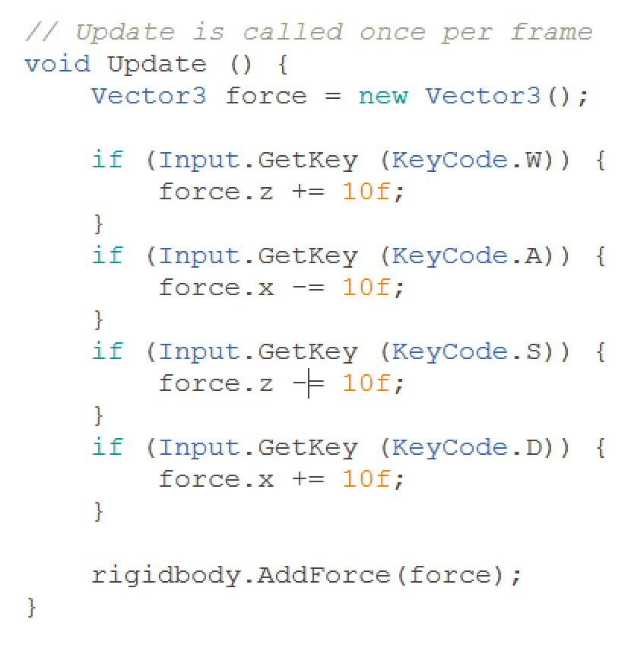
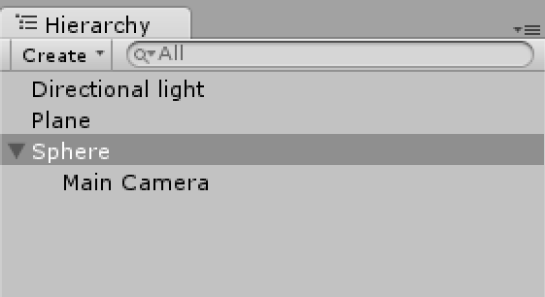
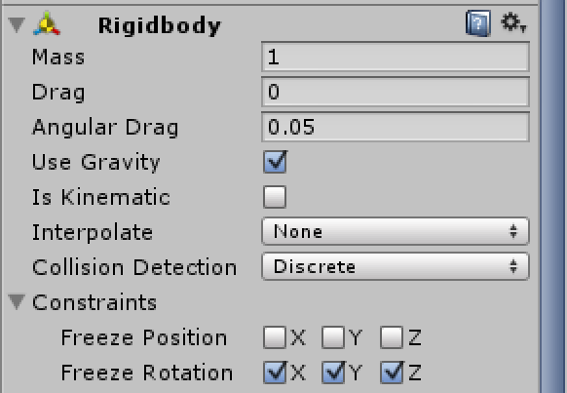
Let’s Add The Controls
We’ll new to apply a force on the ball when WASD is pressed
Let’s also nest the camera onto the sphere so that the camera will follow the player
Make sure you lock the rotation of the sphere so the camera doesn’t start whirling around!

Slide 30
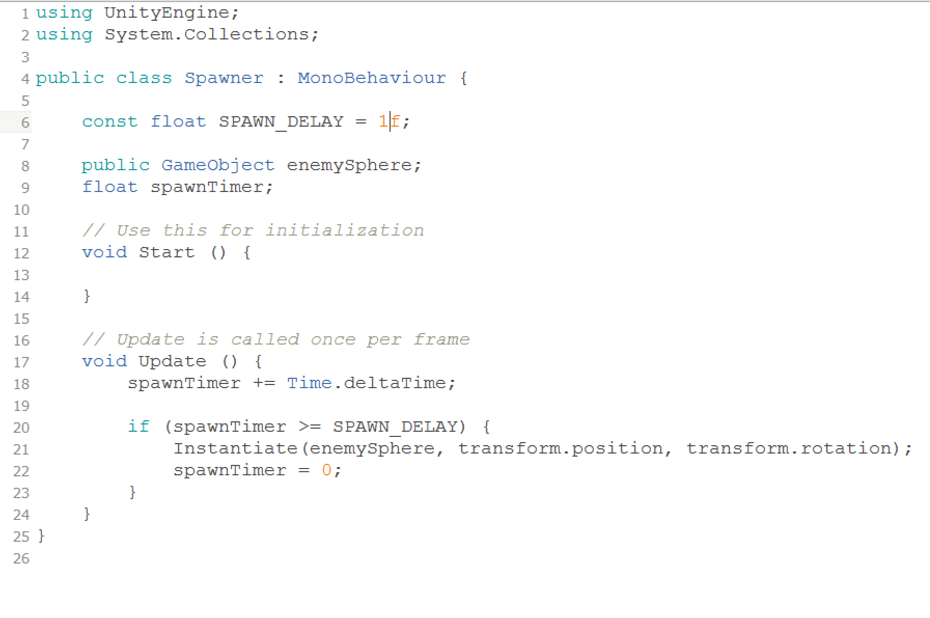
Let’s Add Some Enemies
We’ll need to create a spawner that spawns enemy spheres, so let’s create a new script and GameObject.
Don’t forget to attach that script onto it!
We’ll need to put some code into that script to make it spawn some enemies
You might be wondering where we get the reference to the enemy sphere…

Slide 31
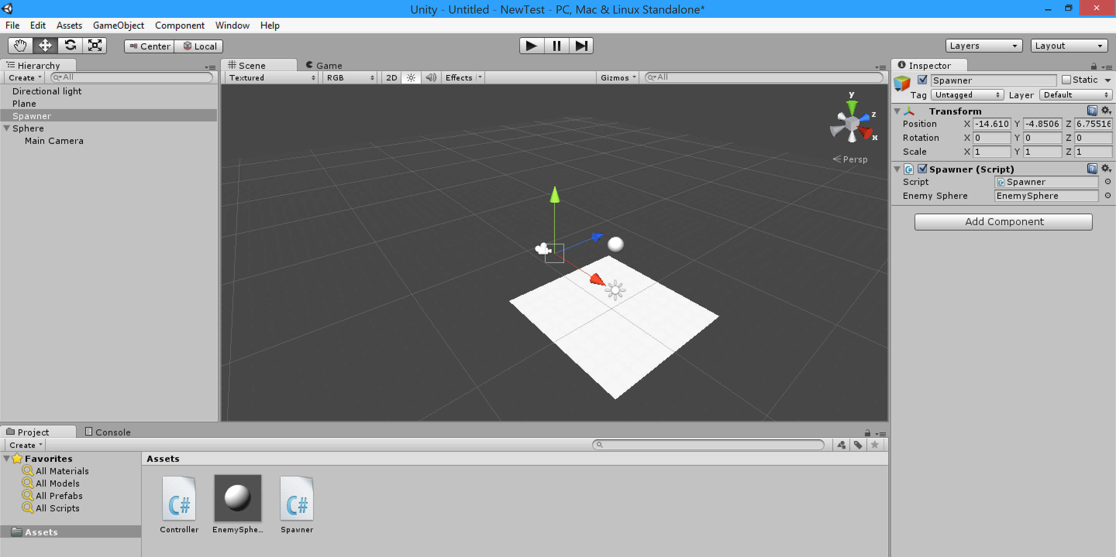
Prefabs!
If you want to create a game object when the game is running, you must make a prefab of it.
Create a new sphere normally and simple drag it from the Hierarchy panel to the project panel
It should look like this

Slide 32
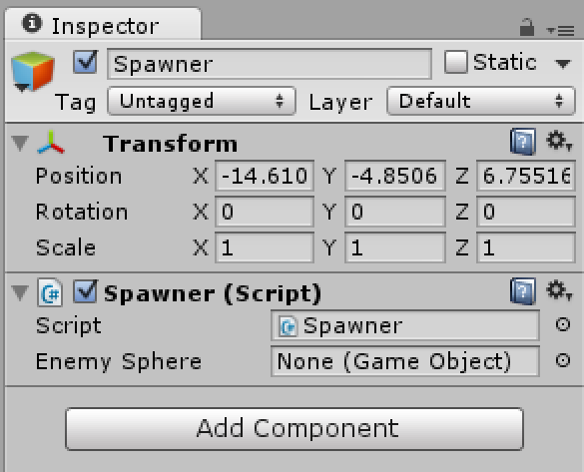
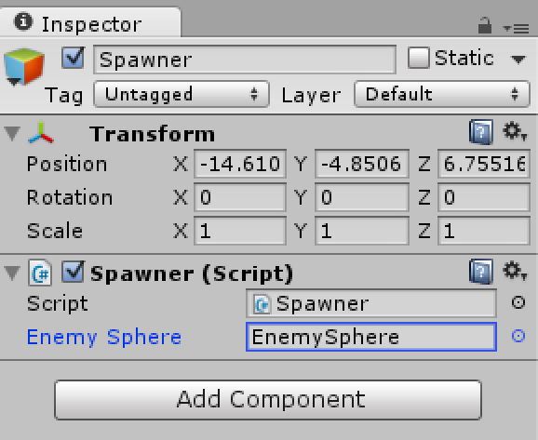
Referencing The Enemy Sphere
In order to spawn our prefab, we first need to grab a reference to it.
If we go to our spawner script in the inspector, we see there’s an empty enemy sphere reference!
Public variables in scripts are automatically exposed in the editor
Let’s drag our enemy prefab into this exposed variable to make it referenced…

Slide 33
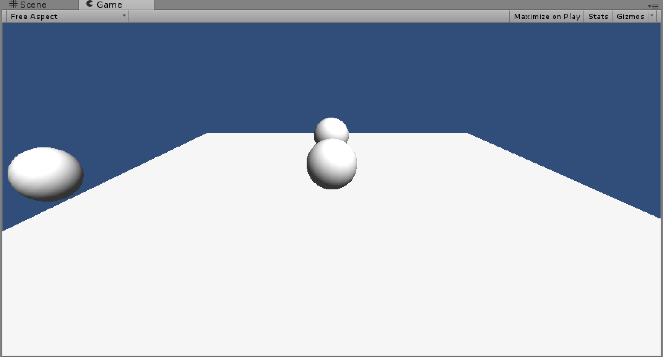
Let’s Test It
If everything was setup correctly, our game should be spawning spheres into existence when the game is running

Slide 34
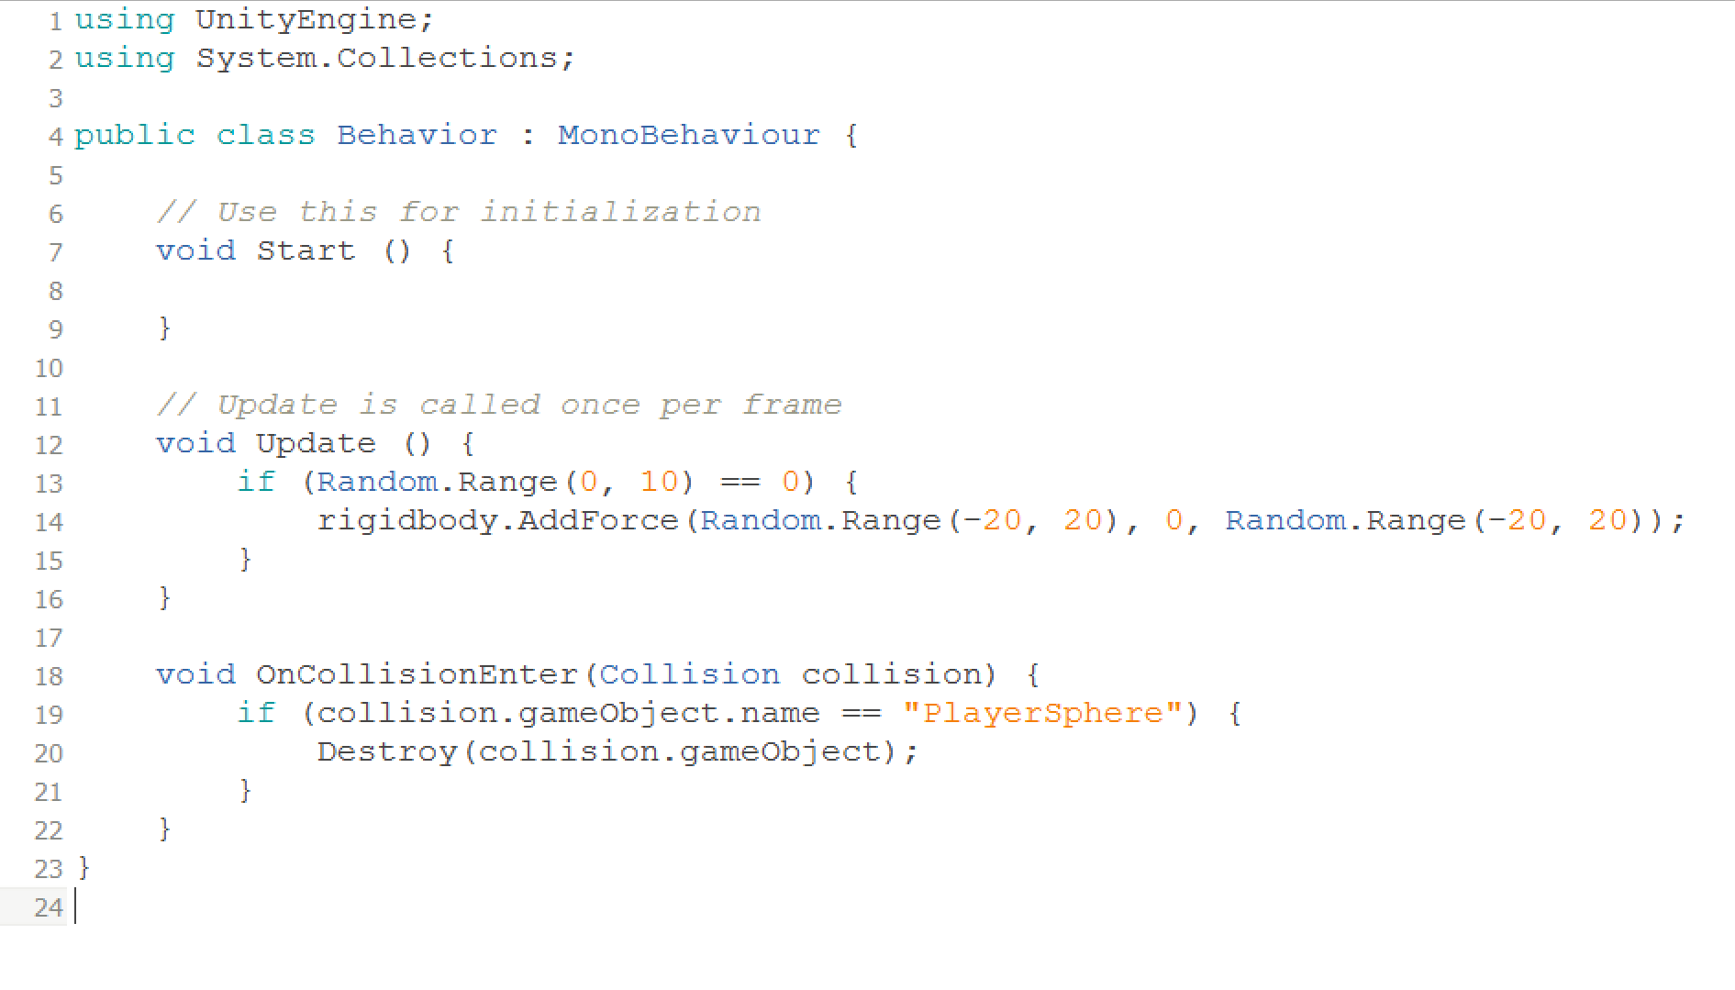
Let’s Make Our Enemies Do Something
Let’s make our enemy sphere destroy the player on contact as well as move randomly

Slide 35
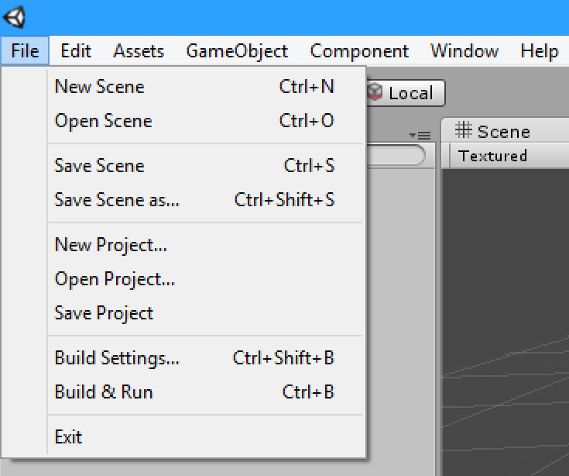
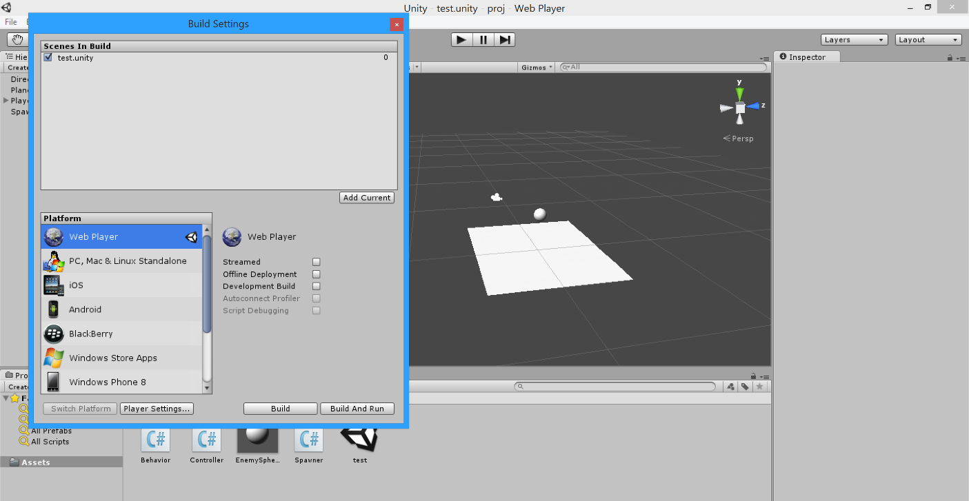
Let’s Build It
We’ll build it to the Unity Web Player so we can play it on the web!
Go to File > Build Settings
Select Web Player and build it
Open the generated HTML file and play!

Slide 36
We’re Done!

