Slide 1

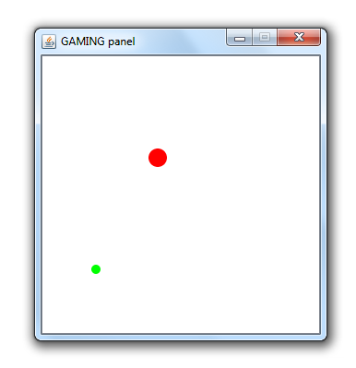
Intro to game programming in Java (with almost-drawingpanel)
Contacts:
Shiny (mootothemax@gmail.com)
Aleksander (aleksander_01@live.com)

Slide 2
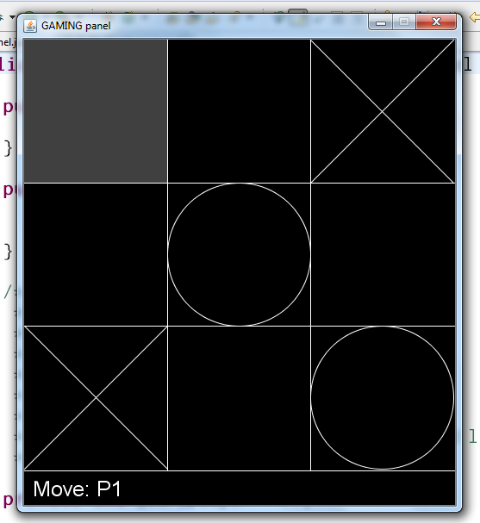
GamePanel
-Based off DrawingPanel and in Java (familiar)
-Way better than any of the other Java alternatives I've used
-Exports as a standalone runnable JAR file.
-Download here (click download zip):
https://github.com/spotco/GamePanel
We're not going to use this forever, but it's a good place to learn the basics!

Slide 3
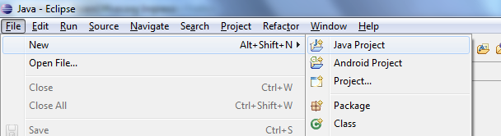
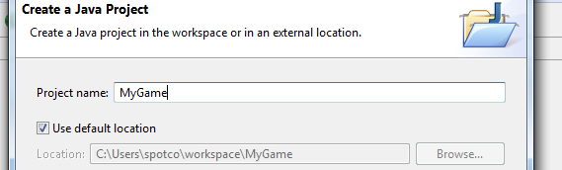
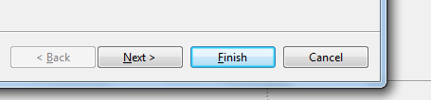
Setup in Eclipse
New java project
Give it a name
Finish

Slide 4
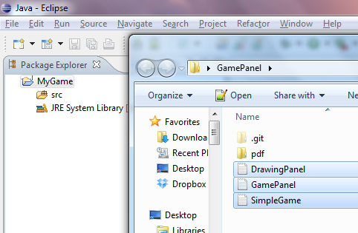
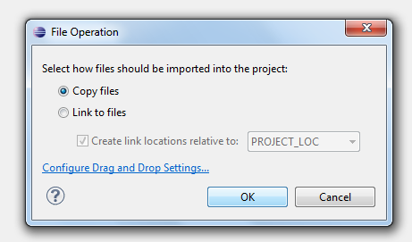
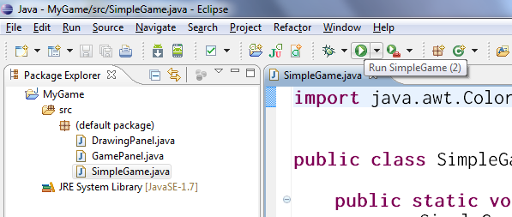
Drag and drop the .java files into the “src” folder
Ok
Try running “SimpleGame” !

Slide 5
Making a new game
public class MyGame extends GamePanel {
public MyGame() {
super(300,300); //the window will be 300 width, 300 height
}
}
And then somewhere else, add a main...
public static void main(String[] args) {
new MyGame();
}

Slide 6
Drawing Stuff
import java.awt.Color;
public class MyGame extends GamePanel {
public MyGame() {
super(300,300);
/*
* _g is an inherited field of type "Graphics"
* (This is the same Graphics you know and love!)
*/
_g.setColor(Color.red);
_g.fillRect(50, 50, 100, 100);
}
}

Slide 7
The “Update Cycle”
public class MyGame extends GamePanel {
public MyGame() {...} //Do initialization stuff here!
@Override
public void update() { //This is a method we're overriding
/*
* This gets run every 20 milliseconds!
*/
System.out.println("test");
}
}

Slide 8
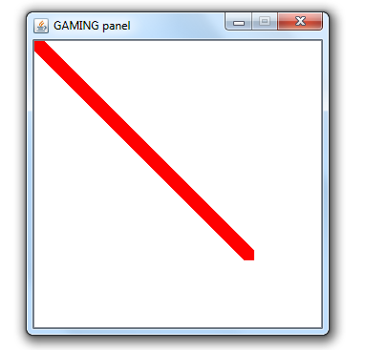
Animating something
public class MyGame extends GamePanel {
private int _x,_y;
public MyGame() {...}
@Override
public void update() {
_g.setColor(Color.red);
_g.fillRect(_x, _y, 10, 10);
_x++;
_y++;
}
}
What's going on here?

Slide 9
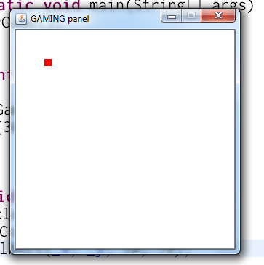
Animating something
public class MyGame extends GamePanel {
private int _x,_y;
public MyGame() {...}
@Override
public void update() {
this.clear();
_g.setColor(Color.red);
_g.fillRect(_x, _y, 10, 10);
_x++;
_y++;
}
}
Clear the screen before drawing.
Fill a white rectangle the size of the screen
OR
this.clear().

Slide 10
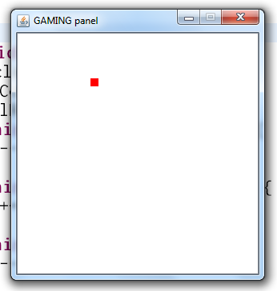
Controlling Something
@Override
public void update() {
this.clear();
_g.setColor(Color.red);
_g.fillRect(_x, _y, 10, 10);
if (this.is_key_down(KEY_LEFT)) {
_x--;
}
if (this.is_key_down(KEY_RIGHT)) {
_x++;
}
if (this.is_key_down(KEY_UP)) {
_y--;
}
if (this.is_key_down(KEY_DOWN)) {
_y++;
}
}

Slide 11
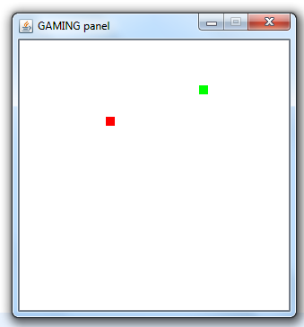
Let's make “Snake”!
You, (the red dot) want to grab the green dot.
How to do this?
-Store the location of the green dot
-If the red dot (player) is close to the green dot, the player just “ate” the green dot
-Increment the score, and move the green dot somewhere random on the screen

Slide 12
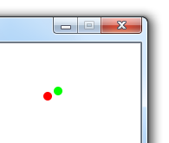
How to detect if the player “hits” the green dot?
Here's a real easy way to do it:
see if circles are colliding!
Two circles are colliding if
(distance between the centers) < (sum of the two radius (radii?))
public bool is_collide(int x1, int y1, int x2, int y2, int radius_sum){...}

Slide 13
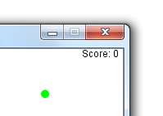
Draw some UI
_g.setColor(Color.black);
_g.drawString("Score: 0", 250, 10);
Make it show the “actual” score, of course!

Slide 14
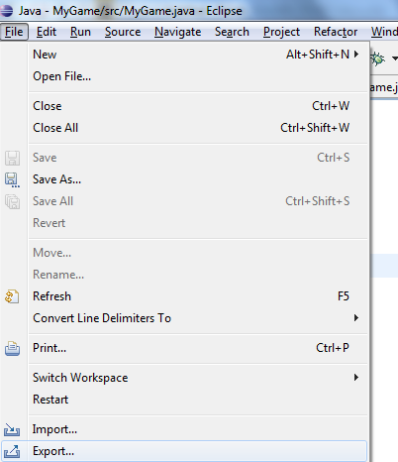
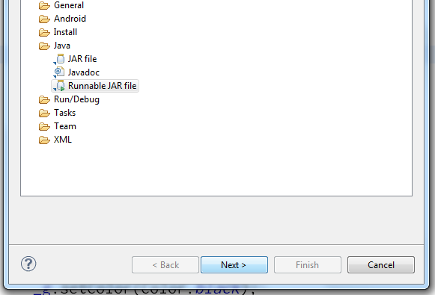
Exporting as a Runnable JAR
File -> export
Select Runnable JAR file, then next

Slide 15
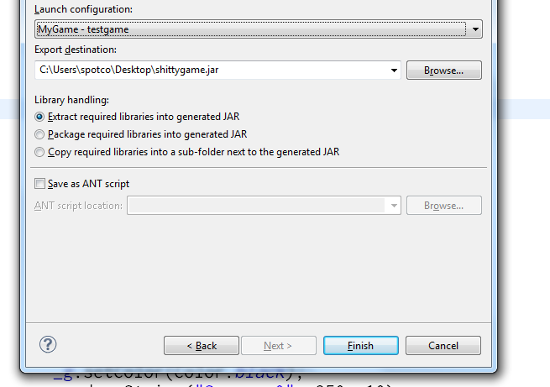
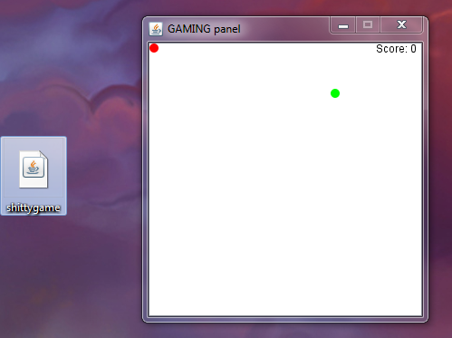
Select the class with your “main” in Launch configuration, and specify the output JAR file name.
Then, Finish.
Run the jar to play the game
outside of eclipse.

Slide 16
A few ideas to get going...
Easy:
Implement the score functionality. Collect the dot to increment score by 1.
If the player walks out of the screen, return him back to the screen.
Medium:
Make multiple green dots that could be collected (maybe of different size and point value). What would be the “smart” way of doing this?
Hard:
Make the dots run away from the player. They don't want to get eaten!

