Slide 1

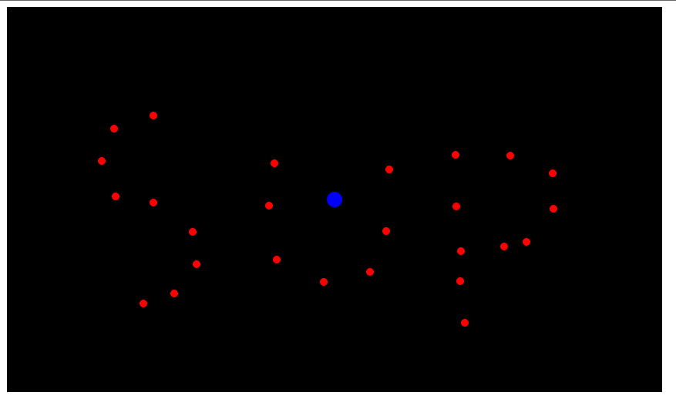
Javascript canvas miscellany:
-Organizing javascript logic
-Using push/pop matrix (and making a player-following camera)
-Loading levels

Slide 2
Understanding script tags
<script>
console.log("whats");
console.log("sup");
</script>
(Is the same as)
<script src="sup.js"></script>
If the file “sup.js” in the same folder contains:
(Is the same as)
console.log("whats");
console.log("up");
<script>
console.log("whats");
</script>
<script>
console.log("sup");
</script>
Use this property to separate your javascript code into distinct parts.

Slide 3
A common separation pattern:
<script src="util.js"></script>
<script src="draw.js"></script>
<script src="levels.js"></script>
<script src="game.js"></script>
Util.js – Anything pertaining to keyboard/mouse input and other commonly used functions (maybe a vector library?)
Draw.js – Drawing library code (see next slides)
Levels.js – Any json levels for the game (see slides at end)
Game.js – All the “game logic”, which will use the libraries linked

Slide 4
Simplifying input
We have this:
window.addEventListener('keydown', key_down);
function key_down(e) {
console.log(e)
}
How do we get something like this?
void update() {
if (this.is_key_down(KEYBOARD.UP)) {
_player_x++;
}
}

Slide 5
Simplifying input
var KEYBOARD = {
LEFT: 37,
UP: 38,
RIGHT: 39,
DOWN: 40
};
var KEYS_DOWN = {};
function key_down(e) {
KEYS_DOWN[e.keyCode] = true;
}
function key_up(e) {
KEYS_DOWN[e.keyCode] = false;
}
//...
window.addEventListener('keydown', key_down);
window.addEventListener('keyup',key_up);
//...
function update() {
if (KEYS_DOWN[KEYBOARD.UP]) {
_player_y -= 5;
}
}
← Hopefully this top part will be in your util/shared js file
← And this would be in your game logic js file

Slide 6
Simplifying drawing (I like my methods better)
var GLIB = {
clear:function() {
_g.clearRect(0,0,WID,HEI);
},
draw_circle:function(x,y,rad,color) {
_g.fillStyle = color;
_g.beginPath();
_g.arc(x,y,rad,0,Math.PI*2);
_g.closePath();
_g.fill();
},
draw_text:function(x,y,text) {
_g.textAlign = "center";
_g.fillStyle = COLOR.BLACK;
_g.fillText(text,x,y);
},
draw_rect:function(x,y,wid,hei,color) {
_g.fillStyle = color;
_g.fillRect(x,y,wid,hei);
}
};
//...
function update() {
GLIB.draw_circle(50,50,10,COLOR.RED);
}
← This would go in drawing js
← And this in your game logic js

Slide 7
Context global state operations
_g.translate(50,50)
This will shift everything you draw by 50px “x” and 50px “y”, forever.
How is this useful?
Other useful methods include
_g.scale(scale_x,scale_y)
_g.rotate(angle)
See:
https://developer.mozilla.org/en-US/docs/Web/API/CanvasRenderingContext2D

Slide 8
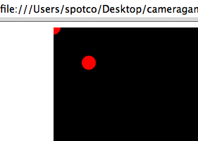
Context save/restore
_g.save();
_g.translate(50,50);
GLIB.draw_circle(0,0,10,COLOR.RED);
_g.restore();
GLIB.draw_circle(0,0,10,COLOR.RED);
This will draw 2 circles, one at (50,50) and one at (0,0).
Save() will save the current “transformation” of the canvas
Restore() will restore the current “transformation” of the canvas to the last save()

Slide 9
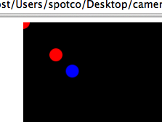
Context save restore stack
_g.save();
_g.translate(50,50);
GLIB.draw_circle(0,0,10,COLOR.RED);
_g.save();
_g.translate(25,25);
GLIB.draw_circle(0,0,10,COLOR.BLUE);
_g.restore();
_g.restore();
GLIB.draw_circle(0,0,10,COLOR.RED);
Think of save as pushing a “current transform” onto the stack. (Does not modify the current transform though!)
Think of restore as popping the top “transform” from the stack.
So how is this useful at all?

Slide 10
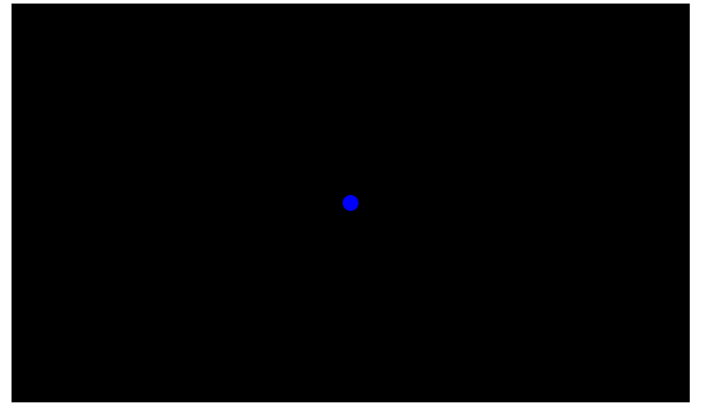
Making a camera centered on the player
_g.save();
_g.translate(WID/2-_player_x,HEI/2-_player_y);
GLIB.draw_circle(_player_x,_player_y,10,COLOR.BLUE);
_g.restore();
If you have nothing else in your game, it'll appear like the player's not moving at all.

Slide 11
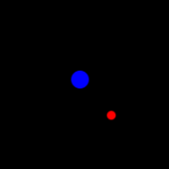
Drawing other objects
_g.save();
_g.translate(WID/2-_player_x,HEI/2-_player_y);
GLIB.draw_circle(_player_x,_player_y,10,COLOR.BLUE);
for (var i_obj = 0; i_obj < _gameobjs.length; i_obj++) {
var itr_obj = _gameobjs[i_obj];
GLIB.draw_circle(itr_obj.x,itr_obj.y,itr_obj.radius, itr_obj.color);
}
_g.restore();
Where in the init, I'm doing:
_gameobjs.push(create_powerup(50,50))
Let's make a more interesting world to walk around.

Slide 12
Level files
var LEVEL = {
objects:[
{x:0, y:0},
{x:50, y:50},
{x:100, y:100},
{x:150, y:150}
]
};
← Store your data in “JSON” notation somewhere
And then somewhere in your init, do this:
for (var i_obj = 0; i_obj < LEVEL.objects.length; i_obj++) {
var itr_obj = LEVEL.objects[i_obj];
_gameobjs.push(create_powerup(itr_obj.x,-itr_obj.y));
}

Slide 13
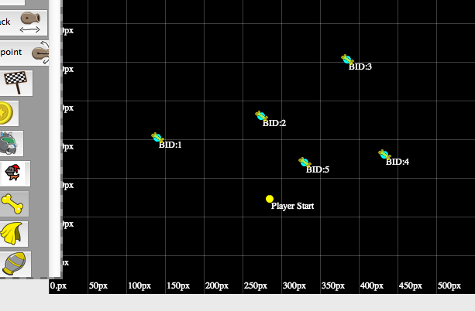
My shitty visual level editor for a game
http://spotcos.com/gogodoggy/editor.html
Add a “point” object by holding down “Q” and clicking.
Change player start by holding down “W” and clicking.
Output the JSON by pressing “P” or clicking “Output JSON”
(It'll be in the text area below)
It outputs some extraneous information as well.
{
"islands": [],
"start_x": 285,
"connect_pts": {},
"start_y": 123,
"objects": [{"x": 140, "label": "BID:1", "y": 202, "bid": 1, "type": "dogbone"}],
"assert_links": 0
}

Slide 14
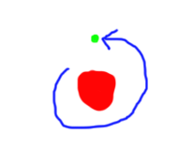
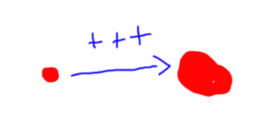
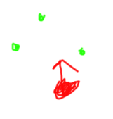
Ideas for save/restore state practice
Implement a “green ball” that orbits the player and follows the player when it moves. (Doable without using save/restore)
Implement a “zoom” functionality for the game.
Press a button to zoom in/out.
Make the camera always rotate behind the player facing.

