Slide 1




Making games with:
Haxe (The language)
OpenFL (The library)

Slide 2


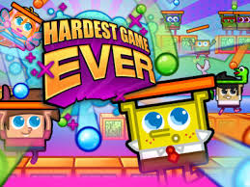


Pros:
-Exports to multiple platforms (flash, html5, windows, android, ios, etc)
-Similar language (Haxe) and API (OpenFL) to actionscript3/flash
-Light weight and open source
Cons:
-Not so great documentation (relatively speaking)
-Kinda complicated to set up (definitely not one click or one step)
-Android/ios builds are sloooooooow

Slide 3
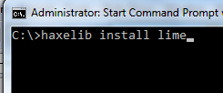
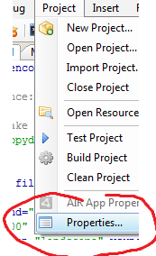
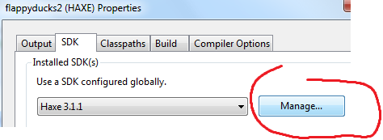
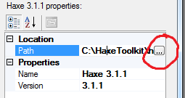

Setup:
-Download+Install Haxe
(http://haxe.org/download)
-Install lime & openfl
(“haxelib install lime”, “haxelib install openfl”)
-Download+Install FlashDevelop
(http://www.flashdevelop.org/)
(If you want an IDE like eclipse, though you can code/compile command line if you really want)
-Link to the Haxe installation in Flashdevelop

Slide 4


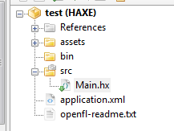
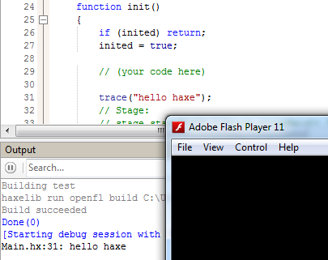
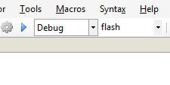
Making a new project in FlashDevelop
Create a new OpenFL project to be able to use the OpenFL library.
The starting point for the code is in “Main.hx”
Assuming everything is set up properly, running and compiling (with this setup) will bring up a blank swf.

Slide 5
Haxe the language
Very similar to Actionscript 3 (think structure like java, code like javascript with types)
package ;
import flash.display.Sprite
class TestClass extends Sprite {
public var field1:Int = 1;
public var field2:String = "string field";
public function new() {
trace("constructor");
this.testmethod();
}
public function testmethod():Bool {
trace(field2);
return true;
}
}
Documentation:
http://haxe.org/ref

Slide 6
OpenFL (flash) the library
Stage (the screen, the root of the display tree, etc)
stage.addEventListener(eventType,onEvent)
for
TouchEvents, MouseEvents, KeyboardEvents,
EnterFrame, etc
stage.addChild(new Sprite())
Sprite (an object on the screen)
sprite.x sprite.y (Float position)
sprite.graphics.beginFill(0xFF0000);
sprite.graphics.drawCircle(x,y,radius);
Graphics (draw things on this sprite)
Official API (kinda shitty)
http://www.openfl.org/documentation/api/flash/display/
Adobe's flash API (pretty good, different language but exact same classes/etc)
http://help.adobe.com/en_US/FlashPlatform/reference/actionscript/3/index.html

Slide 7
Game setup
(In Main.hx)
Create a new “FlappyGame” class (that extends flash.display.Sprite) and add it to the stage in Main in init()
function init() {
if (inited) return;
inited = true;
stage.addChild(new FlappyGame());
}
(In FlappyGame.hx)
public function new() {
super();
this.addEventListener(Event.ADDED_TO_STAGE,
function(e:Event) {
init();
}
);
}
In the FlappyGame constructor, add a event listener to this for Event.ADDED_TO_STAGE. Call your own initializaton method in the callback.
In your initialization method, add an event listener for Event.ENTER_FRAME to this and call your update method in the callback.
This is your update cycle.
public function init():Void {
//do other initialization stuff here
stage.addEventListener(Event.ENTER_FRAME, function(e:Event) {
update();
}
);
}

Slide 8
Input
stage.addEventListener(MouseEvent.CLICK,
function(e:MouseEvent) {
//called when clicked
}
);
stage.addEventListener(TouchEvent.TAP,
function(e:TouchEvent) {
//called touched (on mobile devices)
}
);
stage.addEventListener(KeyboardEvent.KEY_DOWN,
function(e:KeyboardEvent) {
//called keys pressed
}
);
Some of these only work on computers (when playing as a flash/html5/windows game), others only work when playing on a mobile device.
Have them all call the same functions.

Slide 9
Game Plan - Moving bird
-Have a field bird:Sprite that is your player, move this sprite around.
-Have a field bird_vy:Float that is the current y velocity of your player
-In your update cycle, decrement your velocity (gravity) and apply your velocity on the player bird's position
bird_vy+=0.5;
bird.y+=bird_vy;
-Any time the player taps/clicks, set the velocity to some high positive number
bird_vy = -8;
-If the player's y position is less than 0 or greater than height, game over
-Make a game_start and game_end function (to start and end the game), as well as a boolean “if the game is over”. Stop the game when the game is over.

Slide 10
Game Plan - Spawn Pipes
-Make a new class that extends flash.display.Sprite, “Pipe”. It should hold a width and height (as well as draw something with its graphics). In addition, give it a
public function hit_player(x:Float, y:Float):Bool
-Make an Array<Pipe> in your flappygame
-Every once in a while, add a new pipe randomly placed on the right side of the screen
-Every update cycle, loop through all the pipes
-Check if the player is hitting the individual pipe, if so end the game
-Move the pipe a little to the left

Slide 11
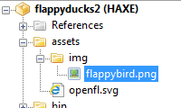
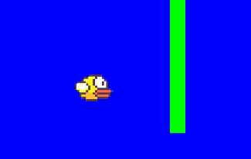
Bonus - Adding an Image
Add your image file in “assets/img” folder
To access this image, call
openfl.Assets.getBitmapData("img/flappybird.png")
(This returns the “BitmapData” object representing your image)
To render the image onto the screen, do:
sprite.addChild(new Bitmap(Assets.getBitmapData(“yourimage.png”)))
QUALITY VIDEOGAME

Slide 12
Big list of Haxe resources:
Flappyducks source code:
https://github.com/spotco/flappyducks
Reasons to use Haxe/OpenFL (especially if you're a flash developer!)
http://gamasutra.com/blogs/LarsDoucet/20140318/213407/Flash_is_dead_long_live_OpenFL.php
Papers, Please! (Popular recent game made with Haxe)
http://papersplea.se/
-----
OpenFL API (kinda shitty)
http://www.openfl.org/documentation/api/flash/display/
Adobe's flash API (pretty good, different language but exact same classes/etc)
http://help.adobe.com/en_US/FlashPlatform/reference/actionscript/3/index.html
Haxe Language Reference
http://haxe.org/ref

