Slide 1
Setting up GitHub
Game Development Club – University of Washington
10/21/15

Slide 2
Create an Account
www.github.com
Sign up for an account
Choose the free option
desktop.github.com
Download the client

Slide 3
What is a repository?
A library for your code to be on the same version
Professional companies and startups all need to maintain repositories
This way your code stays up to date between everyone who handles the code

Slide 4
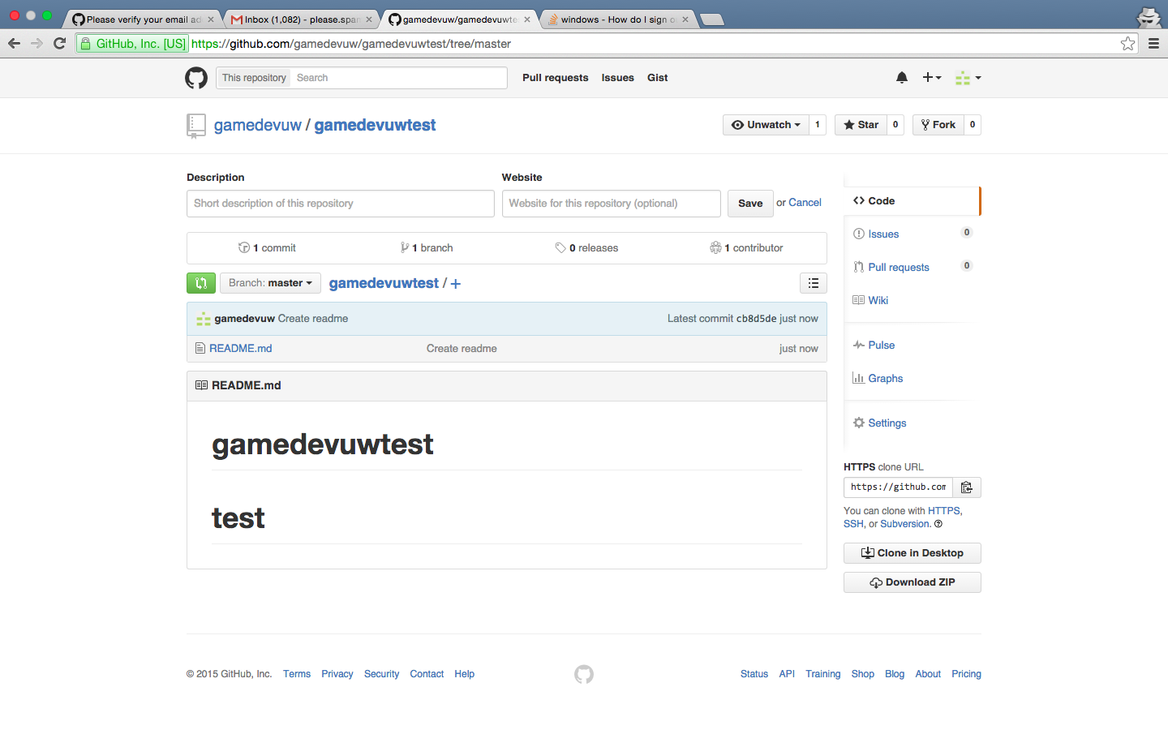
Clone a repository
https://github.com/gamedevuw/gamedevuwtest

Slide 5
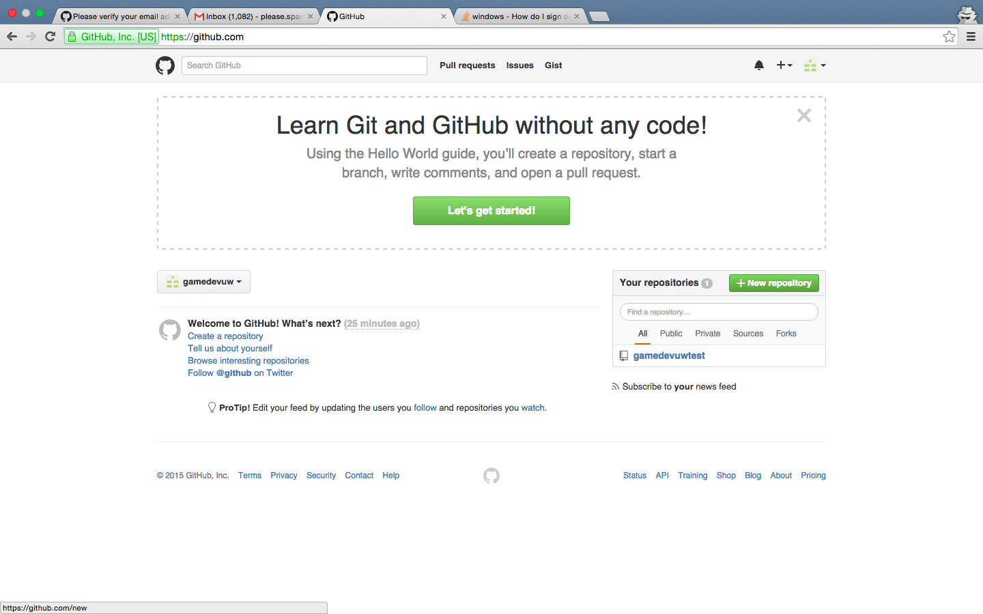
Create a new repository
Create a new repo

Slide 6
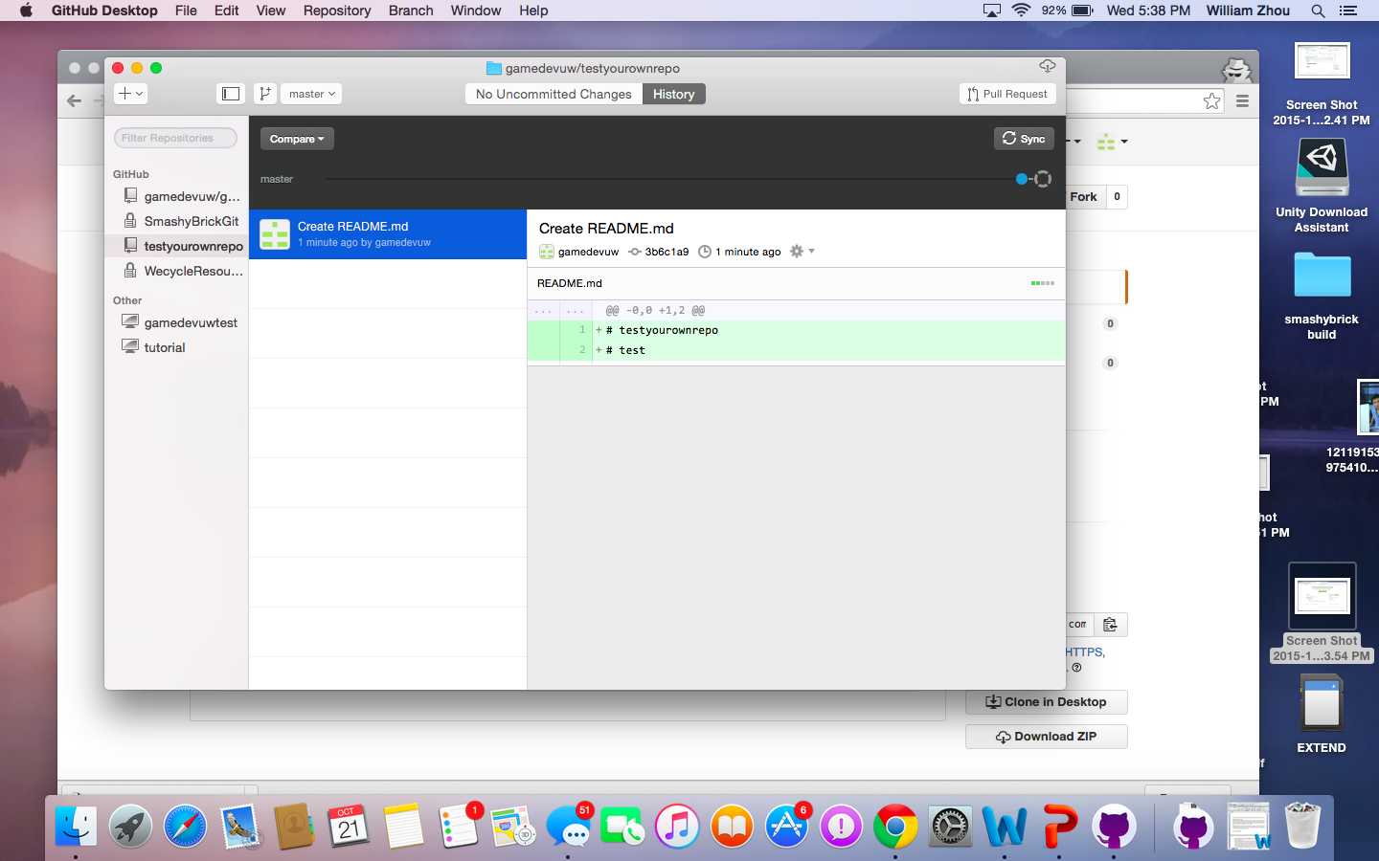
Sync on GitHub Desktop
Sync on Desktop

Slide 7
Making Changes
Now that the repository is shared among several members, anyone can make changes and push their changes
Git Ignore
http://pastebin.com/bczJeNe4
Add Unity Files to the Folder we created

Slide 8
Branches, Merges
We will cover this in the future

