Slide 1
TableauProject_JalenClaytor
File created on: 3/8/2025 10:12:55 PM

Slide 2
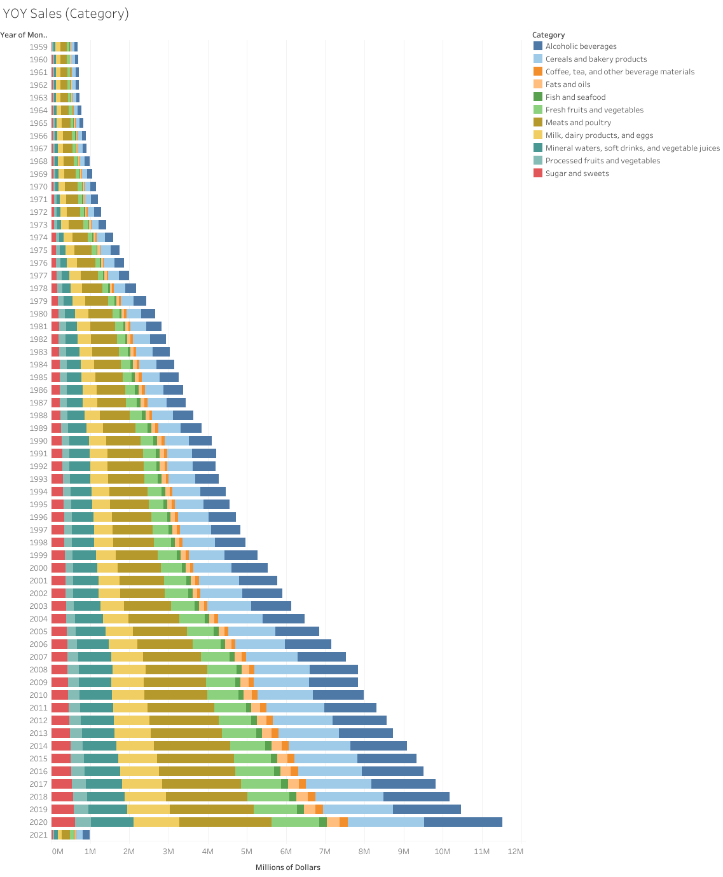

Slide 3
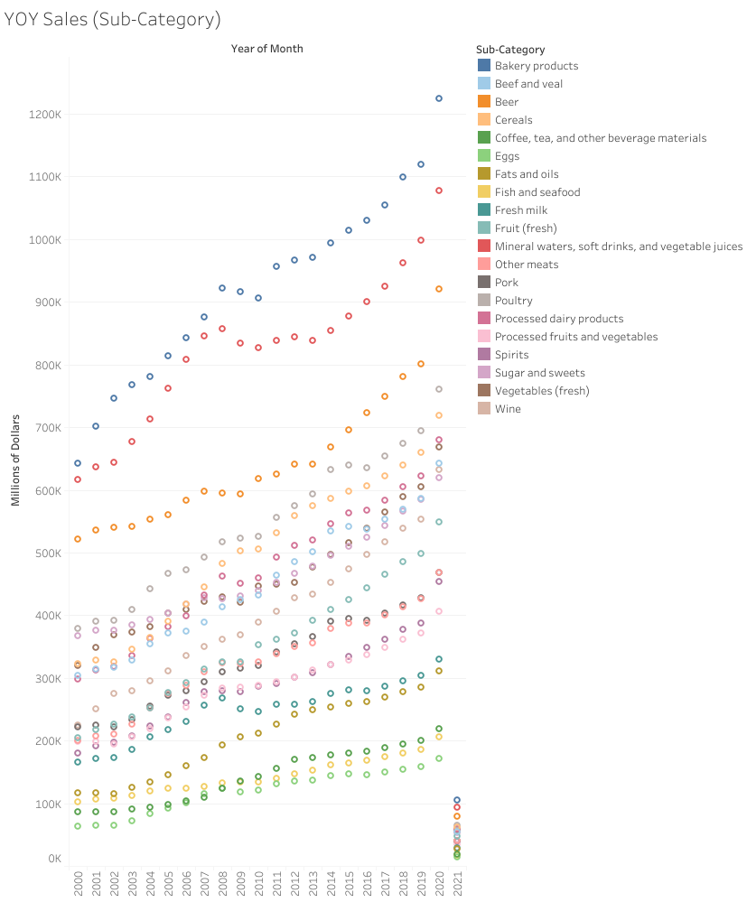

Slide 4
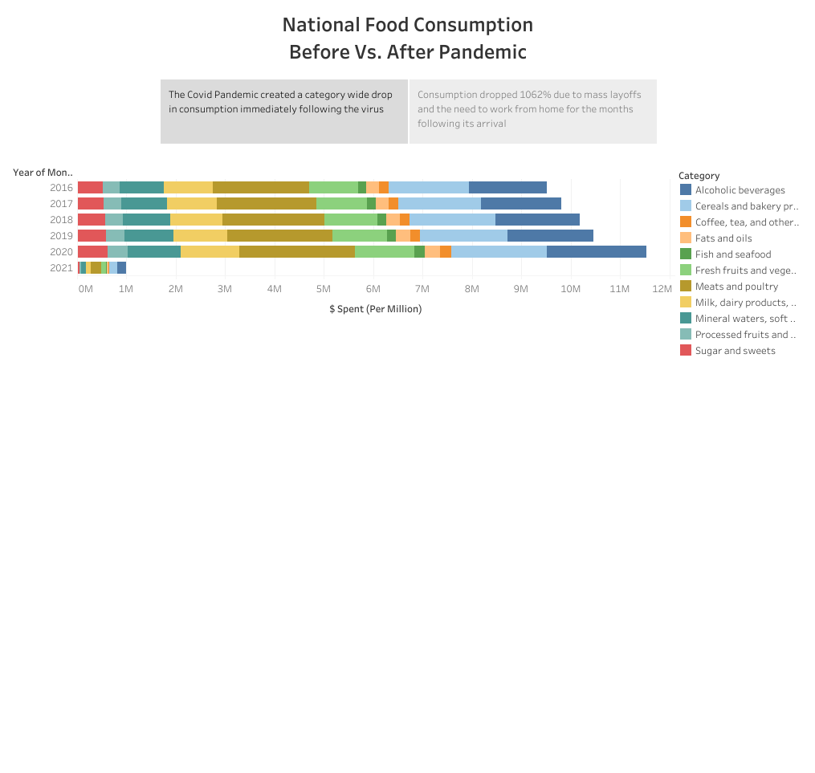

Slide 5
