Slide 1

TTOS
2
COMING SOON
Shutdown
Welcome to the fastest PowerPoint OS ever

Slide 2
TTOS
2
Welcome to the fastest PowerPoint OS ever

Slide 3
TTOS
2
TTOS

Slide 4
TT Store
Games
…. ....
TT
Documents
TT Browser
Music
Videos
--------------------
TTech
TTOS
Notes
Calendar
Images
TTOS
About
--------------------
----
1
Prototype
End
TTOS

Slide 5
TT Store
X
Just exit from this PPTOS and make your own app. (Not in this slide)
-Tuna Tezer aka TTech
TTOS

Slide 6
Music
X
Clap
Breeze
Laser
Wind
Vacuum
Bomb
Speed
Coin
Slide Projector
Voltage
TTech
TTOS
Bell
Camera
Arrow
Click
Cash Register
Prototype
Typewriter
Lead Tab
Explosion
Unnamed
TTOS

Slide 7
Documents
X
Nothing found.
TTOS

Slide 8
Videos
X
TTOS

Slide 9
Notes
X
1
2
3
4
TTOS

Slide 10
Notes
X
1
2
3
4
TTOS

Slide 11
Notes
X
1
2
3
4
TTOS

Slide 12
Notes
X
1
2
3
4
TTOS

Slide 13
Calendar
X
It’s too hard to make a calendar.
-Tuna Tezer aka TTech
TTOS

Slide 14
Games
X
Nothing found.
TTOS

Slide 15
X
TTOS

Slide 16

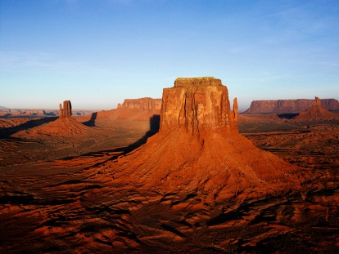

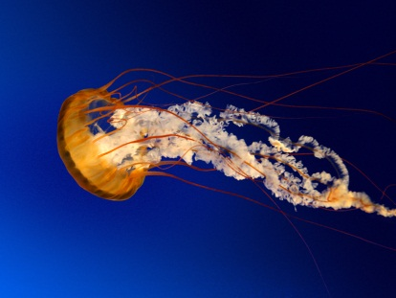


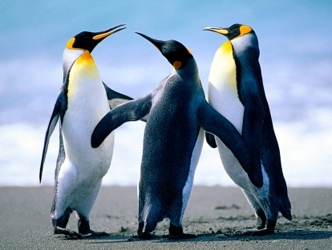

Images
X
TTOS

Slide 17
About
X
TTOS 2
Codename Boxes
© TTech 2015.
TTOS
2
TTech
TTOS
Prototype
TTOS

Slide 18
End
Select a thing.
TTech
TTOS
Prototype
End
S
Lg
R
Lc
C
TTOS

Slide 19
TTOS
2
Locked
Unlock

