Slide 2

KidsOS2
alpha

Slide 3


sign ni to desktop
Error
USER
login

Slide 4
USER

Slide 5





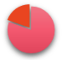

Google Chrome|PowerPoint
Shut down

Slide 6


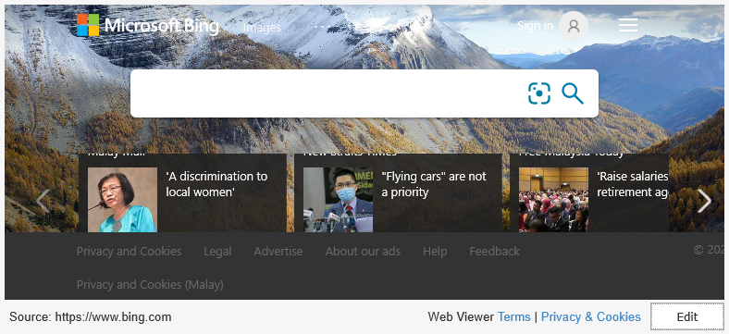
www.bing.com

Slide 7
Witre
wOffice3

Slide 8
Hello World.txt
Home
Edit
Insent
1

Slide 9
Show
wOffice3

Slide 10
Hello World.ppt
p
Home
Edit
Insent
1

Slide 11
Table
wOffice3

Slide 12

Hello World.xls
Home
Edit
Insent
1
hello | world

Slide 13



Setting
Connect
About

Slide 14


Connect
Wi-Fi_1 5G Connect
Wi-Fi

Slide 15
About
Kids OS 2 alpha on power point
RAM:3GB
ROM:128GB
Drive Name:K2aPPT-DESKTOP
Made In Wibo 2020

Slide 16
Shut Down

