Slide 2
WIPO
Wipo by 2021

Slide 4

Wipo.ltd 2020-2021

Slide 6

Sunday, 11 April, 2021

Slide 7





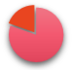



i
ShutDown
Restart
Lock
11/4/2021

Slide 8

wFile

Slide 9
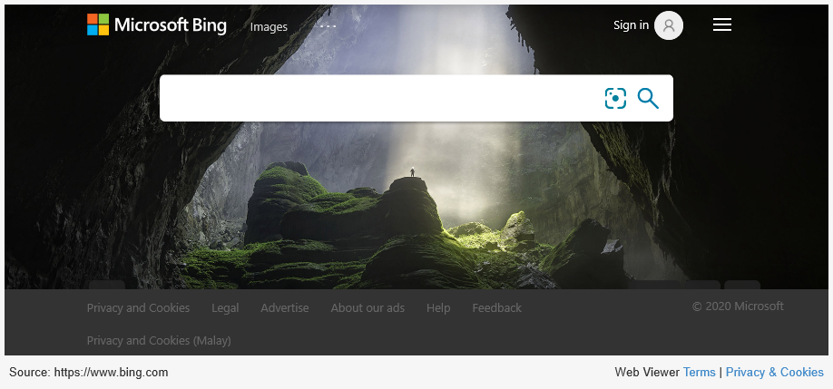
wBrower
Bing
bing.com

Slide 10
wStore
Search
Office
wText
wDemo
wTable

Slide 11
wMail
Login Mail
Username
Password

Slide 12
wText

Slide 13
wDemo

Slide 14
wTable

Slide 15
i
Setting
Update
KindOS2.0
Wipo.ltd 2020-2021
No Update
info

Slide 16
Shut Down

