Slide 1
KidsOS1
start down

Slide 2
login user
USER
1

Slide 3
loding

Slide 4
LaOffice
s
on tab

Slide 5
LaOffice2

Slide 6
LaOffice 2
Open
Text
Open
Demo
Open
Table
New

Slide 7
Text
100

Slide 8
MyWord.txt
Open
.txt
text
.docx
word(New)
.ltf
LaOffice Text(New)

Slide 9
text2
MyWord.txt
file
save

Slide 10
text2
MyWord.txt
file

Slide 11
Demo
100

Slide 12
MyPPT.pptx
Open
.ppt powerpoint(1-97)
.pptx powerpoint(New)
.ldm
LaOffice Demo(New)

Slide 13
File
Demo
MyPPT.pptx

Slide 14
Save
File
Demo
MyPPT.pptx

Slide 15
LaMap

Slide 16
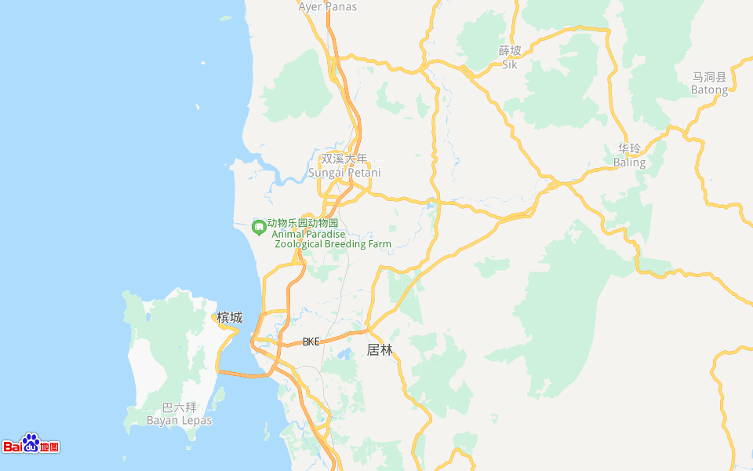
YouLove 1

Slide 17
setting

Slide 18
SETTING
Internet
Body Setting

Slide 19
SETTING
wi-fi:home@uniti WPA2
Internet
Body Setting
bluetooth:no drive

Slide 20
SETTING
Internet
PC NAME:LAPTOP-K1
Body Setting
Kids OS:1.0

Slide 21
shut down

