Slide 1
Pitch-Event Slide Deck Template
Summer Term 2024

Slide 2
Agenda
Potential topics for the presentation
Intro & Team
Idea and Project Outline
Problems & Solutions
Learnings
Demo

Slide 3
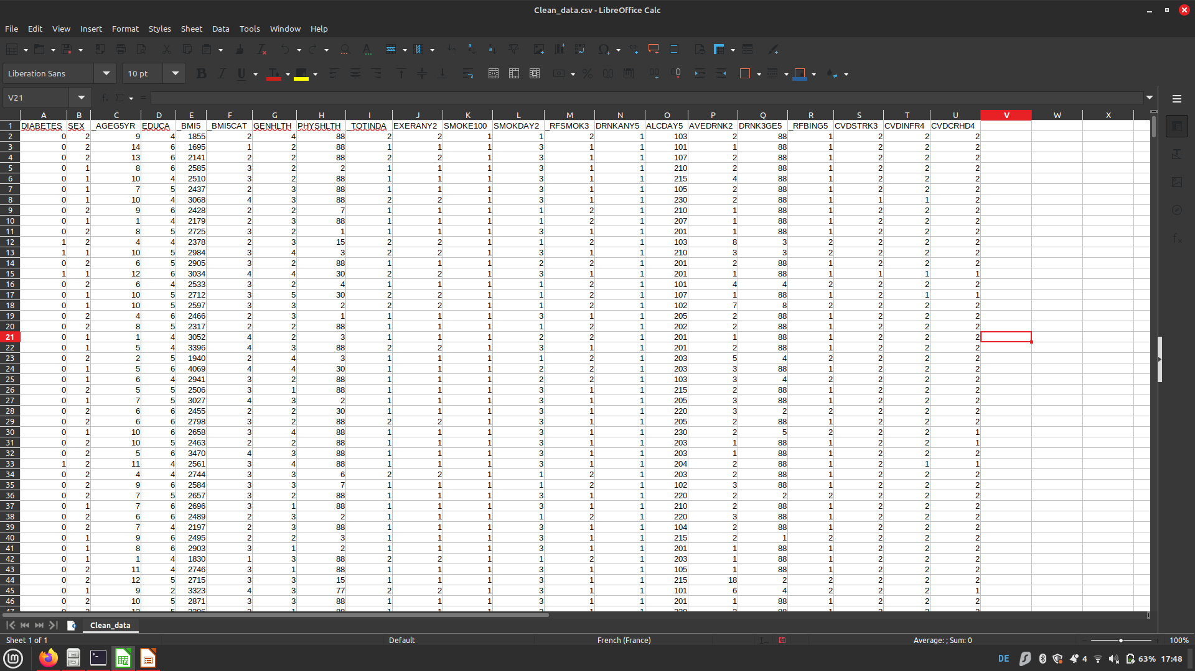
Intro & Team
Some ideas for this section
We tried predicting if someone had diabetes based on a set of metrics that were either habits, medical history or physical properties
  Team members:
Nima
Irem
Florian
  Mentor:
Patrick
"sex",
"age"
"education"
"body_mass_index"
"bmi_cat"
"estimated_health"
"bad_physhealth_days"
"had_phys_activity"
"any_exercise"
"smoked_over_100"
"smokes_daily"
"is_smoker"
"alcohol_past_30"
"one_drink_per_day_month_last_30"
"average_drinks"
"more_than_5_drinks"
"more_than_5_drinks_on_one_occasion"
"had_stroke"
"had_heart_attack"
"had_angina"

Slide 4
Idea & Project Outline
Some ideas for this section
What did plan to do in the beginning? What technologies did you intend to use?
How did your planning change during the project phase?
How much time did you spend on what tasks?
Which problem would you like to solve with your project?
Diabetes not being predicted (cost of not predicting it?)
Where did your idea come from? Patrick gave us data and pushed us in direction

Slide 5
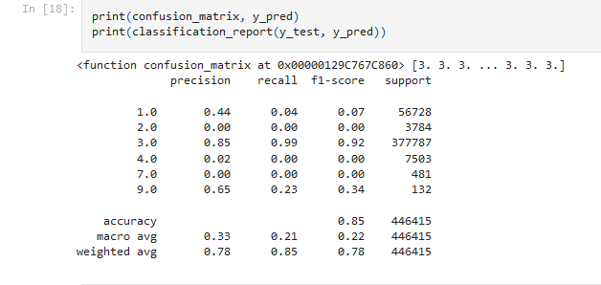
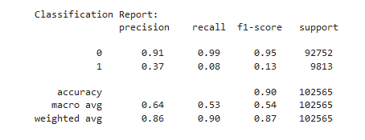
Problems & Solutions
Some ideas for this section
What experiences did your mentor bring to your team?
Problem: big imbalance, group without diabetes made up majority of data. We could have an precision of 86% but only catch 36% of diabetes cases
Solution:
Focus on recall, not accuracy.
Explanation of recall vs accuracy?
Tools used:
Sklearn:
RandomForestClassifier
pandas

Slide 6
Demo
Some ideas for this section
Briefly present your final results
For websites: Show us the features of your website and maybe also some bugs!
For analysis and models: Show us a visual representation of your work!
...

Slide 7
PROJECT NAME
Group #XY

