Slide 1


GitHub

Slide 2
What is GitHub?
At its core, GitHub is a distributed version control system (DVCS).
Allows users to work on changes/features locally via the code repositories.
Changes are not finalized until they’re committed and pushed to a remote repository.
Tools for collaboration and project management.

Slide 3

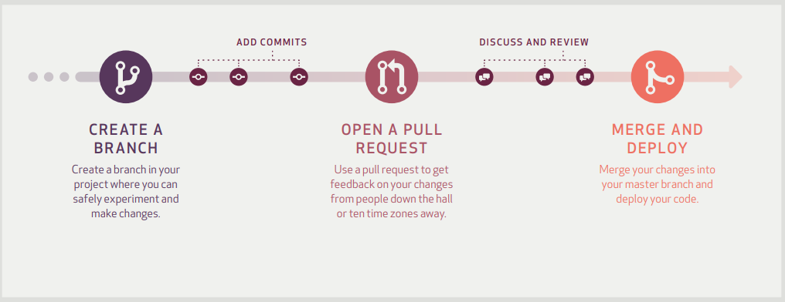
GitHub
GitHub Flow
Source: https://guides.github.com/pdfs/githubflow-online.pdf

Slide 4
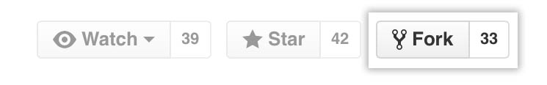

GitHub
Creating a branch
When collaborating on remote repository, begin by forking the current repository.
This will create a copy of the current repository into the local user’s account.
From here, clone the repository using the link provided.
git clone <clone_url>

Slide 5
Feature enhancements or bug fixes to the branch
GitHub
Make any code changes locally.
To begin tracking new or modified files, execute:
cd <Repository_Folder> : the parent directory will have folder named “.git”
git add <filename>’ : track individual file changes.
git add . : track all files that have been changed.
When changes are ready to be staged, commit!
Committing will stage your current changes (i.e., tracked files).
git commit –m “<Useful message to identify changes like Issue#”

Slide 6
Keeping the fork in-sync
GitHub
Create an upstream repository for syncing changes from the collaboration repository to your repository.
git remote add upstream <original_repository>
‘git remote add upstream https://github.com/CottonTechnologyAllicance/Recap’
Verify upstream
git remote -v
Get the latest changes from the upstream repository.
git fetch upstream
Be sure local branch is checked out
git checkout master
Merge the upstream changes with the local branch
git merge upstream/master : (and hope for no conflicts!)

Slide 7
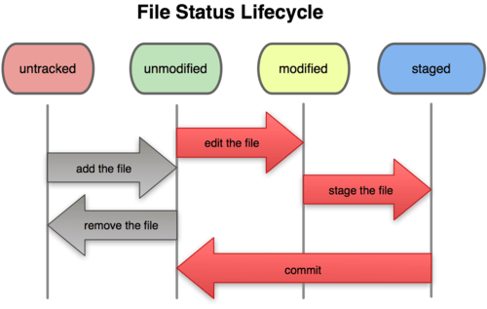
File change lifecycle
GitHub

Slide 8
GitHub
Pushing changes
Pushing changes from you local repository to the forked repository on GitHub
git push -u <remote> <branch> (for example, git push –u origin master)
The “-u” argument allows the user to do argument-less git pull after a git push (*reference).

Slide 9

GitHub
Pull Requests
Go to the original repository: https://github.com/<username_organiztion>/<repository>
Ex: https://github.com/CottonTechnologyAlliance/Recap
Click New Pull Request
Click Compare Across Forks to review proposed changes.
Click Create Pull Request to submit.

Slide 10
GitHub
Merging Pull Requests
Under the repository, click Pull requests.
Find the pull request to merge and click Merge pull request.
There are several options for merging; see https://help.github.com/articles/merging-a-pull-request/

Slide 11
GitHub
Project Management and Collaboration Tools
Projects
Creating projects to group major feature changes.
Issues
Using Kanban board to track issues and move through workflow.
Wiki
Documentation and FAQ

Slide 12
Links
GitHub boot camp:
https://help.github.com/categories/bootcamp/
GitHub introductory guide:
https://guides.github.com/introduction/flow/
GitHub collaborating:
https://help.github.com/categories/collaborating-with-issues-and-pull-requests/
GitHub cheat sheet:
https://education.github.com/git-cheat-sheet-education.pdf

