Slide 1
HTML & CSS basics
HTML & CSS Course – Chapter 1

Slide 2
HTML Tags
HTML Semantics
CSS syntax
CSS properties -background, colors
CSS order of applying and overwriting

Slide 3
What's HTML?

Slide 4
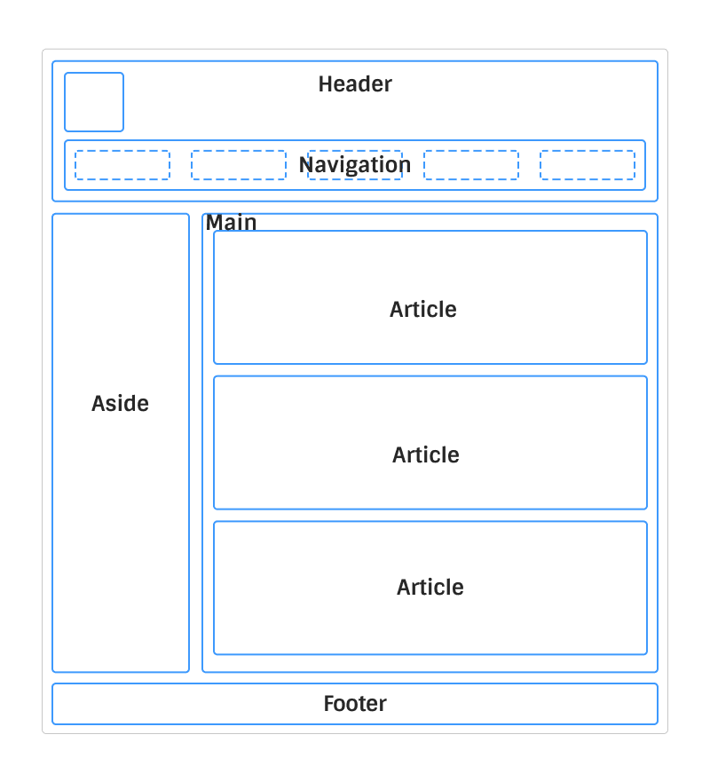

Slide 5
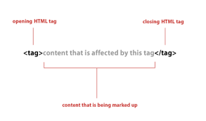
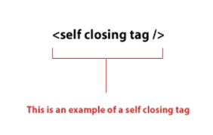
HTML Tags - Syntax

Slide 6
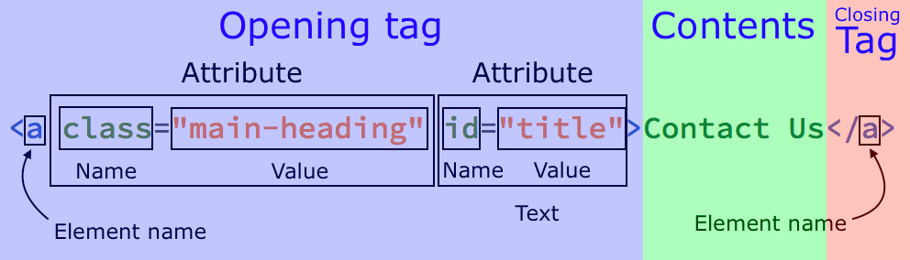

Slide 7
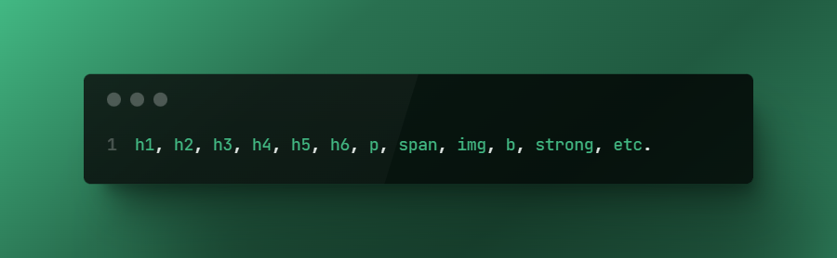
HTML Tags
https://developer.mozilla.org/en-US/docs/Web/HTML/Element
https://www.w3schools.com/html/html_elements.asp

Slide 8
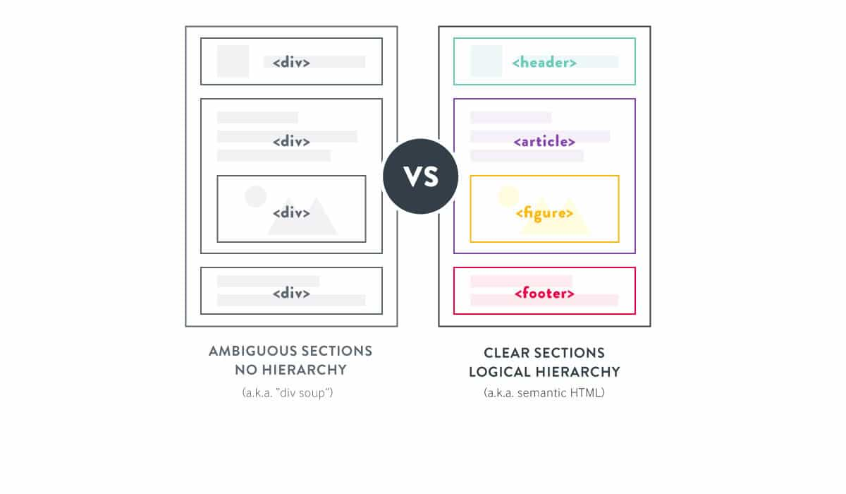
HTML Semantics

Slide 9
Why care?
Reading
Browsers
Page readers (accessibility)
Crawlers
SEO
Browser functionalities – validations, submission, styles, etc.
DX - Usability and support

Slide 10
What’s CSS?

Slide 11
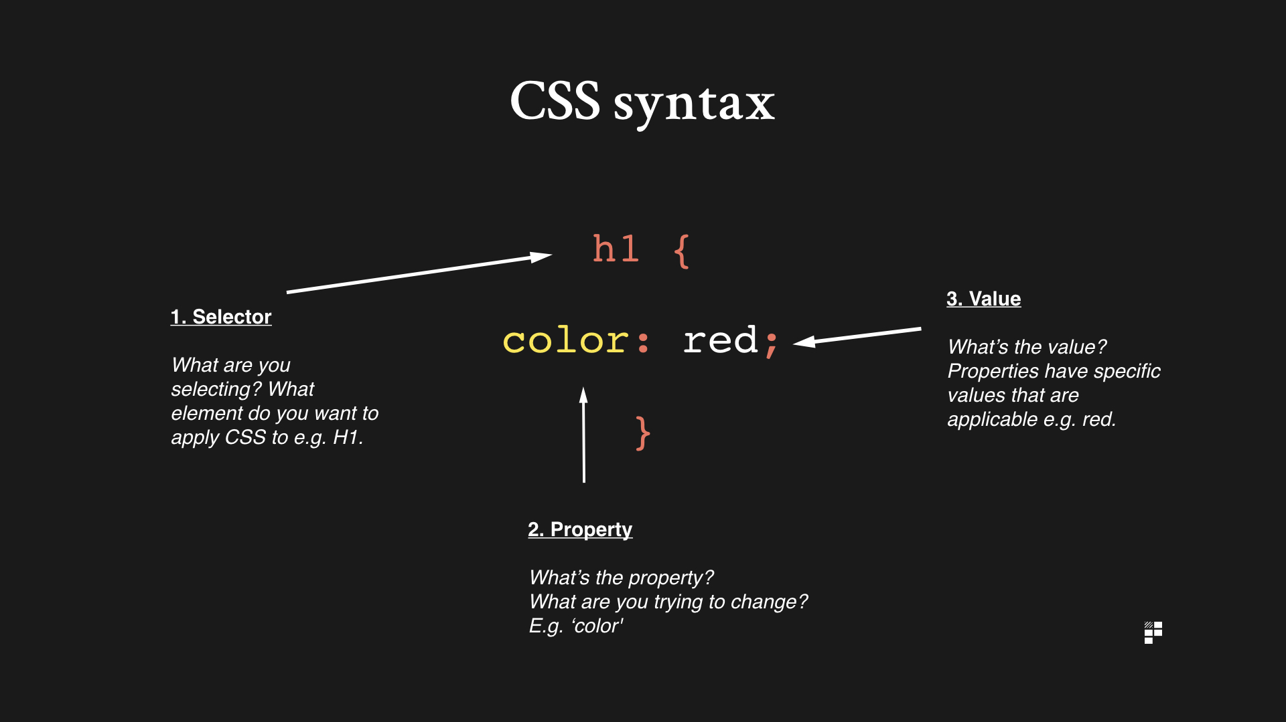

Slide 12
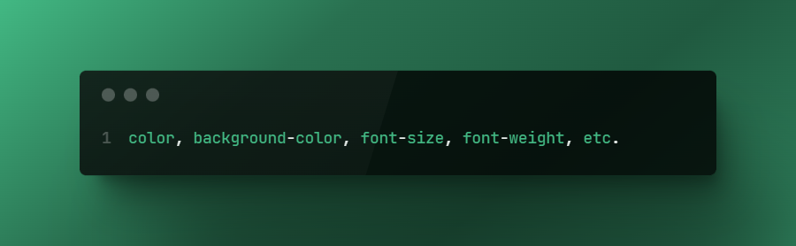
CSS Properties

Slide 13
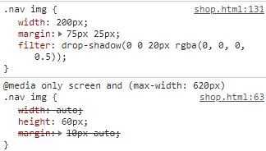
CSS order and overwriting

Slide 14
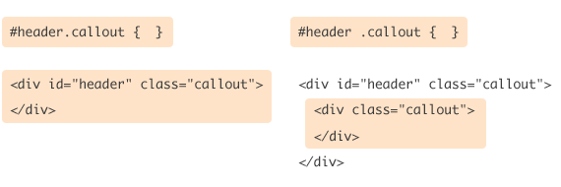
Class vs. ID

Slide 15
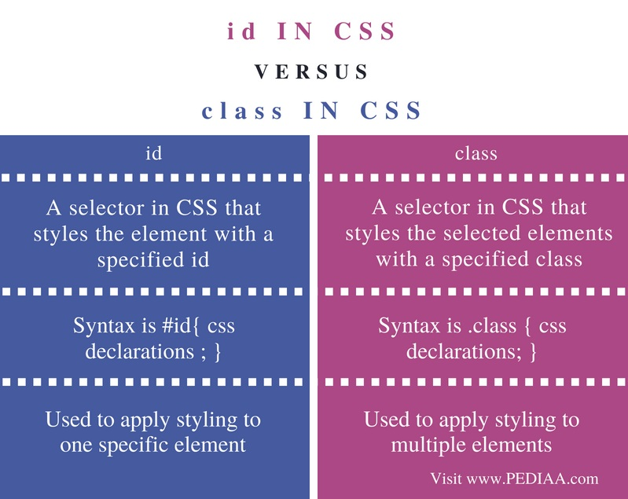
Class vs. ID

Slide 16
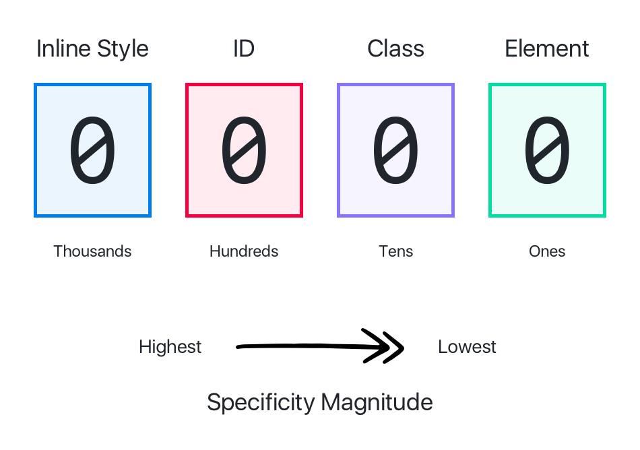
Specificity
https://css-tricks.com/specifics-on-css-specificity/

Slide 17
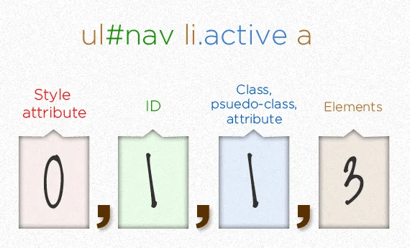
Specificity

