Slide 1
CSS Basics

Slide 2
Topics
Quick overview: Specificity & IDs & classes
Working with text – fonts, loading, using
Inline & block elements
Basic properties – width, height
Units in CSS – PX, EM, REM, %, PT, VH, VW

Slide 3
CSS Selectors & Specificity QUIZ

Slide 4
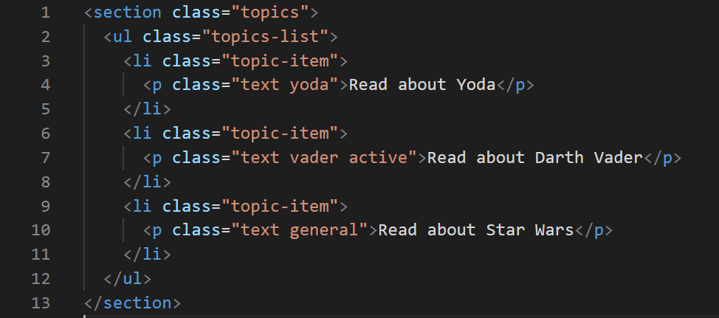
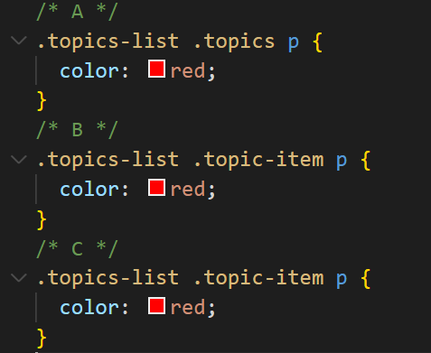
Which selector is WRONG?
Answer: A

Slide 5
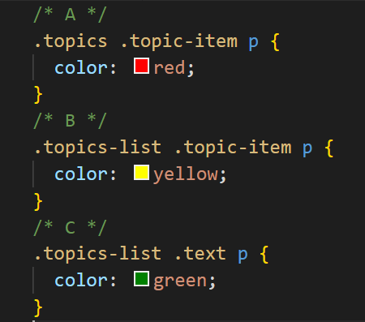
Which style will be activated?
Answer: B - yellow

Slide 6
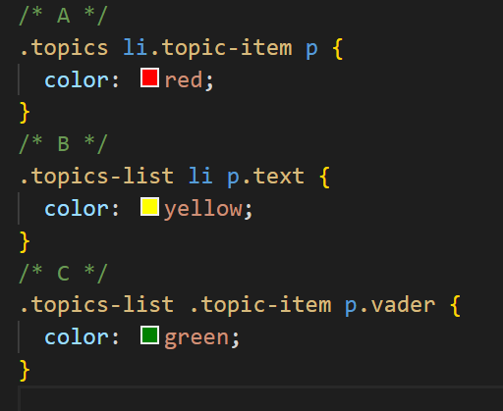
Which style will be activated?
Answer: C - green

Slide 7
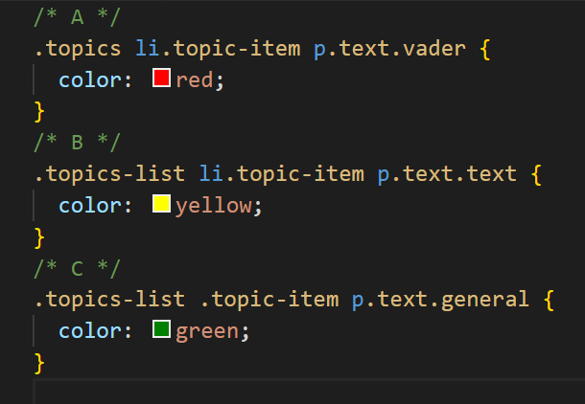
Open question – how will this be styled in the browser?

Slide 8
Text & Typography
Semantics
Tags examples

Slide 9
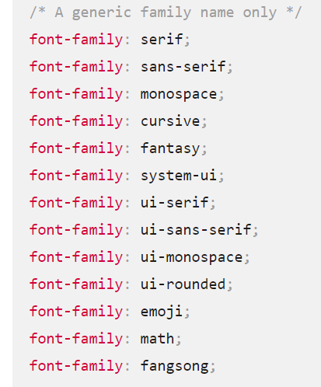
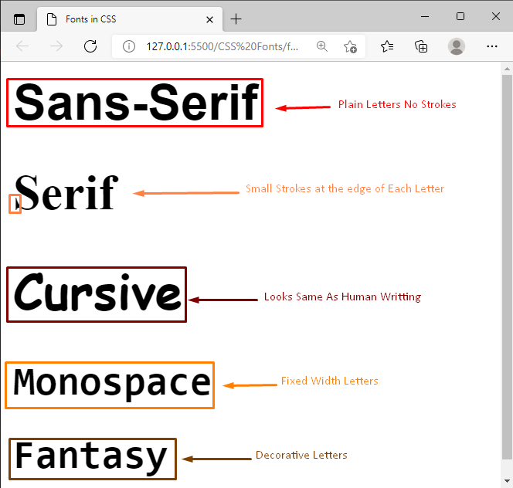
Using fonts - Generics
https://www.w3schools.com/css/css_font.asp
https://developer.mozilla.org/en-US/docs/Web/CSS/font-family

Slide 10
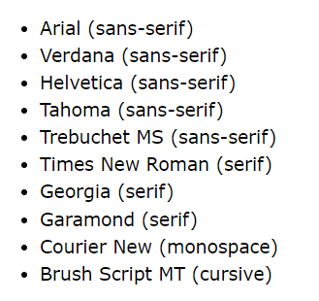
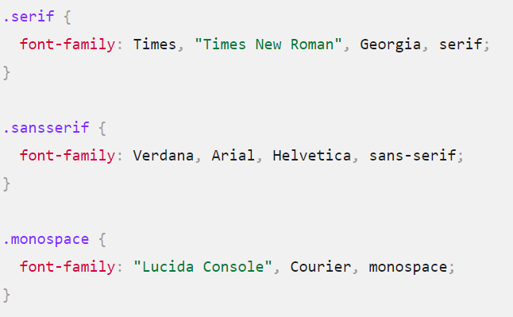
CSS Web Safe Fonts

Slide 11
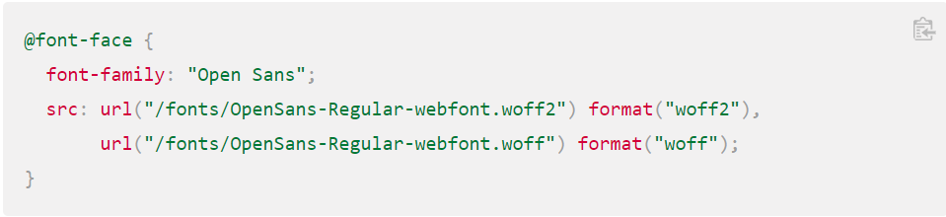
Custom & Google Fonts
https://developer.mozilla.org/en-US/docs/Web/CSS/@font-face#syntax

Slide 12
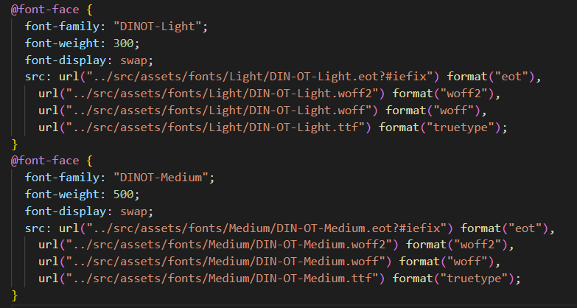
Example

Slide 13
Text properties
Font-size
Font-weight
Text-decoration
Text-transform
Line-height
Letter-spacing

Slide 14
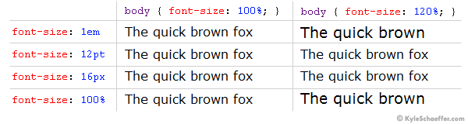
Units in CSS

