Slide 1
Title
An Example MSE

Slide 2
Introduction

Slide 3
MSE Framework

Slide 4
Red Snapper & Gag Grouper Operating Model
from assessments

Slide 5
Simulate the Historical Fishery
imported into the MSE framework
multi-stock/fleet model
simulated historical dynamics match assessments

Slide 6
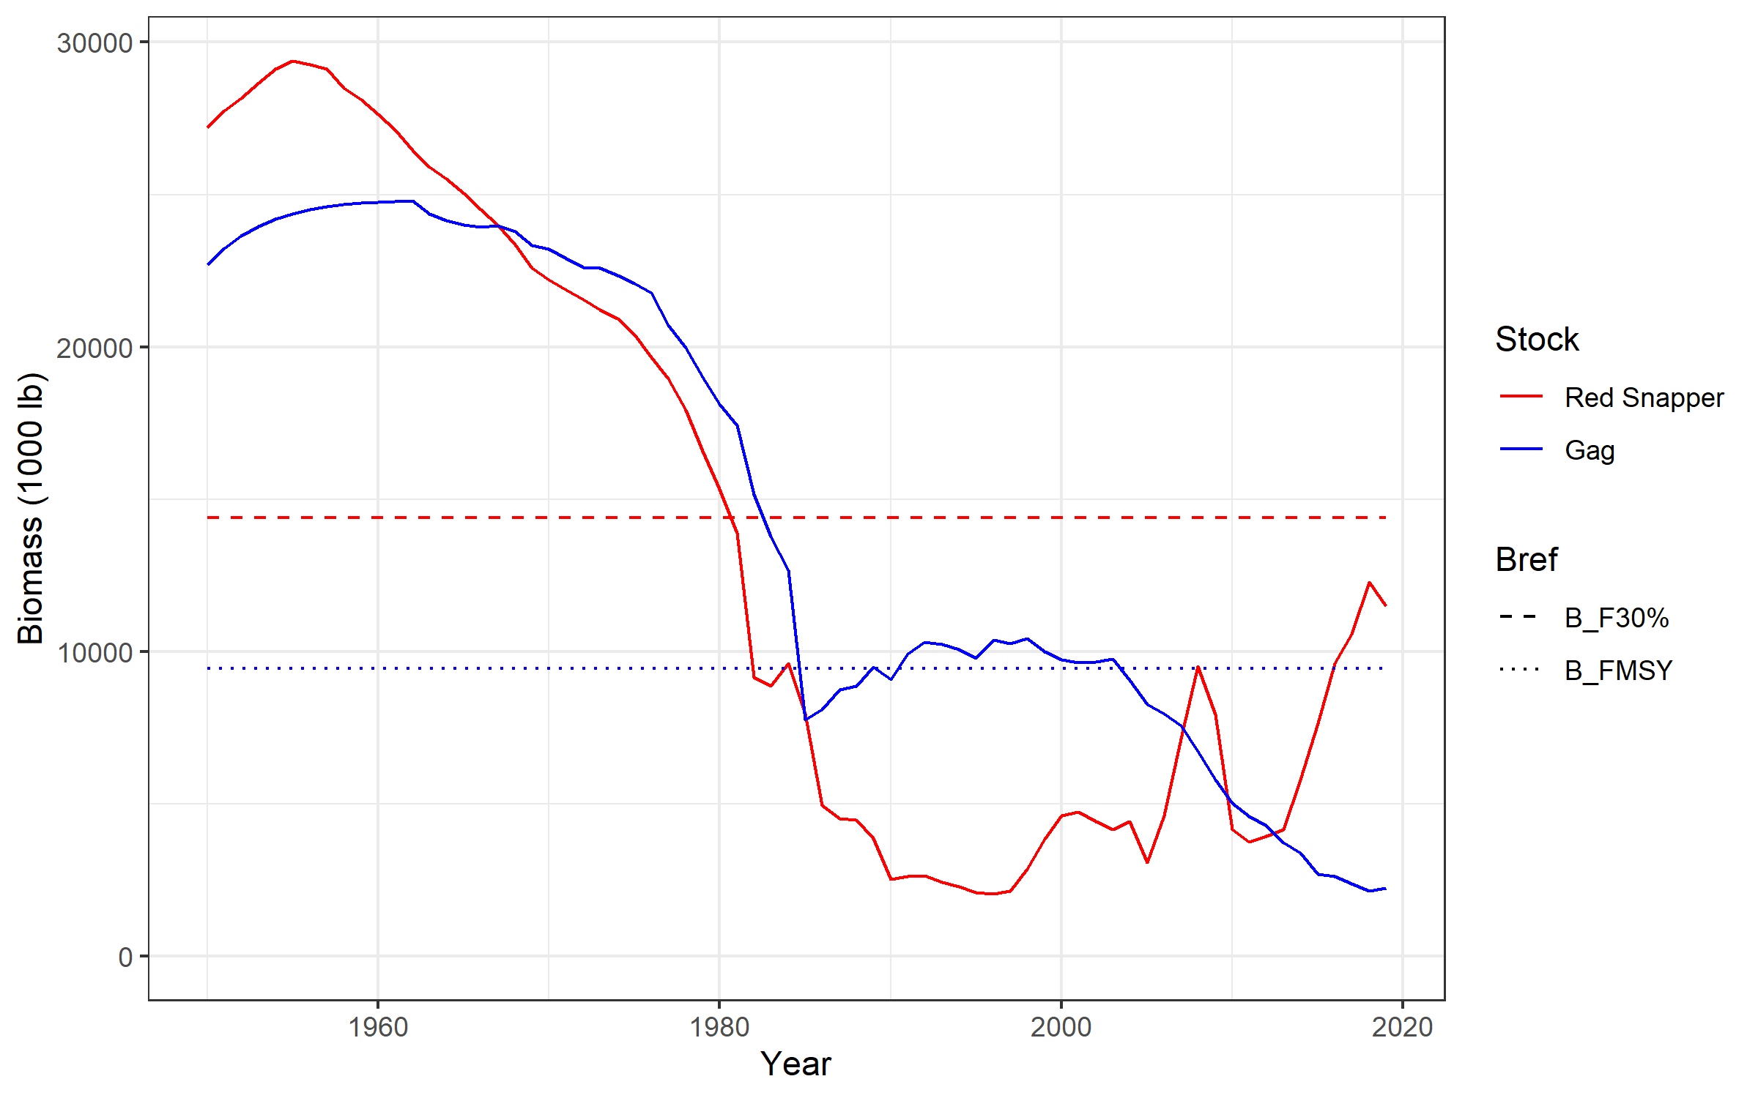
Total Stock Biomass

Slide 7
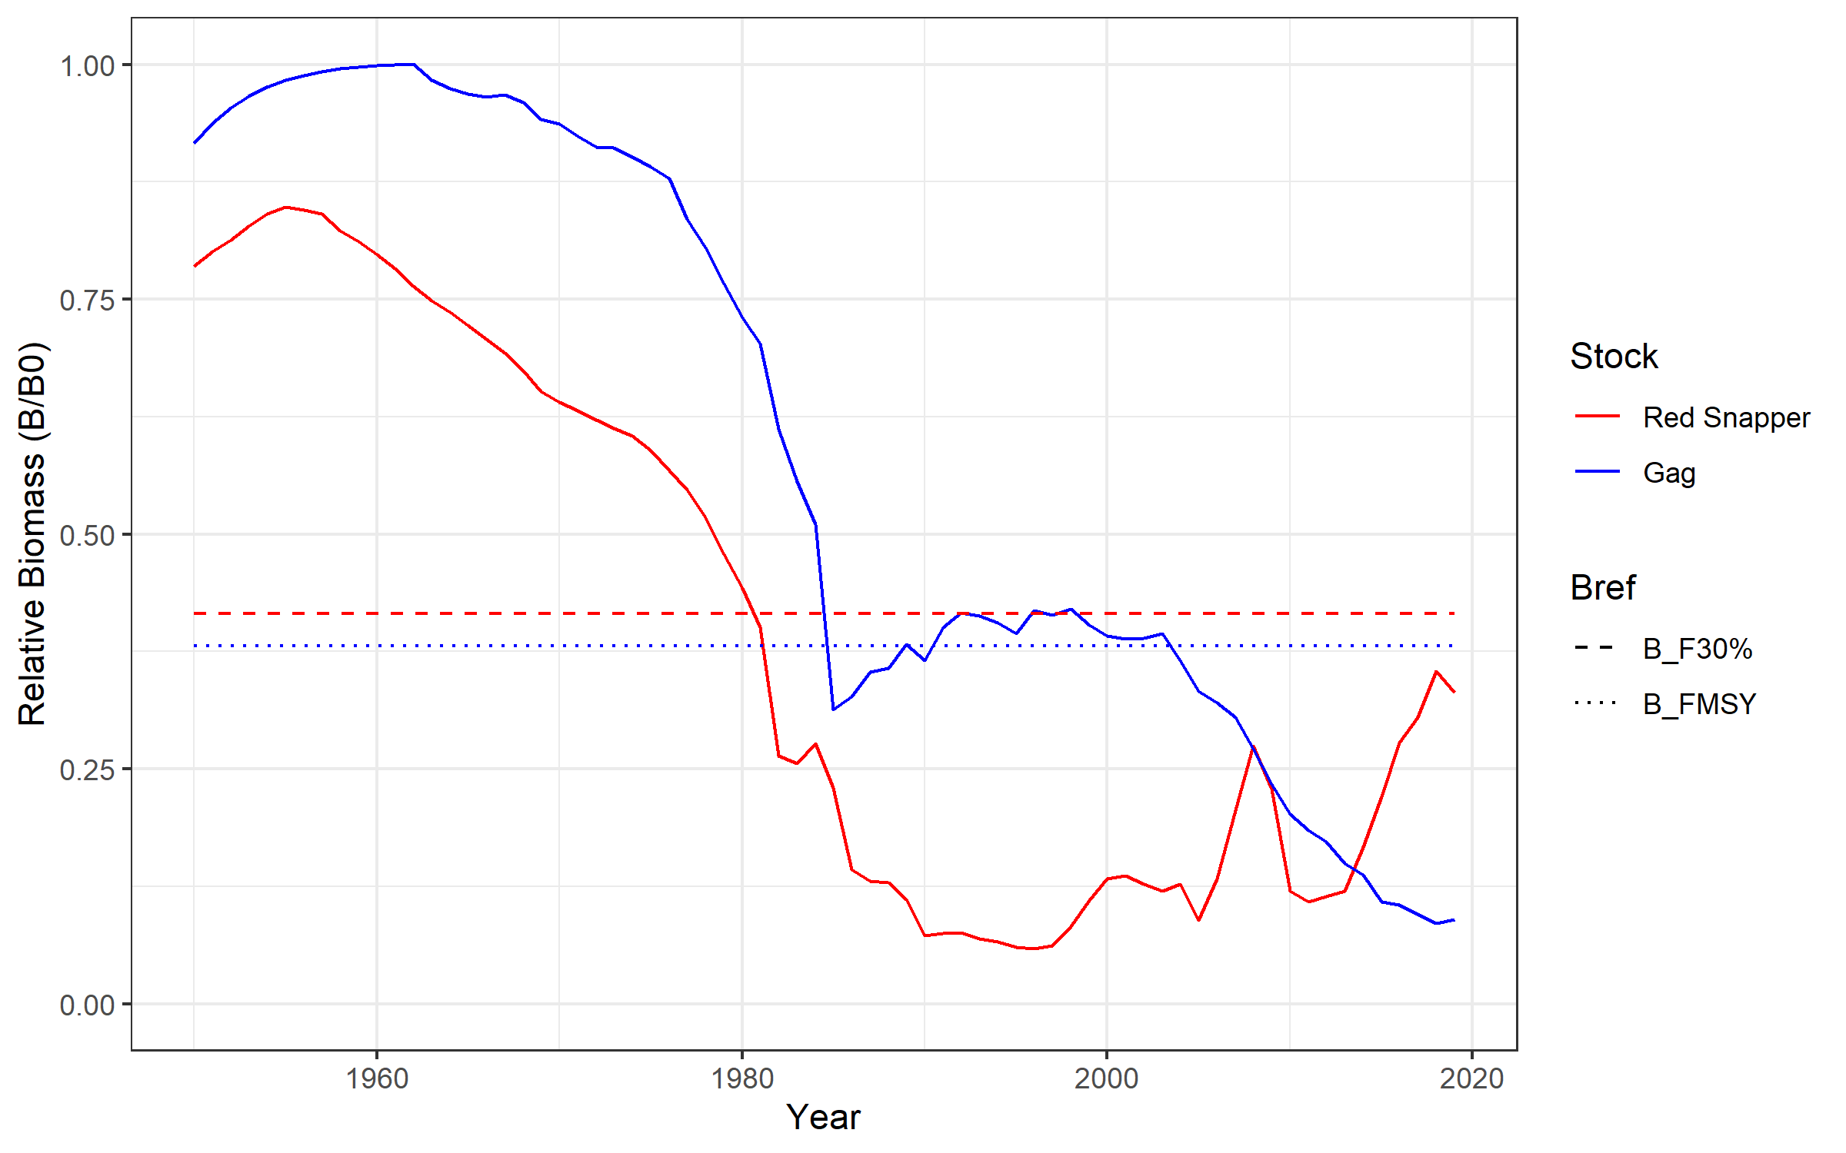
Relative Total Stock Biomass

Slide 8
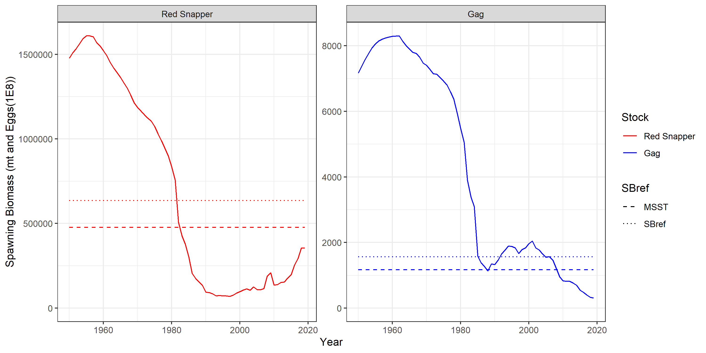
Spawning Biomass

Slide 9
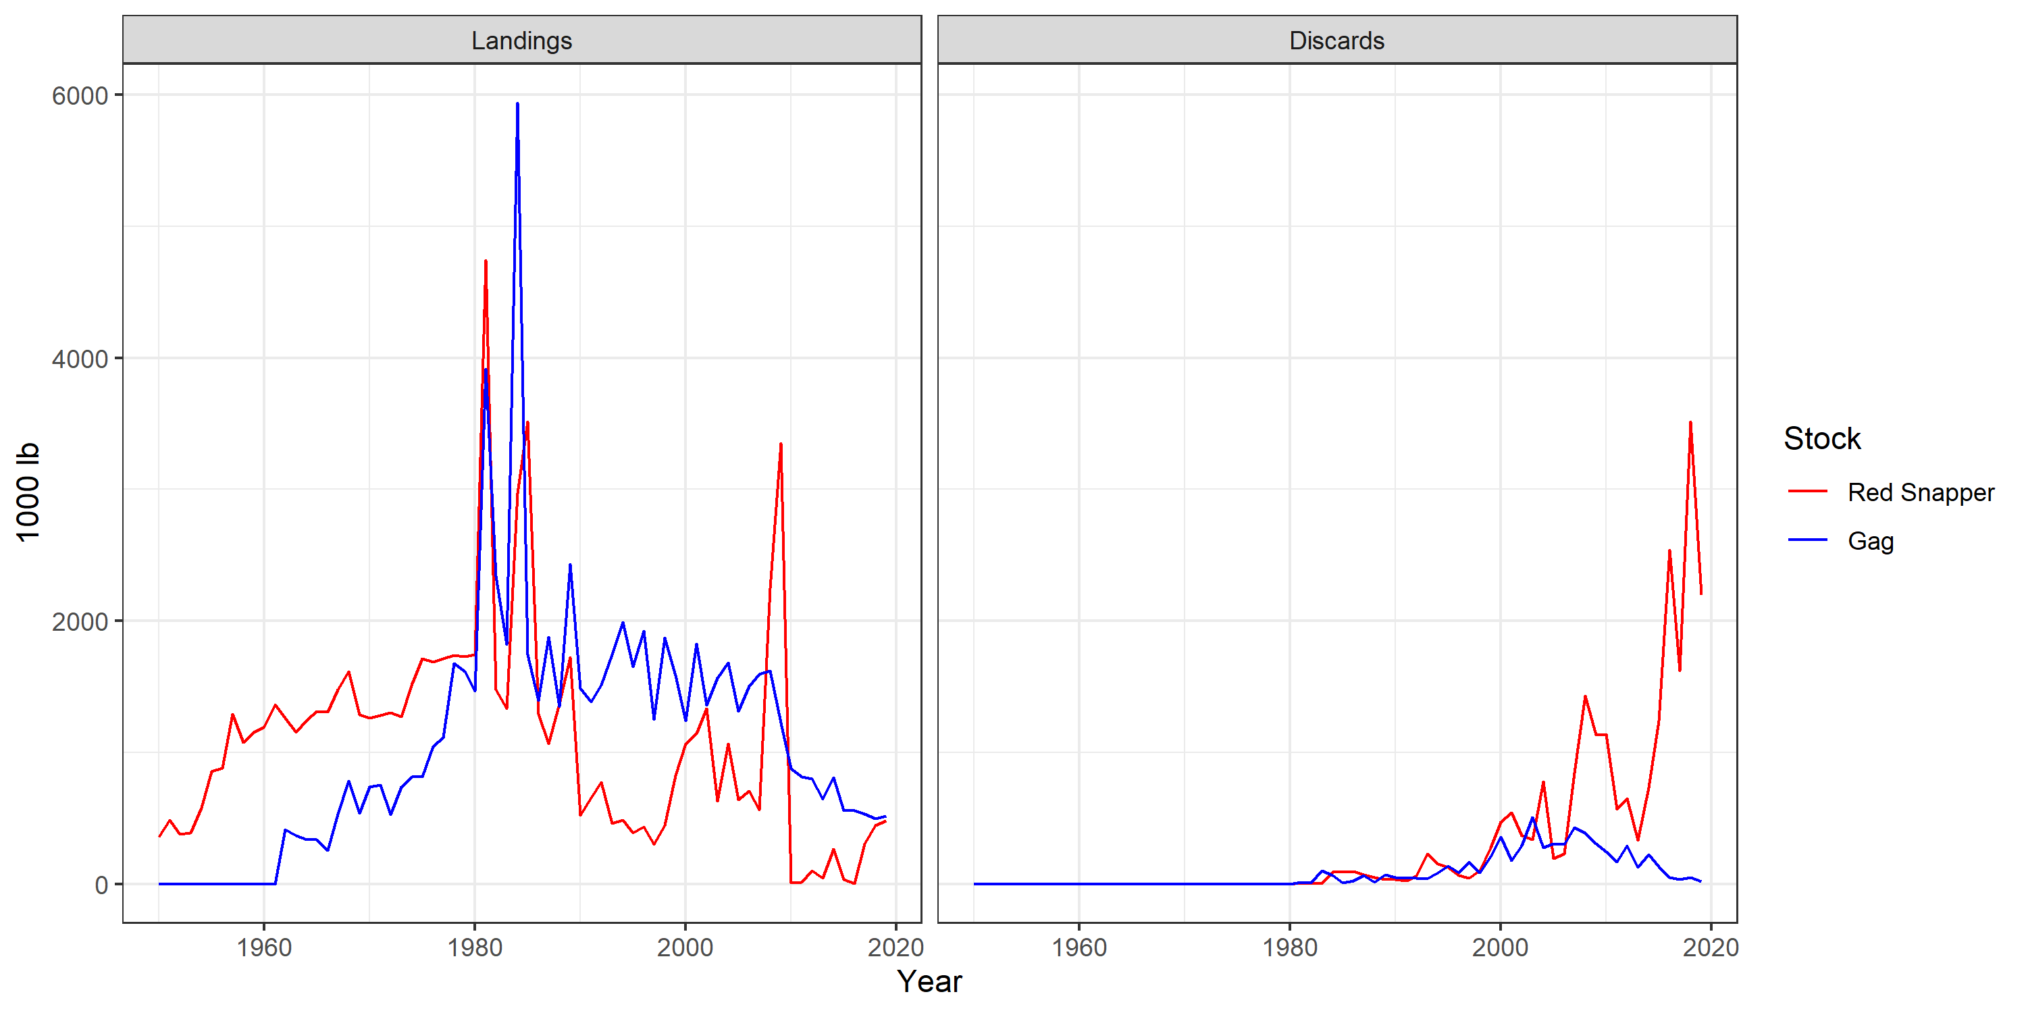
Landings and Discards

Slide 10
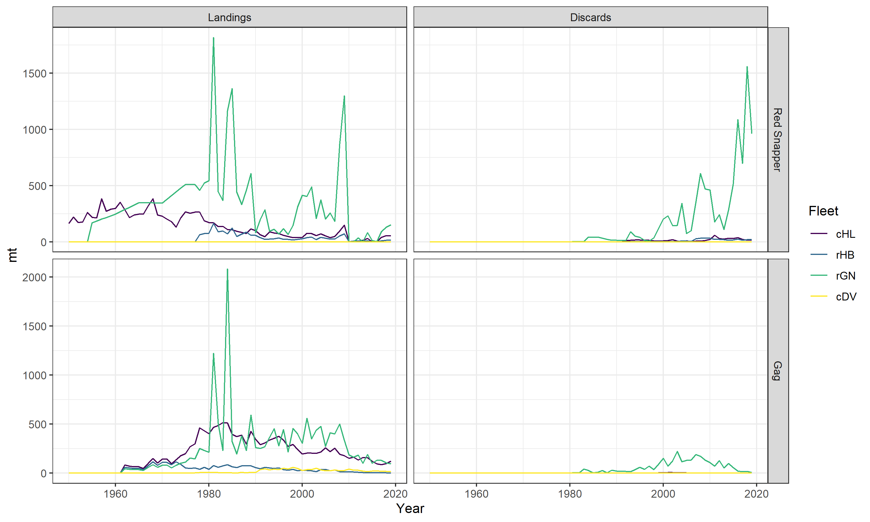
Landings and Discards by Fleet

Slide 11
Closed-Loop Projections
cMPs
assumptions for stock/obs etc
nsim

Slide 12
Management Procedures
management options by stock & fleet
management plan

Slide 13
Management Procedures some simple examples
current_effort:
current_catch:

Slide 14
Management Procedures some simple examples
current_effort:
current_catch:

Slide 15
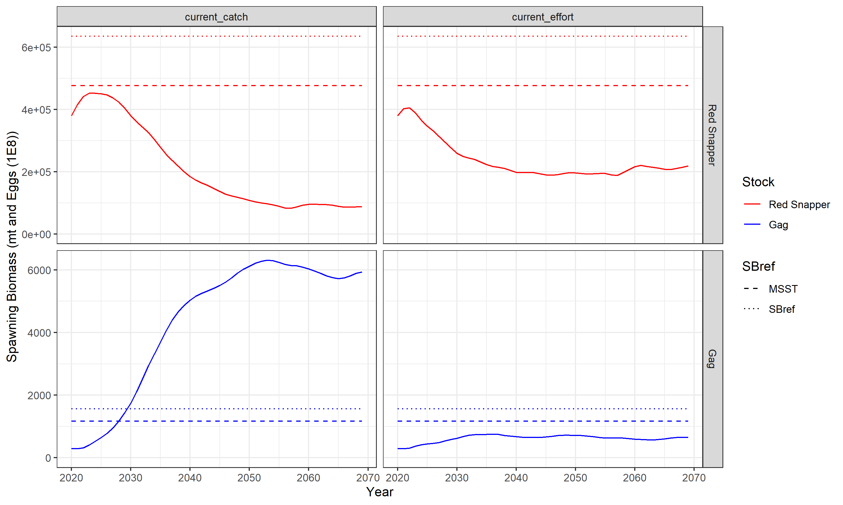
Projections: Spawning Biomass

Slide 16
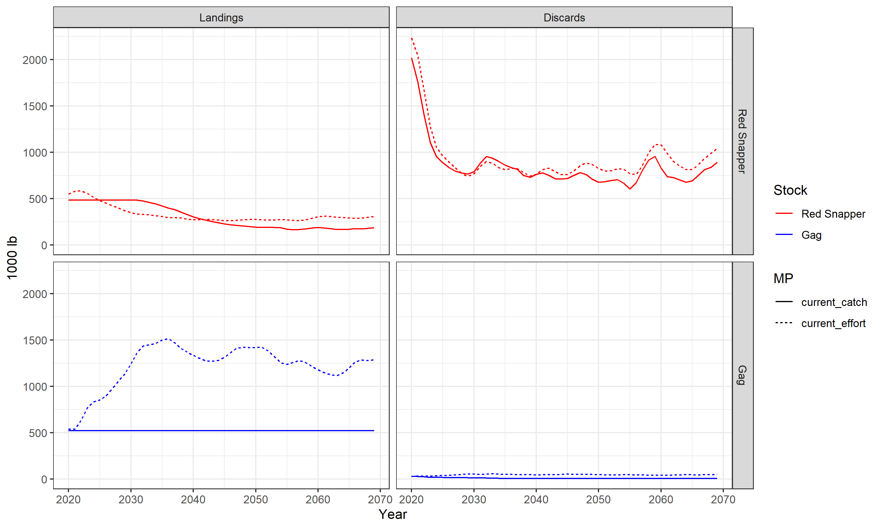
Projections: Landings and Discards

Slide 17
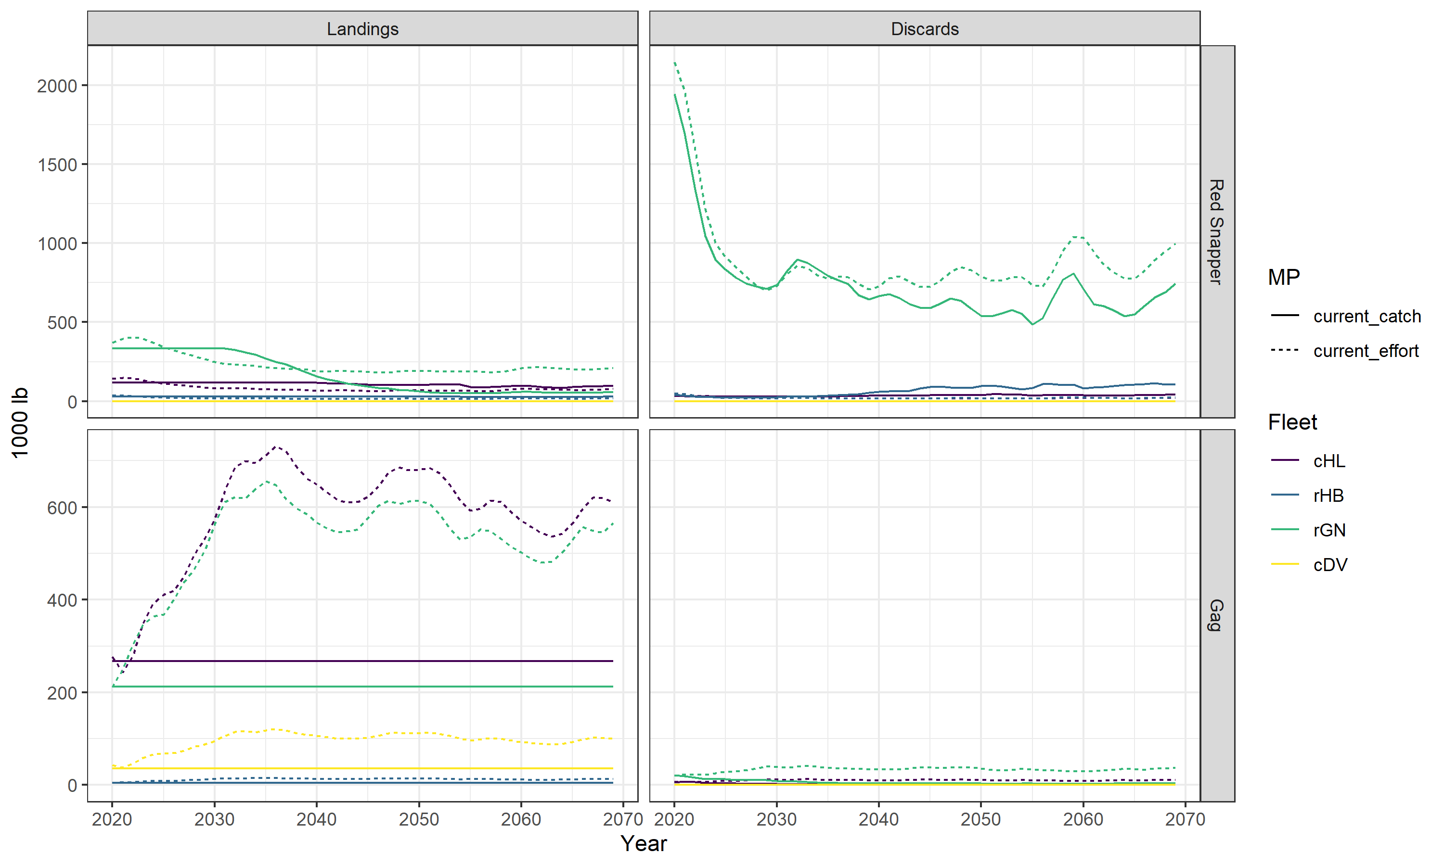
Projections: Landings and Discards by Fleet

Slide 18
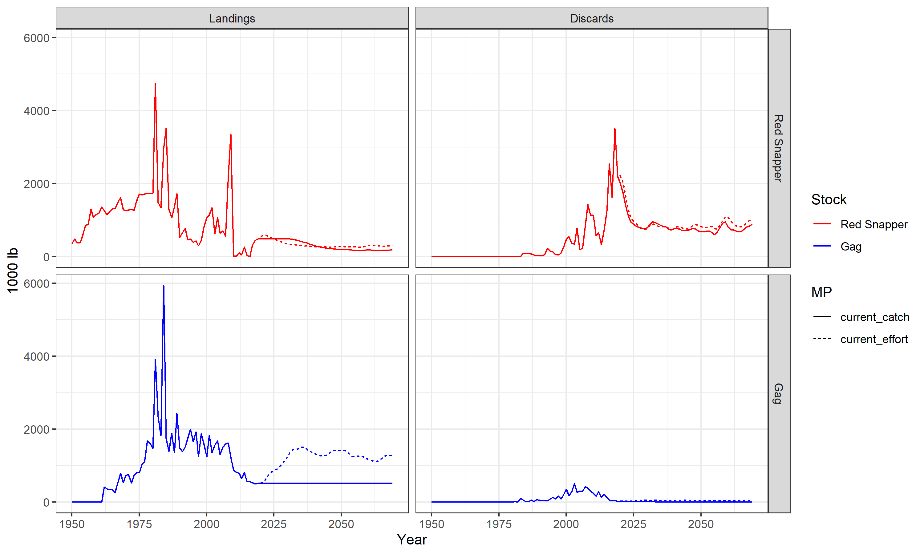
Historical and Projection: Landings and Discards

Slide 19
Why do discards fall with constant catch?
assumptions for projection period
recruitment deviations – show plot of recent historical and projection

Slide 20
Historical and Projection: Spawning Biomass

Slide 21
Historical and Projection: Spawning Biomass

Slide 22
Management Procedures slightly more complex examples

Slide 23
Calculating Performance

