Slide 1

An Overview of the MSE Process
A Demonstration using the Red Snapper and Gag Grouper
Adrian Hordyk
adrian@bluematterscience.com
Snapper – Grouper Advisory Panel Meeting
19 October 2022

Slide 2
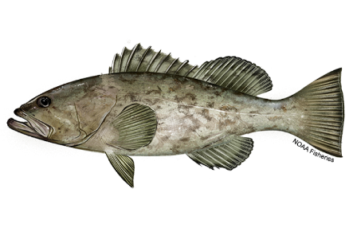

Outline
Contrasting Stock Assessment with Management Strategy Evaluation
The MSE Process: An Example with the Red Snapper and Gag Grouper
Objectives
Demonstrate what the MSE process could look like for this fishery
Highlight the key issues that will be discussed further

Slide 3




Slide 4
Contrasting Stock Assessment with Management Strategy Evaluation
Stock Assessment
Key Question: What is the current (and historical) state of the fish stock?
how many fish are in the water (biomass)?
is the stock over-exploited (reference points)?
should the management regulations be changed?
Output:
estimate of key population parameters (scale and productivity)
current state of the stock relative to reference points
advice to managers: short-term projections of population state subject to different harvest policies

Slide 5





Contrasting Stock Assessment with Management Strategy Evaluation
Stock Assessment
Fishery Data
Assessment Model
Results
Action

Slide 6
Contrasting Stock Assessment with Management Strategy Evaluation
Management Strategy Evaluation
Key Question: What management policy (management procedure, management strategy) is most appropriate for this fishery?
what process should be used to convert fishery data into management advice?
is this process robust to uncertainty?
under what conditions is this process likely to fail?
Output:
A reproducible and transparent process for selecting a management plan
An agreed process (management plan) for going from data to management advice
Identification of conditions where the management plan requires revision

Slide 7
Contrasting Stock Assessment with Management Strategy Evaluation
Management Strategy Evaluation
Fishery Data
Operating Models
Model 1
Model 2
Model 3
…
Management Policy
MP 1
MP 2
Stakeholder driven process
MP 3
…
Closed-Loop Evaluation
Evaluate the MPs using Closed-Loop Simulation Testing
Results
Quantity and compare the performance of the MPs
Action
Select the best performing MP and adopt for managing the fishery

Slide 8
The MSE Process: The Main Components
Collaboration between Stakeholders to:
Develop Operating Models
Develop Candidate Management Plans (aka Management Procedures)
Determine Evaluation Criteria (aka Performance Metrics)
Evaluate Performance of MPs against Performance Metrics

Slide 9

The MSE Process: Operating Models
Operating Models
Model 1
Model 1
Model 2
…
Fish Stock 1
Biology (growth, maturity, etc)
Spatial distribution & movement
etc
Model 3
A plausible description of the properties of the fishery system:
stock (biology)
exploitation (fishing activities)
Fishing Fleet 1
Selectivity pattern (gear type)
Fishing effort (seasonal, overall)
Spatial distribution & targeting
Fishing Fleet 2
Selectivity pattern (gear type)
Fishing effort (seasonal, overall)
Spatial distribution & targeting
Fishing Fleet …
Selectivity pattern (gear type)
Fishing effort (seasonal, overall)
Spatial distribution & targeting

Slide 10
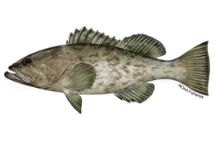
The MSE Process: Operating Models
Model 1
Operating Models
Model 1
Model 2
Fish Stock 1
Biology (growth, maturity, etc)
Spatial distribution & movement
etc
Fish Stock 2
Biology (growth, maturity, etc)
Spatial distribution & movement
etc
Model 3
…
Multi-Species
Fishing Fleet 1
Selectivity pattern (gear type)
Fishing effort (seasonal, overall)
Spatial distribution & targeting
Fishing Fleet 1
Selectivity pattern (gear type)
Fishing effort (seasonal, overall)
Spatial distribution & targeting
Interactions:
Spatial over-lap
Preferential targeting
How will management regulations for one stock affect the other?
Fishing Fleet 2
Selectivity pattern (gear type)
Fishing effort (seasonal, overall)
Spatial distribution & targeting
Fishing Fleet 2
Selectivity pattern (gear type)
Fishing effort (seasonal, overall)
Spatial distribution & targeting
Fishing Fleet …
Selectivity pattern (gear type)
Fishing effort (seasonal, overall)
Spatial distribution & targeting
Fishing Fleet …
Selectivity pattern (gear type)
Fishing effort (seasonal, overall)
Spatial distribution & targeting

Slide 11


The MSE Process: Operating Models
Model 1
Model 2
Operating Models
Abundance
Model 1
Model 2
Model 3
…
Fish Stock 1
Fish Stock 2
Fish Stock 1
Fish Stock 2
Fishing Fleet 1
Fishing Fleet 1
Fishing Fleet 1
Fishing Fleet 1
Uncertainties
Stock characteristics:
Biological parameters?
Spatial distribution & movement?
Abundance?
Discard mortality?
Fleet characteristics:
Selectivity pattern?
Fishing effort?
Spatial distribution?
Fishing Fleet 2
Fishing Fleet 2
Fishing Fleet 2
Fishing Fleet 2
Fishing Fleet …
Fishing Fleet …
Fishing Fleet …
Fishing Fleet …
Model 3
Model …
Spatial distribution
?
Fish Stock 1
Fish Stock 2
Fish Stock 1
Fish Stock 2
Fishing Fleet 1
Fishing Fleet 1
Fishing Fleet 1
Fishing Fleet 1
Fishing Fleet 2
Fishing Fleet 2
Fishing Fleet 2
Fishing Fleet 2
Fishing Fleet …
Fishing Fleet …
Fishing Fleet …
Fishing Fleet …

Slide 12
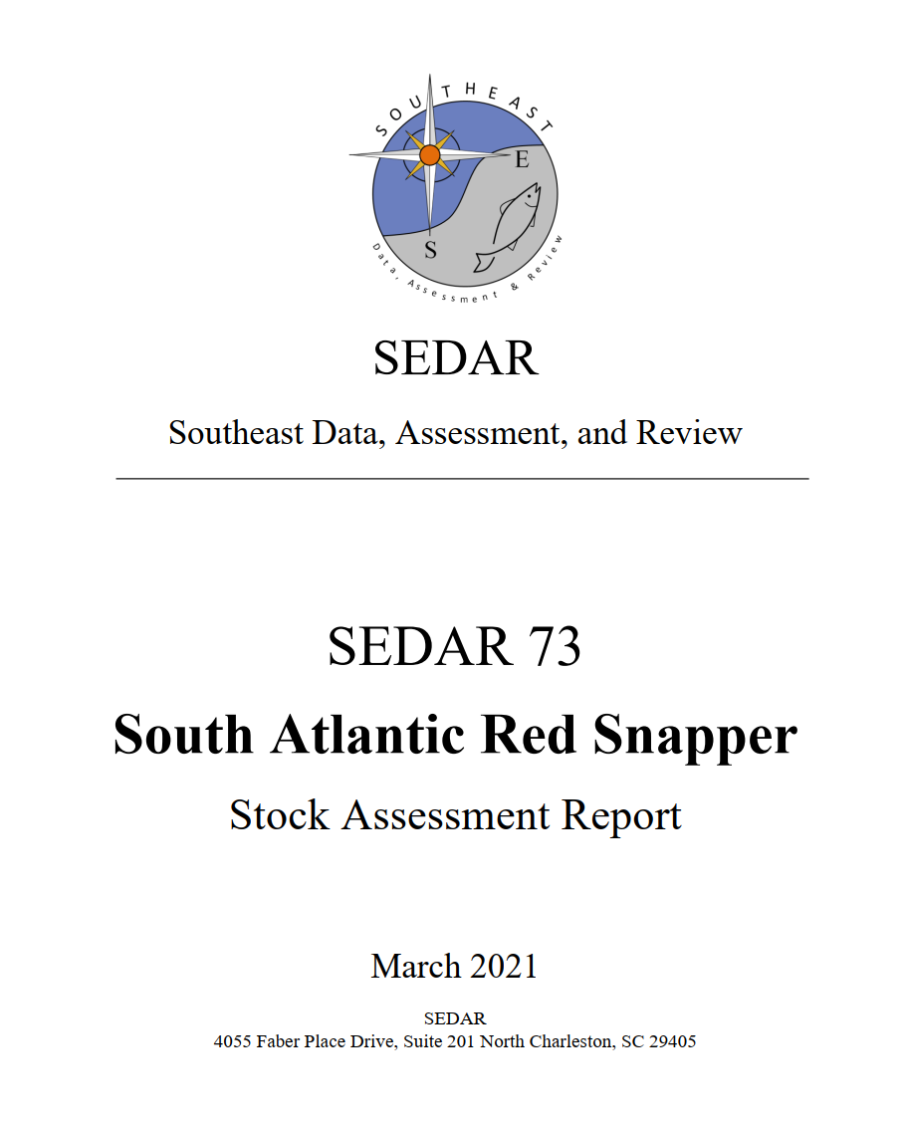

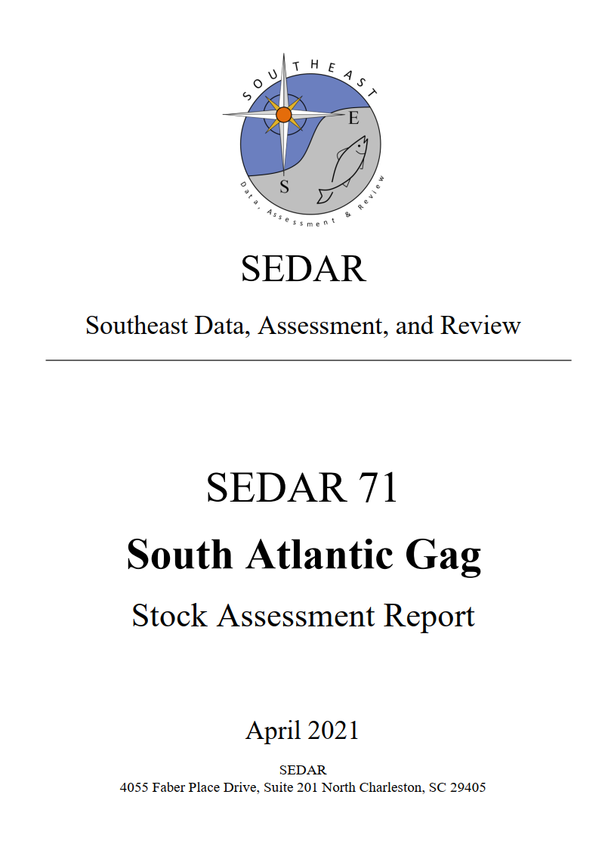
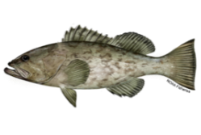
The MSE Process: Operating Models
Building the Operating Models
Model 1
Fish Stock 1: Red Snapper
Fish Stock 2: Gag Grouper
Fishing Fleet 1: Commercial handline
Fishing Fleet 1: Commercial handline
Fishing Fleet 2: Recreational headboats
Fishing Fleet 2: Commercial diving
Fishing Fleet 3: General recreational
Fishing Fleet 3: Recreational headboats
Fishing Fleet 4: General recreational

Slide 13
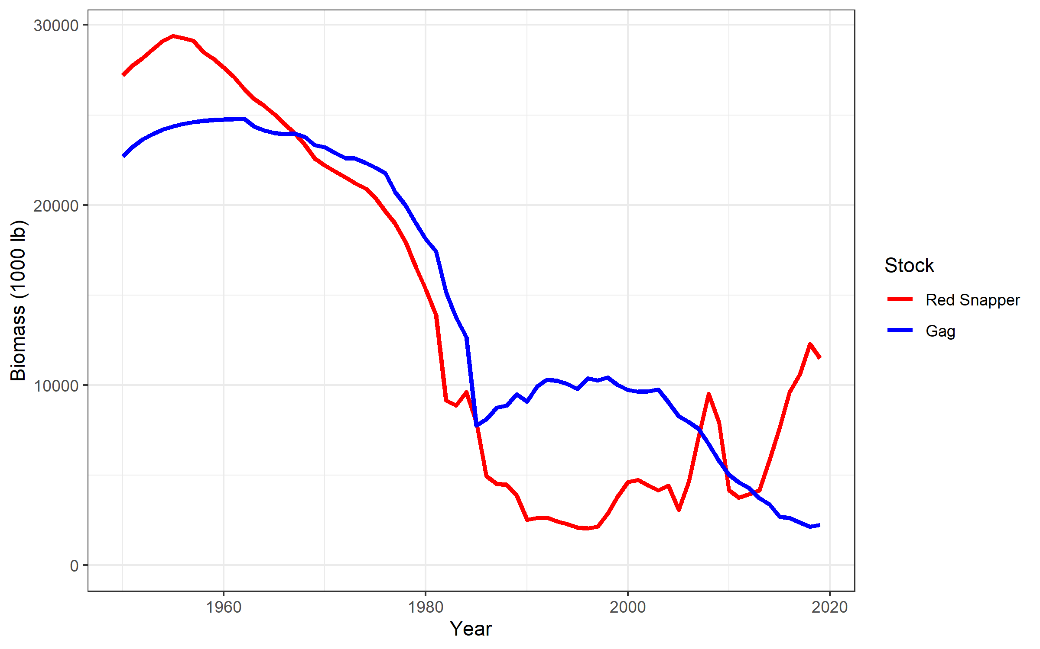
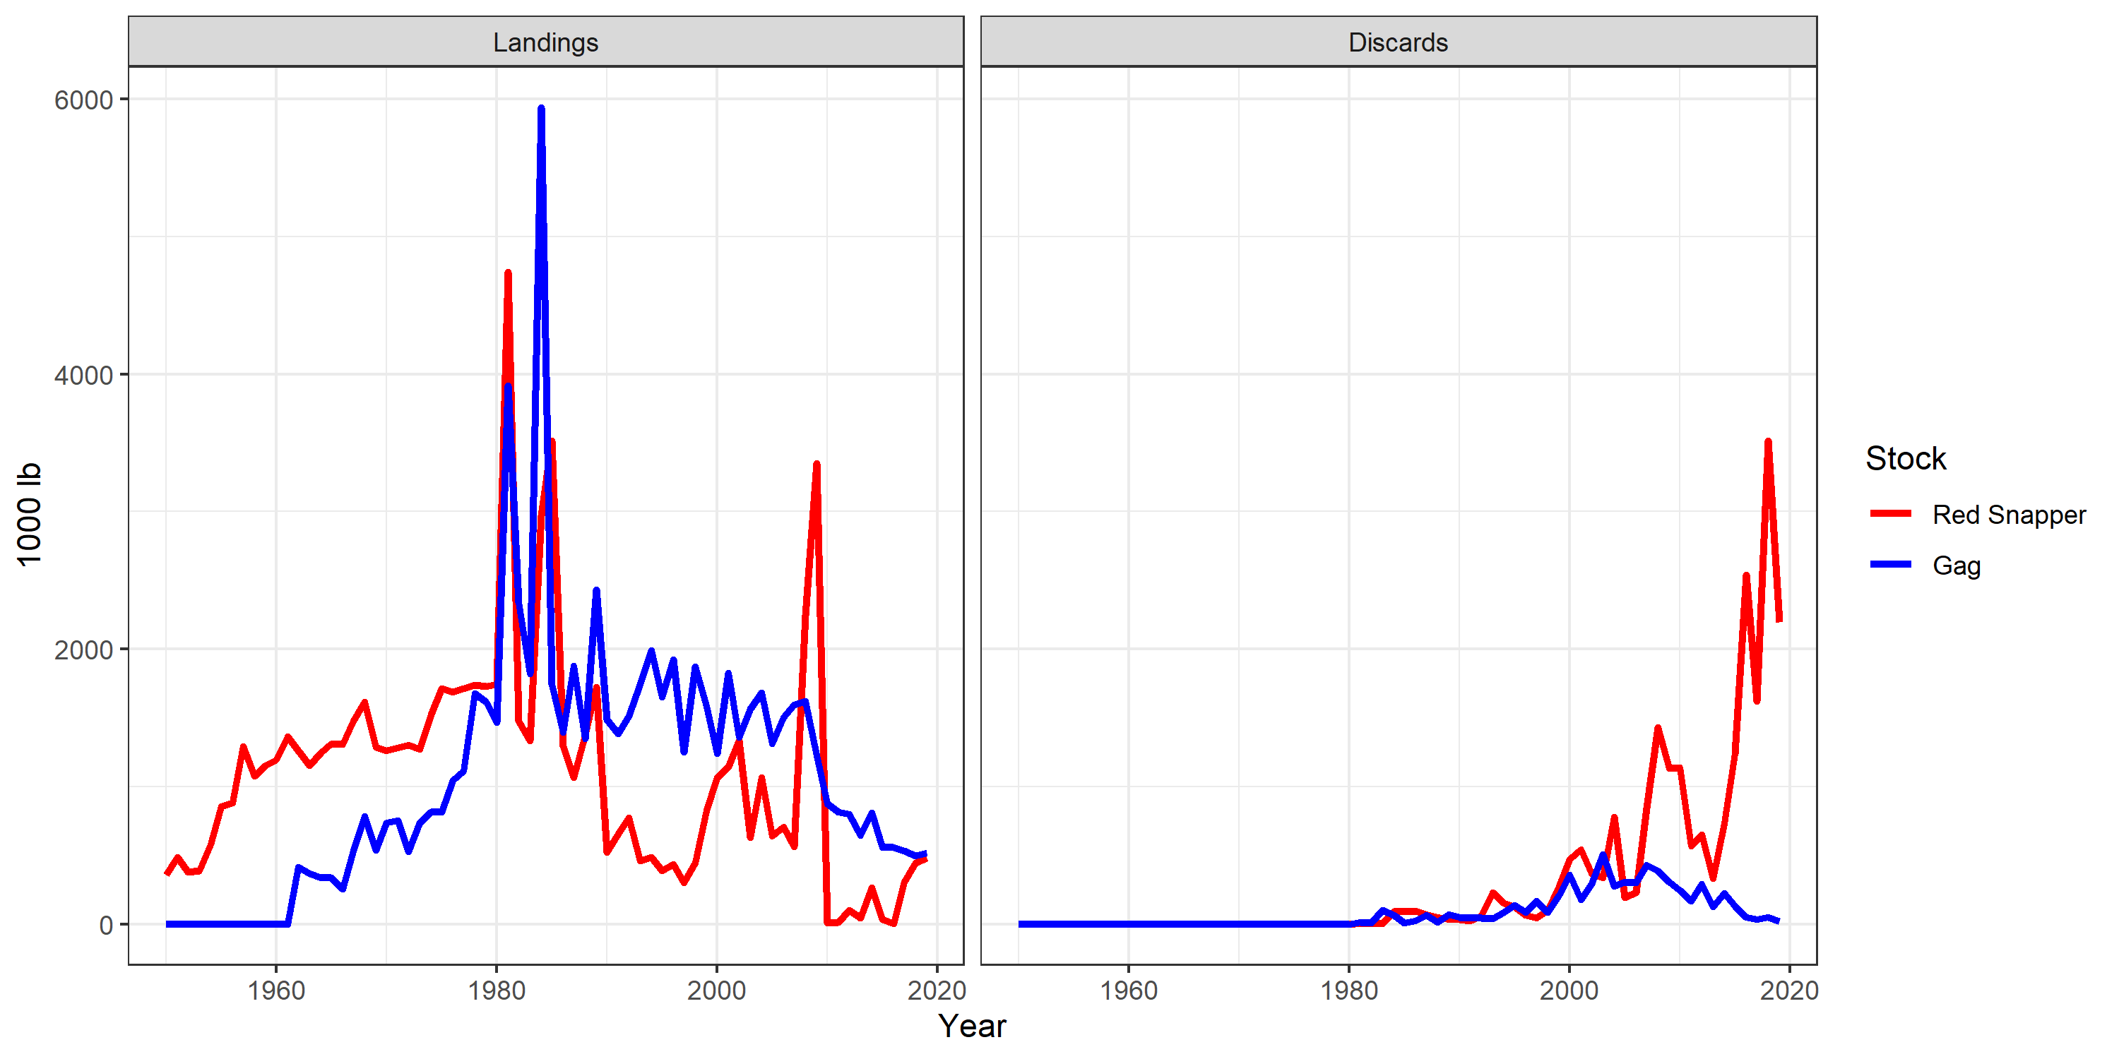

The MSE Process: Operating Models
Building the Operating Models
Model 1

Slide 14
The MSE Process: Operating Models
Building the Operating Models
Model 2

Slide 15
The MSE Process: Operating Models
Building the Operating Models
Questions:
Which stocks to include?
What information is available?
What are the interactions between stocks?
What are the key uncertainties?
Operating Models
Model 1
Model 2
Model 3
Model …

Slide 16
The MSE Process: Management Procedures
Operating Models
Management Procedure: A process for going from data to a management decision
Model 1
Model 2
Management Procedure
Model 3
…
Data
what data are collected
how are the data processed?
Management Policy
MP 1
MP 2
MP 3
…
Rules
how are the data converted to management advice?
static or adaptive?
How is this different to the traditional approach?
reproducible (different people, same result)
agreed upon (no haggling)
simulation tested (some confidence the approach will achieve the objectives)
Management
implement management decision

Slide 17
The MSE Process: Management Procedures
Operating Models
A Simple Example:
Model 1
Model 2
Model 3
…
Management Procedure
Management Policy
Data
collect catch-per-unit-effort data
standardize it into an index of abundance
MP 1
MP 2
MP 3
…
Rules
if the index is above a target level, increase catch limit by 10%
if the index is below a limit level, decrease catch limit by 10%
otherwise, leave it the same
Management
update the catch limit every 3 years

Slide 18
The MSE Process: Management Procedures
Operating Models
Multi-gear General Example: Commercial and Recreational
Model 1
Model 2
Model 3
…
Management Procedure
Management Policy
Data
monitor commercial and recreational data streams
e.g., catch rates, size composition, etc
MP 1
MP 2
MP 3
…
Rules
Commercial
change (or maintain) catch limit
Recreational
change (or maintain) bag/size limit
Management
implement the regulations at a set interval

Slide 19
The MSE Process: Management Procedures
Operating Models
Multi-species and Multi-gear General Example: Commercial and Recreational
Model 1
Model 2
Model 3
…
Multi-Species Management Plan
Management Policy
Data
monitor commercial and recreational data streams
e.g., catch rates, size composition, etc
Management Controls:
Any combination of:
spatial closures
seasonal closures
size limits
bag limits
total effort limits
total catch limits
MP 1
MP 2
MP 3
…
Rules
Commercial
Commercial
Recreational
Recreational
Management
implement the regulations at a set interval

Slide 20
The MSE Process: Management Procedures
Operating Models
Candidate Management Procedures
Model 1
Model 2
Model 3
…
Management Policy
Questions:
What data can be used to inform management?
Feasible management options?
by gear type?
by stock?
Management update cycle?
MP 1
MP 2
MP 3
…
Candidate Management Procedures
MP 1
Data and Rules
MP 2
Different Rules (and data?)
MP 3
Different Rules (and data?)
MP …
Different Rules (and data?)

Slide 21


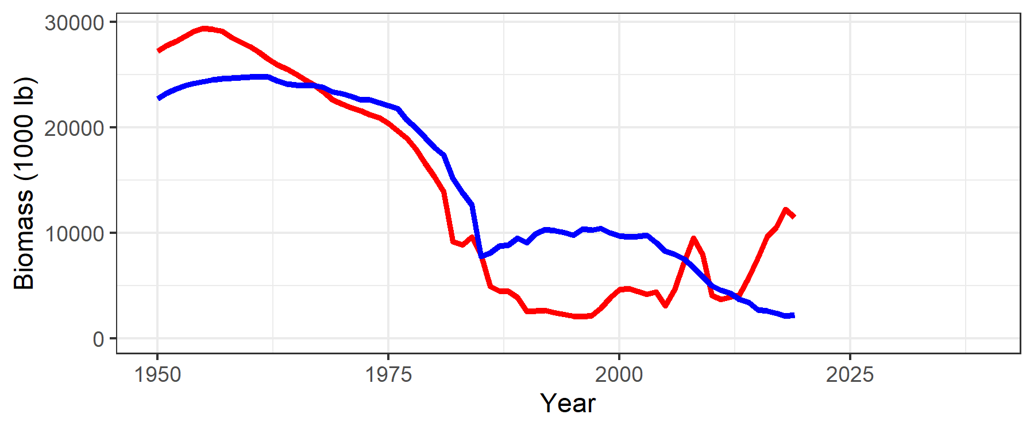
The MSE Process: Evaluation
Operating Models
Closed-Loop Simulation Testing
Simulate Fishery
Model 1
Model 2
Operating Model
Operating Model
Model 3
…
Management Policy
MP 1
MP 2
MP 3
…
Model 1
Closed-Loop Evaluation

Slide 22
The MSE Process: Evaluation
Operating Models
Closed-Loop Simulation Testing
Simulate Fishery
Model 1
Model 2
Operating Model
Management Policy
Operating Model
Model 3
…
MP 1
MP 1
Management Policy
Data
5-year management cycle
MP 1
MP 2
MP 3
…
Model 1
Apply MP
MP
Closed-Loop Evaluation
Management Regulations

Slide 23

The MSE Process: Evaluation
Operating Models
Closed-Loop Simulation Testing
Simulate Fishery
Model 1
Model 2
Operating Model
Management Policy
Operating Model
Model 3
…
MP 1
MP 1
Management Policy
Data
5-year management cycle
MP 1
MP 2
MP 3
…
Model 1
Update
Apply MP
Operating Model
MP
Closed-Loop Evaluation
Implement
Management Regulations
MP 1

Slide 24
The MSE Process: Evaluation
Operating Models
Closed-Loop Simulation Testing
Simulate Fishery
Model 1
Model 2
Operating Model
Management Policy
Operating Model
Model 3
…
MP 1
MP 1
Management Policy
Simulate Data
Data
5-year management cycle
MP 1
MP 2
MP 3
…
Model 1
Update
Apply MP
Operating Model
MP
Closed-Loop Evaluation
Implement
Management Regulations
MP 1

Slide 25
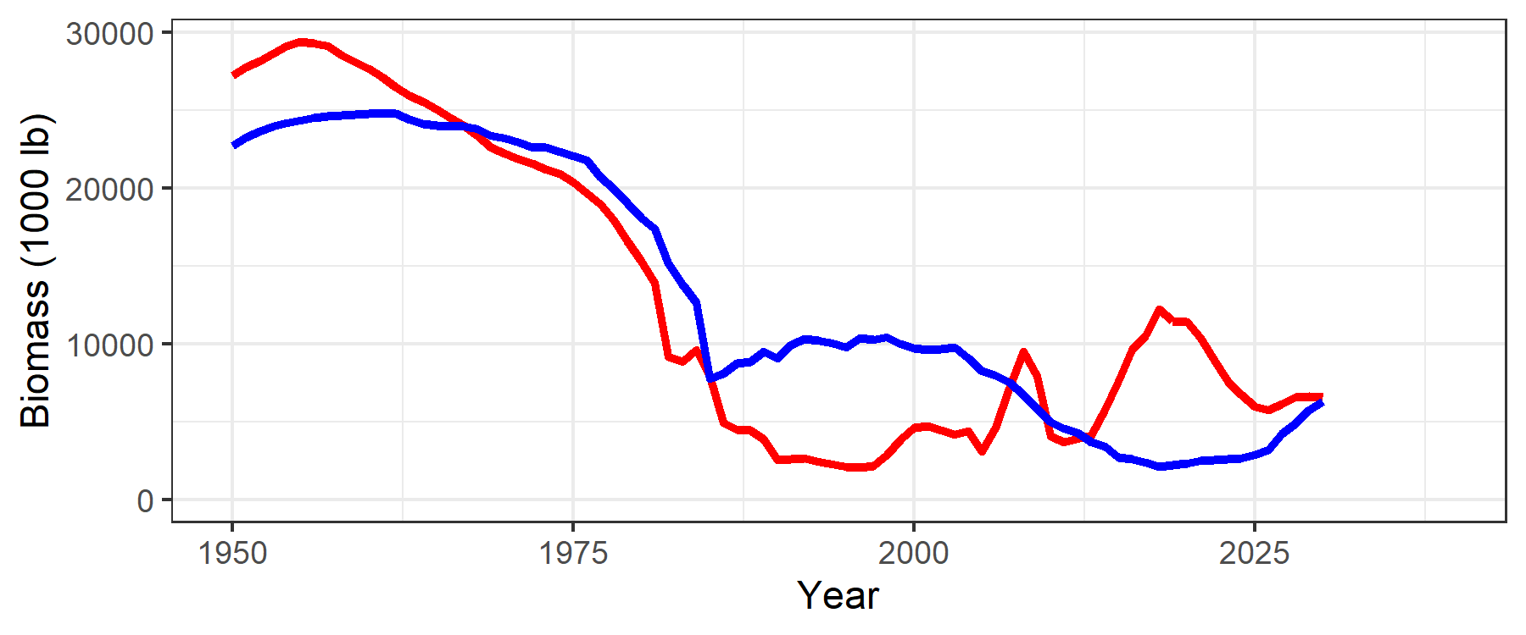
The MSE Process: Evaluation
Operating Models
Closed-Loop Simulation Testing
Simulate Fishery
Model 1
Model 2
Operating Model
Management Policy
Operating Model
Model 3
…
MP 1
MP 1
Management Policy
Simulate Data
Data
5-year management cycle
MP 1
MP 2
MP 3
…
Model 1
Update
Apply MP
Operating Model
MP
Closed-Loop Evaluation
Next Cycle
Implement
Management Regulations
MP 1

Slide 26
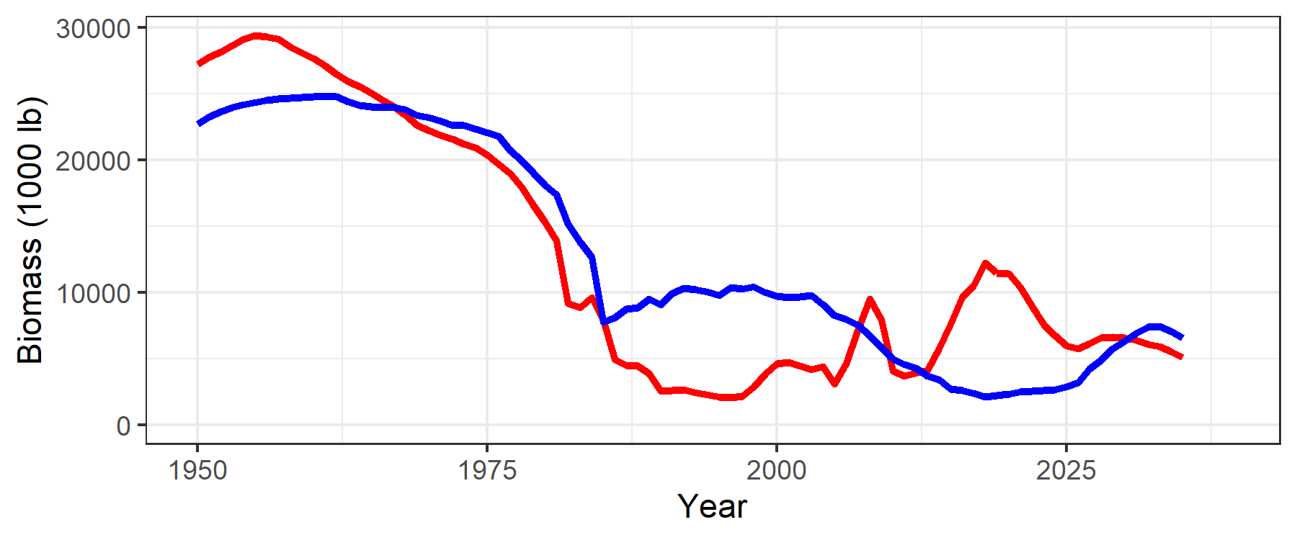
The MSE Process: Evaluation
Operating Models
Closed-Loop Simulation Testing
Simulate Fishery
Model 1
Model 2
Operating Model
Management Policy
Operating Model
Model 3
…
MP 1
MP 1
Management Policy
Simulate Data
Data
5-year management cycle
MP 1
MP 2
MP 3
…
Model 1
Update
Apply MP
Operating Model
MP
Closed-Loop Evaluation
Next Cycle
Implement
Management Regulations
MP 1

Slide 27
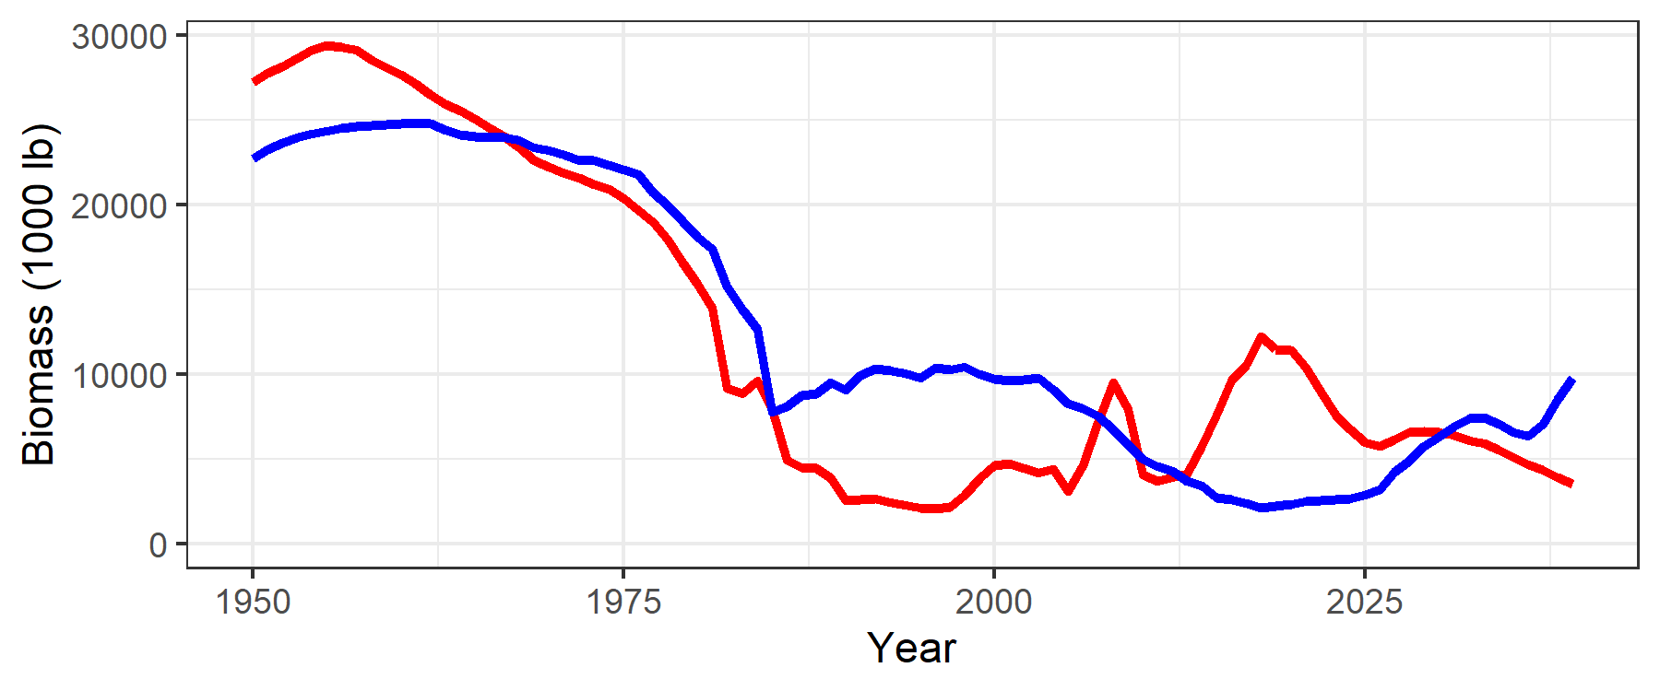
The MSE Process: Evaluation
Operating Models
Closed-Loop Simulation Testing
Simulate Fishery
Model 1
Model 2
Operating Model
Management Policy
Operating Model
Model 3
…
MP 1
MP 1
Management Policy
Simulate Data
Data
5-year management cycle
MP 1
MP 2
MP 3
…
Model 1
Update
Apply MP
Operating Model
MP
Closed-Loop Evaluation
Next Cycle
Implement
Management Regulations
MP 1

Slide 28
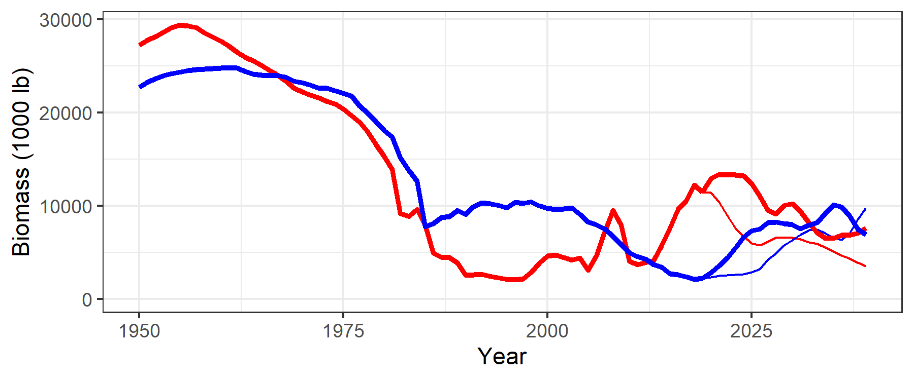
The MSE Process: Evaluation
Operating Models
Closed-Loop Simulation Testing
Simulate Fishery
Model 1
Model 2
Operating Model
Management Policy
Operating Model
Model 3
…
MP 1
MP 1
Management Policy
Simulate Data
Data
5-year management cycle
MP 1
MP 2
MP 3
…
Model 1
Update
Apply MP
Operating Model
MP
Closed-Loop Evaluation
Another Simulation: Different Environmental Conditions
Implement
Management Regulations
MP 1

Slide 29
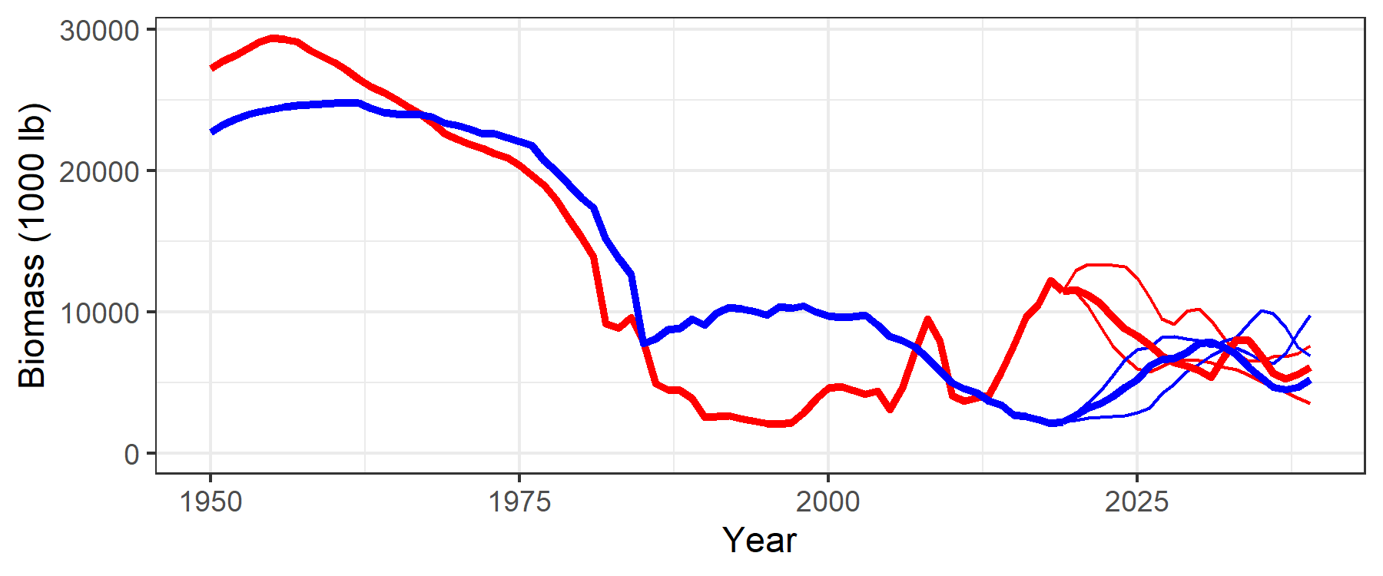
The MSE Process: Evaluation
Operating Models
Closed-Loop Simulation Testing
Simulate Fishery
Model 1
Model 2
Operating Model
Management Policy
Operating Model
Model 3
…
MP 1
MP 1
Management Policy
Simulate Data
Data
5-year management cycle
MP 1
MP 2
MP 3
…
Model 1
Update
Apply MP
Operating Model
MP
Closed-Loop Evaluation
A Third Simulation
Implement
Management Regulations
MP 1

Slide 30
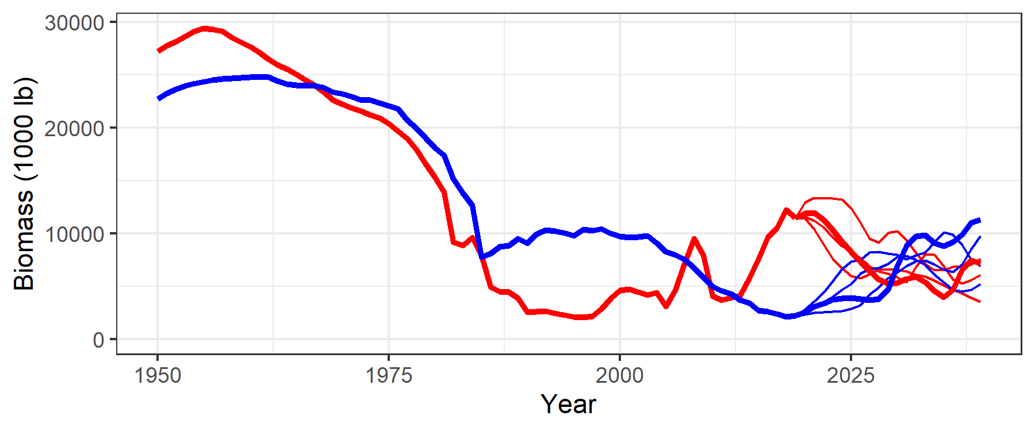
The MSE Process: Evaluation
Operating Models
Closed-Loop Simulation Testing
Simulate Fishery
Model 1
Model 2
Operating Model
Management Policy
Operating Model
Model 3
…
MP 1
MP 1
Management Policy
Simulate Data
Data
5-year management cycle
MP 1
MP 2
MP 3
…
Model 1
Update
Apply MP
Operating Model
MP
Closed-Loop Evaluation
And Another
Implement
Management Regulations
MP 1

Slide 31
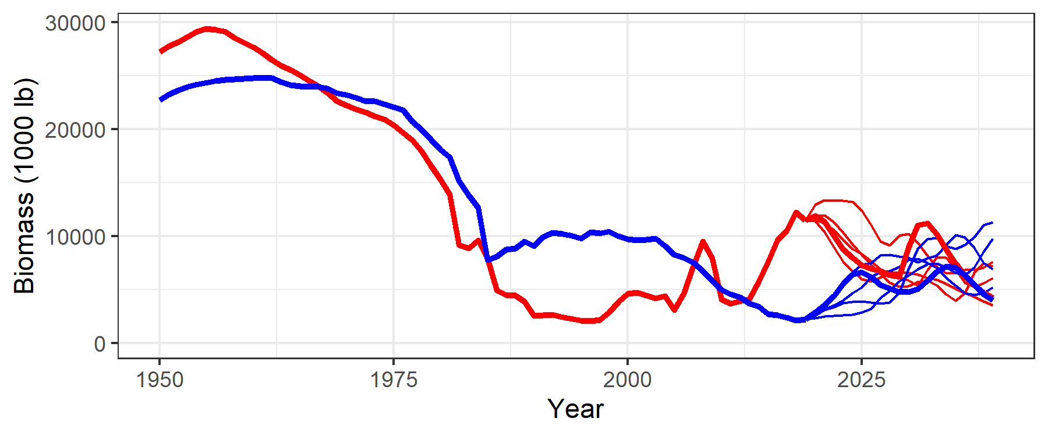
The MSE Process: Evaluation
Operating Models
Closed-Loop Simulation Testing
Simulate Fishery
Model 1
Model 2
Operating Model
Management Policy
Operating Model
Model 3
…
MP 1
MP 1
Management Policy
Simulate Data
Data
5-year management cycle
MP 1
MP 2
MP 3
…
Model 1
Update
Apply MP
Operating Model
MP
Closed-Loop Evaluation
And so on …
Implement
Management Regulations
MP 1

Slide 32
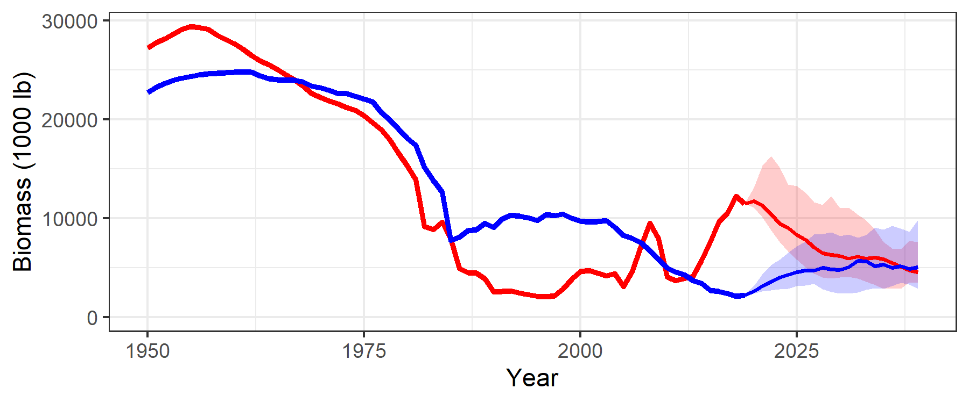
The MSE Process: Evaluation
Operating Models
Closed-Loop Simulation Testing
Simulate Fishery
Model 1
Model 2
Operating Model
Management Policy
Operating Model
Model 3
…
MP 1
MP 1
Management Policy
Simulate Data
Data
5-year management cycle
MP 1
MP 2
MP 3
…
Model 1
Update
Apply MP
Operating Model
MP
Closed-Loop Evaluation
And so on …
Implement
Management Regulations
MP 1

Slide 33
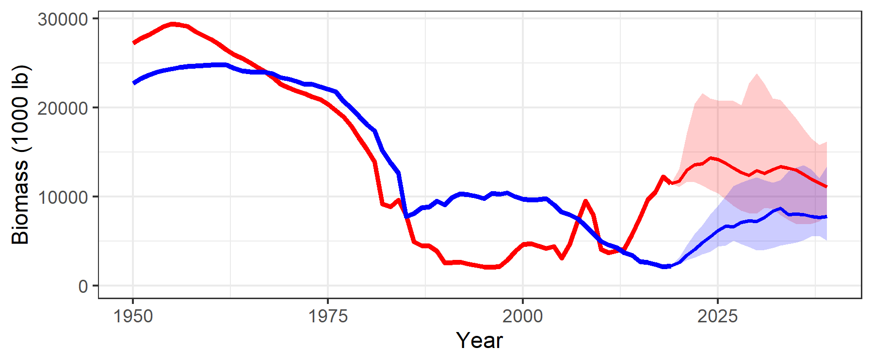
The MSE Process: Evaluation
Operating Models
Closed-Loop Simulation Testing
Simulate Fishery
Model 1
Model 2
Operating Model
Management Policy
Operating Model
Model 3
…
MP 2
MP 2
Management Policy
Simulate Data
Data
5-year management cycle
MP 1
MP 2
MP 3
…
Model 1
Update
Apply MP
Operating Model
MP
Closed-Loop Evaluation
Repeat for MP 2
Implement
Management Regulations
MP 2

Slide 34
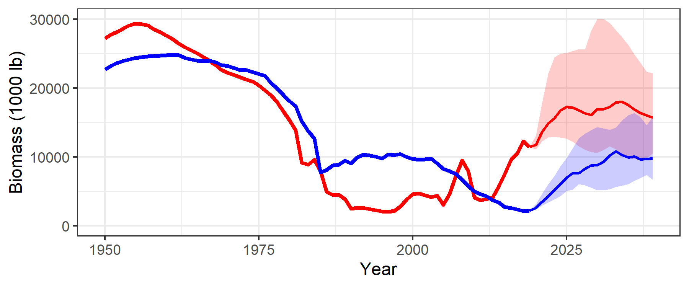
The MSE Process: Evaluation
Operating Models
Closed-Loop Simulation Testing
Simulate Fishery
Model 1
Model 2
Operating Model
Management Policy
Operating Model
Model 3
…
MP 2
MP 2
Management Policy
Simulate Data
Data
5-year management cycle
MP 1
MP 2
MP 3
…
Model 1
Update
Apply MP
Operating Model
MP
Closed-Loop Evaluation
And so on for all MPs
Implement
Management Regulations
MP 3

Slide 35
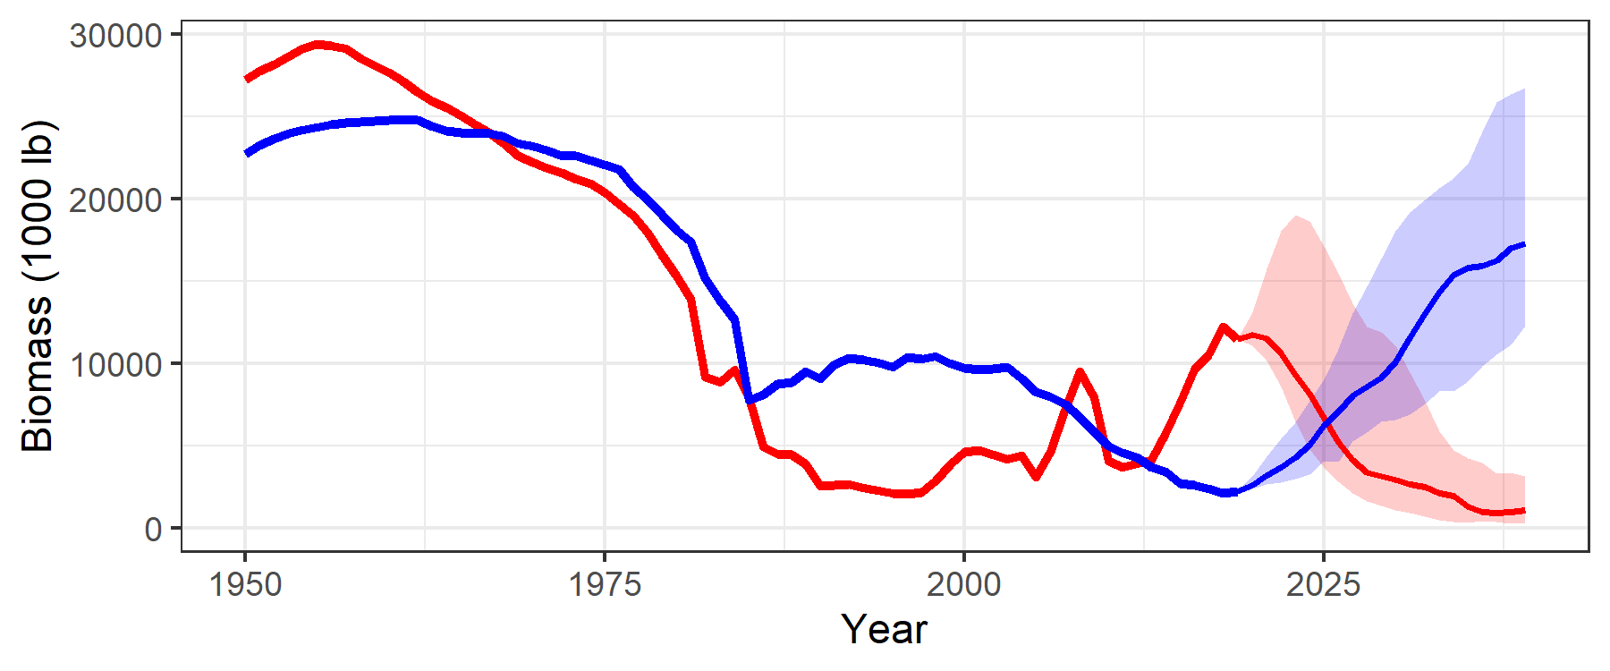
The MSE Process: Evaluation
Operating Models
Closed-Loop Simulation Testing
Simulate Fishery
Model 1
Model 2
Operating Model
Management Policy
Operating Model
Model 3
…
MP 2
MP 2
Management Policy
Simulate Data
Data
5-year management cycle
MP 1
MP 2
MP 3
…
Model 1
Update
Apply MP
Operating Model
MP
Closed-Loop Evaluation
And so on for all MPs
Implement
Management Regulations
MP 4

Slide 36
The MSE Process: Evaluation
Operating Models
Model 1
Model 2
MP 1
MP 2
Model 3
…
Management Policy
MP 1
MP 2
MP 3
…
MP 3
MP 4
Closed-Loop Evaluation
How do we rank the MPs?
Which have good performance?
Which have bad performance?

Slide 37
The MSE Process: Evaluation Criteria
Operating Models
How do we determine good and bad performance?
Model 1
Model 2
What do we care about?
How do we define good management outcomes?
How do we define bad management outcomes?
Model 3
…
Management Policy
MP 1
MP 2
MP 3
…
Performance Metrics:
Quantitative measures of management outcomes to be achieved (or avoided)
Determined by stakeholders
Some required by law, e.g., to ensure sustainability of resource
May differ among stakeholders
Used to evaluate the trade-offs among the management procedures
Closed-Loop Evaluation

Slide 38
The MSE Process: Evaluation Criteria
Operating Models
How do we determine good and bad performance?
Model 1
Model 2
Some examples:
In order to be considered acceptable for management, an MP must demonstrate:
Biological Sustainability: at least 90% probability that the stock remains above the limit reference point
Stability: no more than 15% change in catch/effort limits between management cycles
Yield: while satisfying 1 and 2, provide the highest catch
Catch composition: maintain acceptable probability of catching 'trophy' sized fish
Others: fraction of the catch that must be discarded; length of fishing season;
Model 3
…
Management Policy
MP 1
MP 2
MP 3
…
Closed-Loop Evaluation
Key Points:
Must be defined quantitatively: e.g., the limit reference point is defined as 0.5B_{MSY}
Require associated probabilities to define acceptable performance: e.g., >90%
Framed so high values = better performance
Can include an number of proposed metrics, but should aim to limit to 4 – 6 key objectives

Slide 39
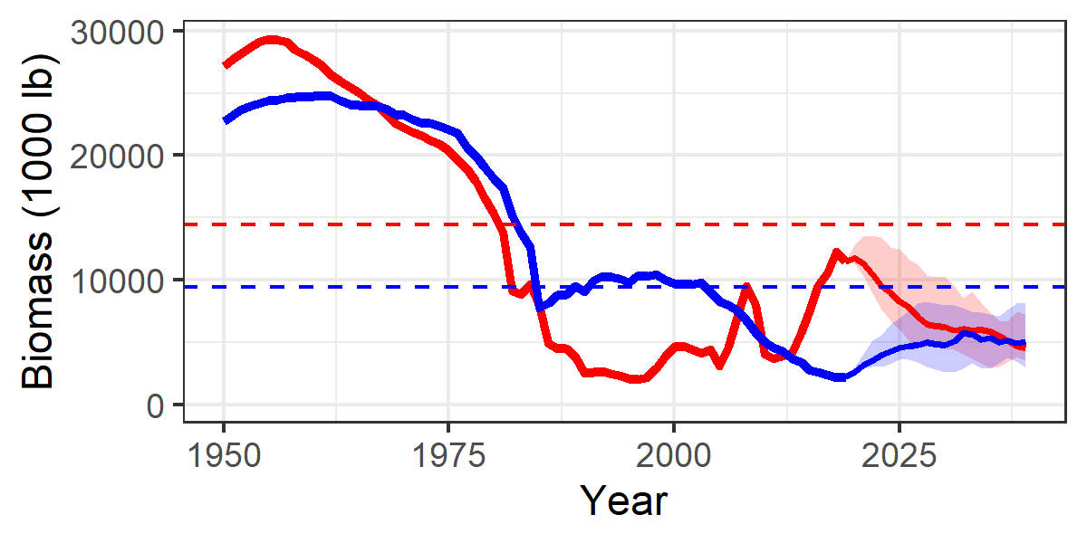
The MSE Process: Calculating Performance
Operating Models
Performance Metrics: A Simple Example
At least 50% probability stock is above B_{target}
Model 1
Model 2
Model 3
…
Management Policy
B_{target}
MP 1
MP 1
MP 2
MP 3
…
Closed-Loop Evaluation
Results

Slide 40
The MSE Process: Calculating Performance
Operating Models
Performance Metrics: A Simple Example
At least 50% probability stock is above B_{target}
Model 1
Model 2
Model 3
…
Management Policy
B_{target}
MP 1
MP 1
MP 2
Low probability for both stocks (<50%)
MP 3
…
Closed-Loop Evaluation
Results

Slide 41
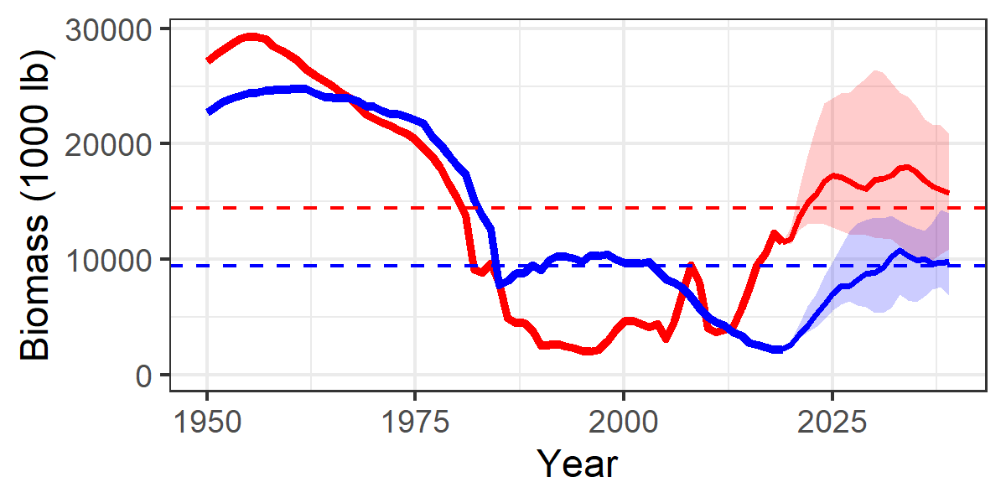
The MSE Process: Calculating Performance
Operating Models
Performance Metrics: A Simple Example
At least 50% probability stock is above B_{target}
Model 1
Model 2
Model 3
…
Management Policy
MP 1
MP 1
MP 2
Low probability for both stocks (<50%)
MP 3
…
Closed-Loop Evaluation
MP 3
>50% both stocks
Results

Slide 42
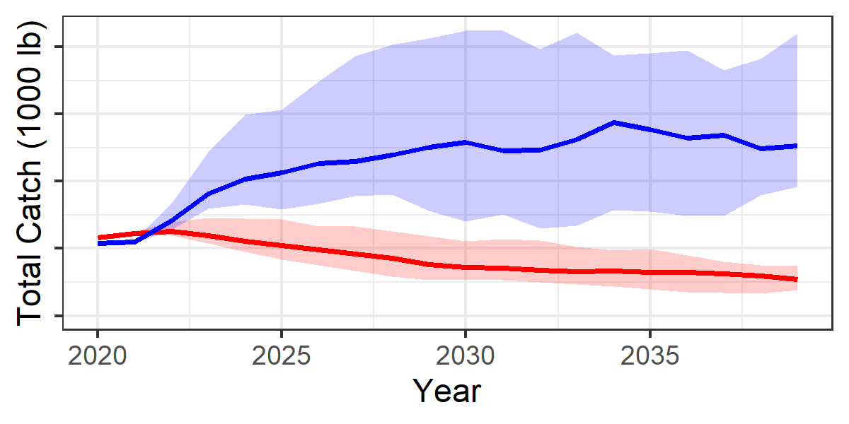
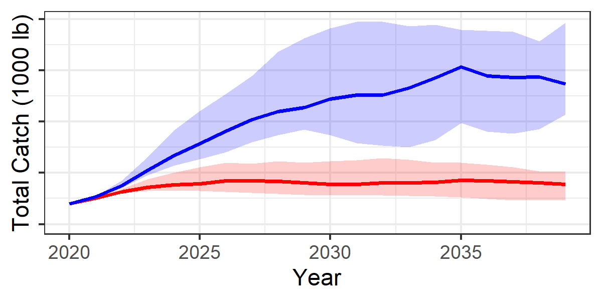
The MSE Process: Calculating Performance
Operating Models
Performance Metrics: A Simple Example
At least 50% probability stock is above B_{target}
Maximize overall catch
Model 1
Model 2
Model 3
…
Management Policy
MP 1
MP 1
MP 1
MP 2
MP 3
…
Closed-Loop Evaluation
MP 3
MP 3
Results
Conclusion:
MP 1 has lower probability of stock reaching target level AND a lower average yield
MP 3 is a better option: reject MP 1 and keep MP 3 for consideration

Slide 43
The MSE Process: Calculating Performance
Operating Models
Model 1
Model 2
Model 3
…
Summary of Calculating Performance:
Perform this analysis for all candidate MPs and across all Operating Models
Eliminate MPs that fail to meet mandatory performance criteria
Examine trade-offs among remaining MPs:
e.g., some may have greater average catch but also more variability
Identify MP(s) that perform the best (most acceptable trade-offs) across all the operating models
Management Policy
MP 1
MP 2
MP 3
…
Closed-Loop Evaluation
Results

Slide 44
The MSE Process: Action
Operating Models
Model 1
Model 2
Model 3
…
Action:
Stakeholders evaluate trade-offs among MPs
Select an MP that is most acceptable
Adopt the MP for managing the fishery
Future management decisions are determined by collecting data and providing it to the MP at the agreed management interval
Monitor the fishery to detect unexpected changes in stock dynamics (exceptional circumstances)
Management Policy
MP 1
MP 2
MP 3
…
Closed-Loop Evaluation
Results
Action

Slide 45
The MSE Process: Review of the Process
Operating Models
Model 1
Model 2
1. Operating Models: develop alternative plausible models of fishery dynamics
Model 3
…
Key points to consider:
stocks to include
key uncertainties: plausible descriptions of stock dynamics
methods & data for generating the alternative OMs
interactions between stocks & management (spatial distribution, preferential targeting)
Management Policy
MP 1
MP 2
MP 3
…
Closed-Loop Evaluation
Results
Action

Slide 46
The MSE Process: Review of the Process
Operating Models
Model 1
Model 2
1. Operating Models: develop alternative plausible models of fishery dynamics
Model 3
…
Management Policy
2. Management Procedures: develop candidate management procedures
MP 1
MP 2
MP 3
…
Key points to consider:
rules for converting data into management actions
feasible management actions by stock and/or gear type
no good or bad ideas: cannot predict expected performance; need to do the closed-loop evaluation
Closed-Loop Evaluation
Results
Action

Slide 47
The MSE Process: Review of the Process
Operating Models
Model 1
Model 2
1. Operating Models: develop alternative plausible models of fishery dynamics
Model 3
…
Management Policy
2. Management Procedures: develop candidate management procedures
MP 1
MP 2
MP 3
…
3. Closed-Loop Evaluation: calculate the performance of all MPs for all OMs
Closed-Loop Evaluation
Key points to consider:
management objectives: what are we aiming for?
performance metrics: quantitative measures of the management objectives
different stakeholders may value different things: examine the trade-offs in the results
Results
Action

Slide 48
The MSE Process: Review of the Process
Operating Models
Model 1
Model 2
1. Operating Models: develop alternative plausible models of fishery dynamics
Model 3
…
Management Policy
2. Management Procedures: develop candidate management procedures
MP 1
MP 2
MP 3
…
3. Closed-Loop Evaluation: calculate the performance of all MPs for all OMs
Closed-Loop Evaluation
4. Results: identify the MP that best meets the objectives
Results
Action

Slide 49
The MSE Process: Review of the Process
Operating Models
Model 1
Model 2
1. Operating Models: develop alternative plausible models of fishery dynamics
Model 3
…
Management Policy
2. Management Procedures: develop candidate management procedures
MP 1
MP 2
MP 3
…
3. Closed-Loop Evaluation: calculate the performance of all MPs for all OMs
Closed-Loop Evaluation
4. Results: identify the MP that best meets the objectives
Results
5. Action: adopt the selected MP for determining future management actions based on the observed data
Action

Slide 50

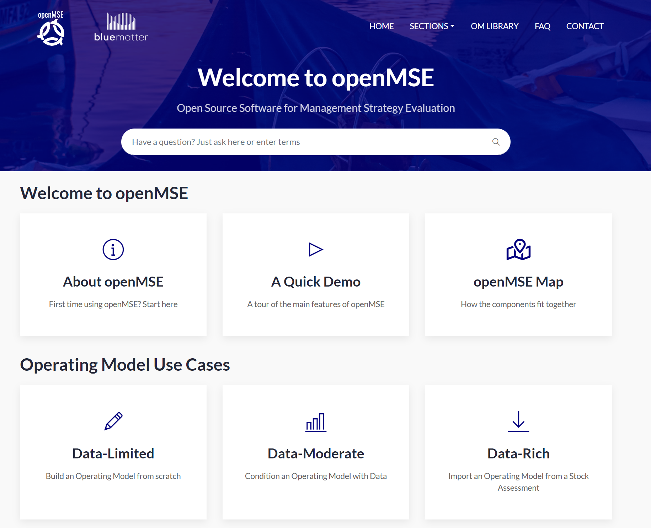
Resources and Information
Closed-Loop Evaluation
open-source
help documentation
openmse.com

Slide 51
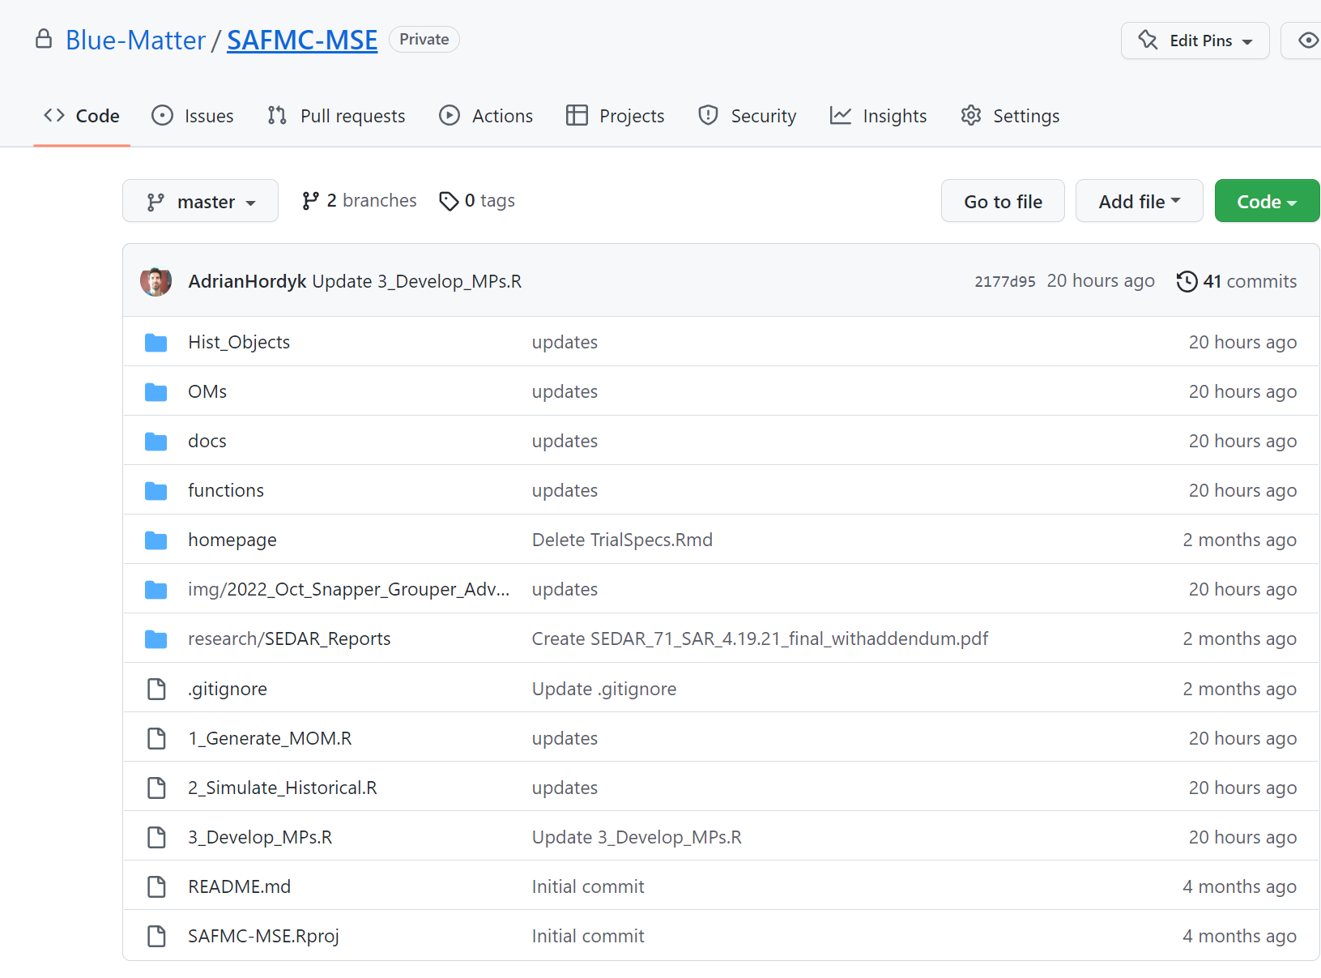
Resources and Information
Closed-Loop Evaluation
all code related to the project
https://github.com/Blue-Matter/SAFMC-MSE
open-source
help documentation
openmse.com

Slide 52
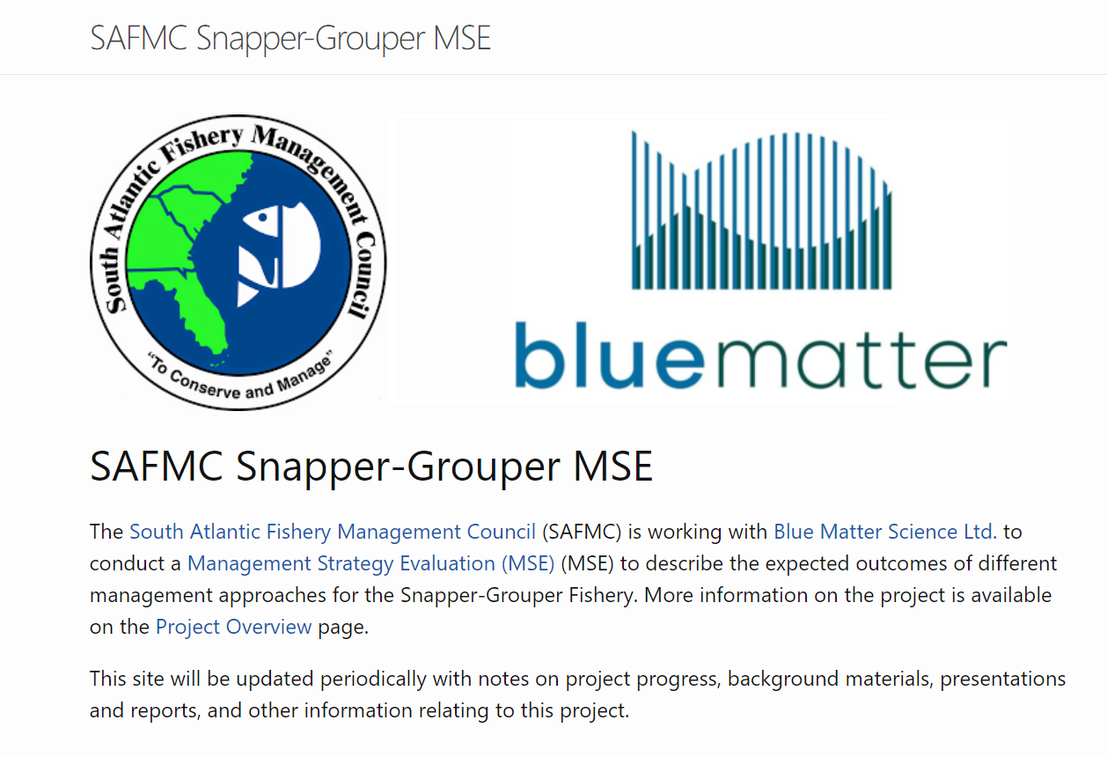
Resources and Information
Closed-Loop Evaluation
all code related to the project
https://github.com/Blue-Matter/SAFMC-MSE
Home page:
resources (papers, presentations, etc)
description of MSE process (living document)
record of decisions made by Group
open-source
help documentation
openmse.com
https://safmc-mse.netlify.app/

Slide 53
Thank You

