Slide 1
A DEMONSTRATION MSE FRAMEWORK FOR WESTERN SKIPJACK TUNA INCLUDING OPERATING MODEL CONDITIONING
Quang Huynh, Tom Carruthers, Bruno Mourato, Rodrigo Sant’Ana, Luís Gustavo Cardoso, Paulo Travassos, and Fabio Hazin
SCRS Tropical Tunas Meeting
September 7-9, 2020
SCRS/2020/140

Slide 2
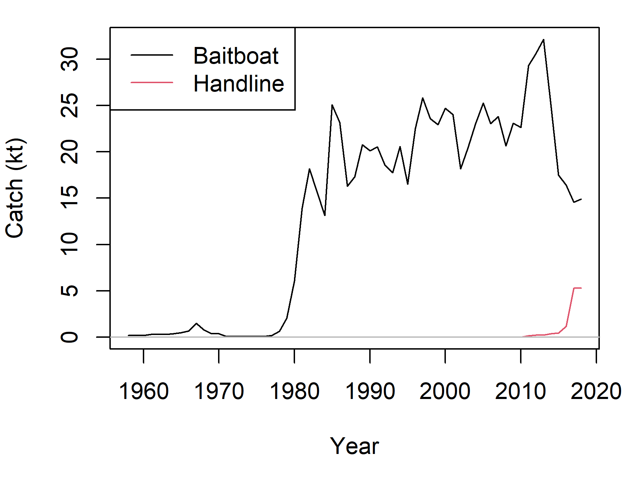
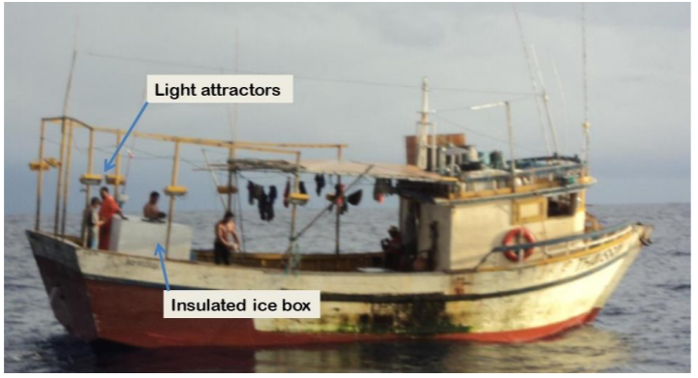
Introduction
Historically, ~90% of western skipjack catches by Brazilian baitboat and handline in the southwest Atlantic (~ 20 kt in 2018)
Previous 2014 assessment had difficulty estimating stock size and reference points from the Brazilian data
Fishery has generally been un-regulated, although fishing practices (“artisanal-like”, use of live bait) limit fishing effort
Goal: Develop a preliminary MSE framework that can be refined and used to adopt a harvest strategy

Slide 3
MSEtool: a framework for doing the technical work of MSE
Open-source R package (CRAN)
Highly flexible operating model (OM; identical to that in DLMtool) –
Many areas, time-varying growth, movement and productivity
Flexible and fast OM conditioning using TMB (from data-sparse to data-rich scenarios)
Model-based TMB assessments (combine with HCRs for MP testing)
Very easy to develop and test new MPs
Extensively documented (and peer reviewed)

Slide 4
Operating models (OMs)
Base_h09 Growth/maturity-at-length from Soares et al. (2019) Natural mortality from 2014 ICCAT assessment, steepness = 0.9 Estimated logistic fleet selectivity
Dome_sel Estimate dome selectivity
Low_h07 Steepness = 0.7 (lower resilience)
HighM_age3+ Higher M for age 3+ (M = 0.75)
Low_t0 von Bertalanffy t₀ = -2 (Young fish are bigger) Maturity-at-age same as (1)
Low_t0_mat Same as (5) and allow lower maturity at age (maturity-at-length follows new growth parameter)

Slide 5
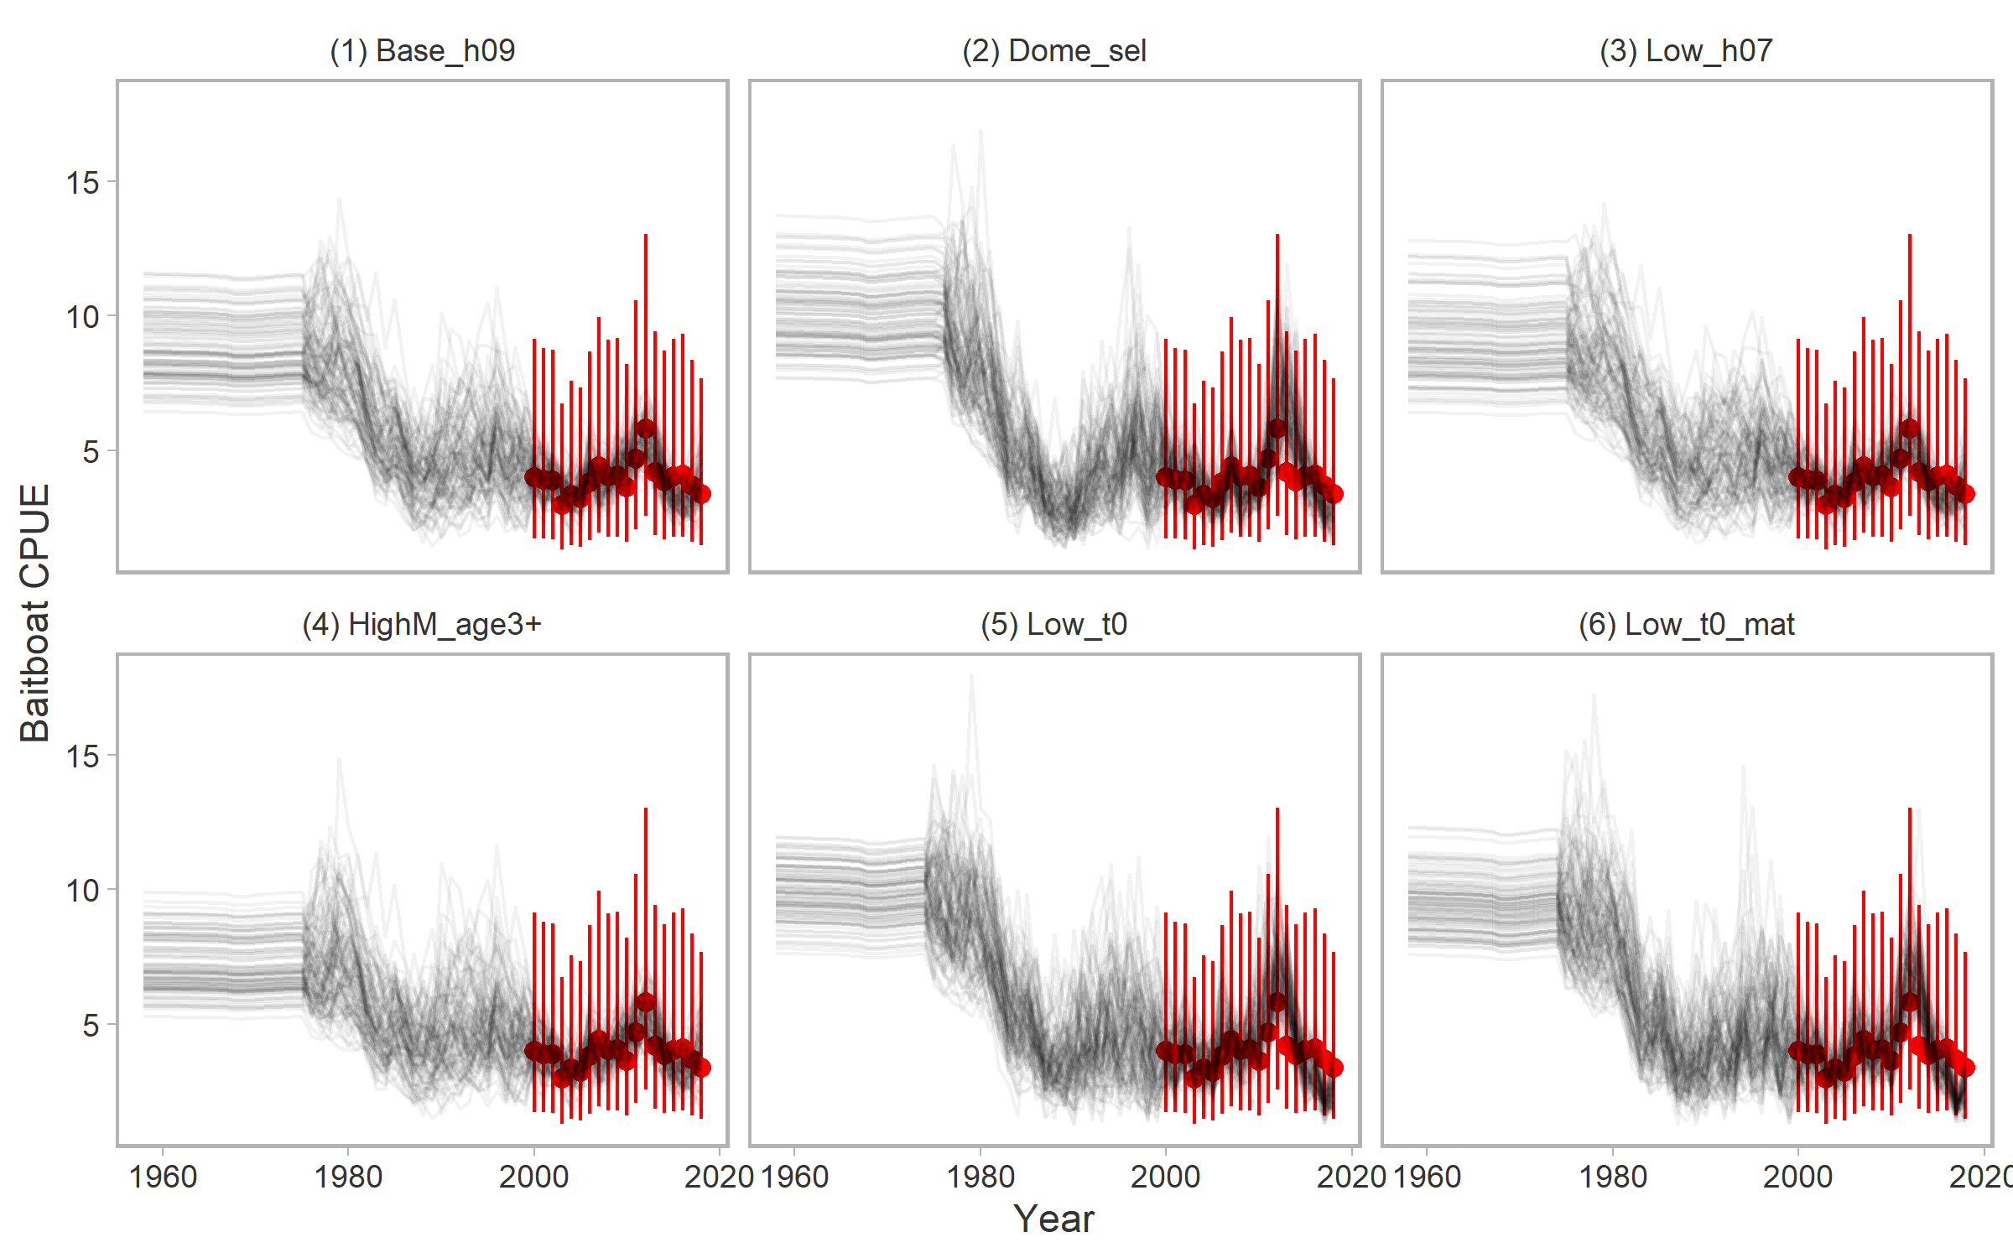
Fit to CPUE
- Fit to SRA model, 100 stochastic simulations for OM by resampling recruitment from covariance matrix
- Coefficient of variation of CPUE is approximately 0.4

Slide 6
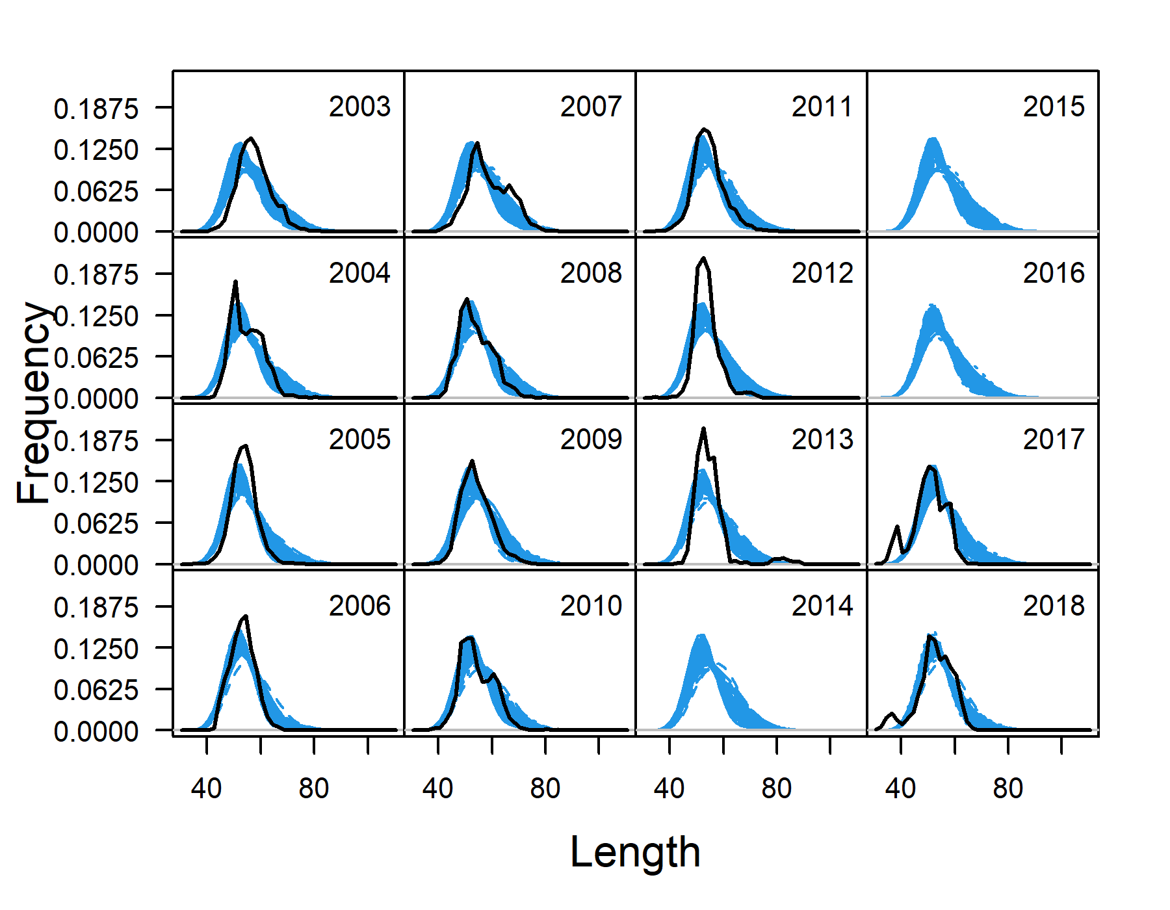
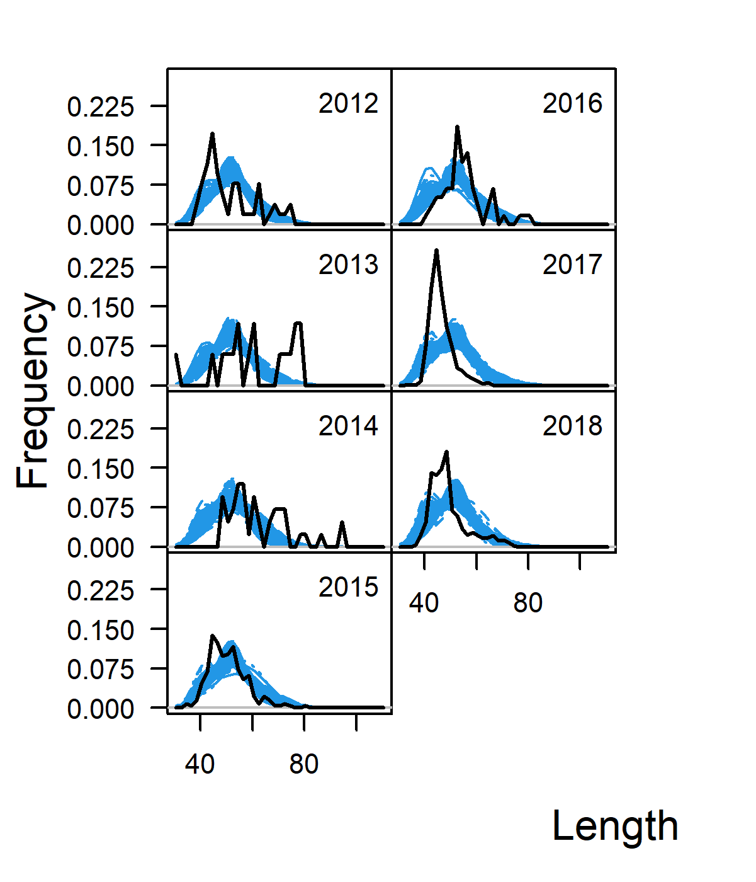
Fit to lengths
Baitboat
Handline

Slide 7
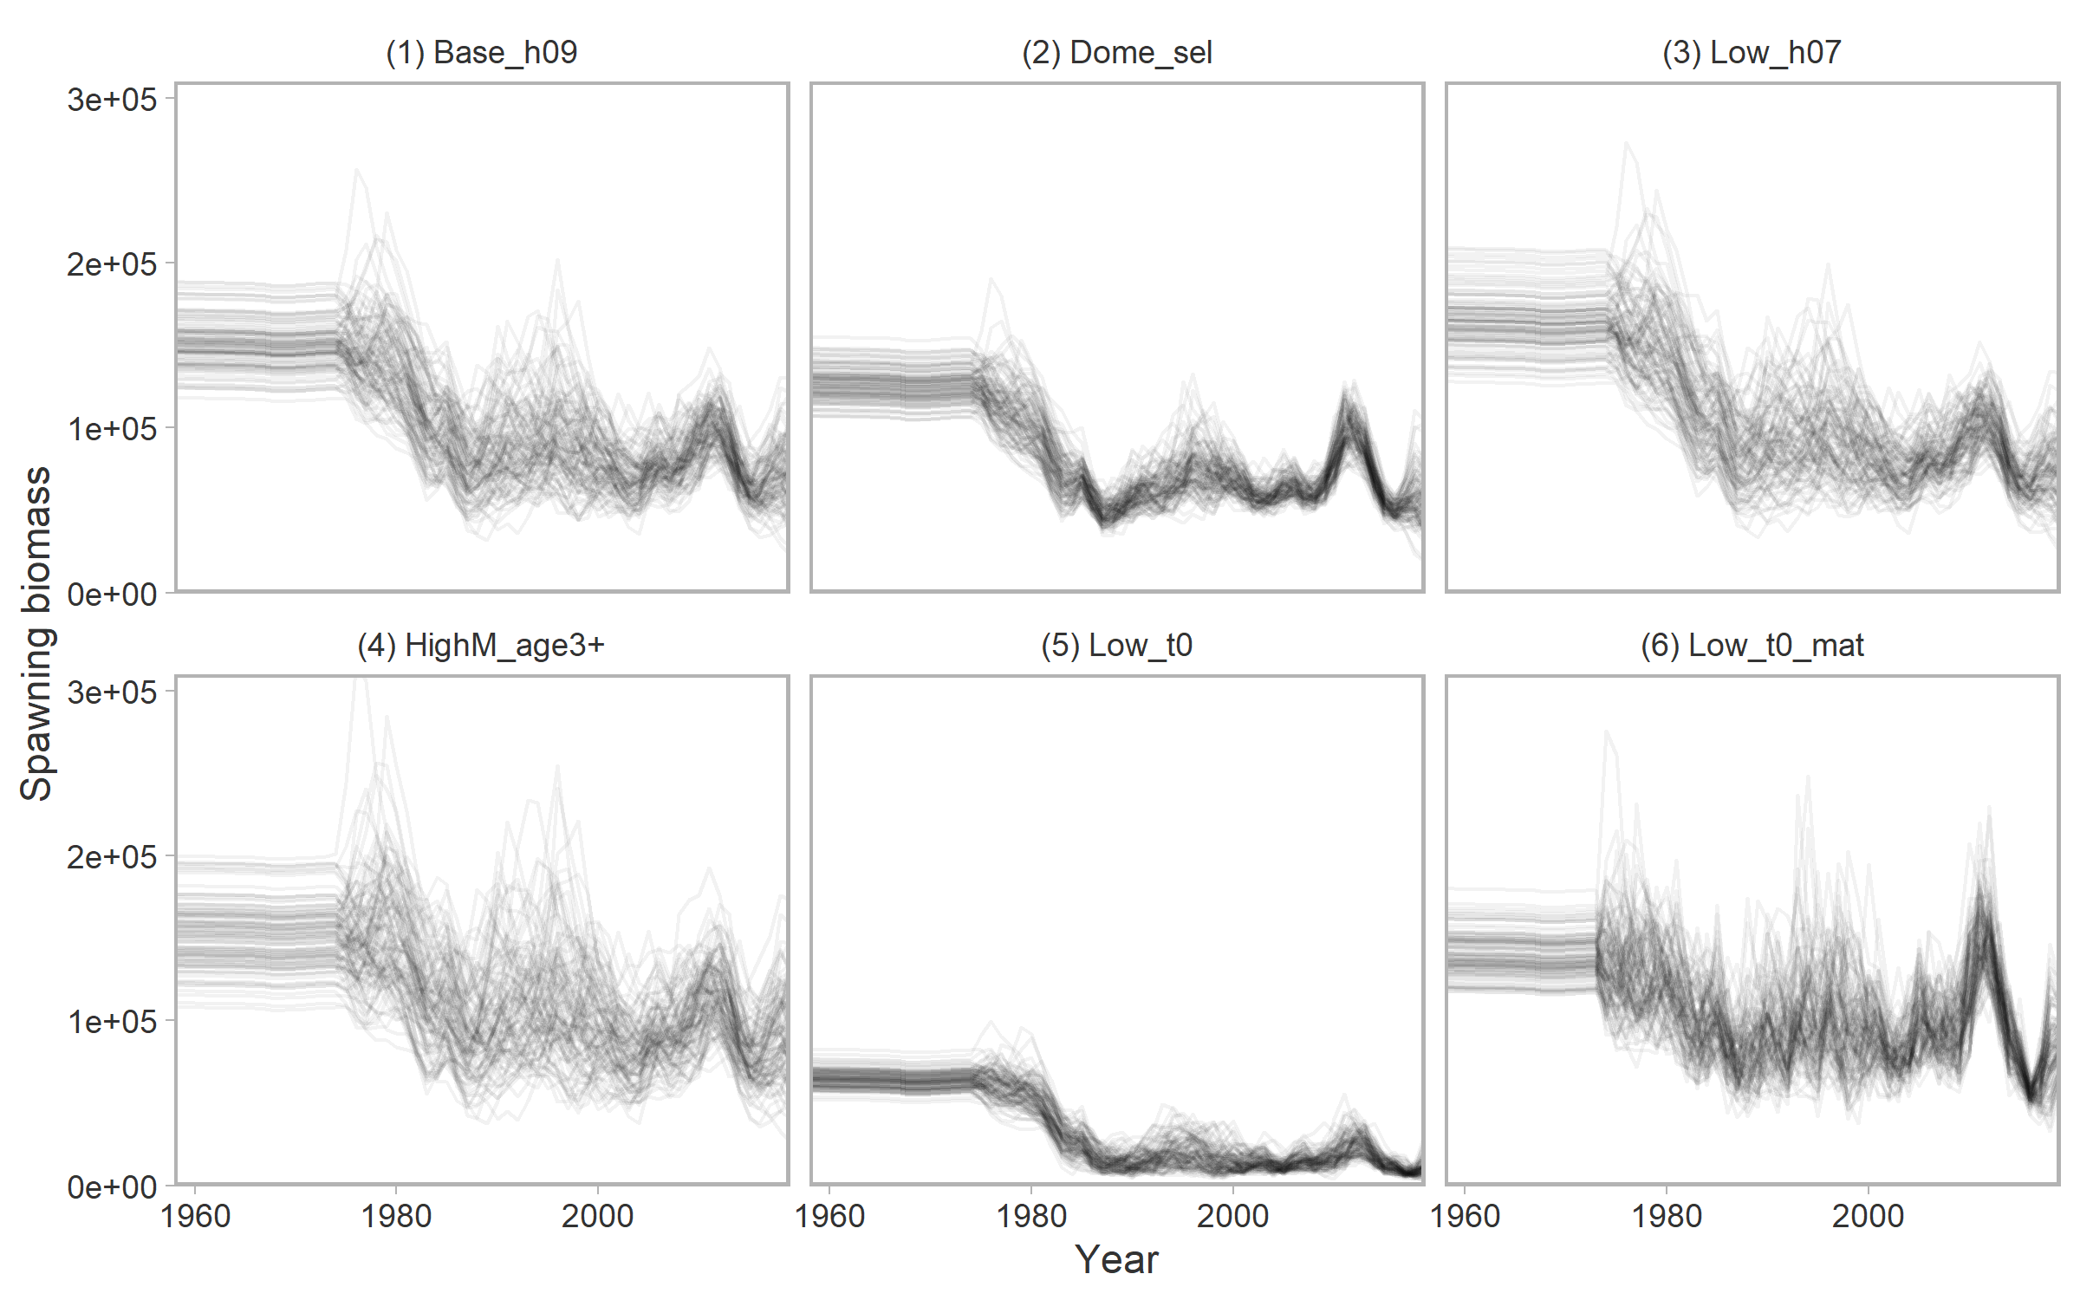
Historical SSB by OM
Higher proportion of immature catch (Maturity > Selectivity)

Slide 8
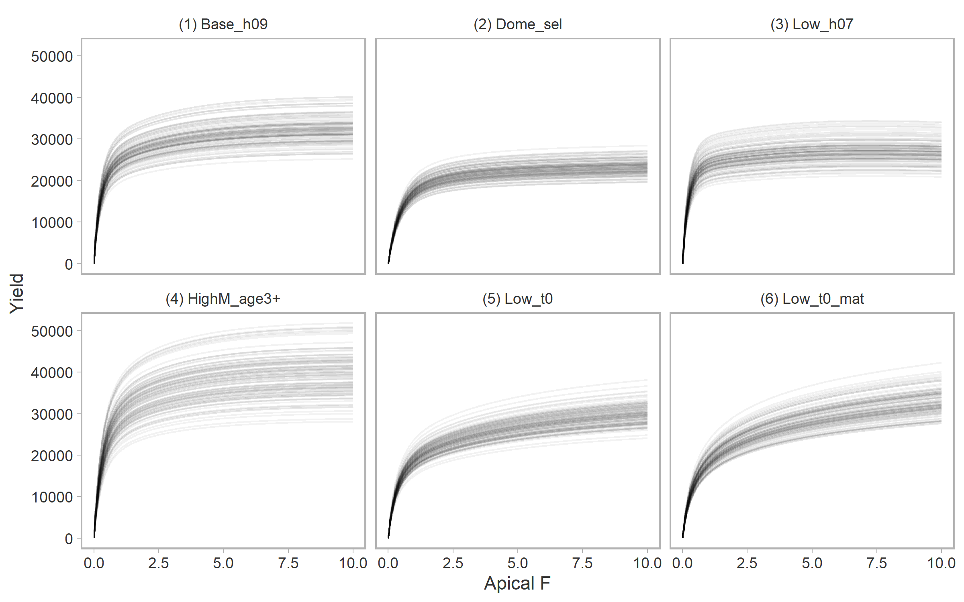
Yield curve
?
- No maximum in the yield function to determine maximum sustainable yield (MSY)
- Selectivity/maturity dynamics and high M of skipjack require alternatives to MSY reference points.
- For example, 40% depletion as a proxy for BMSY.

Slide 9
Management procedures (MPs)
MPs for this demonstration:
Constant catch MPs 15 kt, 20 kt, or 30 kt
Index-based MPs GBslope, Islope, Iratio
Harvest control rule (HCR) MPs spict_4010
Reference MPs can help us understand the OM
No fishing – how fast could the stock rebuild? (NFref)
Current Effort (Status quo F) (curE)
Notes:
Add 25 and 35 kt MPs?

Slide 10
Performance metrics
Preliminary performance metrics:
40% B0 Probability that B > 0.4 B0 (years 1 – 40)
STC30 (short-term catch) Probability that catch > 30 kt (years 1-10)
LTC30 (long-term catch) Probability that catch > 30 kt (years 11-20)
AAVC (annual variability in catch) Probability that AAVC < 20% (years 1-40)
Additional STC metrics relative to 20, 25, …, 40 kt

Slide 11
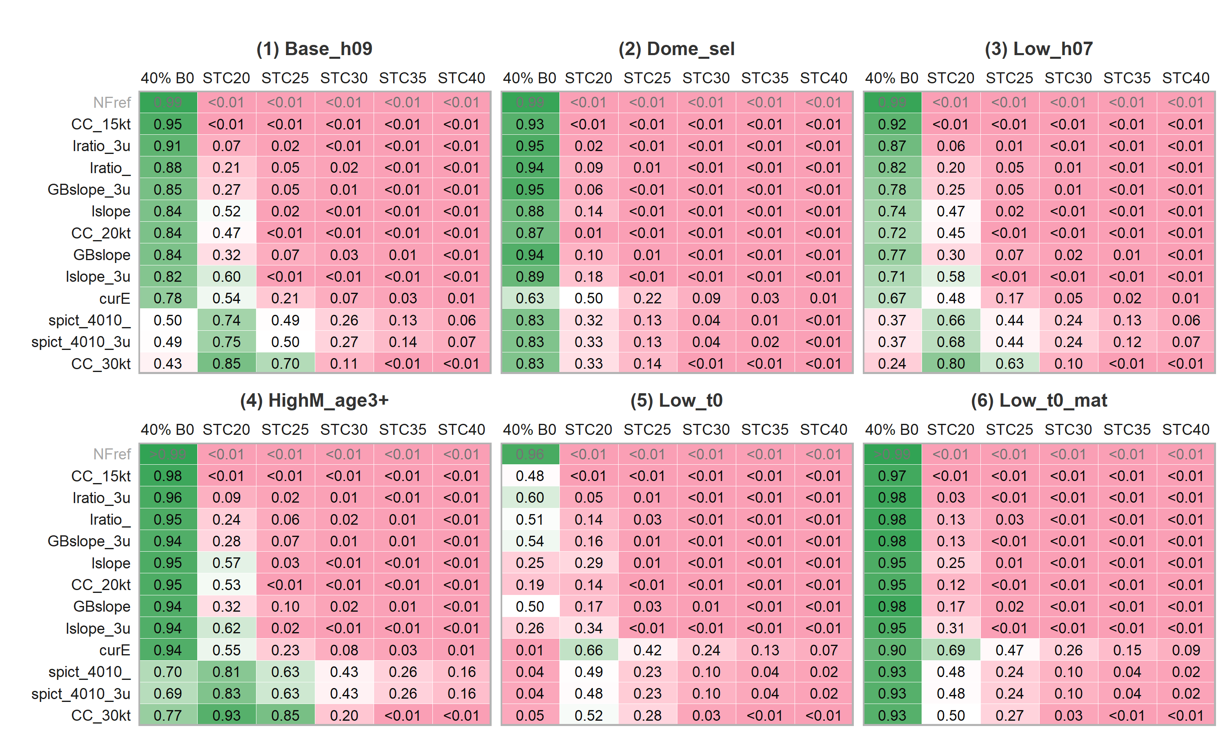
Performance metrics

Slide 12
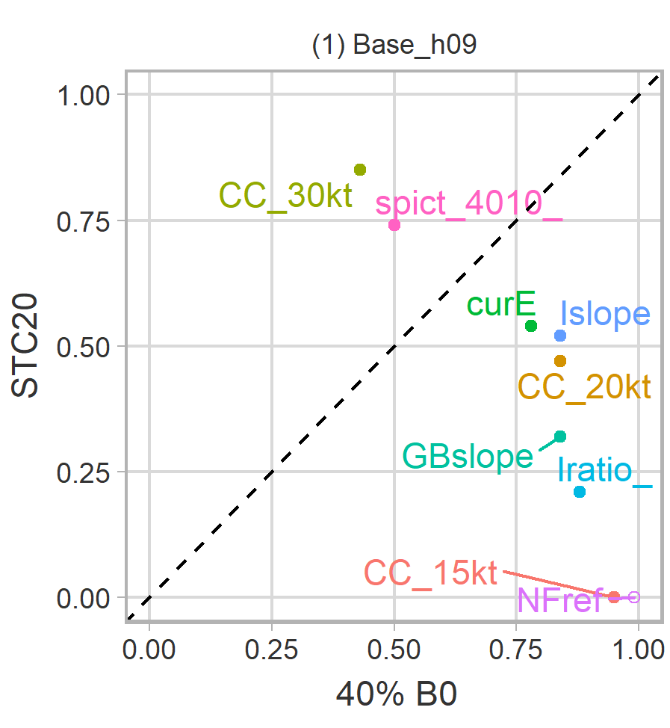
Performance metrics
(“3u” = Triennial TAC update)

Slide 13
Conclusions and next steps
Short-lived life history → maturity (relative to selectivity) was most important in generating contrast in OMs
Clear trade-off between biomass/catch objectives
Difficult to achieve 30-kt catches from this set of OMs and MPs
Additional OM scenarios identified from engagement with biologists, e.g., availability of skipjack correlated with environmental conditions
Condition an OM from standardized CPUE series that uses oceanographic conditions as a covariate
Future engagement with Brazilian fishery managers and stakeholders to
Consider and propose potential MPs and MP types (e.g., effort-based) and
Refine performance metrics to identify “best” MP
Consider stock structure for future MSE and incorporate such considerations in exceptional circumstances protocol if MP is adopted

