Slide 1
Chapter 3 Algorithms and Program Development
Jing Cheng
QQ: 42546062

Slide 2
Outline
3.1 What is Algorithm and Program？
3.2 Algorithm Features
3.3 Program Features
3.4 Strategies for Program Design
3.5 A Simple Example

Slide 3
3.1 What is Algorithm? and Program？
Algorithm: a process or a set of rules to be followed in calculations or other problem-solving operations.
Program： is an implementation of an algorithm in a particular language to run on a particular kind of computer.

Slide 4
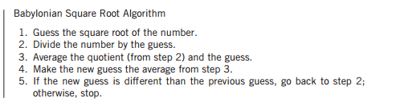
Babylonian square root algorithm (古巴比伦平方根算法)
How to get the Python code？

Slide 5
3.2 Algorithm Features
We need a good algorithm
There are some characteristics that good algorithms share.

Slide 6
Qualities of an Algorithm
Detailed
Effective
Specific as to its behavior
General purpose

Slide 7

3.3 The Features of Good Program
Readability（可读性）
Robustness（鲁棒性）
Correctness（正确性）

Slide 8
Readability
There are some good rules for readable programs：
good naming
Using comments
Indenting Code

Slide 9
Robustness
Programs should be as robust as possible in the face of unpredictability.
Programs should be able to recover from inputs that are unanticipated.
In an ideal world, all input should be predictable, but the reality is different.
The program designer should account for error situations in the design of a program.

Slide 10


Correctness

Slide 11
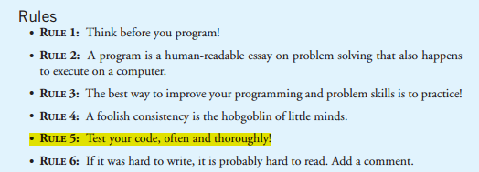
程序设计的基本原则

Slide 12
3.5 A Simple Example
古巴比伦算法求平方根

Slide 13
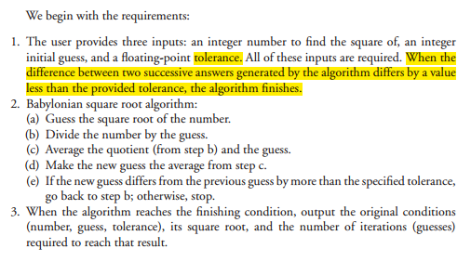
Requirements

Slide 14
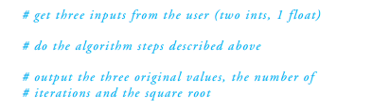
1. Build the Skeleton

Slide 15
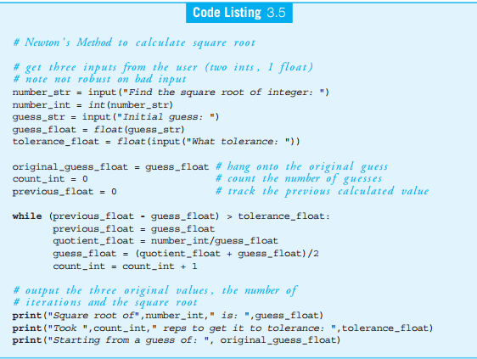
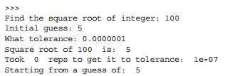

Slide 16
