Slide 1
Chapter 4 Strings（字符串）
Jing Cheng
QQ: 42546062

Slide 2
Importance of String
MUCH OF THE TIME SPENT ON COMPUTERS INVOLVES WORKING WITH WORDS.
write emails and essays
send text messages and instant messages
post to blogs
Google for information, and we read web pages

Slide 3
Outline
4.1 The String Type
4.2 String Operators
4.3 A Preview of Functions and Methods
4.4 Formatted Output of Strings
4.5 Control and Strings
4.6 Working with Strings
4.7 More String Formatting
4.8 Unicode

Slide 4
4.1 The String Type

Slide 5
Several concepts
Many Collection types in Python
String，tuple，list，dict，set（python的内置数据类型）
a collection is a group of Python objects that can be treated as a single object.
A Sequence
a collection type in which objects organized in some order
A Python string is a sequence of characters.

Slide 6
1. How to Construct a String
字符串可以是单引号括起来，也可以是双引号括起来。但是不能混用。
用双引号括起来更方便和常用。“ Jing’s Dog！”
str构造函数的使用
>>> print( "Hello World!” )
Hello World!
>>> ss = 'Hello, Jing!'
>>> print(ss)
Hello, Jing!
“ Jing‘s Dog！”

Slide 7
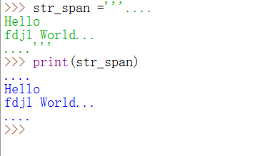
The Triple-Quote String
This kind of string preserves all the format information of the string. If the string spans multiple lines, those carriage returns between lines are preserved. If there are quotes, tabs, any information at all, it is preserved.

Slide 8
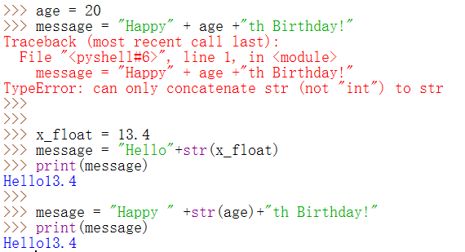
例子，字符串使用的常见错误

Slide 9
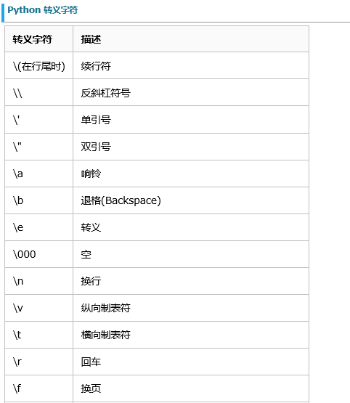
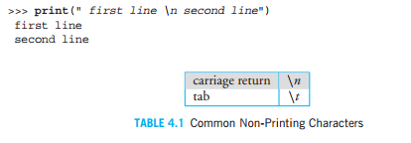
2. Non-Printing Characters（Escape character转义字符）

Slide 10
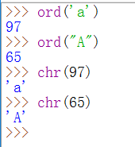
3. String Representation（字符串在计算机内存中的表示）
A character is stored in computer as an integer (Unicode, UTF-8）.
UTF-8, is a subset of Unicode.
Two functions related with the Unicode of a character:
ord(), takes a character and returns its UTF-8 integer value
chr() takes an integer and returns the UTF-8 character.

Slide 11
Subset of UTF-8
x=1
X=‘1’
演示：两者的区别

Slide 12
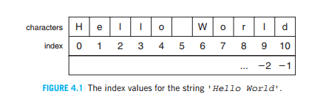
4.1.4 Strings as a Sequence
index：从0开始
using the indexing operator

Slide 13
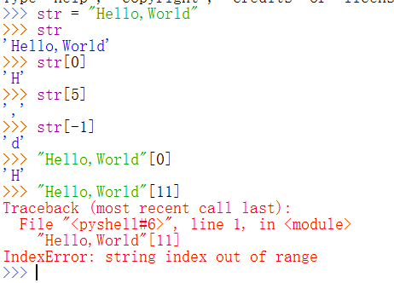

Slide 14
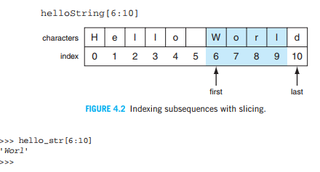
Indexing and Slicing
The indexing operator can not only help us to get a single character, but also get a subsequences of the string.
The subsequence of a string —— a slice.
Python uses a half-open range（半开区间）

Slide 15
Slicing 的基本格式
str[begin, end, step]

Slide 16
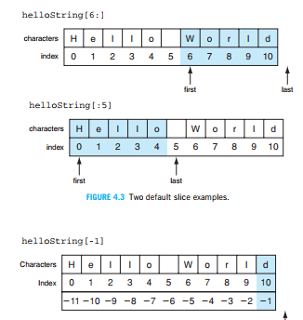
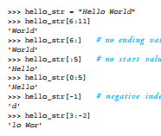
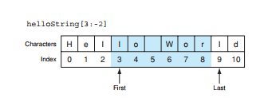

Slide 17
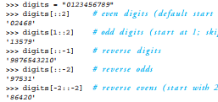

Slide 18
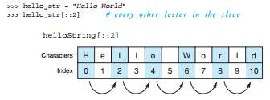


Slide 19
4.2 String Operations
+，*
String compare( == , !=, <, >, <=, >=)
len( )
in
slice
iterable

Slide 20
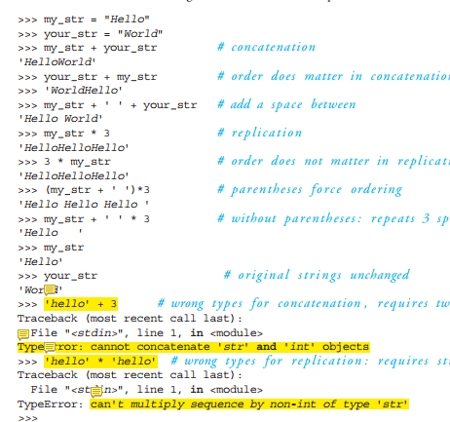
1. Operators：+ and *
+：concatenate （连接运算符）
* : repeat. （重复运算符）

Slide 21
2. Comparison Operators
Comparing the Single-Character
运算符 | 例子 | 结果
= = | ‘a’ == ‘A’ | False
!= | 'a‘ != 'A' | True
< | 'a‘ < 'A' | False
> | 'a‘ > 'A' | True
<=
>=
All comparisons between two single characters are done on the basis of their UTF-8 code.

Slide 22
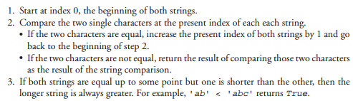
Comparing Strings
String comparison， examine both string characters at some index and then walk through both strings until a difference in characters is found.

Slide 23
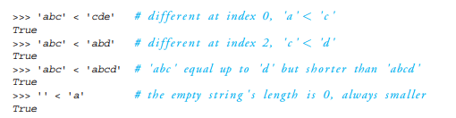

Slide 24


4. The in Operator
The in operator is useful for checking membership in a collection.
The return value: True/False.

Slide 25
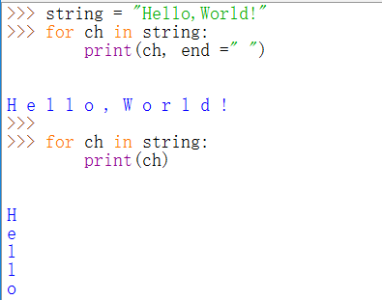
5. slice（查看前面）
6. iterable

Slide 26
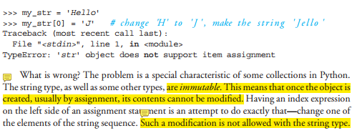
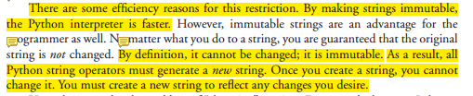
5. String Collections Are Immutable(不可改变的）

Slide 27


那么如何才能改变字符串呢？
方法是从现有的字符串mystring创建一个新的字符串“Jello”.

Slide 28
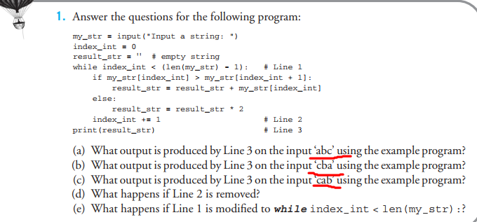
练习：

Slide 29
4.3 Functions and Methods
字符串的find()方法

Slide 30
1. What Is a Function?
A function can be seen as a small program that performs a specific task. It can take some input parameters, perform some task, finally return a result.
Functions encapsulate the code, instead of writing the same code over and over again.
Python provide many predefined functions, and you can choose write your own functions by yourself.

Slide 31
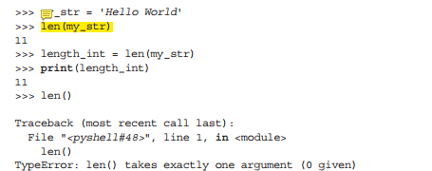
Some Concepts of function
Predefined Functions / User-defined Functions
The parameters of a function
The returned value of a function
The function is invoked，or called

Slide 32
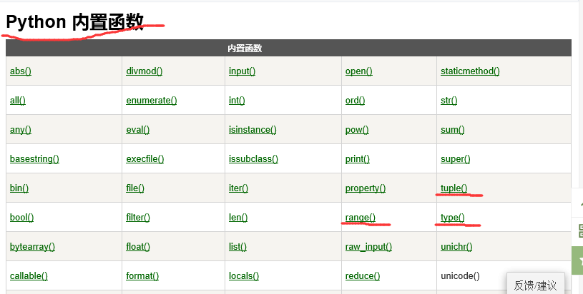
Python的内置函数

Slide 33
2. String method（方法）
A method is a variation on a function( they are similar, but they are different)
like a function, it represents a program
like a function, it has input arguments and an output
Unlike a function, it is applied in the context of a particular object.
方法从属于特定对象，方法不能独立存在
This is indicated by the dot notation invocation
点操作连接对象与方法

Slide 34
Example
upper is the name of a method. It generates a new string that has all upper case characters of the string it was called with.
my_str = 'Python Rules!'
my_str.upper() ⇒ 'PYTHON RULES!'
The upper() method was called in the context of my_str, indicated by the dot between them.
Different objects have different methods.

Slide 35
More dot notation（点操作）
in generation, dot notation looks like:
object.method(…)
It means that the object in front of the dot is calling a method that is associated with that object's type.
The method's that can be called are tied to the type of the object calling it. Each type has different methods.

Slide 36
函数的独立的
可直接用
方法是依赖对象的
不能直接用
s=“hello”
s是一个string对象
upper()
find()
len(s)
求s的长度
s.upper()
将s变成大写

Slide 37
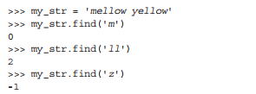
字符串的find( )方法
The find method’s task is to locate a substring within the calling string.
The find method returns the index of the substring in the string where the substring first occurs (if there are multiple occurrences) but returns -1 if the substring is not found

Slide 38
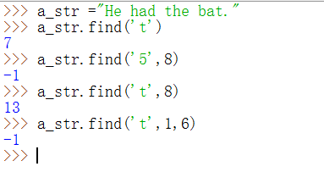
Optional Arguments(可选参数）
str.find( “substring”, start, end)
You can provide the second or the third arguments for find.
But if you don’t provide them, by default, find method will start at index 0, and stop at the end of the string.
Default →缺省参数

Slide 39
Chaining methods（方法链）
Methods can be chained together.
Perform first operation, yielding an object
Use the yielded object for the next method
my_str = 'Python Rules!'
my_str.upper() ⇒ 'PYTHON RULES!'
my_str.upper().find('O')
T = my_str.upper()
T.find('O')
⇒ 4
调用顺序从左到右，依次执行方法

Slide 40
Nesting of Methods
You can also use method and function invocations as arguments to another method call.
This kind of “method in a method” is called nesting.
a_str.find('t', a_str.find('t')+1)

Slide 41
课堂练习
调用find函数，找出关键字在字符串中的所有位置。

Slide 42
3. 选择方法的名字和参数

Slide 45
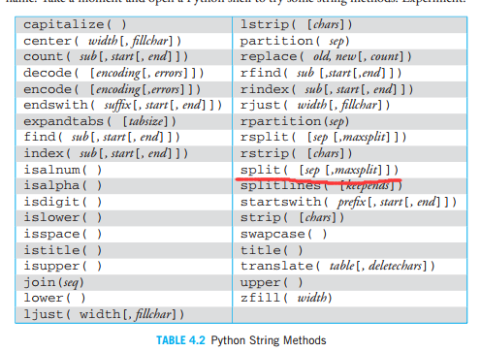
4. 字符串对象有哪些方法？
https://www.runoob.com/python/att-string-split.html
P: 200

Slide 46
4.4 Formatted Output of Strings

Slide 47
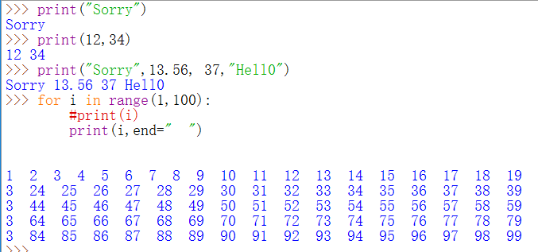
Using the default print function

Slide 48
String formatting, better printing
So far, we have just used the defaults of the print function
We can do many more complicated things to make that output “prettier” and more pleasing.
We will use it in our display function
更美观的打印输出

Slide 49

format method
format is the string objects’ method that creates a new string.
Basic form of the format method
"format string".format(data1, data2, ...)

Slide 51
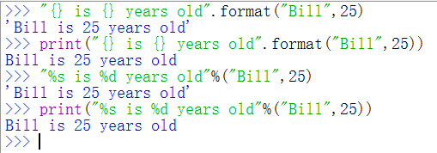
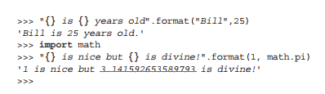

Slide 52


the format commands
each brace can include formatting commands
{ :[align] [minimum width] [.precision] [descriptor]}
descriptors

Slide 53
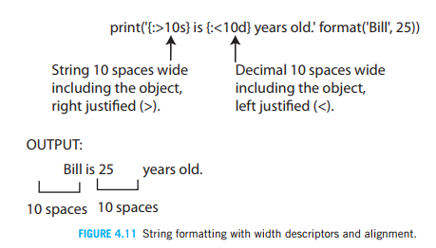

Slide 54
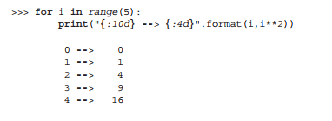

Slide 55
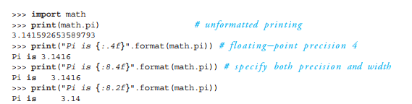

Floating-Point Precision Descriptor
% floating point descriptor that converts from a decimal to a percent

Slide 56
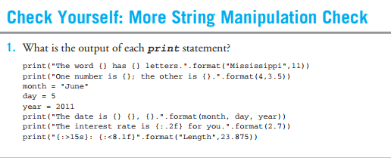

Slide 57
4.5 Control and Strings

Slide 58



Thinking about the method find
How does the find method actually find a character and return its index?

Slide 59
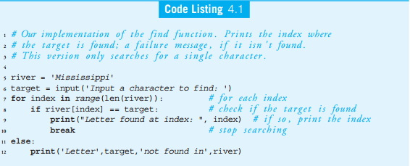

Slide 60
课堂练习
查找单个字符第一次出现下标
查找单词位置第一次出现下标
查找单个字符出现的所有位置
查找单词出现的所有位置

Slide 61
4.6 Working with StringsS

Slide 62
Example 1：Reordering a Person’s Name
Problem:
Transform a name from the order of ‘First Middle Last’ to the order of ‘Last, First Middle’
The string split method
https://www.runoob.com/python/att-string-split.html

Slide 63
reorder a name

Slide 64
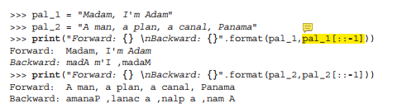
Example 2：Palindromes（回文）
A palindrome is a string that reads the same forward as backward.
“Madam, I’m Adam” and “A man, a plan, a canal, Panama”.

Slide 65
To write a code to determine if a string is a palindrome
Two tasks:
1. Modify the input string so that:
The case of all the characters is the same.
Only letters and digits are in the string.
2. Once modified, compare the string forward and backward to see whether it is the same string.

Slide 66
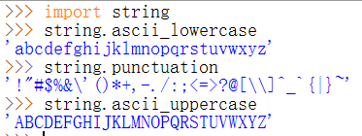
Only Letters and Digits
string模块
in操作符
string方法：replace

