Slide 1

PROPOSTA DI TRADUZIONE
DEL VIDEOGIOCO RED EMBRACE
RELATRICE:
Prof.ssa Francesca Perozziello
CORRELATRICE:
Prof.ssa Lisa Meschi
CANDIDATO:
Ilaria Pisanu

Slide 2
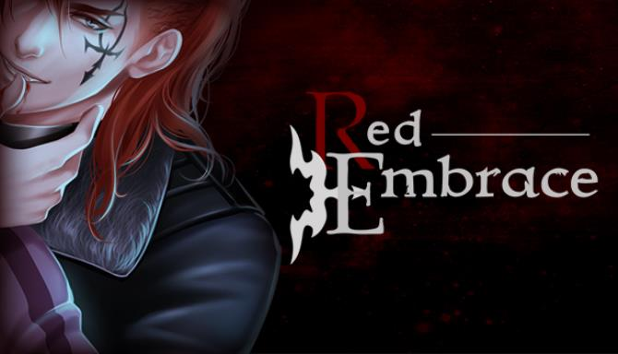
Red Embrace
A visual novel developed by Argent Games, Seattle (USA)

Slide 3
VISUAL NOVEL
Sub-genre of Japanese adventure games and a form of interactive fiction.

Slide 4
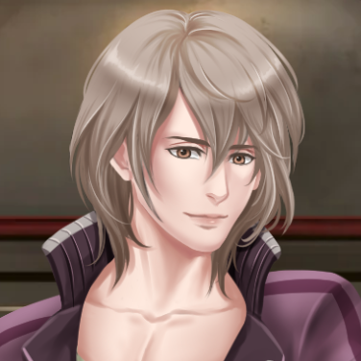
PLOT
MC works the night shift at a dingy diner in San Francisco, until his life is turned upside-down when he finds himself in the middle of a war between vampires

Slide 5
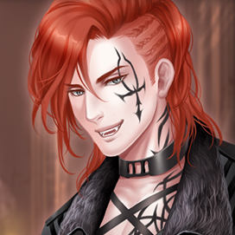
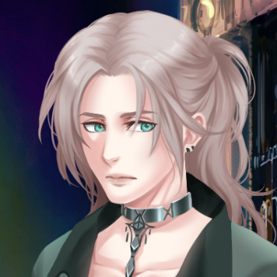
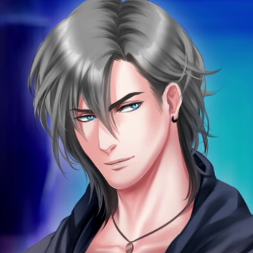
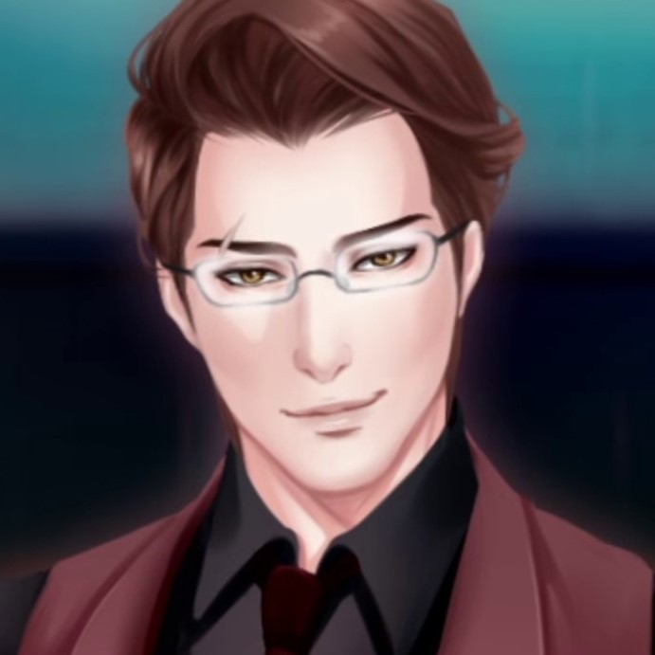
MEET THE CHARACTERS
ISAAC
REX
DOMINIC
LUKA
Isaac reeks of "unscrupulous businessman," and makes no effort to hide it
Wild, impulsive and bloodthirsty, Rex wears his vampiric nature like a badge of pride
A man of few words, but his silence suggests a deep conflict going on beneath the surface
Proud and determined, Luka seems to be hunting for someone obsessively

Slide 6
MECHANICS
The player leads the story through choices, shaping their own personality

Slide 7
PERSONALITY
TRAITS
Charming
Blunt
Gentle
Agressive

Slide 8
GENRE AND NARRATIVE STYLE
Fantasy romance for adults
First person narrative
Present tense
Direct speech
Low register

Slide 9
SWEAR WORDS
Importance of respecting the occurrence in target language

Slide 10
CULTURAL DIFFERENCES
Some concepts cannot be transposed into Italian because they don’t exist in our culture

Slide 11
CULTURAL DIFFERENCES
DINER
TAVOLA CALDA
Typical restaurant in the US inspired by the aesthetic of train carts and with a strong 50s vibe.
Serves food and drinks for quick meals at the counter, usually hamburgers and pies.
Italian restaurant that serves quick meals at the counter.
Products are usually part of local gastronomy.

Slide 12
PUNS AND IRONY
Particularly hard elements to translate being extremely linked to the specific words

Slide 13
PUNS AND IRONY
ORIGINAL
TRANSLATION
# mc "\"–That's a whole pie, sir. Are you sure you really want a {i}whole{/i} pie?\"“
# u "\"High? I'm not high, you're high!\""
mc "\"Signore, è uno sformato intero. È sicuro di volere un {i}intero{/i} sformato?\"«
u "\"Fumato? Io non sono fumato, tu sei fumato!\""

Slide 14
PUNS AND IRONY
ORIGINAL
TRANSLATION
# n "Man, I really get why they call it the \"graveyard shift\"…“
# n "It feels like I'm watching over a cemetery sometimes. One that smells like greasy burgers."
n "Cavolo, dovrebbero chiamarlo il \"turno dei morti \"…"
n "A volte mi sembra di fare il guardiano in un cimitero. Un cimitero che puzza di unto."

Slide 15
IDIOMS AND COLLOQUIALISMS
They may not be translatable literally so research and knowledge of both languages are fundamental

Slide 16
…A FEW EXAMPLES
ORIGINAL | TRANSLATION
Like a porcupine retracting its quills | Come un gatto che ritrae gli artigli
It seems it's not in the cards | Sembra che non sia destino
Hey, is it always so dead in here? | Ehi, è sempre un mortorio qui?

Slide 17
TEXT MESSAGES
ORIGINAL
TRANSLATION
# mcp "\"…'Sry abt 2nite. Meet me @ club skyline tmrw nite. Want 2 apolygize.'\""
mcp "\"Scs x sta ntt. C vediamo allo Skyline dmn ntt. Voglio chied scs.\""

Slide 18
VAMPIRE THEME
The vampiric world has its own terminology:
Clan
Coven
Embrace
Dark gift
Not every one of these could be translated

Slide 19
OTHER FILES
Graphical User Interface
Screens
Store page

Slide 20
THANKS FOR THE ATTENTION!
Does anyone have any questions?

