Slide 1


/?
Notes:
/?

Slide 2

FLY
/ability
Notes:
/?

Slide 3

/agent
Notes:
/?

Slide 4


/alwaysday
Notes:
/?

Slide 5


/camerashake
Notes:
/?

Slide 6


/clear
Notes:
/?

Slide 7


/clearspawnpoint
Notes:
/?

Slide 8
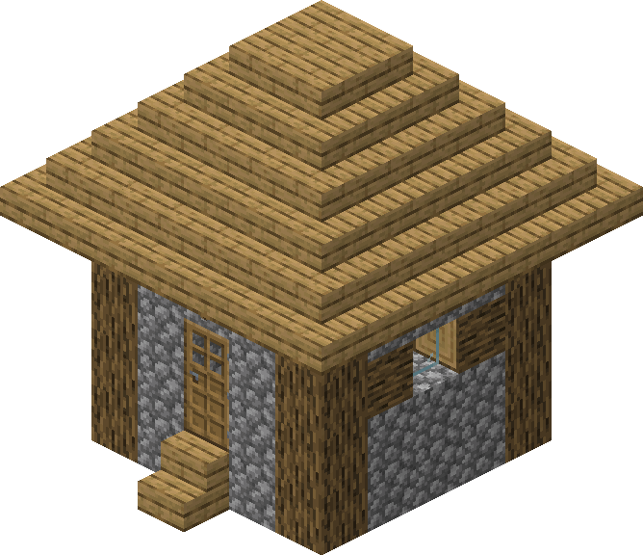
/clone
Notes:
/?

Slide 9



/connect
Notes:
/?

Slide 10
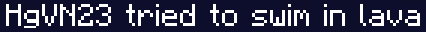


???
/damage
Notes:
/?

Slide 11
/daylock
Notes:
/?

Slide 12



/deop
Notes:
/?

Slide 13
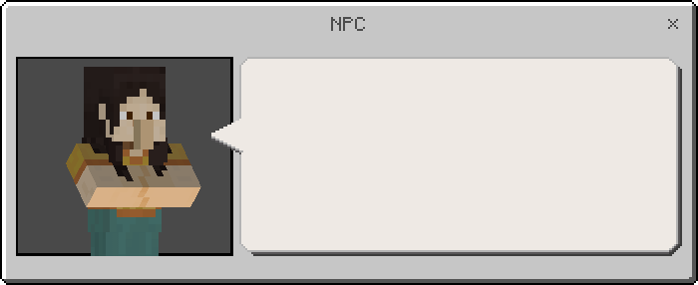
/dialogue
Notes:
/?

Slide 14

/difficulty
Notes:
/?

Slide 15



/effect
Notes:
/?

Slide 16



/enchant
Notes:
/?

Slide 17


/event
Notes:
/?

Slide 18

/summon
/execute
Notes:
/?

Slide 19

/fill
Notes:
/?

Slide 20
/fog
Notes:
/?

Slide 21
/setblock
/fill
/kill
/summon
/function
Notes:
/?

Slide 22

/gamemode
Notes:
/?

Slide 23




/gamerule
Notes:
/?

Slide 24
/gametest
Notes:
/?

Slide 25


/give
Notes:
/?

Slide 26
/help
Notes:
/?

Slide 27


/immutableworld
Notes:
/?

Slide 28



/kick
Notes:
/?

Slide 29
/kill
Notes:
/?

Slide 30
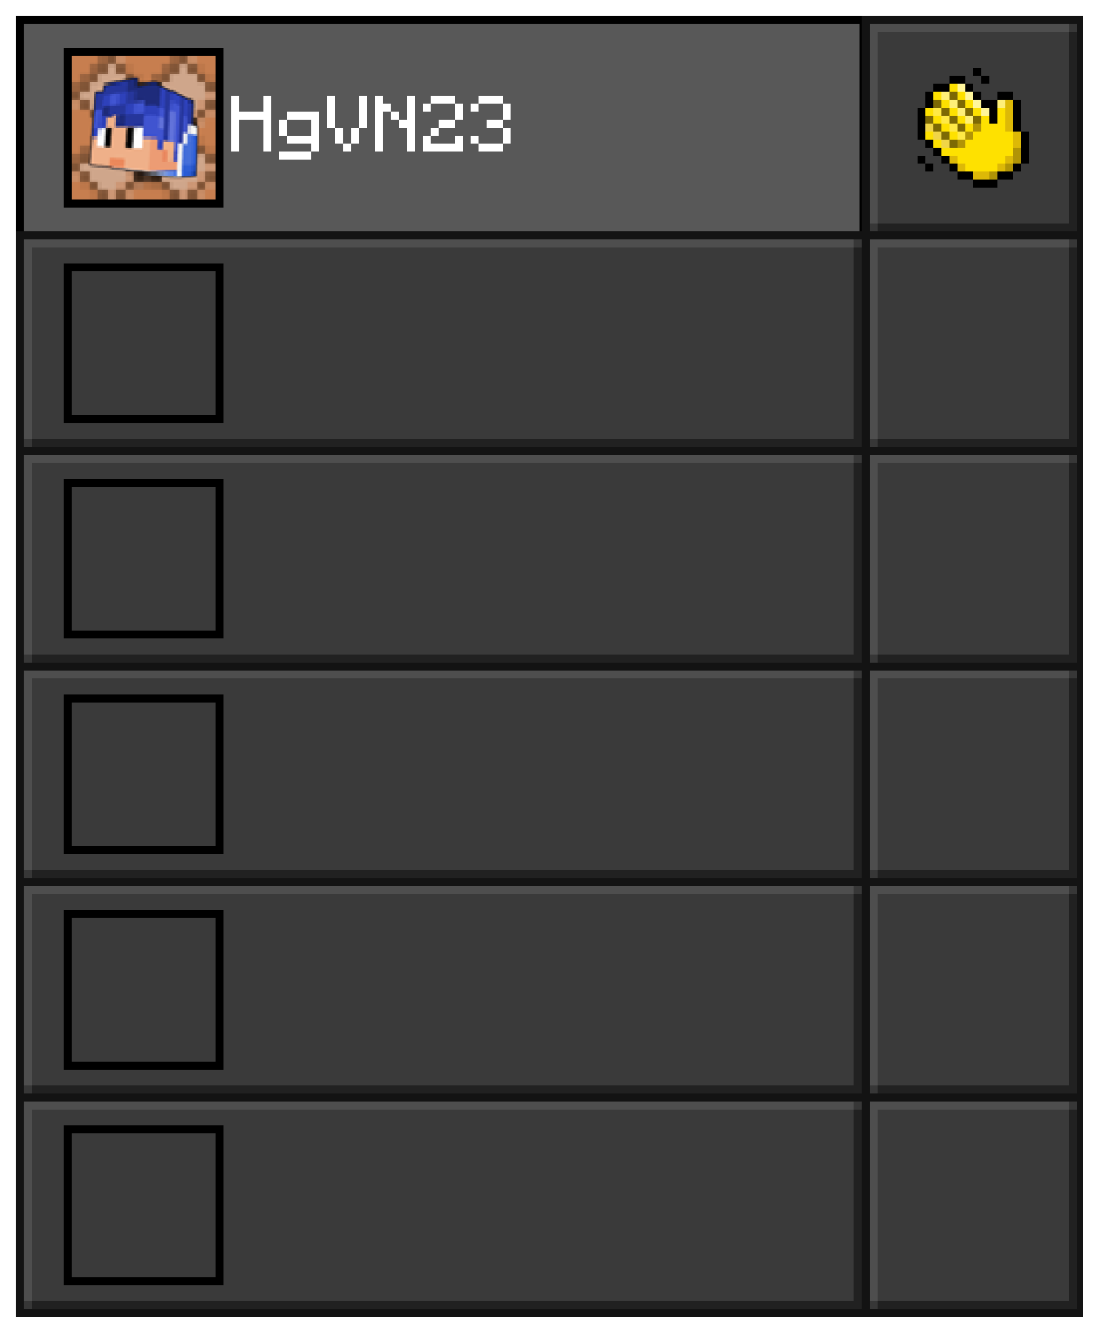
/list
Notes:
/?

Slide 31
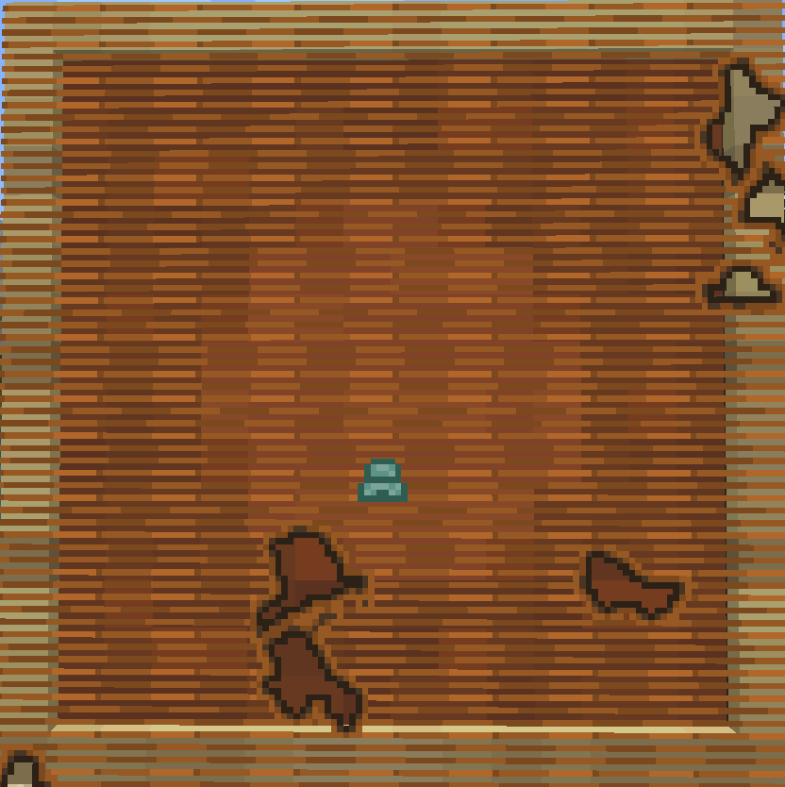
/locate
Notes:
/?

Slide 32


/loot
Notes:
/?

Slide 33

HI
/me
Notes:
/?

Slide 34

/mobevent
Notes:
/?

Slide 35
HI
Hm?
Sup
/msg
Notes:
/?

Slide 36


/music
Notes:
/?

Slide 37

/op
Notes:
/?

Slide 38


/particle
Notes:
/?

Slide 39

/playanimation
Notes:
/?

Slide 40






/playsound
Notes:
/?

Slide 41

/kill
/setblock
/summon
/fill
/reload
Notes:
/?

Slide 42
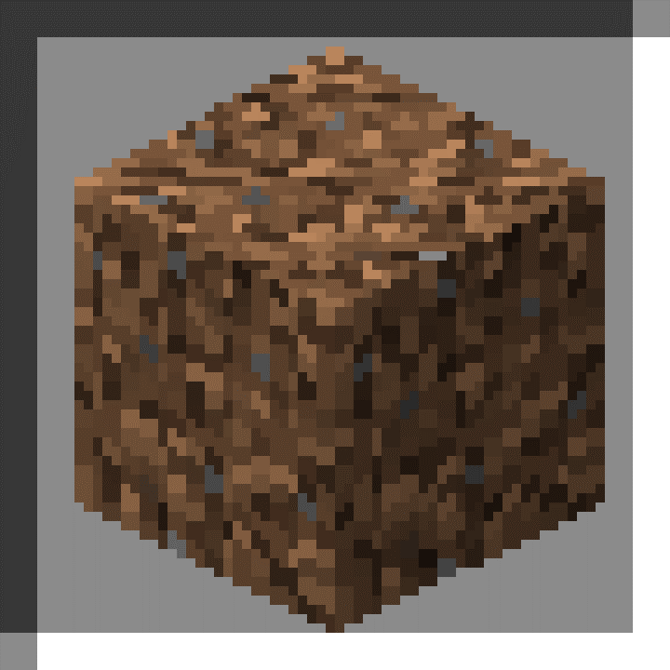
/replaceitem
Notes:
/?

Slide 43
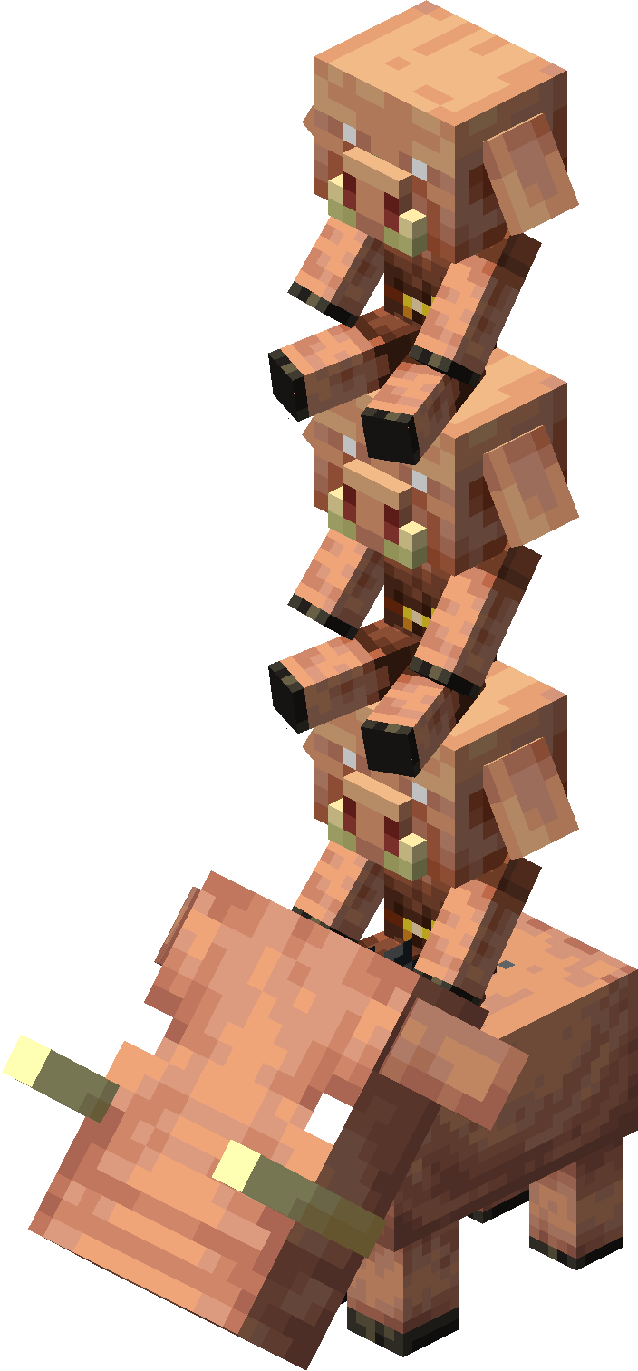
/ride
Notes:
/?

Slide 44
???
/say
Notes:
/?

Slide 45
/kill
/setblock
/summon
/fill
/schedule
Notes:
/?

Slide 46

/scoreboard
Notes:
/?

Slide 47
/script
Notes:
/?

Slide 48
/setblock
Notes:
/?

Slide 49
2/2
/setmaxplayers
Notes:
/?

Slide 50


/setworldspawn
Notes:
/?

Slide 51

/spawnpoint
Notes:
/?

Slide 52

/spreadplayers
Notes:
/?

Slide 53

/stopsound
Notes:
/?

Slide 54
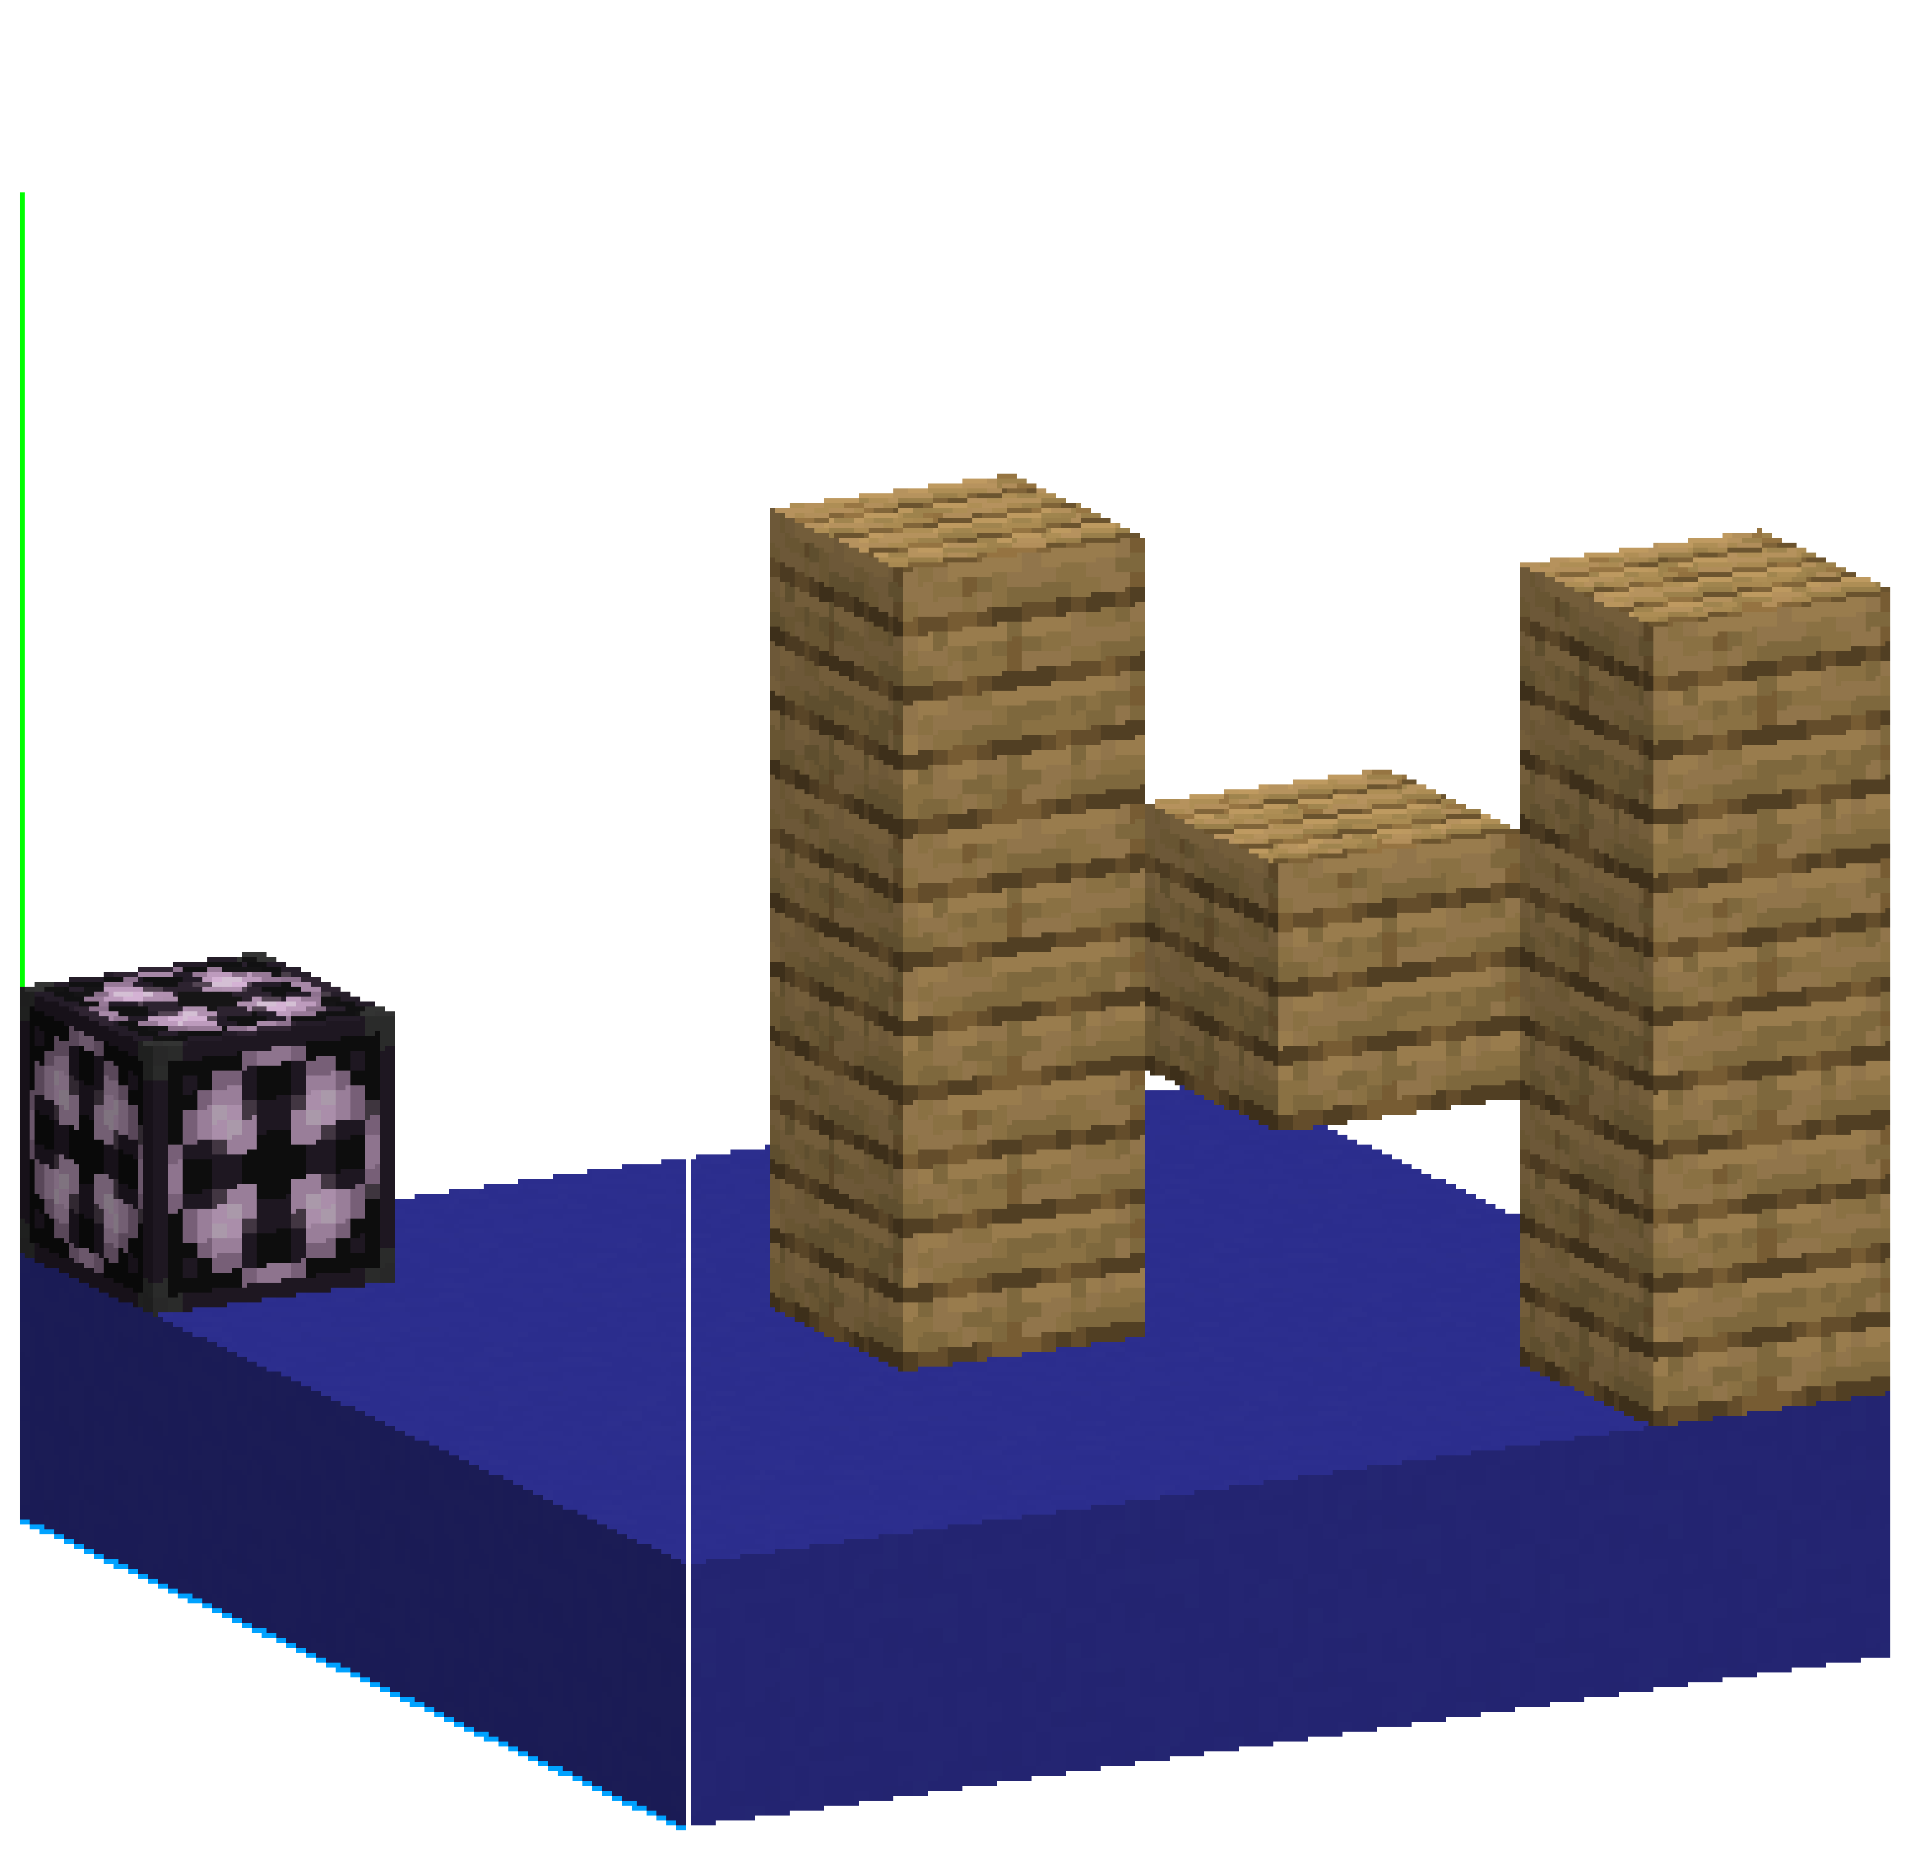
/structure
Notes:
/?

Slide 55
/summon
Notes:
/?

Slide 56
a
b
/tag
Notes:
/?

Slide 57
/teleport
Notes:
/?

Slide 58
HI
Hm?
Sup
/tell
Notes:
/?

Slide 59
???
/tellraw
Notes:
/?

Slide 60


/testfor
Notes:
/?

Slide 61
/testforblock
Notes:
/?

Slide 62
/testforblocks
Notes:
/?

Slide 63


/tickingarea
Notes:
/?

Slide 64





/time
Notes:
/?

Slide 65
???
/title
Notes:
/?

Slide 66
???
/titleraw
Notes:
/?

Slide 67

/toggledownfall
Notes:
/?

Slide 68
/tp
Notes:
/?

Slide 69
/volumearea
Notes:
/?

Slide 70
HI
Hm?
Sup
/w
Notes:
/?

Slide 71
/wb
Notes:
/?

Slide 72


/weather
Notes:
/?

Slide 73
/worldbuilder
Notes:
/?

Slide 74
/wsserver
Notes:
/?

Slide 75

/xp
Notes:
/?

Slide 76
/
Notes:
/?

Slide 77

Target
Notes:
/?

Slide 78
Animation Id
Notes:
/?

Slide 79
Block state Id
Notes:
/?

Slide 80
Component Id
Notes:
/?

Slide 81
Damage Id
Notes:
/?

Slide 82
Effect Id
Notes:
/?

Slide 83
Enchantment Id
Notes:
/?

Slide 84
Event Id
Notes:
/?

Slide 85
Fog Id
Notes:
/?

Slide 86
Gamerule Id
Notes:
/?

Slide 87
Loot Id
Notes:
/?

Slide 88
Particle Id
Notes:
/?

Slide 89
Raw message Id
Notes:
/?

Slide 90
Sound Id
Notes:
/?

Slide 91
Track Id
Notes:
/?

Slide 92
Id
Notes:
/?

Slide 93
! ~ ^ §
Toán tử kí tự

Slide 94
/command
Cấu trúc Command

Slide 95
Command Block

Slide 96
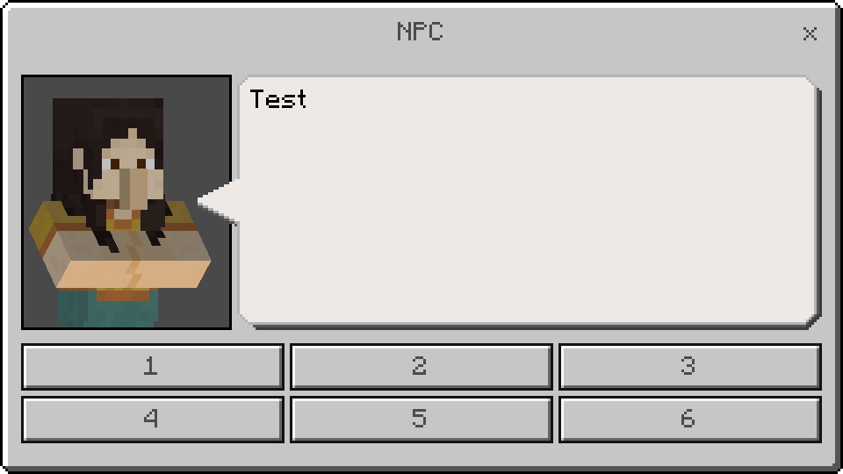
NPC

Slide 97
29e3c5d3-e87f-457a-7d3b-8b7a8eb855f4
Tạo UUID v4

Slide 98
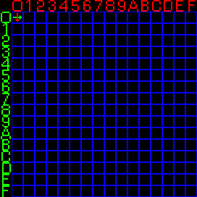
Tra kí tự trong Glyph

Slide 99
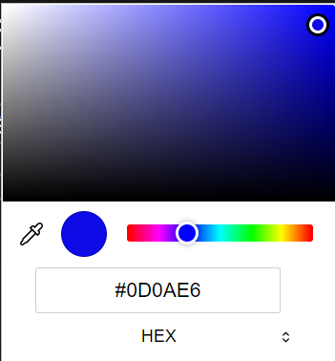

Hex -> Dec Color Code

Slide 100
Tạo dialogue.json

Slide 101

Easter Egg

Slide 102
Hg

Slide 103

404 Error

