Slide 1


/?
Notes:
/?

Slide 2

FLY
/ability
Notes:
/?

Slide 3


/alwaysday
Notes:
/?

Slide 4


/camerashake
Notes:
/?

Slide 5


/clear
Notes:
/?

Slide 6


/clearspawnpoint
Notes:
/?

Slide 7
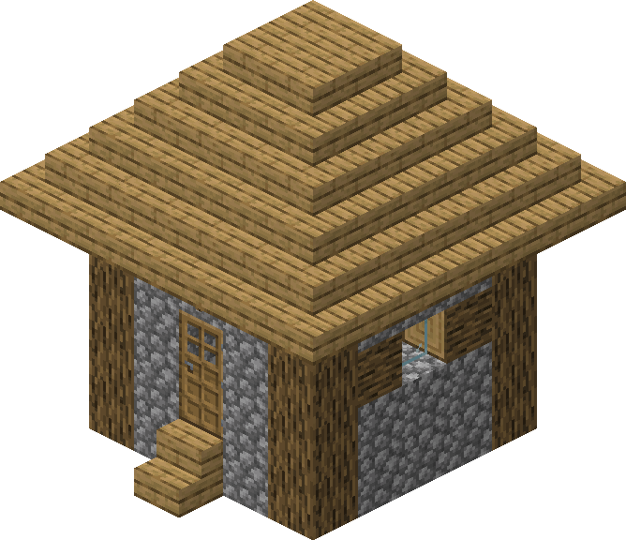
/clone
Notes:
/?

Slide 8



/connect
Notes:
/?

Slide 9
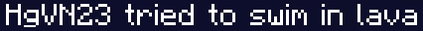


???
/damage
Notes:
/?

Slide 10
/daylock
Notes:
/?

Slide 11



/deop
Notes:
/?

Slide 12
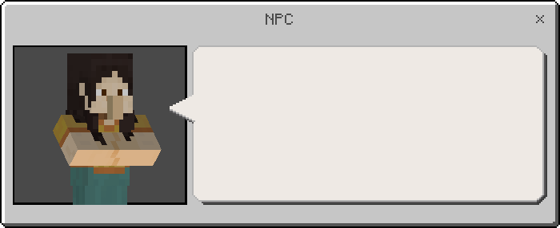
/dialogue
Notes:
/?

Slide 13

/difficulty
Notes:
/?

Slide 14



/effect
Notes:
/?

Slide 15



/enchant
Notes:
/?

Slide 16


/event
Notes:
/?

Slide 17

/summon
/execute
Notes:
/?

Slide 18

/fill
Notes:
/?

Slide 19
/fog
Notes:
/?

Slide 20
/setblock
/fill
/kill
/summon
/function
Notes:
/?

Slide 21

/gamemode
Notes:
/?

Slide 22




/gamerule
Notes:
/?

Slide 23
/gametest
Notes:
/?

Slide 24


/give
Notes:
/?

Slide 25
/help
Notes:
/?

Slide 26


/immutableworld
Notes:
/?

Slide 27



/kick
Notes:
/?

Slide 28
/kill
Notes:
/?

Slide 29
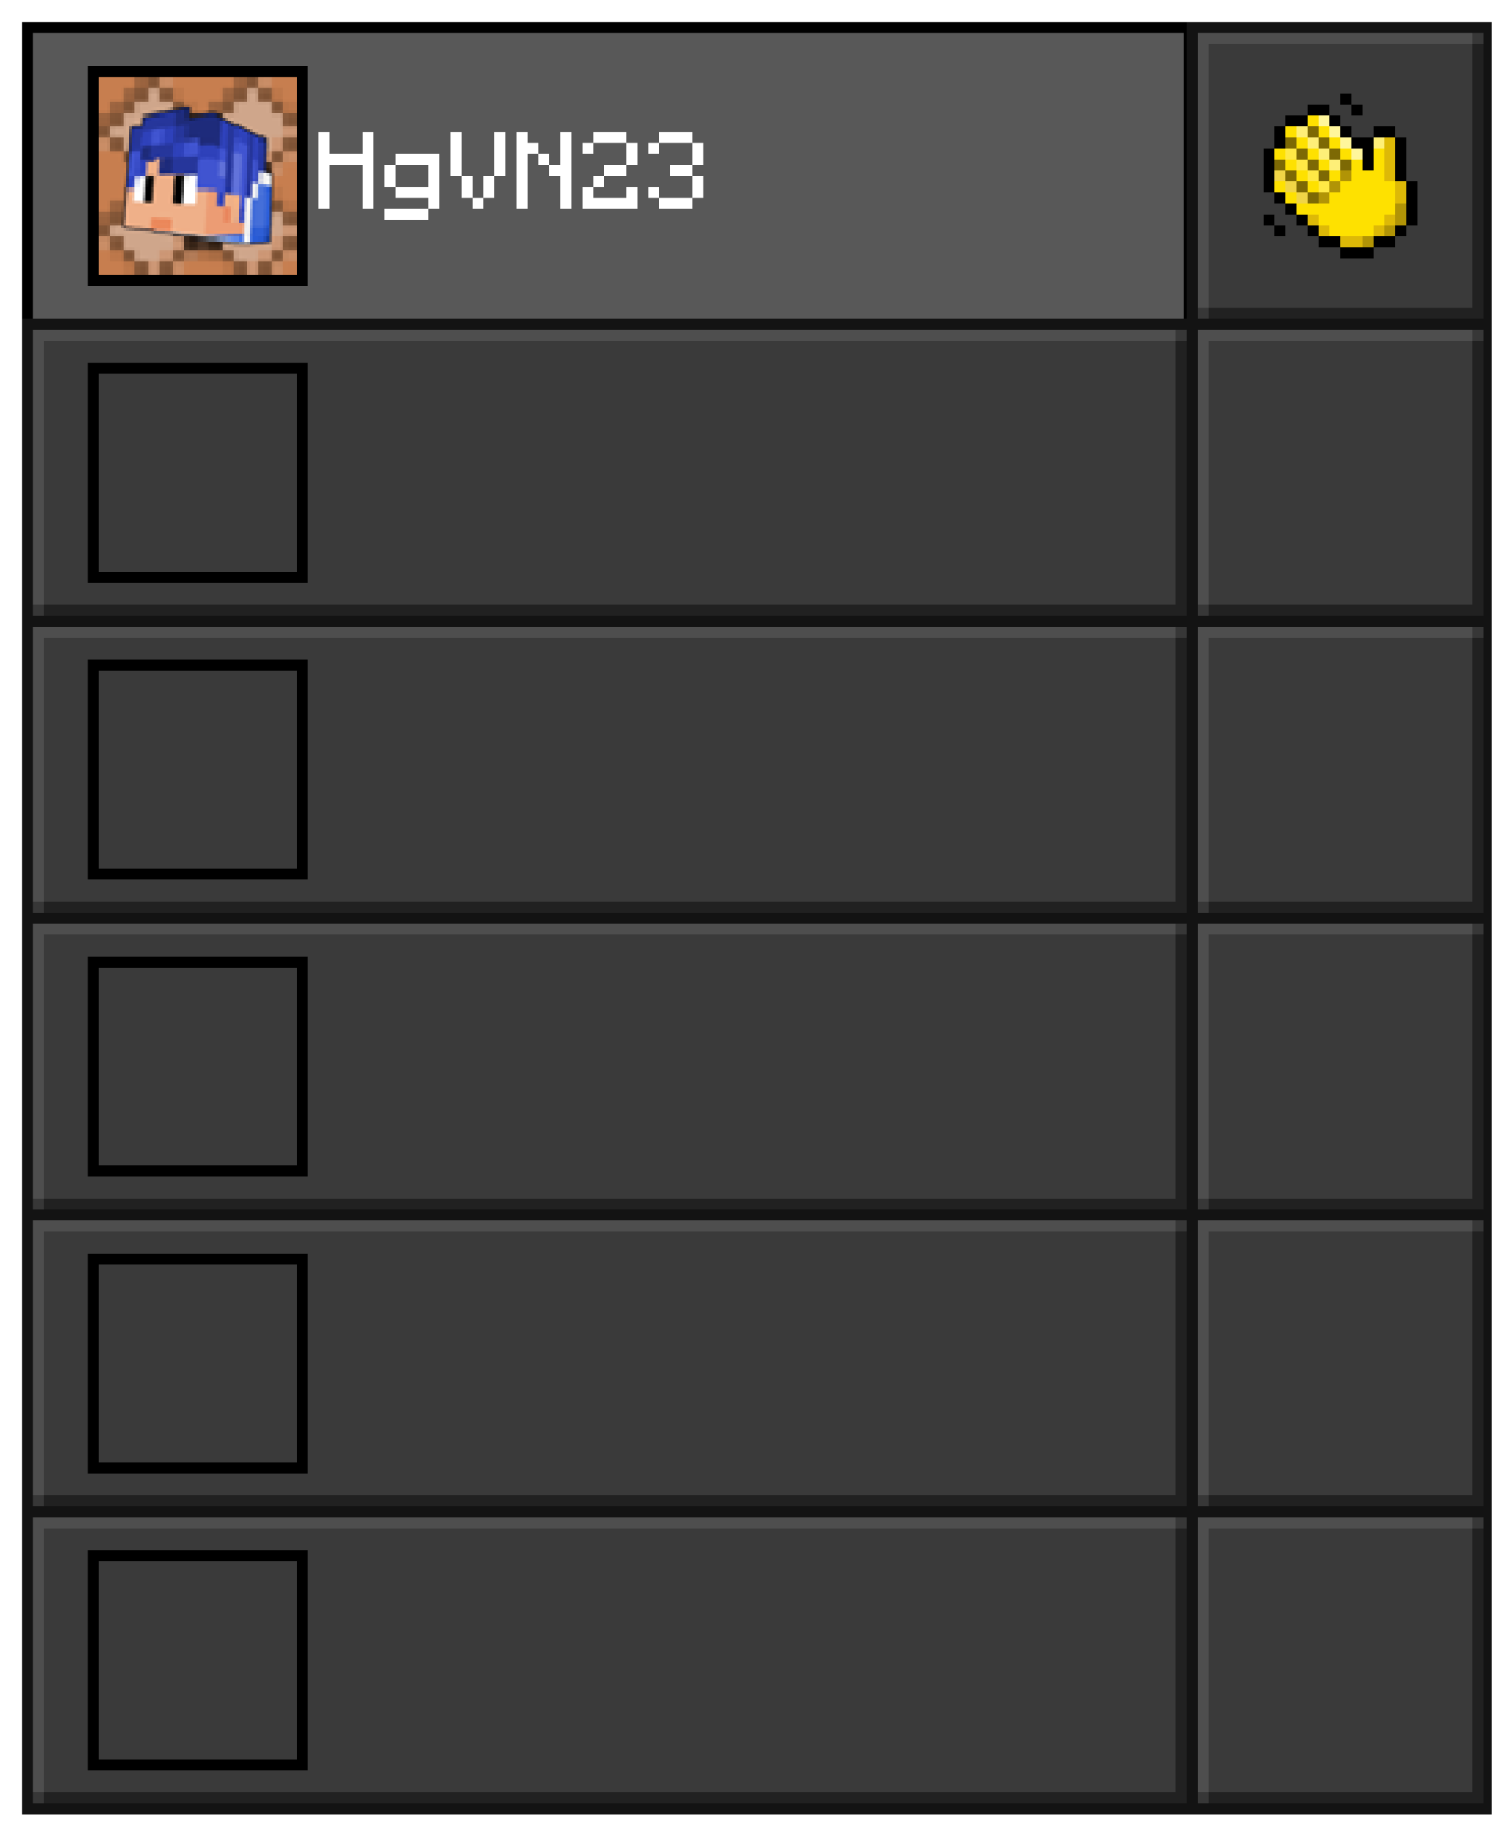
/list
Notes:
/?

Slide 30
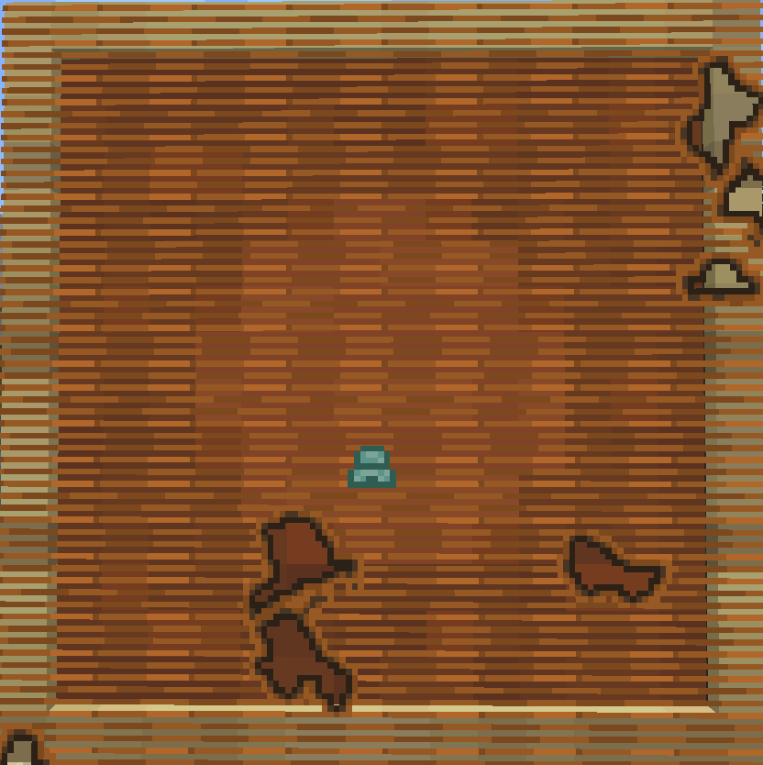
/locate
Notes:
/?

Slide 31


/loot
Notes:
/?

Slide 32

HI
/me
Notes:
/?

Slide 33

/mobevent
Notes:
/?

Slide 34
HI
Hm?
Sup
/msg
Notes:
/?

Slide 35


/music
Notes:
/?

Slide 36

/op
Notes:
/?

Slide 37


/particle
Notes:
/?

Slide 38

/playanimation
Notes:
/?

Slide 39






/playsound
Notes:
/?

Slide 40

/kill
/setblock
/summon
/fill
/reload
Notes:
/?

Slide 41
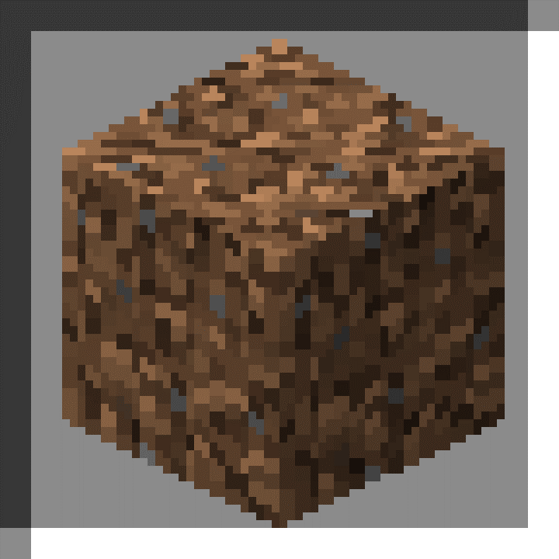
/replaceitem
Notes:
/?

Slide 42
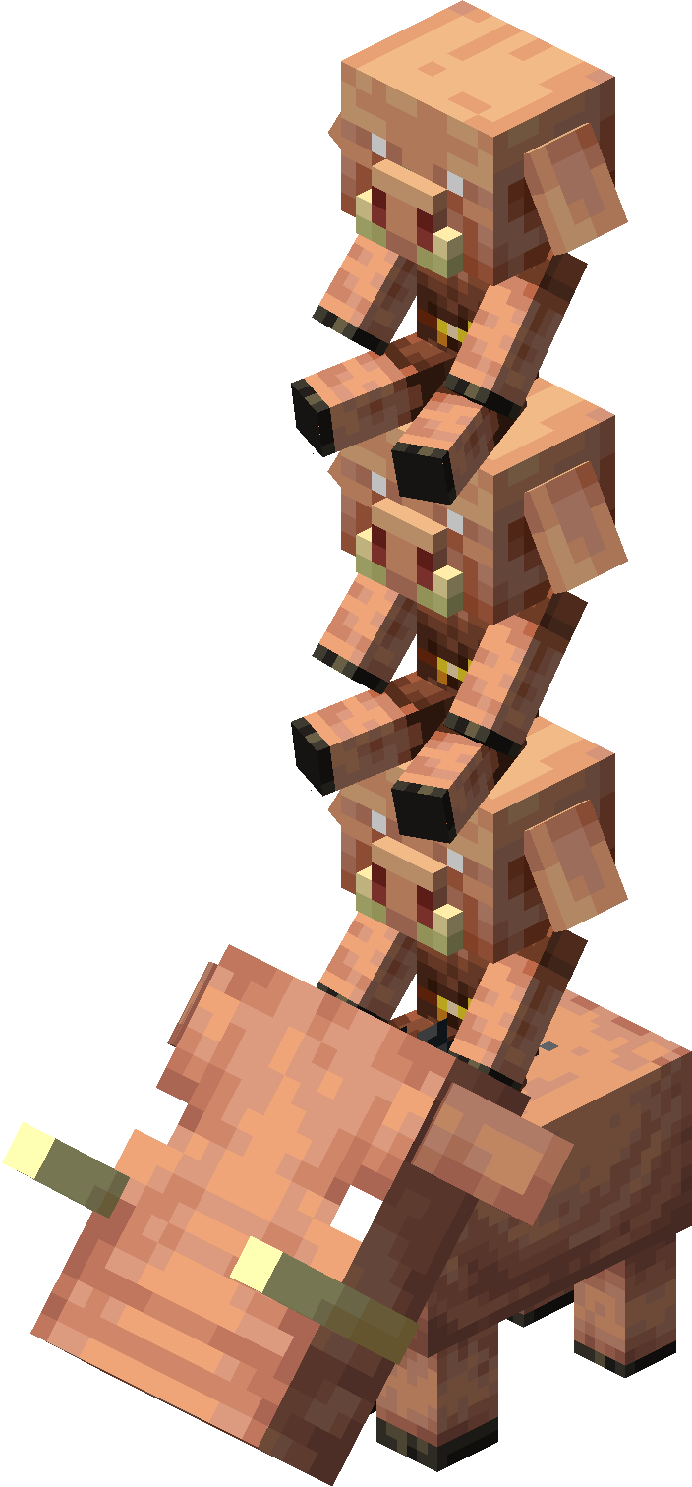
/ride
Notes:
/?

Slide 43
???
/say
Notes:
/?

Slide 44
/kill
/setblock
/summon
/fill
/schedule
Notes:
/?

Slide 45

/scoreboard
Notes:
/?

Slide 46
/script
Notes:
/?

Slide 47
/setblock
Notes:
/?

Slide 48
2/2
/setmaxplayers
Notes:
/?

Slide 49


/setworldspawn
Notes:
/?

Slide 50

/spawnpoint
Notes:
/?

Slide 51

/spreadplayers
Notes:
/?

Slide 52

/stopsound
Notes:
/?

Slide 53
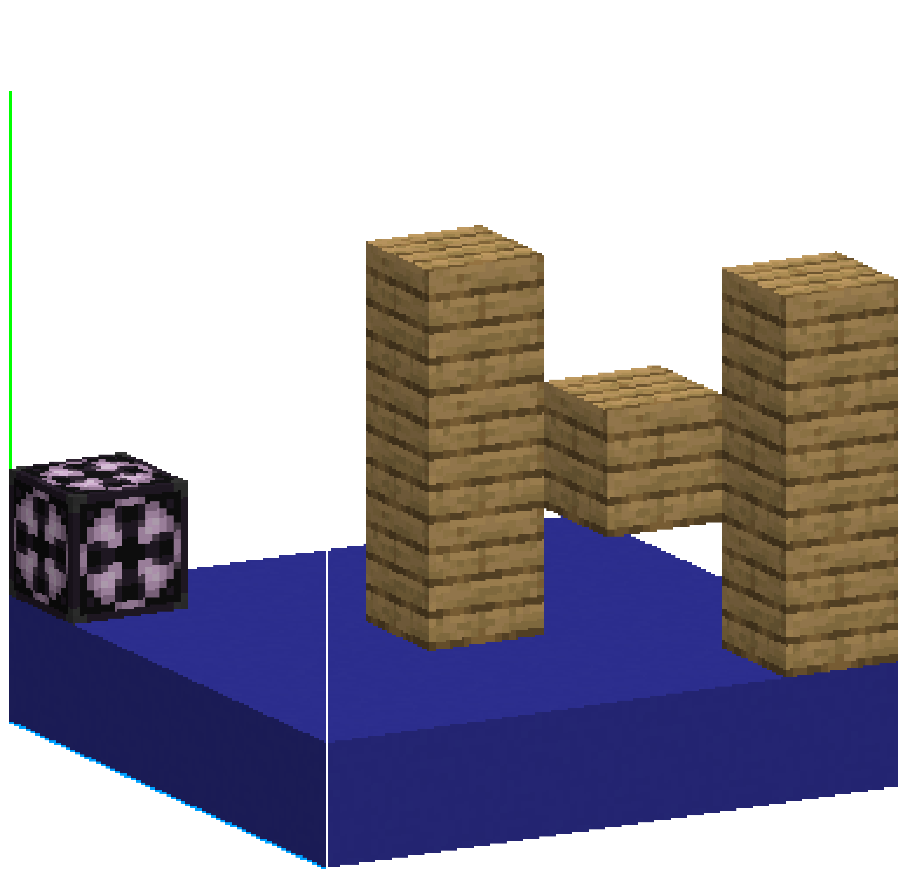
/structure
Notes:
/?

Slide 54
/summon
Notes:
/?

Slide 55
a
b
/tag
Notes:
/?

Slide 56
/teleport
Notes:
/?

Slide 57
HI
Hm?
Sup
/tell
Notes:
/?

Slide 58
???
/tellraw
Notes:
/?

Slide 59


/testfor
Notes:
/?

Slide 60
/testforblock
Notes:
/?

Slide 61
/testforblocks
Notes:
/?

Slide 62


/tickingarea
Notes:
/?

Slide 63





/time
Notes:
/?

Slide 64
???
/title
Notes:
/?

Slide 65
???
/titleraw
Notes:
/?

Slide 66

/toggledownfall
Notes:
/?

Slide 67
/tp
Notes:
/?

Slide 68
/volumearea
Notes:
/?

Slide 69
HI
Hm?
Sup
/w
Notes:
/?

Slide 70
/wb
Notes:
/?

Slide 71


/weather
Notes:
/?

Slide 72
/worldbuilder
Notes:
/?

Slide 73
/wsserver
Notes:
/?

Slide 74

/xp
Notes:
/?

Slide 75
/
Notes:
/?

Slide 76

Target
Notes:
/?

Slide 77
Animation Id
Notes:
/?

Slide 78
Block state Id
Notes:
/?

Slide 79
Component Id
Notes:
/?

Slide 80
Damage Id
Notes:
/?

Slide 81
Effect Id
Notes:
/?

Slide 82
Enchantment Id
Notes:
/?

Slide 83
Event Id
Notes:
/?

Slide 84
Fog Id
Notes:
/?

Slide 85
Gamerule Id
Notes:
/?

Slide 86
Loot Id
Notes:
/?

Slide 87
Particle Id
Notes:
/?

Slide 88
Raw message Id
Notes:
/?

Slide 89
Sound Id
Notes:
/?

Slide 90
Track Id
Notes:
/?

Slide 91
Id
Notes:
/?

Slide 92
! ~ ^ §
Toán tử kí tự

Slide 93
/command
Cấu trúc Command

Slide 94
Command Block

Slide 95
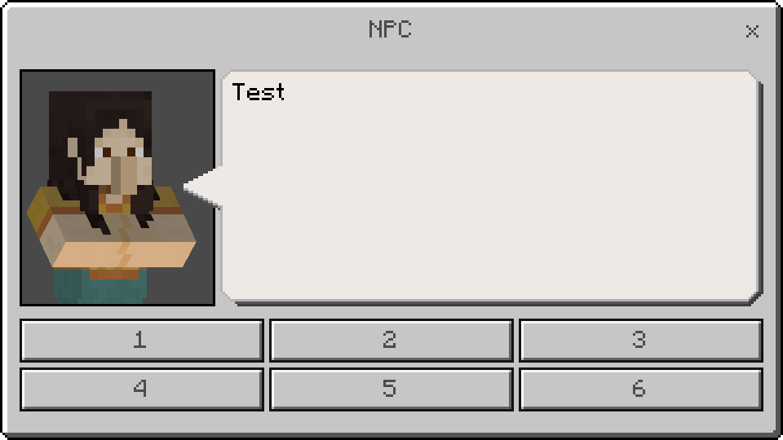
NPC

Slide 96
29e3c5d3-e87f-457a-7d3b-8b7a8eb855f4
Tạo UUID v4

Slide 97
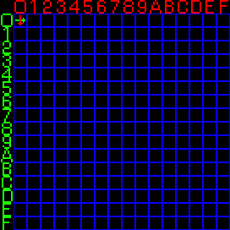
Tra kí tự trong Glyph

Slide 98
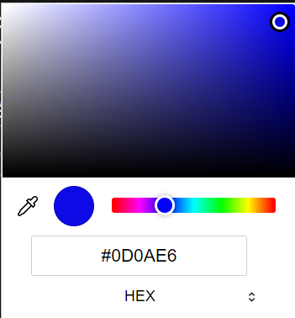

Hex -> Dec Color Code

Slide 99
Tạo dialogue.json

Slide 100

Easter Egg

Slide 101
Hg

Slide 102

404 Error

