Slide 1
WP5 – meeting
23 September 2025
Ariel Oleksiak, Marcin Adamski, Franciszek Sidorski, Tomasz Ciesielczyk
PSNC

Slide 2
WP5 – agenda
  WP5 work plan, status
    T5.1 - status
      „InterConnect DSO interface + Intoduction to the Knowledge Engine” (presentation by Youssef)
      Knowledge Engine in Enea Operator pilot
    T5.2 - status
    T5.3 – status
      „Provision of Flexibility Trade-off Services and Frameworks” (presentation by Franek)

Slide 3
WP5 - Timing & Efforts
 | Leader | 1 | 2 | 3 | 4 | 5 | 6 | 7 | 8 | 9 | 10 | 11 | 12 | 13 | 14 | 15 | 16 | 17 | 18 | 19 | 20 | 21 | 22 | 23 | 24 | 25 | 26 | 27 | 28 | 29 | 30 | 31 | 32 | 33 | 34 | 35 | 36
T5.1 – Implementation of standardized flexibility frameworks and interfaces | Inetum
T5.2 – Standardization of proprietary flexibility frameworks and interfaces and comparative analysis | EK
T5.3 – BlueBird Flexibility Trading module | PSNC
D5.1
D5.2
Partner | Effort (MM)
Inetum | 12
CIMNE | 9
UPC | 0
WeSmart | 4
imec | 5
PSNC | 17
Partner | Effort (MM)
SEEBG | 0
Karno | 4
ENEA | 4
DTU | 10
AMB | 3
AIT | 0
Partner | Effort (MM)
USTUTT | 0
TERSA | 3
BPIE | 0
ENK | 7
EWH | 4

Slide 4
WP5 – Work Plan - T5.1
Name: implementation of standardized flexibility frameworks and interfaces.
functionality described in the proposal:
  Create or use/implement the interface to energy markets (for pilots that do not yet have a connection to energy markets?)
    DSO Standard Interface (from Interconnect),
    USEF,
    Interflex
    Web scraping -> in same cases
Leader: Inetum
  Participants: CIMNE, WeSmart, PSNC, Karno Energy, ENEA, AMB, TERSA, EK, EWH

Slide 5
InterConnect DSO interface + Intoduction to the Knowledge Engine
Youssef Dahman
Inetum - BE

Slide 6
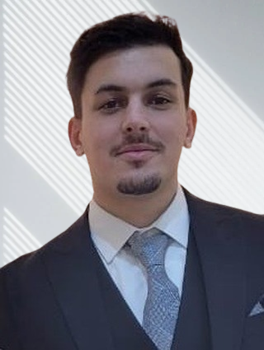
Short self-Introduction – Youssef Dahman
I’m 28 years old
Software Developer at Inetum Belgium since 2021
Major Projects:
  InterConnect (2 years): Contributed to an EU-funded smart energy pilot in Greece. Developed microservices for IoT-based peak shaving, demand response, and load forecasting. Led partner collaboration, AKS deployment, and end-to-end testing across partner integrations.
  CV comparator: Designed and deployed an AI-driven platform that analyzes CVs against job requirements, providing recruiters with compatibility scores and skill gap insights.
  Employee Assignment Review: Digitized annual performance reviews by building a secure, multilingual web application with Keycloak authentication, Angular frontend, and automated evaluation workflows.

Slide 7
Short Introduction of InterConnect – Greek pilot
Core Mission: Create seamless interoperability between energy grid operators, smart home devices, and residential consumers to optimize demand response and energy efficiency.
Reactive DR: An immediate emergency response system that kicks in when the electrical grid is currently experiencing problems ( Too much demand ). They have direct control on devices based on preset prefrences made by the end user for a certain time using our demand response solution.
Proactive DR: A predictive planning system that prevents grid problems before they occur by recommending tomorrow's energy actions to users. The DSO asks for a forecast of power consumption for a certain region or district and based on that forecast they define when it more profitable for the user to use their devices.

Slide 8
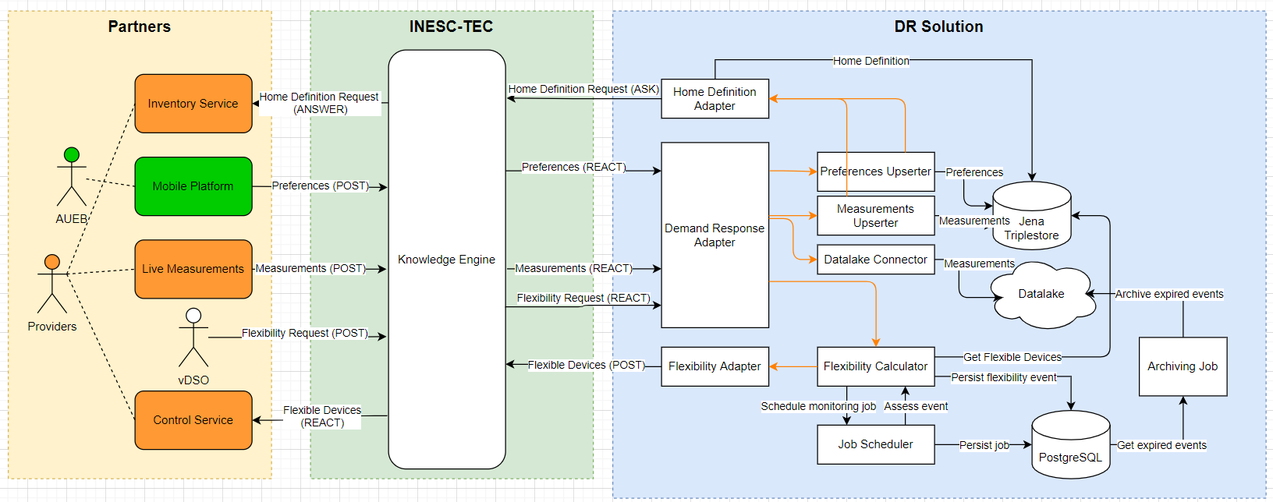
InterConnect DSO interface

Slide 9
What is Knowledge Engine?
The knowledge engine is a platform through which services can communicate with each other. The way they do this is special; clients don't specify who they want their requests to be sent to. They only specify the "shape" (interface) of the data they can send or receive to the knowledge engine, and the platform calculates who the request should be sent to.
The way the interface is provided is in the RDF format (sort of like XML). This format has to fit within an "ontology" that is provided to the knowledge engine. SAREF is the ontology that was developed in Interconnect
This way, all services that connect with knowledge engine are speaking the same "language".
This makes a few points possible:
- Knowledge engine can automatically identify and make links between services without any additional work.
- Easy onboarding for new stakeholders, they just need to translate their data to the ontology and connect their service to knowledge engine.

Slide 10
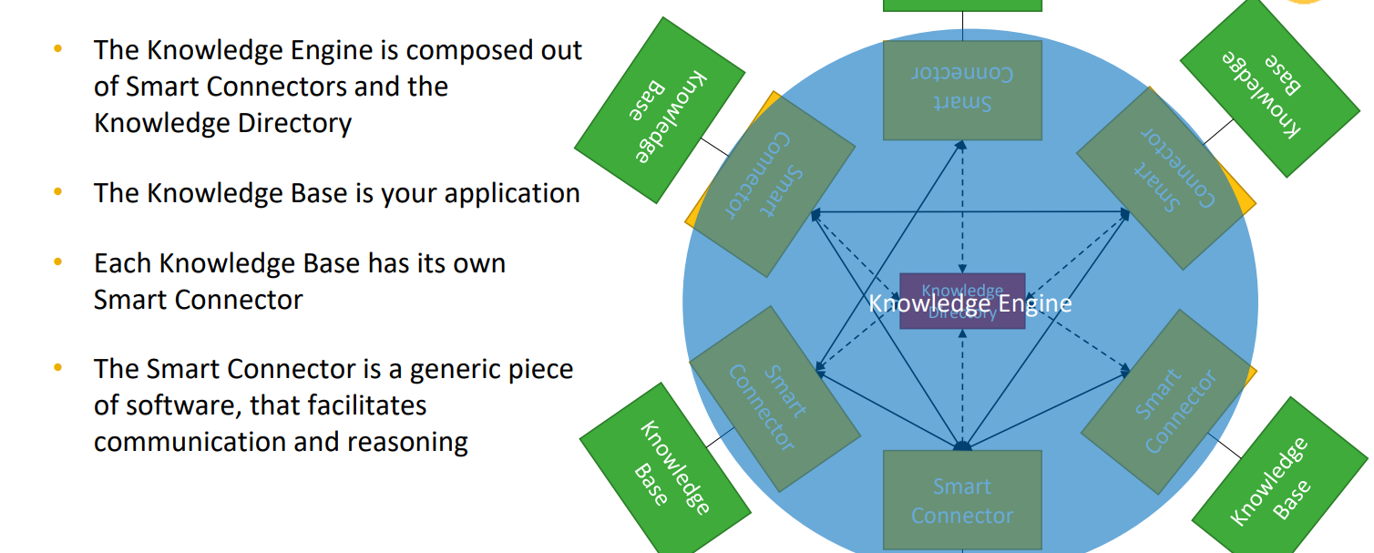
Knowledge Engine introduction

Slide 11
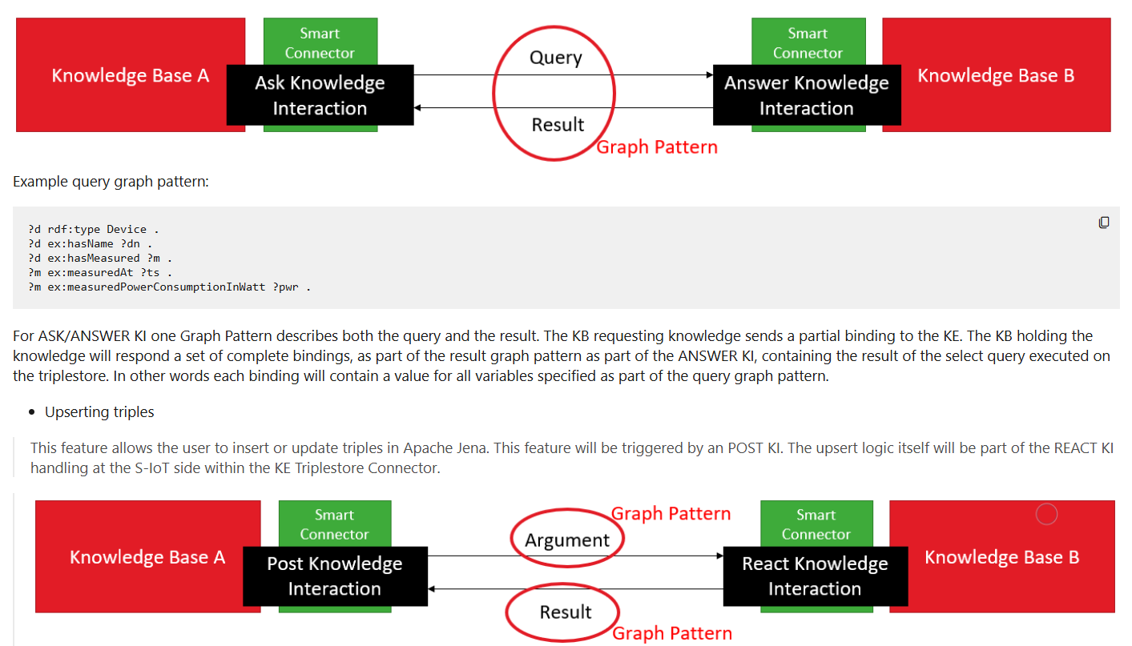
Knowledge Engine interactions
The Knowledge Engine supports 4 types of interaction:
  Ask: Request knowledge
  Answer: Provide results
  Post: Insert or update data
  React: Respond to changes

Slide 12
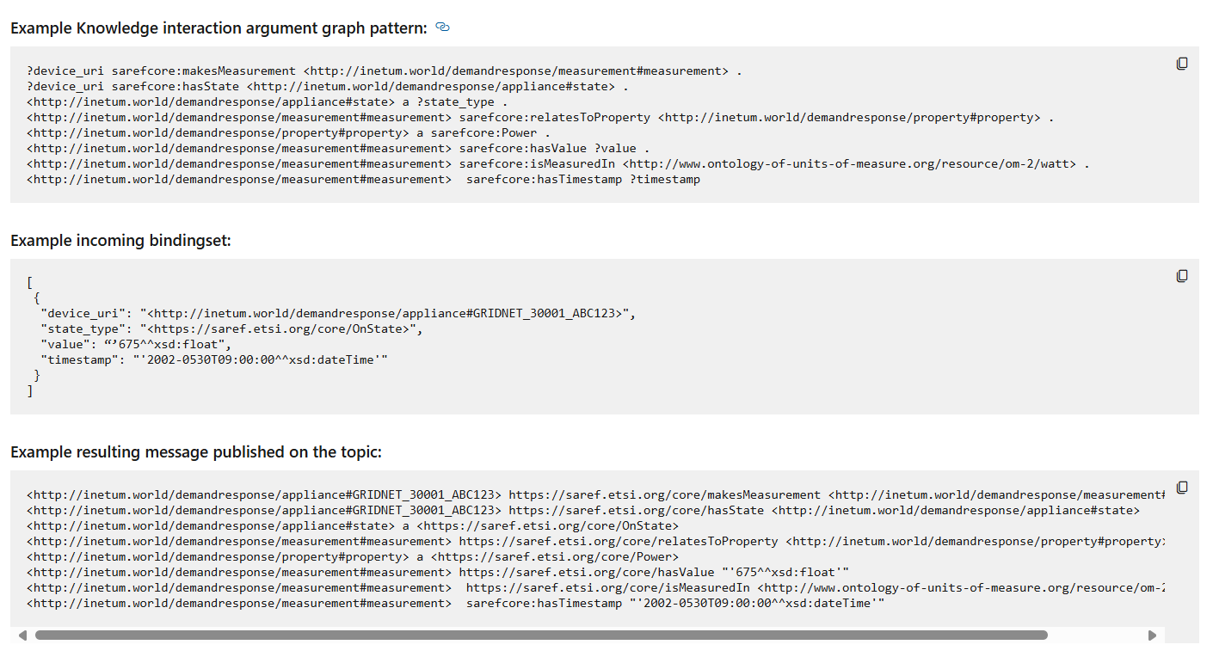
RDF Graph pattern & SAREF Ontology
The example illustrates how IoT devices are linked to SAREF classes using RDF, enabling interoperability across platforms and standardized data exchange.

Slide 13
Thank you!

Slide 14

Knowledge Engine in ENEA Operator pilot
BlueBird
KE register
KE register
Knowledge Engine interface (python)
Trading Manager (TM)
Flexibility evaluation
Knowledge Engine interface (python)
Capacity market
REACT – read flexibility offers,
POST – publish market demand
POST – power baseline , available flexibility , flexibility offer
REACT – subscribe to capacity market (waiting for requests)
Market API
Knowledge Engine (KE)
KE REST
TM REST
KE REST
Flexibility
Power Demand
Negotiation
ENEA Grid Server
ENEA Grid facility 1
ENEA Grid facility …
ENEA Grid facility n

Slide 15
WP5 – Work Plan - T5.2
Name: standardization of proprietary flexibility frameworks and interfaces and comparative analysis
functionality described in the proposal:
  the standardization of existing flexibility frameworks and communication interfaces based on the BlueBird data model (for pilots which already have connection to energy market?),
  compare analysis between frameworks (also to delivered by T5.1).
Leader: EK
Participants: CIMNE, imec, PSNC

Slide 16
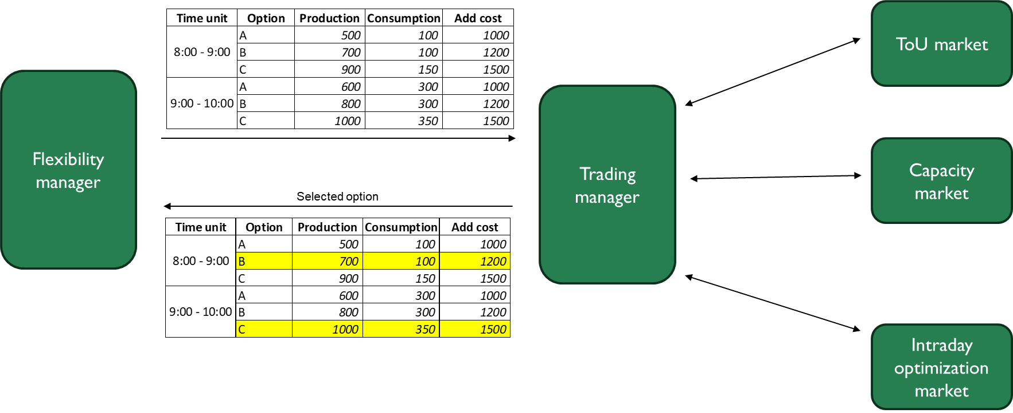
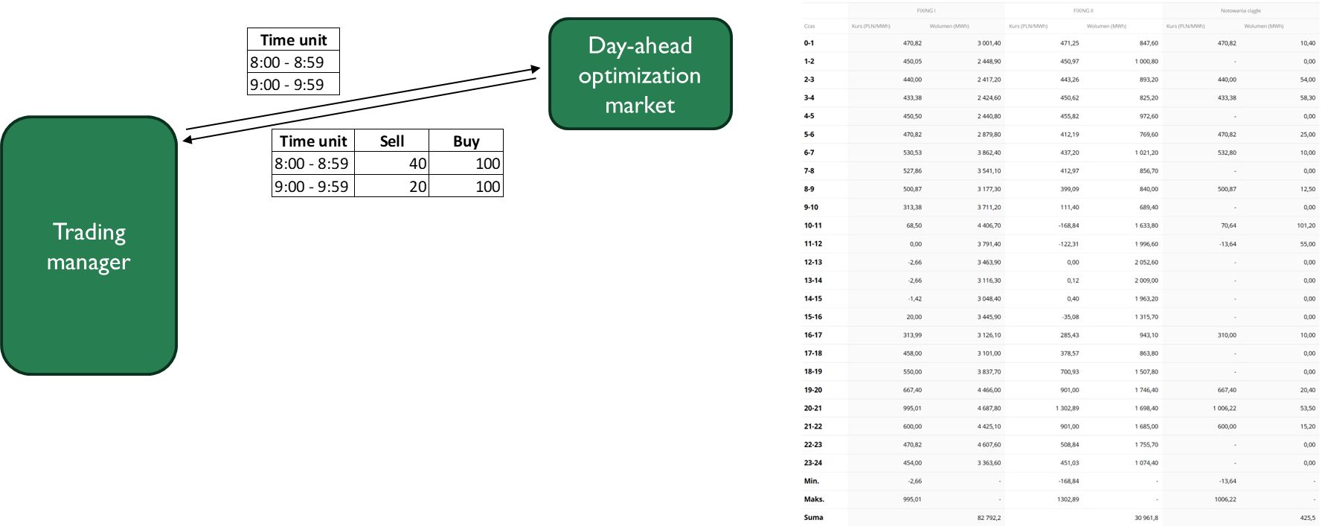
WP5 – Work Plan - T5.3
Name: Trading module
functionality described in the proposal:
  the negotiation capabilities between the UBFlex Interface and the towards-the-grid flexibility
Leader: PSNC
Participants: Inetum, DTU
Current works:
  next concepts of communication between TM and FM
  Using Knowladge Engine in Enea pilot (how to connect to TM)
  Provision of Flexibility Trade-off Services and Frameworks

Slide 17
WP5 – first proposition
T.5.1
for pilots that do not yet have a connection to energy markets
T.5.3
ToU market
Flexibility manager
Trading manager
Capacity market
Selected option
Intraday optimization market
T.5.2
for pilots which already have a connection to energy markets

Slide 18
WP5 – next proposition
T.5.1
for pilots that do not yet have a connection to energy markets
T.5.3
ToU market
Time unit | Option | Production | Consumption | Add cost
8:00-9:00 | min | 500 | 100 | cost_function
 | max | 900 | 150
9:00-10:00 | min | 600 | 100 | cost_function
 | max | 900 | 200
10:00-11:00 | min | 700 | 100 | cost_function
 | max | 900 | 300
Flexibility manager
Trading manager
Capacity market
Selected option
Time unit | Option | Production | Consumption | Add cost
8:00-9:00 |  | 500 | 100 | 300
9:00-10:00 |  | 900 | 200 | 400
10:00-11:00 |  | 900 | 100 | 500
Intraday optimization market
T.5.2
for pilots which already have a connection to energy markets

Slide 19
WP5 – third proposition
T.5.1
for pilots that do not yet have a connection to energy markets
T.5.3
ToU market
Time unit | Production | Consumption | Add cost
8:00-16:00 | production function | consumption function | additional cost function
Flexibility manager
Trading manager
(quantization
proccess depends on market)
Capacity market
Selected option
Time unit | Production | Consumption | Add cost
8:00-9:00 | 500 | 100 | 300
9:00-10:00 | 900 | 200 | 400
10:00-11:00 | 900 | 100 | 500
11:00-12:00 | 500 | 100 | 300
12:00-13:00 | 900 | 200 | 400
13:00-14:00 | 900 | 100 | 500
14:00-15:00 | 500 | 100 | 300
15:00-16:00 | 900 | 200 | 400
Intraday optimization market
T.5.2
for pilots which already have a connection to energy markets

Slide 20
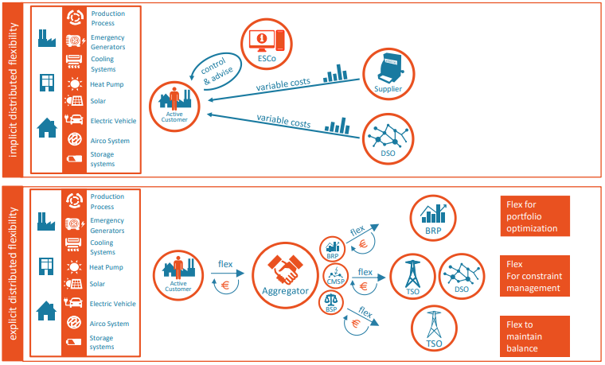
Explicit vs implicit distribution flexibility
Source: https://www.usef.energy/app/uploads/2021/05/USEF-The-Framework-Explained-update-2021.pdf
WP5 Meeting, 23.09.2025​

Slide 21
Markets indicated by pilots for trading manager - summary
Implicit distribution flexibility
  ToU optimization
    AMB
    WeSmart (with test of Interconnect DSO interface)
    EWH
WP5 Meeting, 23.09.2025​

Slide 22
Markets indicated by pilots for trading manager - summary
Explicit distribution flexibility
  Day-ahead optimization
    WeSmart
    ENK Enlion
  Intraday optimization
    AMB (2 intraday markets)
    ENK Enlion
  Grid capacity management
    AMB
    Enea Operator Grid
WP5 Meeting, 23.09.2025​

Slide 23
Thank you!
Any questions?

