Slide 1
Home Energy Management in the context of consumer-centric power systems:
Data-efficient and explainable control algorithms to exploit energy flexibility
Chris Develder, et al.
AI4E Team, IDLab, Ghent University – imec

Slide 2
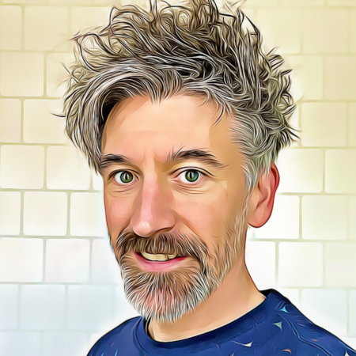
Self-Introduction – Chris Develder^{[1]}
Professor at UGent since Oct. 2007
    Research Interests:
    - AI4E Team: Artificial intelligence for energy applications^{[2]}: data analysis & machine learning for the energy transition
    - T2K Team: Natural language processing (NLP)^{[3]}: information extraction (IE), conversational agents, etc.
    - Past: track record in dimensioning and optimizing optical networks
    Visiting researcher at UC Davis, CA, USA, Jul-Oct. 2007 (optical networks)
    Visiting researcher at Columbia Univ., NY, USA, 2013-15 (IE & information retrieval)
Industry Experience: Network planning/design tools
    Former OPNET Technologies, 2004-2005
PhD in optical networking, UGent, 1999-2003
  [1] http://users.ugent.be/~cdvelder/
  [2] https://ugentai4e.github.io/
  [3] https://ugentt2k.github.io/

Slide 3
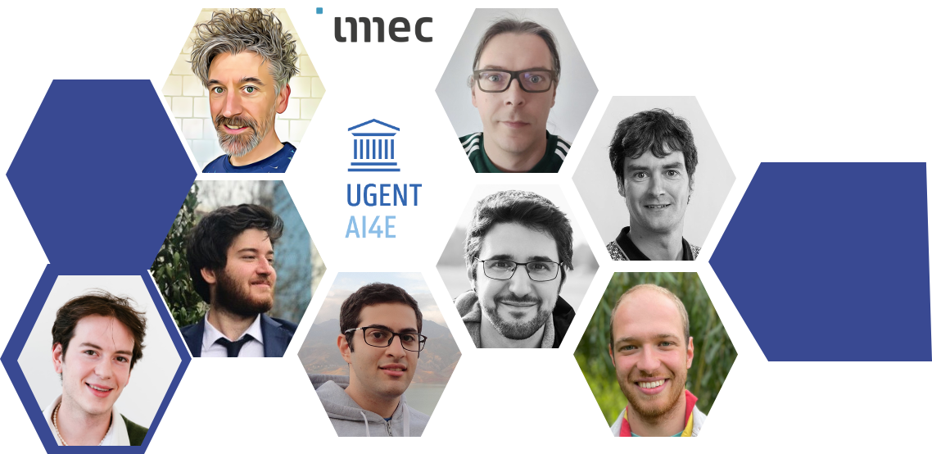
The AI4E team at IDLab, Ghent University
https://ugentai4e.github.io/

Slide 4
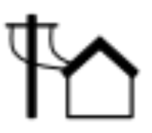

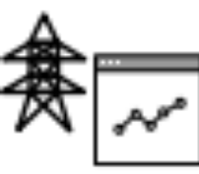
RESEARCH TRACKS
Data-driven decision making for . . .
Home Energy Management (HEM)
  Value stacking (capacity tariff / dynamic pricing / ...)
  Heterogeneous households (Heat pump / EV / Home battery / Thermal Storage)
Real/short-time (24h down to 1s) flexibility optimization
  Multi-market day-ahead and real-time trading in energy and flexibility markets (EU/UK)
  Multi-asset flexibility coordination, focusing on residential flexibility
Support tools for power system operators
  Decision support for consumer-centric market vision
  (Imbalance forecasting; RTP price calculations; digital twins …)
  State estimation and forecasting (DSO/TSO)

Slide 5
TECHNOLOGY
Creating scalable / practical / intuitive / performant AI that is . . .
fit-for-purpose (provide a solution, not a method)
a holistic solution, not just an optimizer (incl. technical/regulatory/legal/... constraints)
Focusing on
Neural network architectures, e.g.:
  Physics-informed neural networks and transfer learning: obtain practical and intuitive (explainable) solutions
  Graph Neural Networks (natural fit with power systems): trading / grid solutions / agent interactions
  Architectures that can handle long time series (e.g., transformers)
Data-driven decision making
  Blending rule-based (apprentice learning) / model-based (MPC) / model-free (Reinforcement Learning)
  Transfer learning and multi-agent decision making

Slide 6
Thank you!
Any questions?
chris.develder@ugent.be
http://users.ugent.be/~cdvelder

