Slide 1
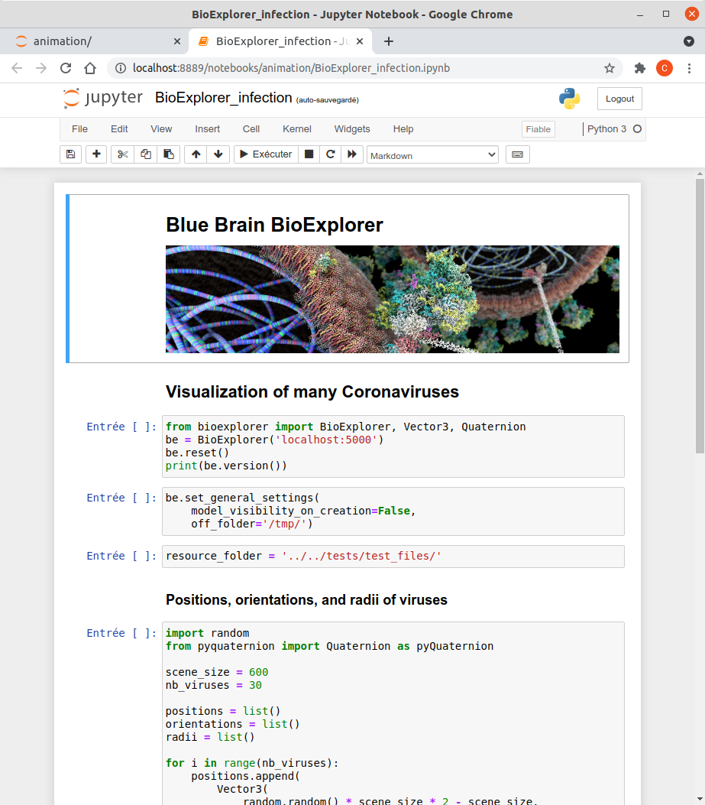
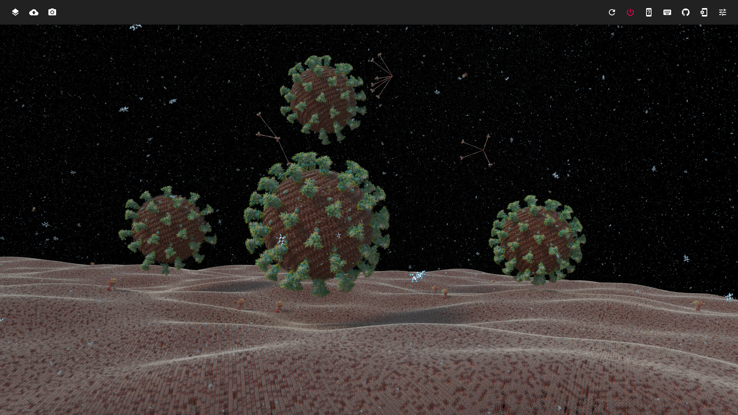
Python SDK
User Interface
BioExplorer
Sonata
Explorer
BlackHole
...
Scientific plug-ins
Core
Platform + technical plugins
PostgreSQL
Database
OSPRay
OptiX
Rendering engines
Sonata
File

