Slide 1
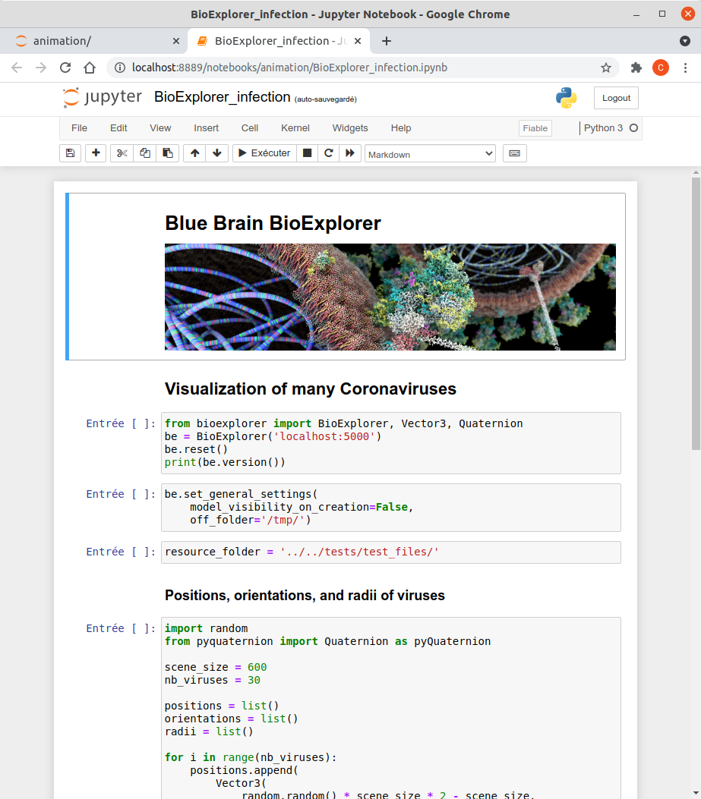
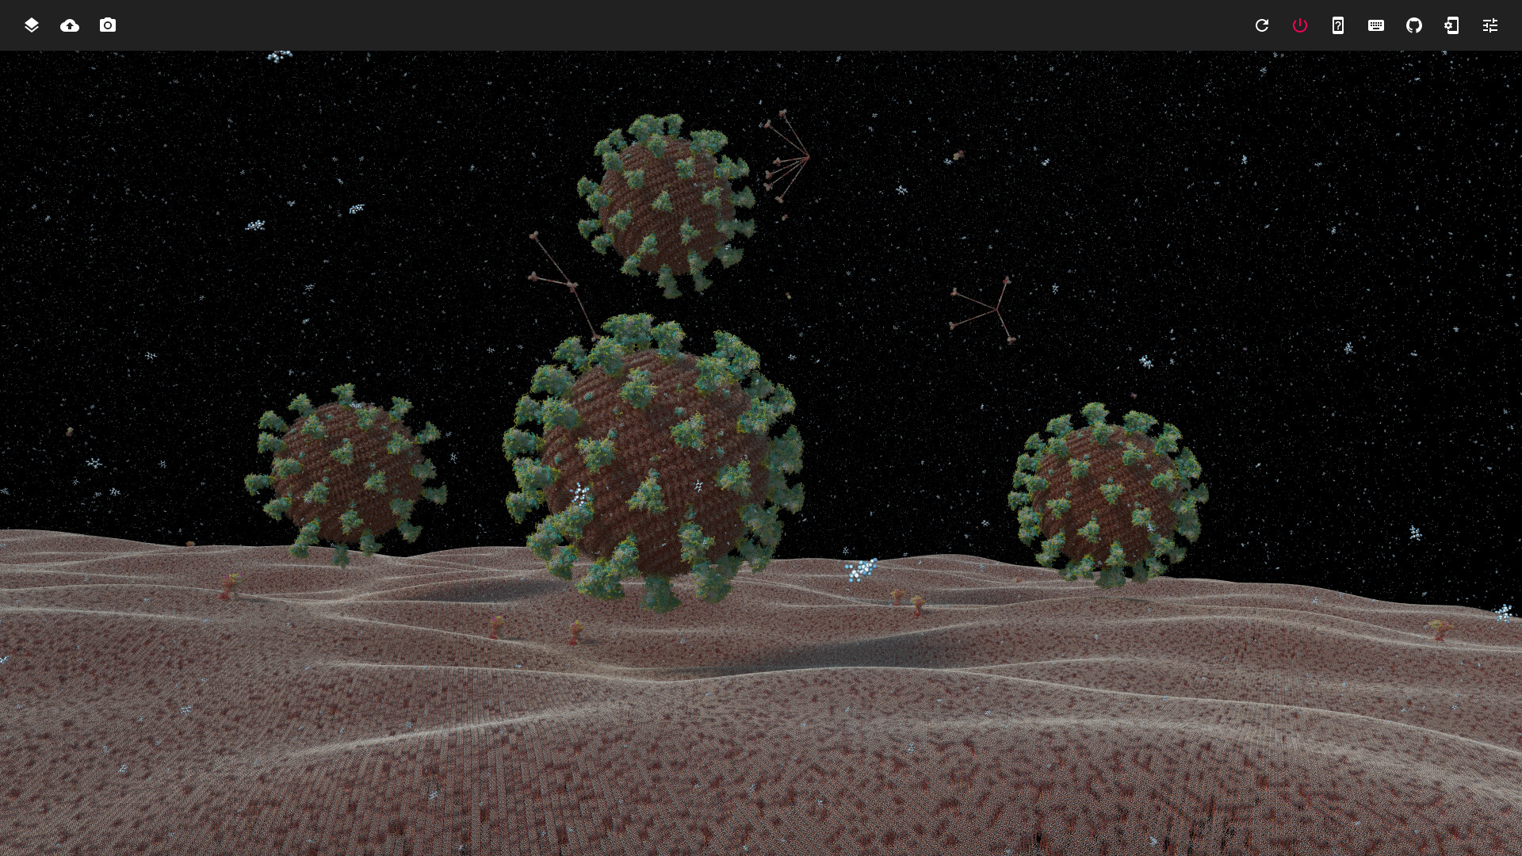
Python SDK
User Interface
API
Plugin
Core
Rendering Engine
DB

