Slide 1
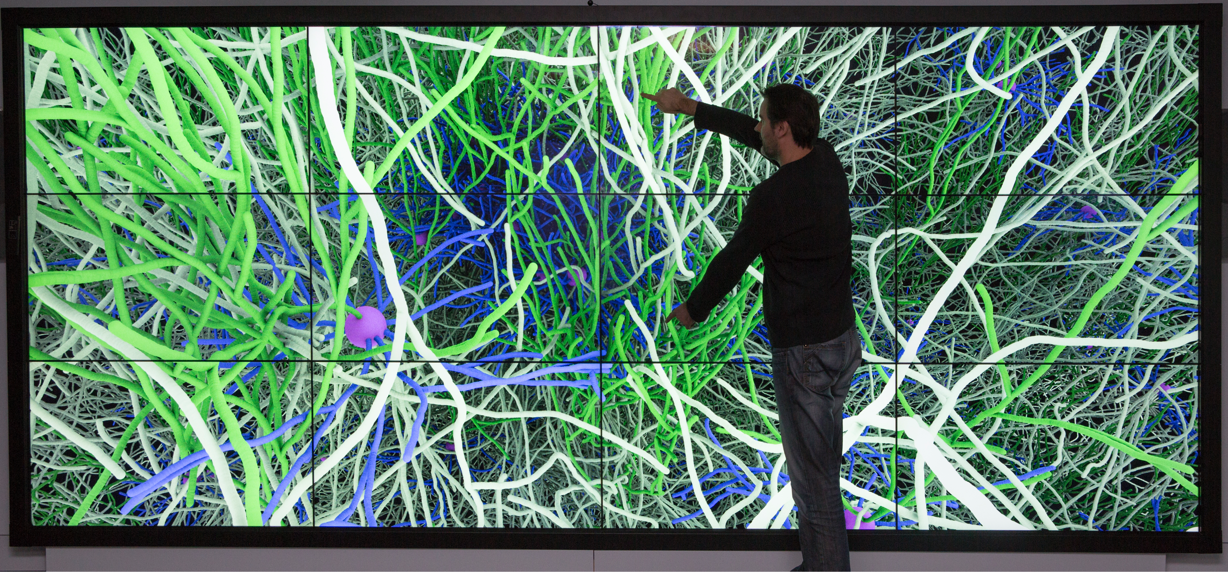
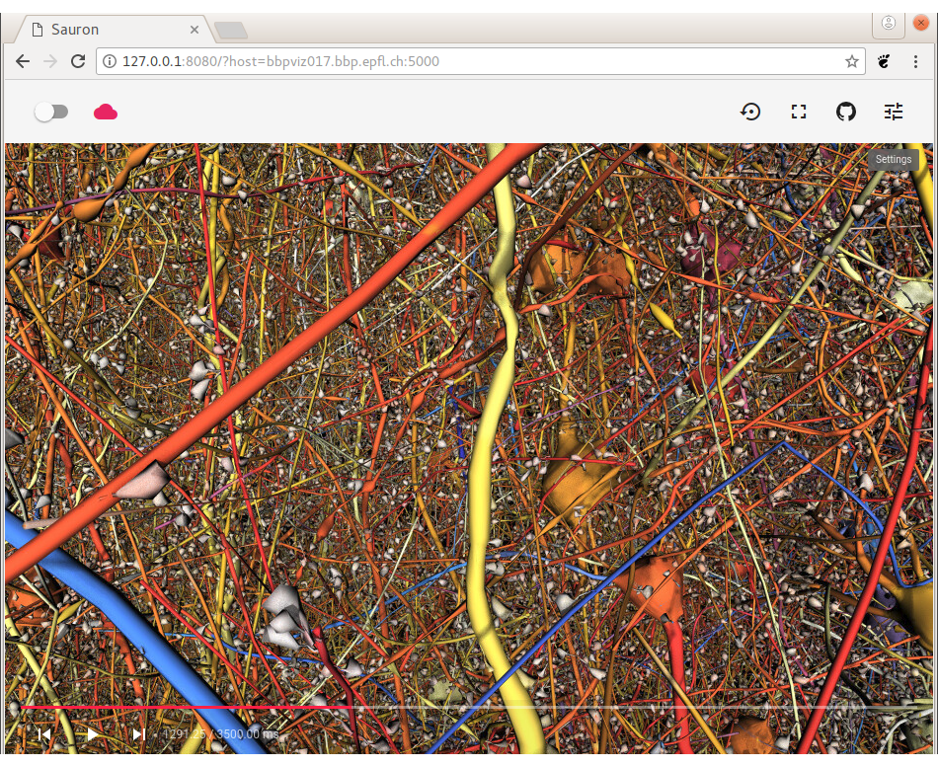
Brion
Brayns
Rockets
Deflect
Tide
OSPRay
Sauron
Use-case
Plug-ins
Rendering
modules

