Slide 1
Interactive NEST
Blue Brain Project
Visualization Team

Slide 2
Why Interactive Supercomputing?
Visualize large circuit activity without dumping the data
  Spike activity on neurons
  Spike densities in space
  Local Field Potential
Connect to running static MPI simulation jobs anytime, anywhere
Modify running simulations and understand the consequences
  Inject stimuli
  Modify circuit

Slide 3
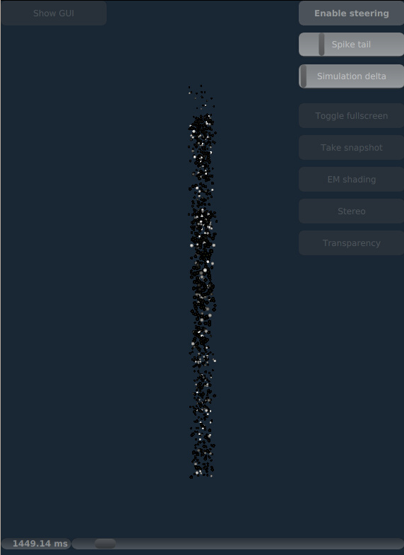
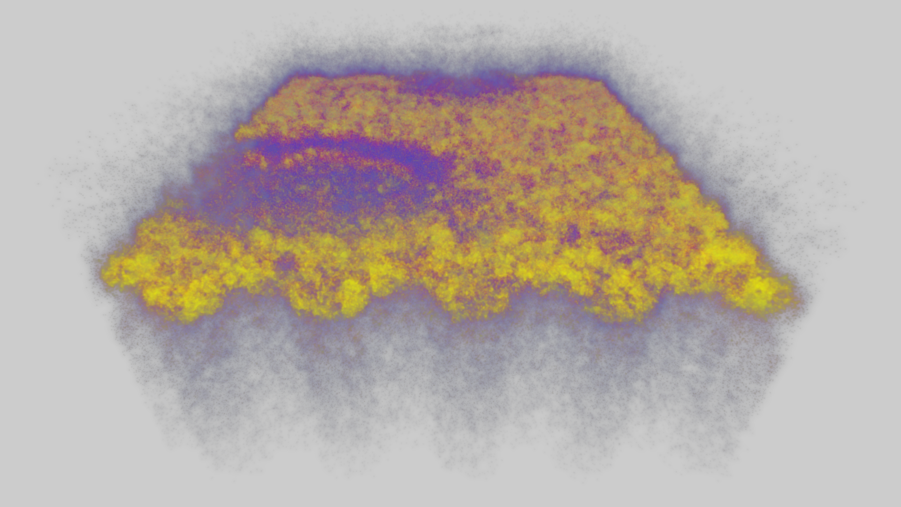
Visualization modalities of spike activity
3.1M neurons, spike density visualization with Livre
1000 neurons, spiking activity visualization with RTNeuron

Slide 4
How did we do all of this?
Static Music Proxy Process communicates to NEST using MPI
Many dynamic consumers using ZeroEQ
Spike streaming and Simulation steering

Slide 5
Software Components
NEST (C++ Application with python interface):
  Large-scale neural network simulator that can be run on distributed computing environments
MUSIC (C++ Application & Library):
  Well-known data exchange library for neural simulators such as NEST, Neuron and Moose
  Can connect large scale neural neural networks
  Has an easy interface for coupling applications with the simulators

Slide 6
Software Components (In-house)
ZeroEQ (C++ library):
  Library for type-safe (FlatBuffers), event based network communication (ZeroMQ) with peer auto-discovery (zeroconf)
Brion (C++ library):
  Low level IO interfaces and plugin mechanism for accessing BBP data
ISC (C++ library & python scripts):
  Brion::SpikeReport streaming plugin implementation
  Construct loosely coupled simulation-observer/controller pairs
  NESteer python class to process steering messages

Slide 7
Software Components
MUSIC Proxy (C++ Application):
  Bridge between the static world of the simulator and dynamic world of the clients
Livre (C++ Application):
  Largescale Interactive Volume Rendering Engine
  Spike density visualization
RTNeuron (C++ Application with python interface):
  BBP mesh circuit visualization tool (not open source)
  Can connect to a running simulation to visualize circuit spike events

Slide 8
Architecture

Slide 9
Future
Full mouse brain on four-rack BlueGene/Q
  N:M Music Proxies:Visualizers
  Endian-safe testing
  Optimization
Interrupt/resume of NEST
Arbitrary information from simulation
  Current NEST does not have a message output port. (But there is a patch ! Thanks to Mikael Djurfeldt)

Slide 10
Questions?
Of course open source on github!
  Brion, ZeroEQ, Livre are open source
  ISC will follow in August

