Slide 1
Interactive NEST
Blue Brain Project
Visualization Team

Slide 2
Interactive Supercomputing
Wouldn’t it be nice if you could analyze and visualize your data as it is being generated, without having to go through a file system? - So called „Streaming“
And wouldn’t it be cool to interact with the simulation, maybe even modifying parameters while the simulation is running? - So called „Steering“

Slide 3
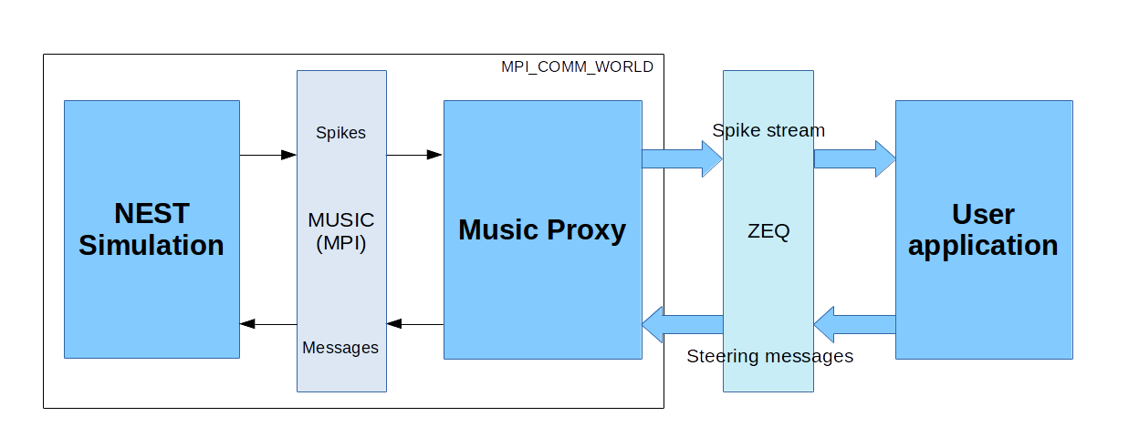
General Overview

Slide 4
Software Components
NEST (C++ Application with python interface):
  Large-scale neural network simulator that can be run on distributed computing environments.
MUSIC (C++ Application & Library):
  Well-known data exchange library for neural simulators such as NEST, Neuron and Moose.
  Can connect large scale neural neural networks and has an easy interface for coupling applications with the simulators.

Slide 5
Software Components (In-house)
ZeroEQ (C++ library):
  Library for type-safe Event Based network communication (ZeroMQ, FlatBuffers) with peer auto-discovery (zeroconf).
Brion (C++ library):
  Low level IO interfaces and plugin mechanism for accessing BBP data.
ISC (C++ library & python scripts):
  Helps users to construct loosely coupled simulation-observer/controller pairs.
  NESteer python class to process steering messages.

Slide 6
Software Components (In-house)
BBPSDK (C++ library):
  High level API for accessing BBP data using Brion.
  Includes a Python wrapping.
MUSIC Proxy (C++ Application):
  Bridge between the static world of the simulator and dynamic world of the clients.
RTNeuron (C++ Application with python interface):
  BBP circuit visualization tool.
  Has the features to connect to a running simulation and visualize spike events in the circuit.

Slide 7
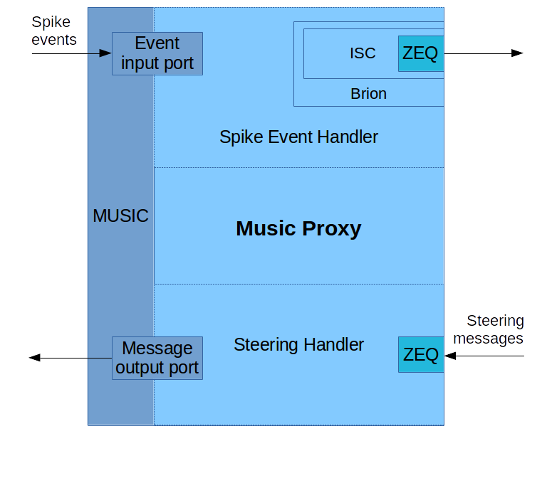
MUSIC Proxy

Slide 8
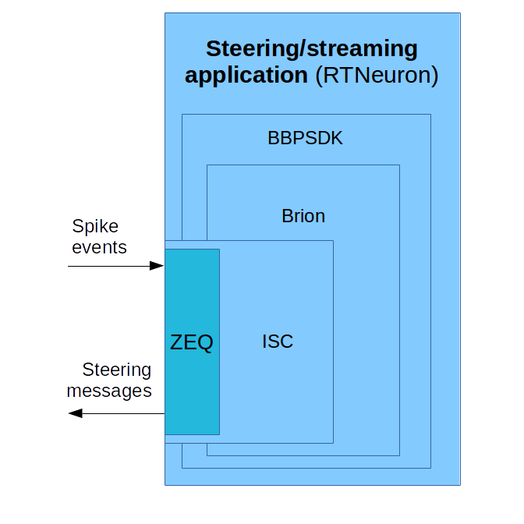
User Application

Slide 9
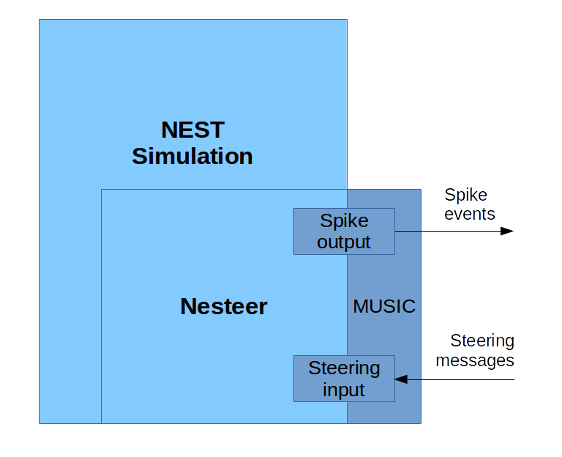
NEST Simulation
NEST Simulation

Slide 10
Open Questions
How do we interrupt and resume simulation ?
  Currently NEST is uninterruptable through the simulation time.
How do we receive arbitrary information from simulation ?
  Current NEST does not have a message output port. (But there is a patch ! Thanks to Mikael Djurfeldt)

