Slide 1
RTNeuron
Interactive tool for scalable visualization of structural and functional properties of the circuits.
Features:
  Different visual representations of neurons: soma, neuronlucida skeletons, meshes.
  Synapse visualization (TODO in python app).
  Levels of detail.
  Spike and compartement report visualization.
  Camera path creation and playback.
  Interactive color map modification.
  Movie production wth high quality anti-alias.
  Order independent transparency algorithms
  Python shell

Slide 2
Useful links
Portal page:https://bbpteam.epfl.ch/project/spaces/display/RTNRN/RTNeuron+-+Portal
Doxygen documentation of release 2.1.0:
https://bbpteam.epfl.ch/reps/common/Documentation.git/plain/RTNeuron-2.1/index.html
Python tutorial (in progress):
https://bbpteam.epfl.ch/reps/common/Documentation.git/plain/RTNeuron-2.1/python_tutorial.html
Jira page:
https://bbpteam.epfl.ch/project/issues/browse/BBPRTN

Slide 3
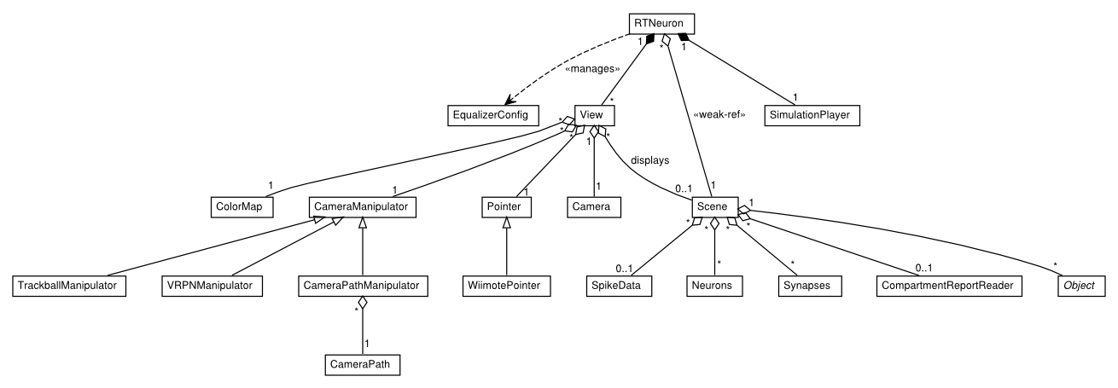
Class diagram

Slide 4
TODOs for June release
Features planned for June release yet to be implemeted
Scene handling:
  Synapses.
  Mesh models.
  Object removal.
  Distribution of scene object attribute modifications.
User interaction:
  Selections using the mouse.
  GUI (overlay?, independent with PyQt?)
Docs:
  Fix list rendering in Python docstrings.

