Slide 1

OEM EV Warranty Management System
Class: SE1815 - Group 7

Slide 2






Team Introduction
Agenda
Project Scope
System Architecture
Workflow / System Flow
Achievements
Limitations & Future Development

Slide 3
Team Introduction
Nguyen Thanh Kien
Nguyen Quang Vinh
Nguyen Khang Thinh
Full-stack Developer
Database Design & Architecture
Frontend Developer
System Function Testing
Frontend Developer

Slide 4
Project Scope
Scope Includes
Warranty Claims
Part Requests
Recall Management
Customer Feedback

Slide 5
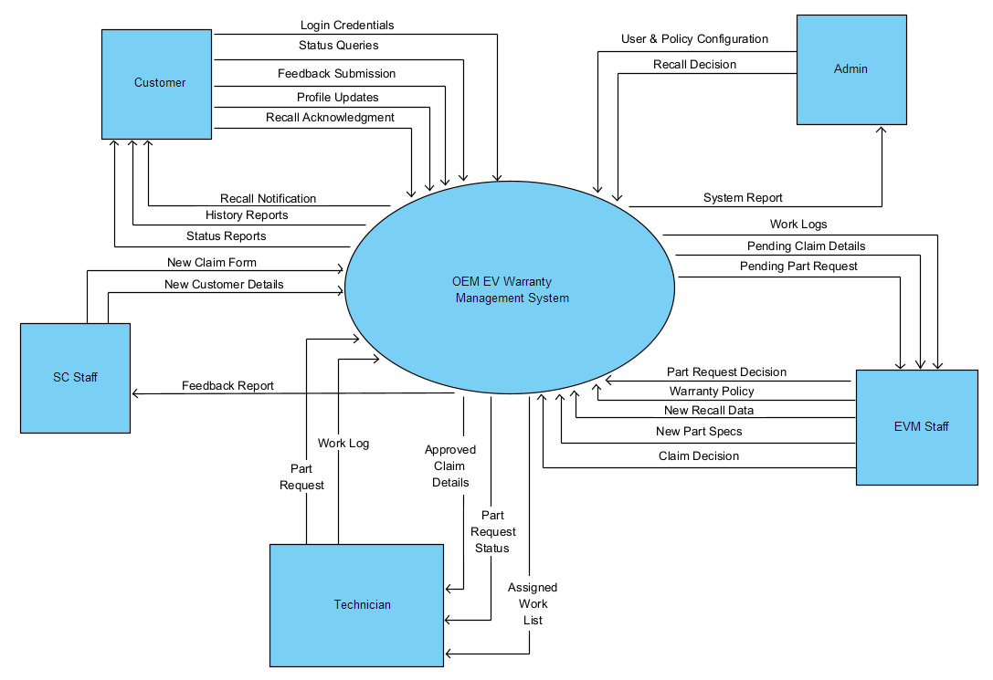
System Architecture – Context Diagram

Slide 6
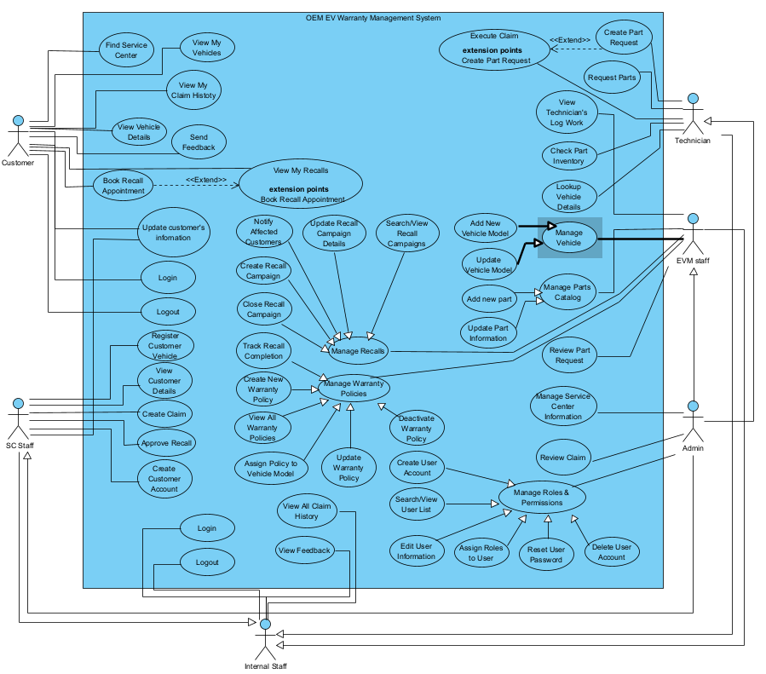
System Architecture – Use Case Diagram

Slide 7
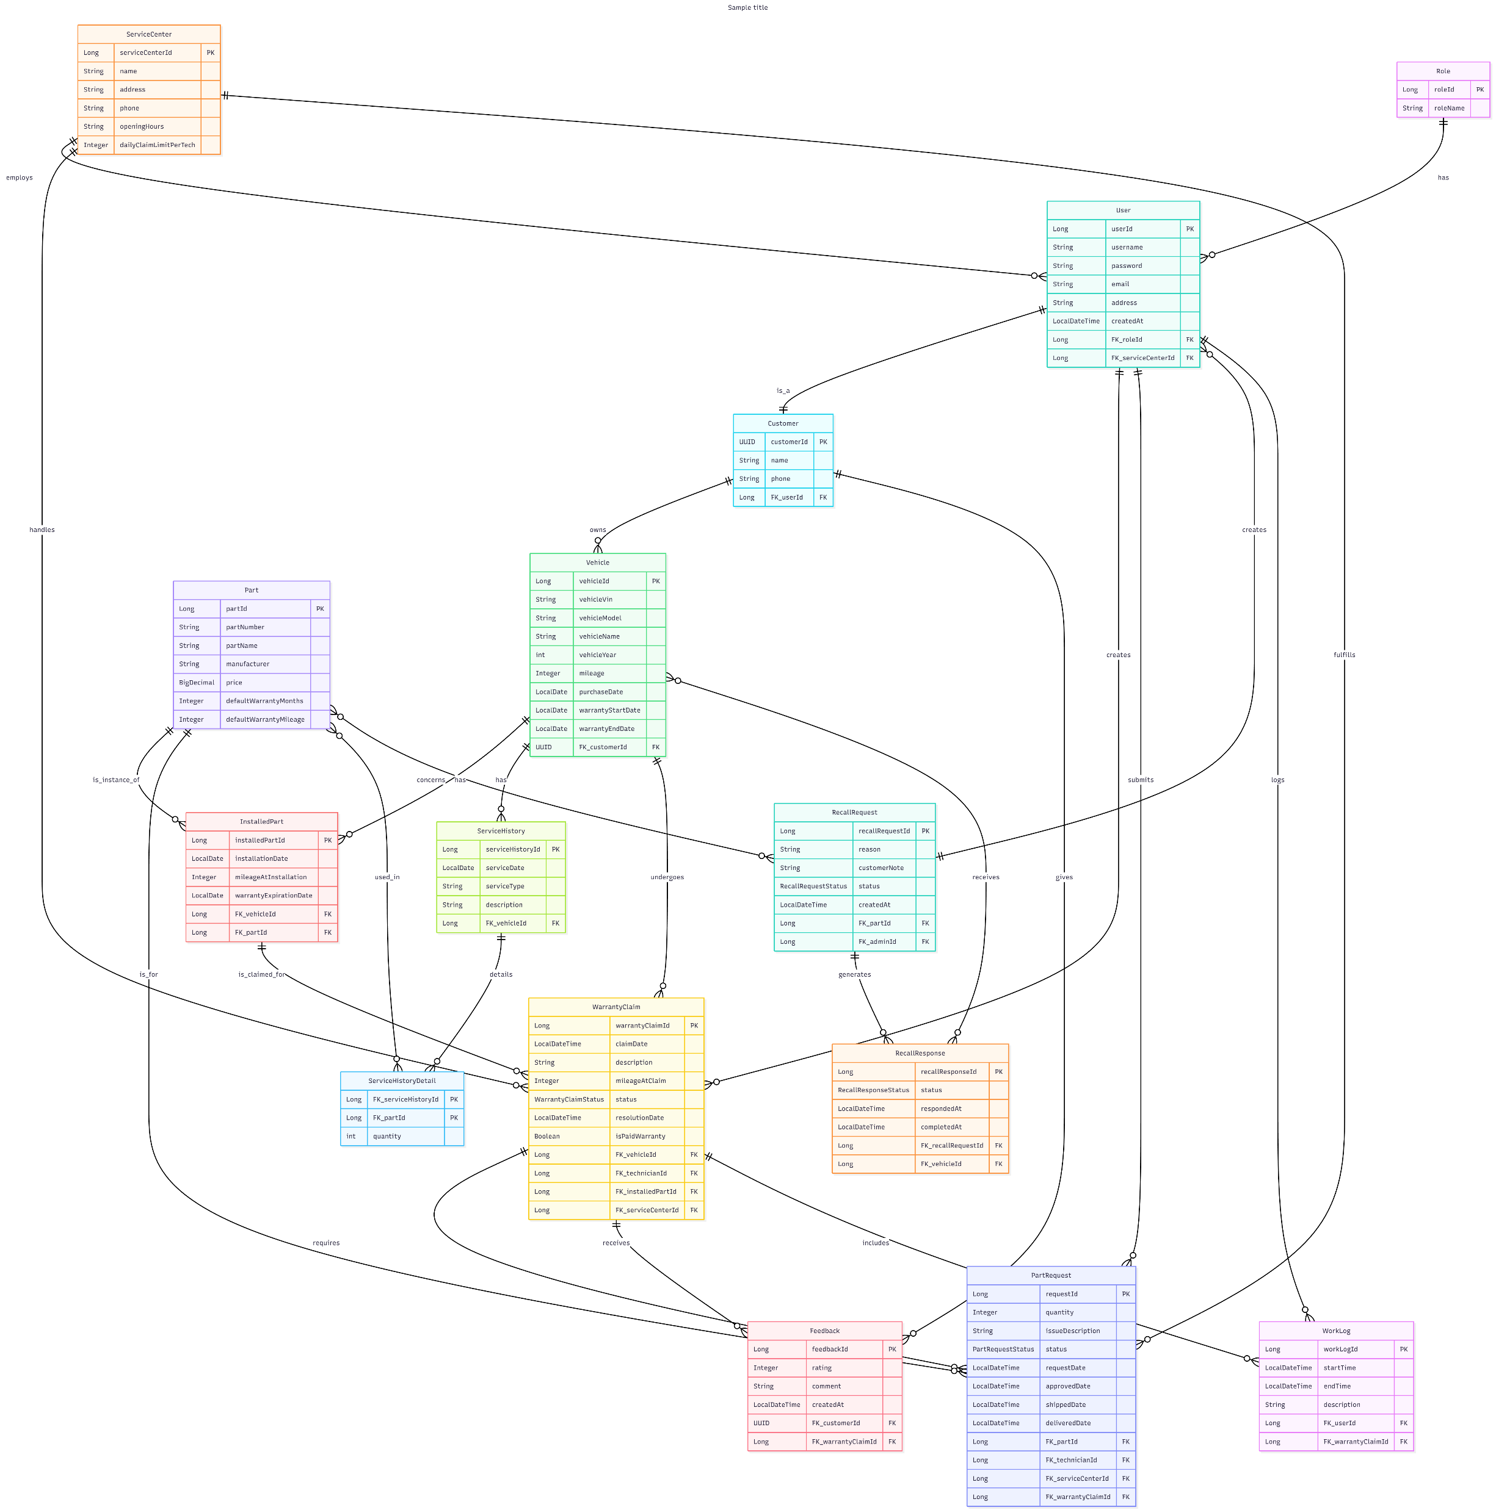
System Architecture – Physical Diagram

Slide 8
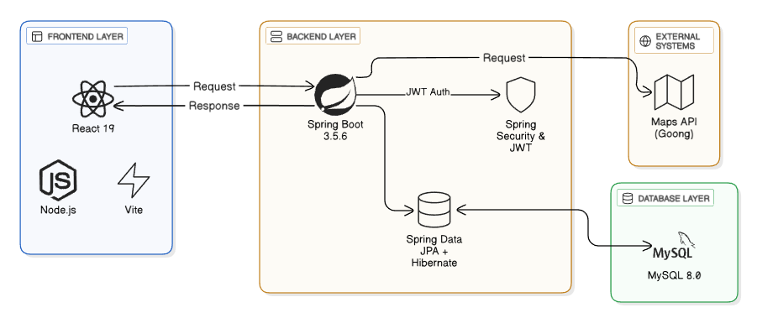
System Architecture

Slide 9
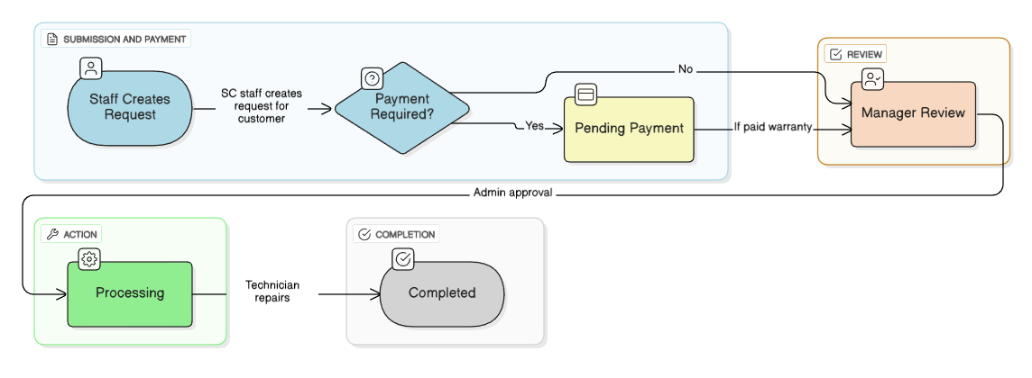
Workflow
Main Flow: Warranty Claim

Slide 10
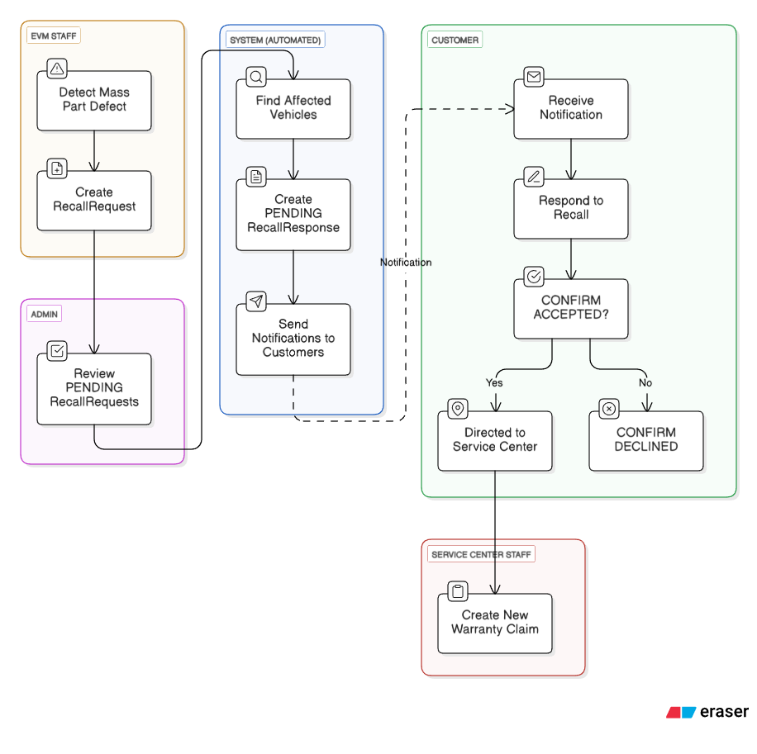
Workflow
Sub Flow: Recall

Slide 11
  Developed web using Java (Spring Boot) + React
  Designed Database, integrated APIs
  Deployed publicly on home server with Docker
  Used AI to speed up coding process
  Managed Git, applied Agile/Scrum, incorporated instructor feedback
Achievements

Slide 12
  Some modules not fully optimized
  Payment system and Google authentication
  Database design improvements for clarity and efficiency
  Email/SMS notification system
Limitations & Future Development

Slide 13

Thank You
OEM EV Warranty Management System
Q&A
GitHub: BlueCloudK/OEM-EV-Warranty-Management-System

