Slide 1
1 1 1
axis = 1
3 3
1 1 1
axis = null
axis = 0
2 2 2
6

Slide 2
Tensorflow
Model.
Resnet
101
Inception
V3
BERT
QRNN
YOLO
Tensorflow
Model.
Image Classification
Text Classification
Object
detection
Full model re-train and transfer learning
Scoring
ML.NET Tensorflow Transaction
Tensorflow.NET C# Binding
Tensorflow C++ API

Slide 3
Visualization
Jupyter-core
Matplotlib.Net
Plot.NET
NLP Support
BotSharp
SpaCy.NET
CherubNLP
High Level APIs
Keras.NET
Scikit-learn.net
TFLearn.NET
.NET Based ML Framework
TensorFlow.NET
Torch.NET
Mxnetlib
Computation SDKs
NumSharp
Pandas.NET
Bigtree.Algorithm
Supporting Tools
CodeMinion
SciSharpCube
SharpCV

Slide 4
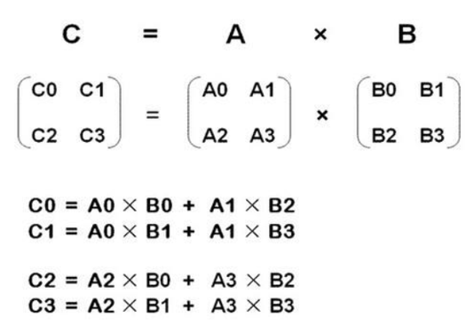
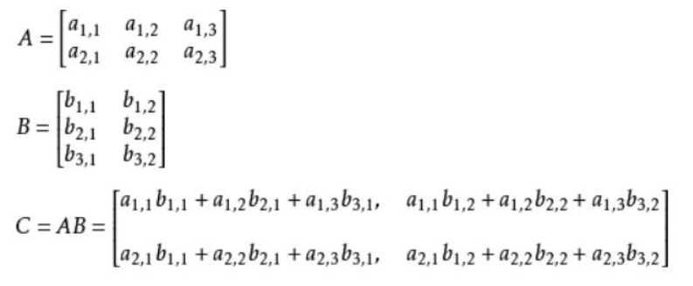

Slide 5
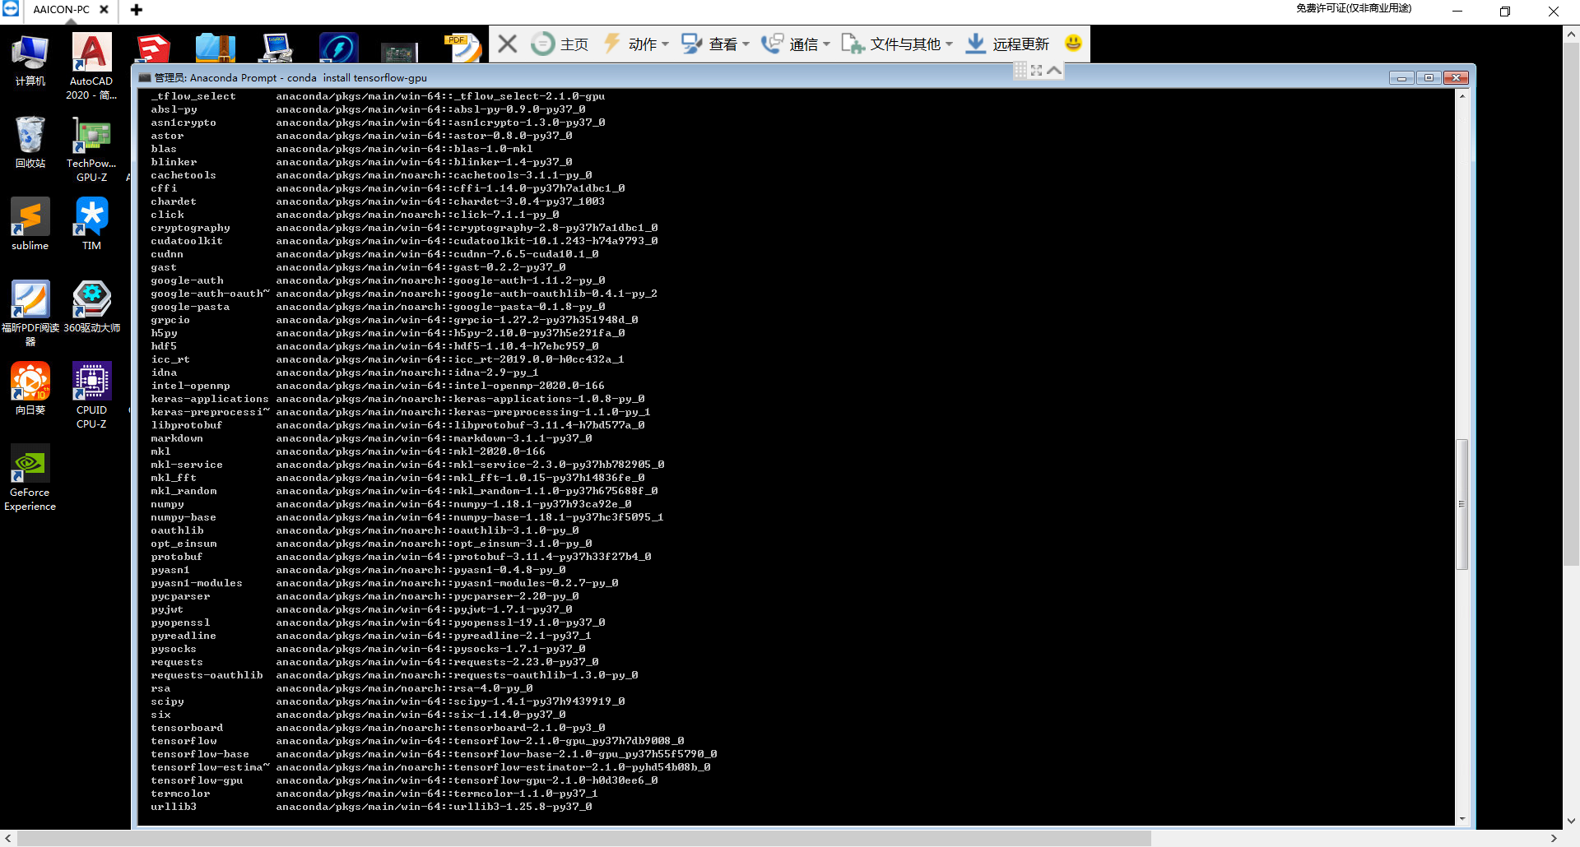

Slide 7
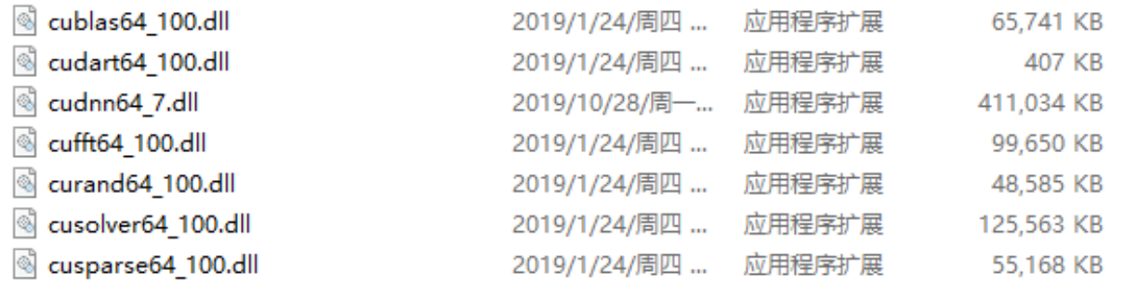
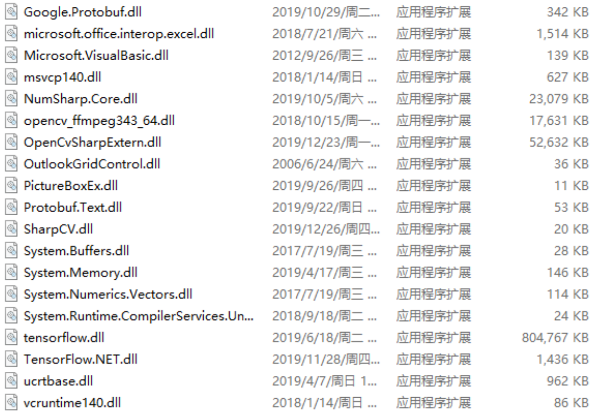
GPU 加速相关的类库
TensorFlow.NET
和系统相关的类库

Slide 8
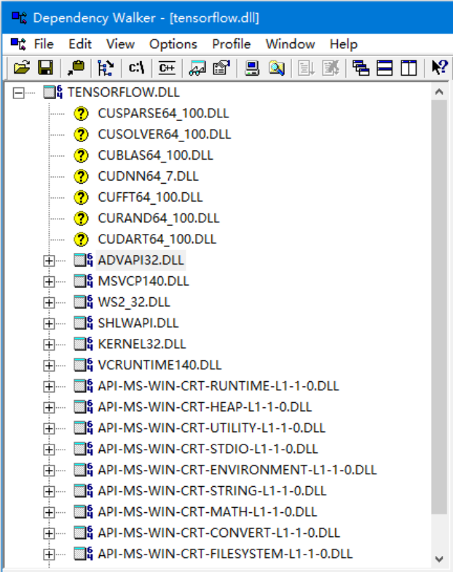
分析的DLL文件
缺少的DLL文件

Slide 9
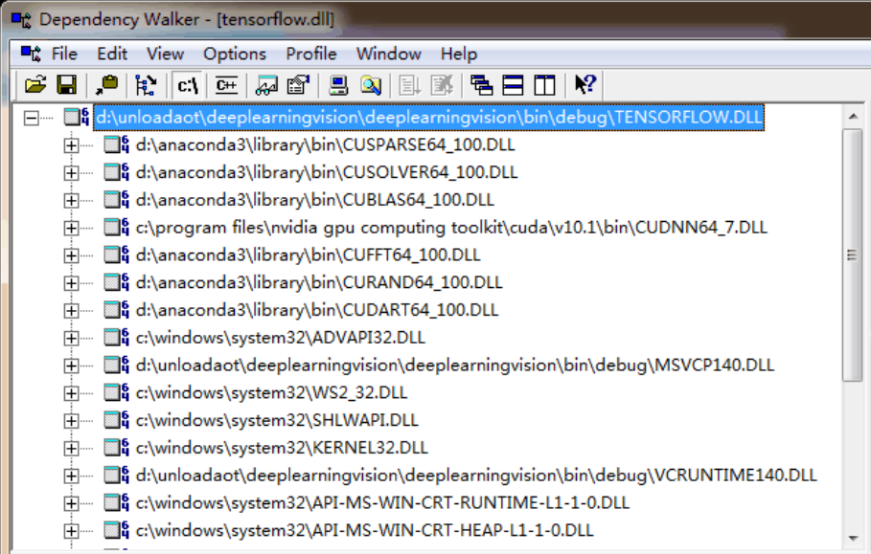
配套DLL文件的详细路径

Slide 10
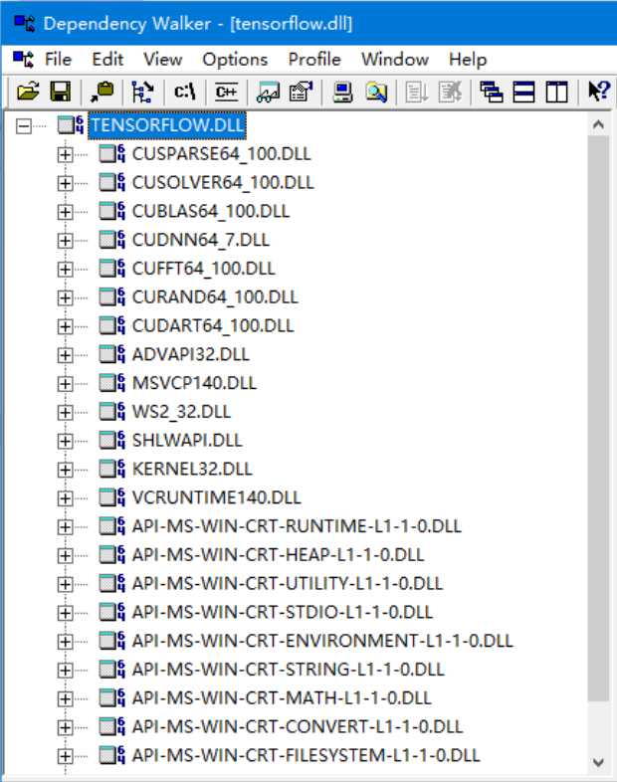
所有DLL均正常引用

