Slide 1
Comparative analysis of deep learning models for plant disease classification
Da silva aguiar, pedro

Slide 2
AGENDA
Objective
METHODOLOGY
Key results
VISUALIZATION
CONCLUSION
REFERENCES

Slide 3
OBJECTIVE
Problem
Plant diseases threaten global food security.
40% global crop loss annually due to palnt diseases (FAO data).
Proposed Solution
Deep Learning models for automated classification.
Attempt to build a Deep Learning model with > 95% accuracy.
Key Differentiator
Systematic comparison of 6 architectures – ResNets VS VGG’s models.

Slide 4
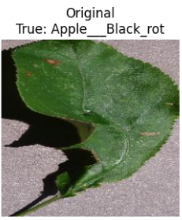
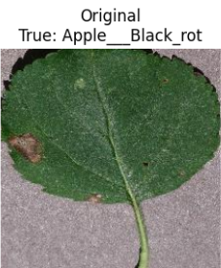
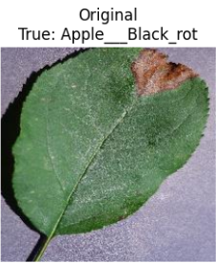
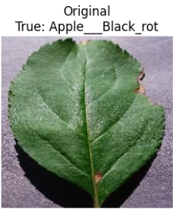
METHODOLOGY
Dataset
Plant diseases color images.
Selected 5 classes - Apple Black Rot / Grap Black Rot / Potato Late Blight / Strawberry Leaf Scorch / Tomato Bacterial Spot.
Preprocessing
Data Augmentation:
Training: Random resizing, flipping, rotation, color jittering.
Validation: Simple resizing and center cropping.
Normalization = (input − [0.485,0.456,0.406]) / [0.229, 0.224, 0.225]

Slide 5
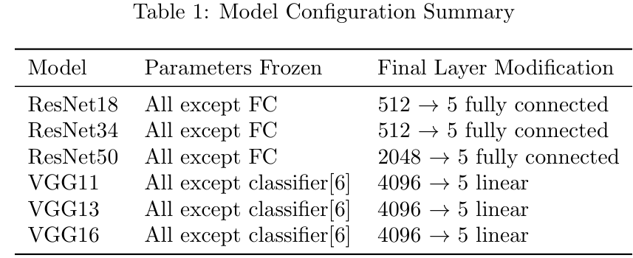
METHODOLOGY
Models
Six pre-trained models were adapted for transfer learning:
Training Hyperparameters
Loss Function: Cross-Entropy
Optimizer: Adam (lr=0.001)
Scheduler: StepLR (step_size=7, gamma=0.1)
Epochs: 15
Batch Size: 32

Slide 6
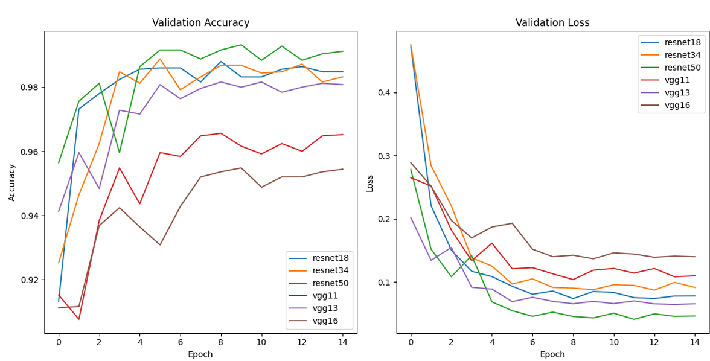
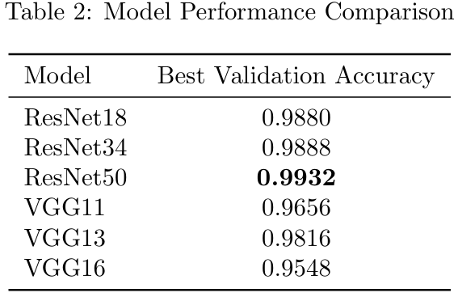
KEY results
Accuracy Result
Validation Accuracy and Loss

Slide 7
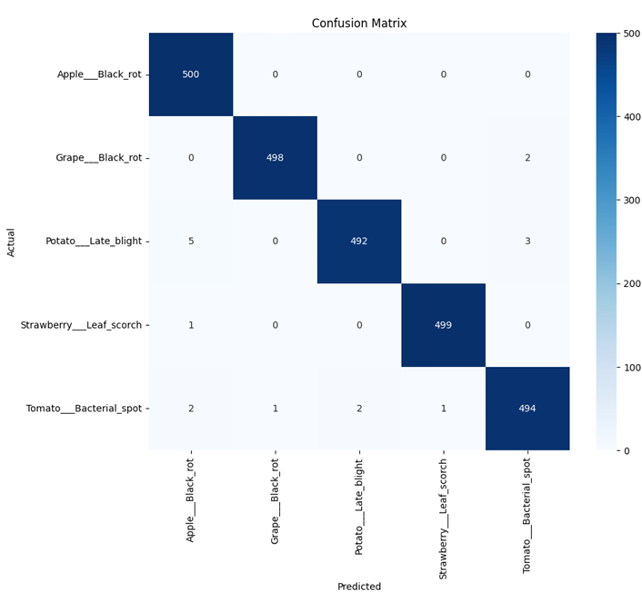
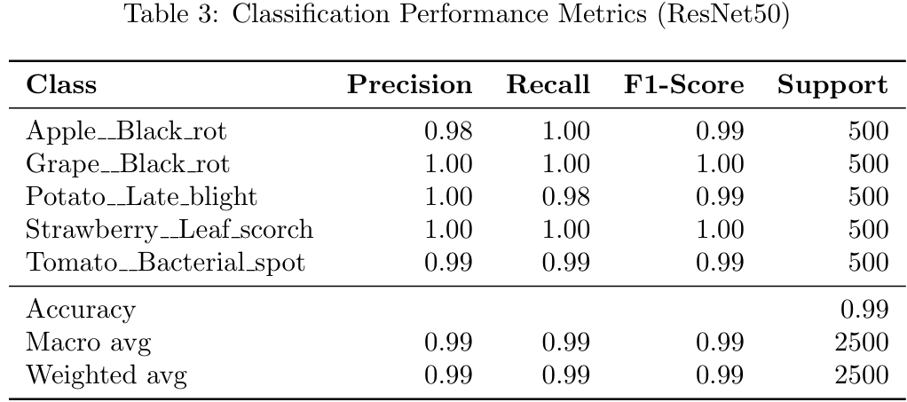
KEY results (RESNET50)
Confusion Matrix – ResNet50
Performance Metrics – ResNet50

Slide 8
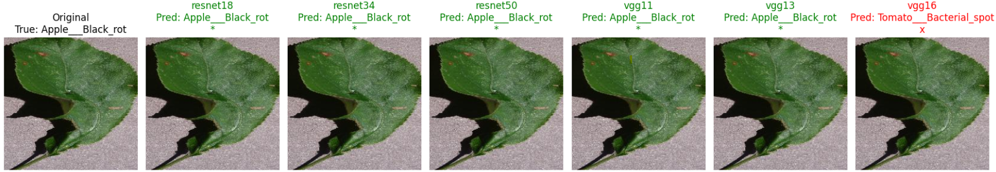
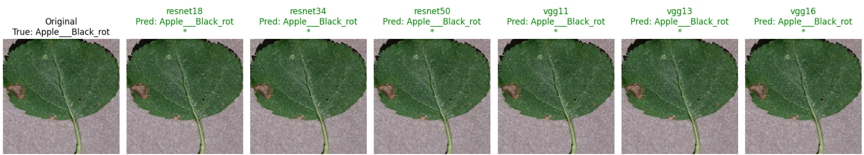
VISUALIZATION

Slide 9
CONCLUSION
Main Finding
ResNet50 is the best model (99% of accuracy).
Recommendations
ResNet18 for source-constrained devices.
ResNet50 for maximum accuracy.
Future work / improvements
Ensemble methods combining multiple models.
Attention mechanisms for interpretability.
Large-scale evaluation across more disease classes.
Hyperparameters Adjustment.

Slide 10


REFERENCES
PlantVillage Dataset - https://www.kaggle.com/datasets/abdallahalidev/plantvillage-dataset
Transfer learning Documentation- https://docs.pytorch.org/vision/main/models.html

