Slide 1
Press Release Analyzer
Dallin Marshall

Slide 2
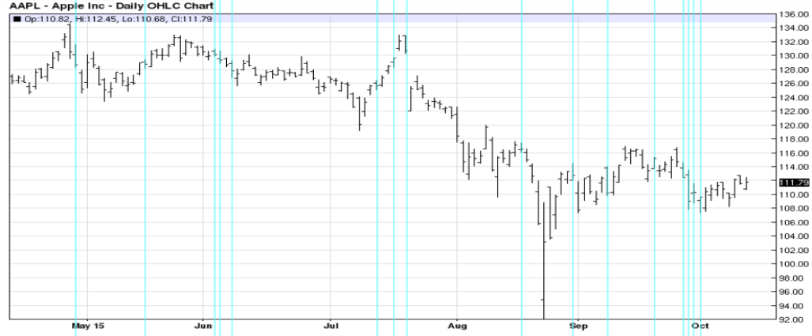
What & Why
Are there other ways to predict stock trends outside number crunching?
Can changes in stocks be predicted by examining press releases?

Slide 3
How
Scrape Apple Press Releases
Split into Training Set
Natural Language Tool Kit to Extract Features
Use Neural Network to find Correlations between Features and Sentiment
Apply to Real Time RSS Feeds about Company of Choice

Slide 4
Demo/Goals
Parts Completed
Next Stages
Pull Stock data for given Stock Symbol
Canned Files and Training Set Split
Pull RSS feeds for Stock Symbol
NLTK Feature Extraction
Encode Features for Neural Network
Train
Test with Real Time Data

