Slide 1
Press Release Analyzer
Dallin Marshall

Slide 2
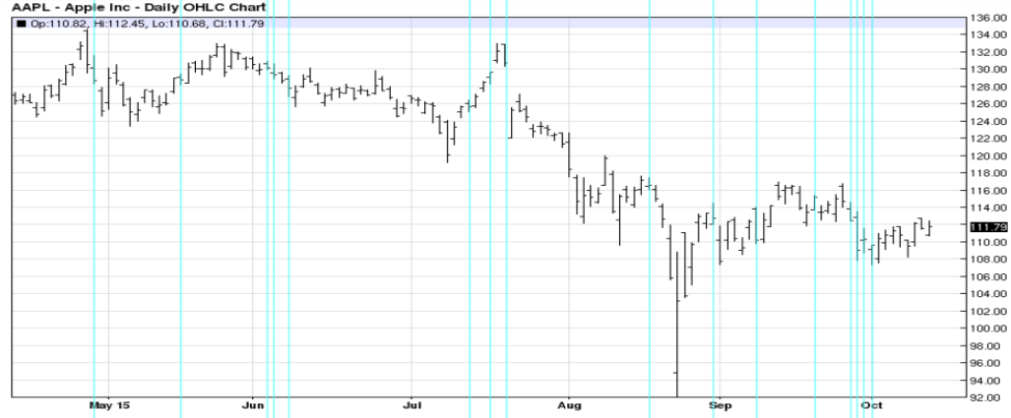
What & Why
Can changes in stocks be predicted by examining press releases?
Use natural language processing to ascertain sentiment of articles.

Slide 3
Demo
Train Naive Bayes NLTK Feature Filter with Official AAPL Press Releases
Pull RSS Feed about AAPL
Extract Features from new Articles
Predict Stock Change From Today’s Content
What is the prediction for AAPL stocks today?

Slide 4
Progress/Goals
Parts Completed
Next Stages
NLTK Feature Extraction
Naive Bayes Filter initial Training.
Stock Prediction based on Training Set
Learning
Test with Real Time Data
Measure Improvement Over Time

