Slide 1
Passive Tracking Device
Dallin Marshall – Computer Engineering

Slide 2
Presentation Overview
Project Problem
Project Purpose
Project Impact
Design Details
System Overview
Subsystem – Microcontroller
Subsystem – GPS Module
Subsystem – Cell Module
Subsystem – Power Regulation
Team Members
Budget
Schedule
Conclusion

Slide 3
Project Problem
Existing Enterprise Solutions – Active Solution
Large
Power Intensive
Automobile Emphasis
Expensive
Difficulty Managing Fleet and Theft

Slide 4
Project Purpose
Create a Passive Tracking Device (PTD) that can be used in power, space, and monetarily constrained environments.

Slide 5
Project Impact
The PTD is an alternative passive tracking solution that emphasizes in the ATV use. This will allow clients to better supervise their vehicles.

Slide 6
Design Details
Microcontroller
GPS Module
Cell Module
Power Regulation Circuitry

Slide 7
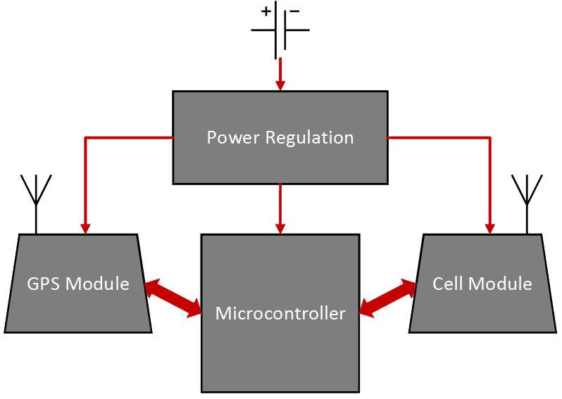
System Overview

Slide 8
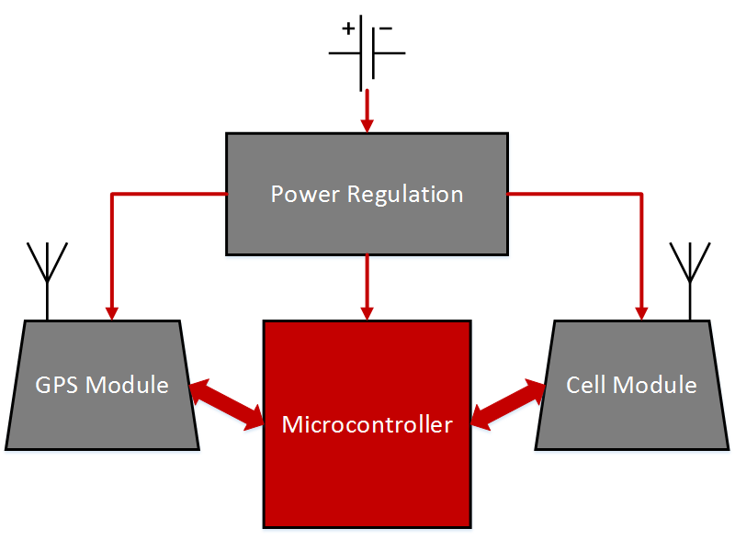
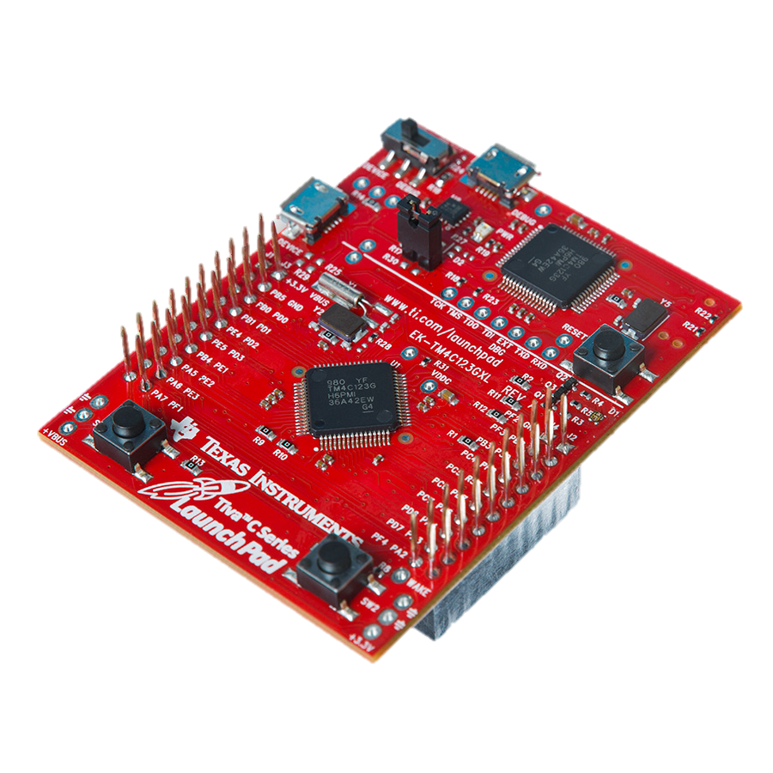
Sub-System – Microcontroller

Slide 9
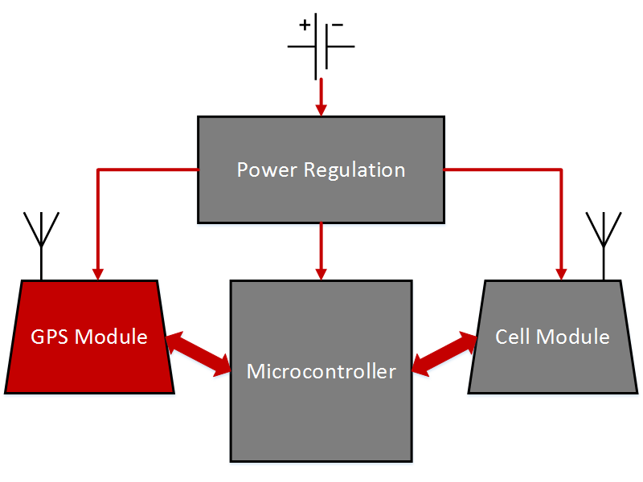
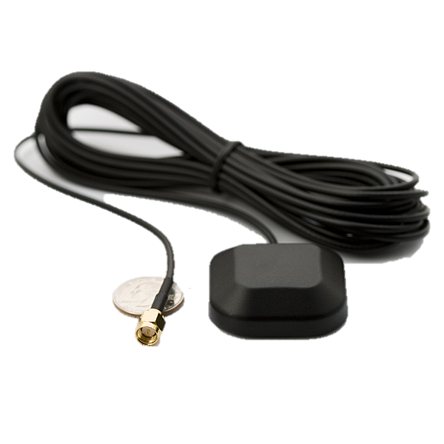
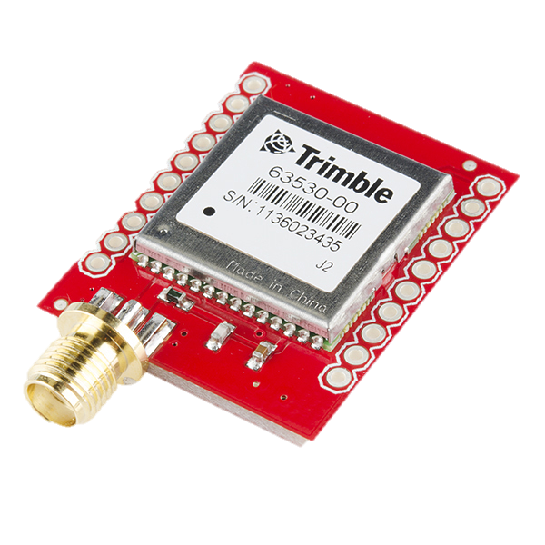
Sub-System – GPS Module

Slide 10
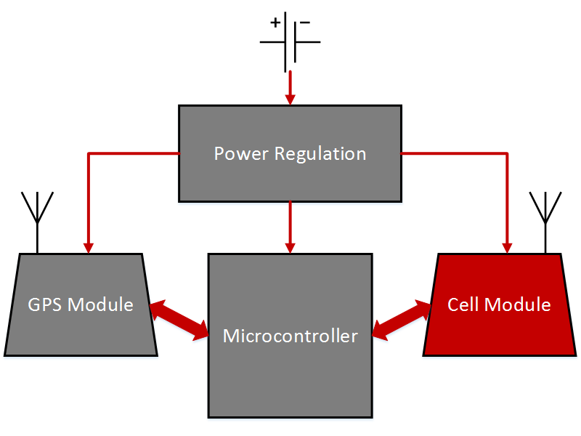
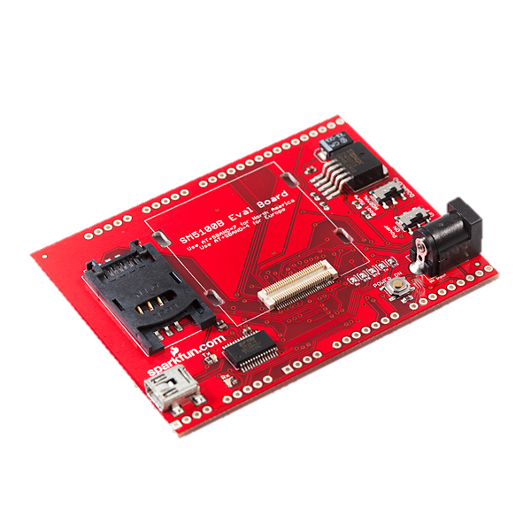
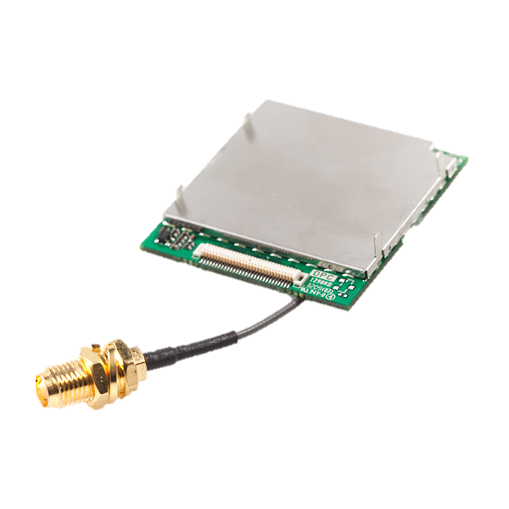
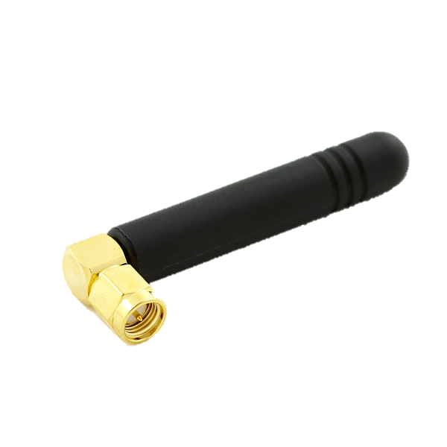
Sub-System – Cell Module

Slide 11
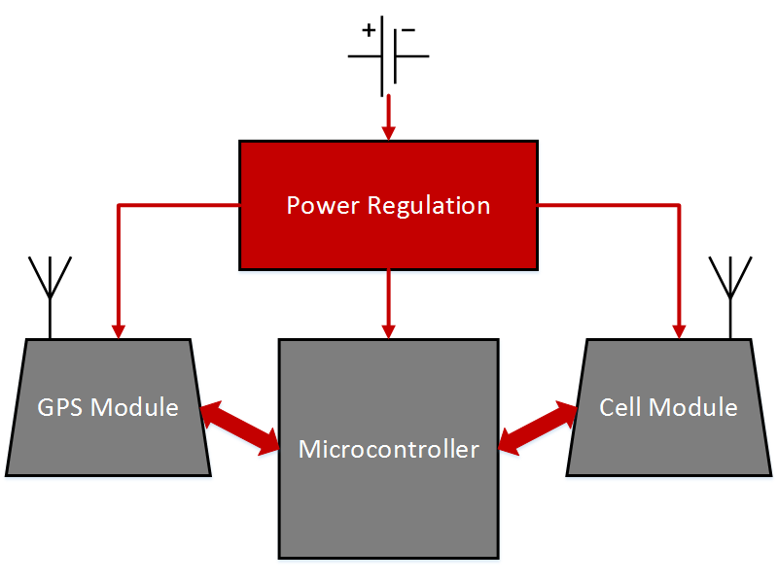
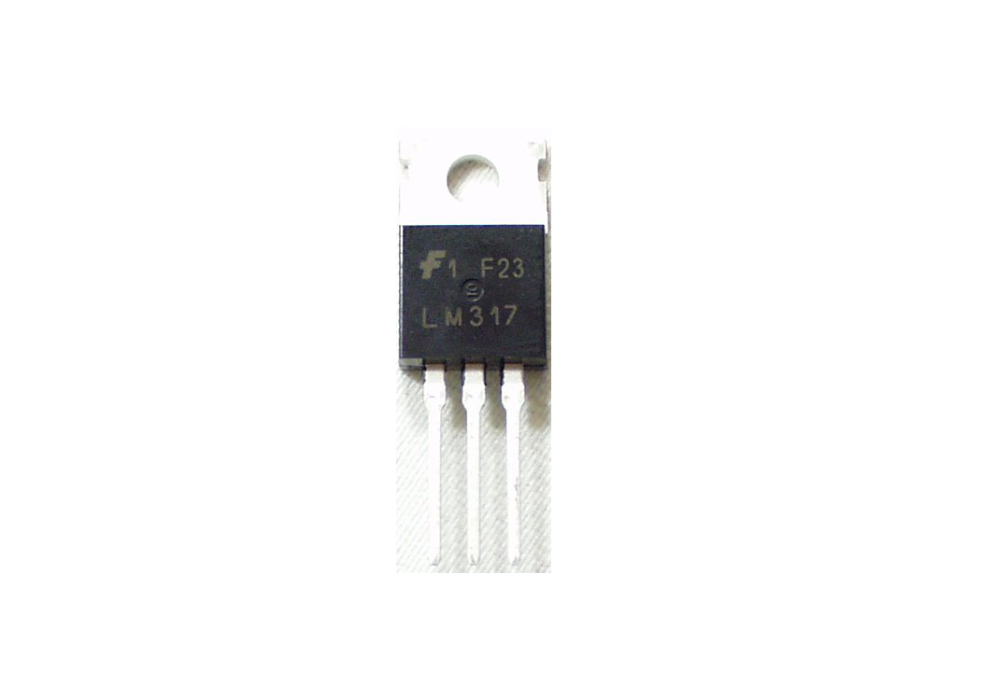
Sub-System – Power Regulation
Voltage/Current Regulation
Current Sourcing
Reliability

Slide 12

Team Members
Dallin Marshall
Utah State University
Computer Engineering

Slide 13
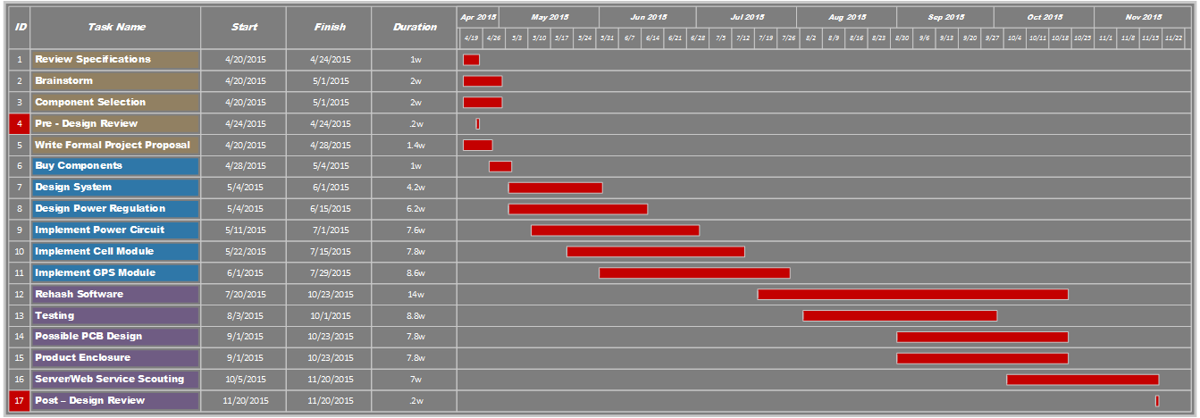
Schedule

Slide 14
Budget
Component | Model | Price (Evaluation Board) | Price (Discrete Component)
Microcontroller | TI Tiva-C TM4C123G | $13.00 | ~ $5.00
GPS Module | Trimble Copernicas 2 | $74.95 | $44.95
GPS Antenna | SPS 3V SMA | $12.95 | $12.95
Cell Module | SM5100B | $119.90 | $59.95
Cell Antenna | Quad-band Antenna | $7.95 | $7.95
Cell Card/Service | T-Mobile Unlimitted | $79.95/6 Months | ~ $13.00/Month
Power Regulation |  | ~ $40.00 | ~ $40.00
Total |  | ~ $348.70 | ~ $183.80

Slide 15
Conclusion
PTD will give businesses another tracking solution with unique benefits
PTD will be cost effective
PTD will allow for better monitoring of ATV fleet
PTD will function in low power environments

Slide 16
Questions

Slide 17
Future Plans
Central Database
Server
Database
24/7 Online Accessibility
Web Interface

