Slide 1
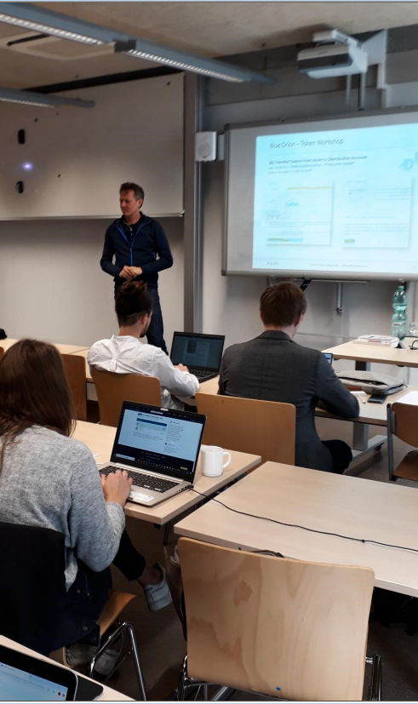
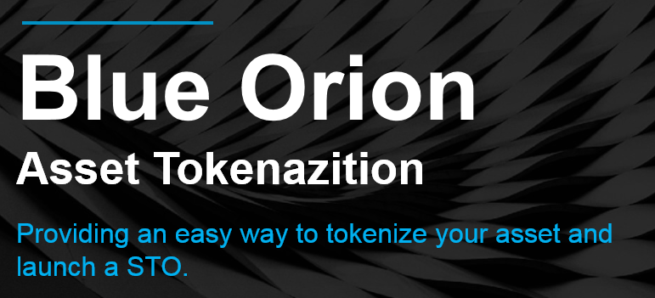
6. Stellar Meetup Munich
Supported by stellar.org and blueorion.cc
Stellar Community Fund
STO - Tokenization
Subscription Service
Networking

Slide 2
Stellar Community Fund
To support valueable projects awarded by the community.
€
Conditions
2 rounds of voting 1) galactictalk.org 2) reddit
distributed among 8 final projects
4 weeks of marketing and promoting
only few voting participants ~ 100
https://medium.com/stellar-community/stellar-community-fund-13b722ca45f4
150.000
Projects which are seen as valueable from the community.
Title, Summary, Goals, Description

Slide 3
SCF Participants
The example text goes here with your own detailed summery.
Competitors
32 international competitors without USA
3 wallets
2 trading platform / trading bot
3 games
5 payment system / plugin
1 community platform
2 SDK
2 stable tokens
others
Europe
stellar.org
Nigeria
Asia

Slide 4
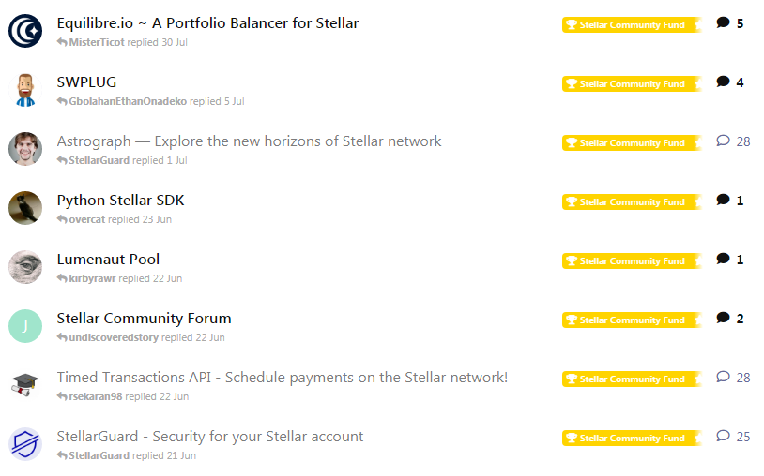
8 SCF Winner
291.793 XLM
~ 23.000 €

Slide 5

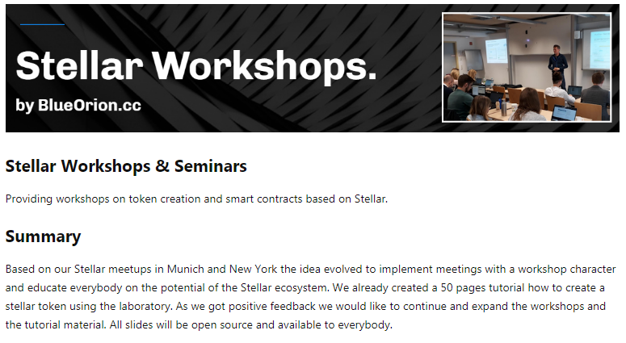
New Fund - Support our Meetups

Slide 6
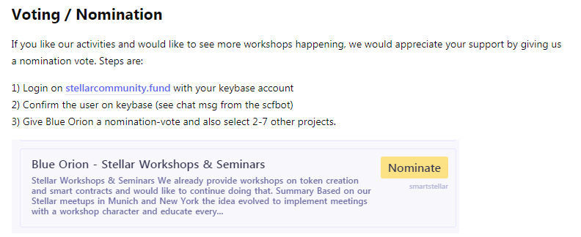
Vote on stellarcommunity.fund

Slide 7

Blue Orion – Tokenization
Problem
How can a digital or real world asset (like real estate) be
turned into a tradable easy to split entity
with minimum costs of administration and
easy monitoring of the asset holder, so dividends can get payedout
Solution
Usage of the blockchain technology to create and assign tokens (digital entities) which are assigned to the asset.
Technical Background
Tokens can be traded, sold and bought without administrative costs. Also its possible to check any time who owns the tokens.

Slide 8
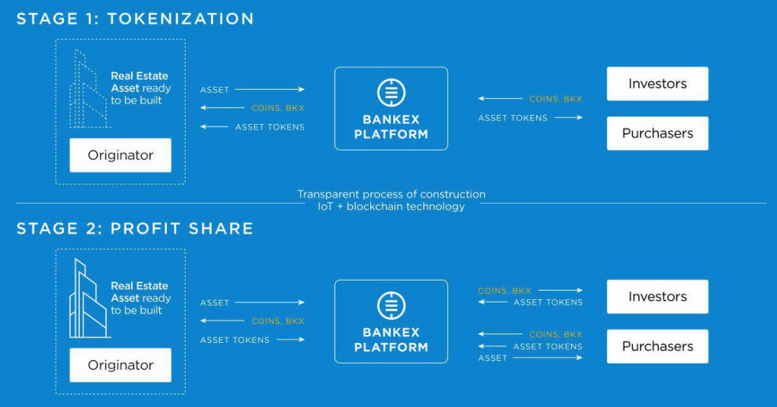
Blue Orion – Tokenization

Slide 9
Blue Orion – Tokenization
Business Modules
Consulting + Platform
Legal
Development
Marketing
create and whitelist escrow company
custodian, holds proof of asset
agreement between: token issuer and escrow company
KYC partner
create token
provide order form to investors
provide wallet
admin tool to distribute dividends
publish articles
promote on ICO/STO platforms
advertise on google, …
other marketing tools to be defined, …

Slide 10
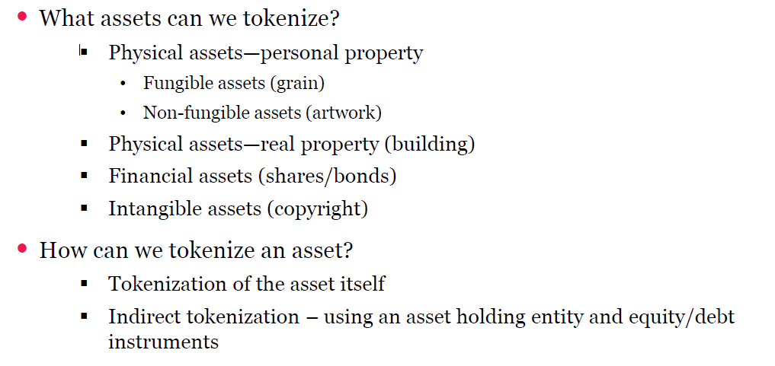
Process – Security Token Offering

Slide 11
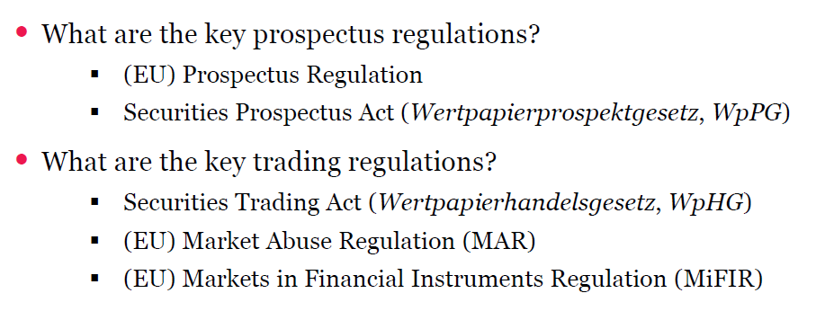
Process – Security Token Offering

Slide 12
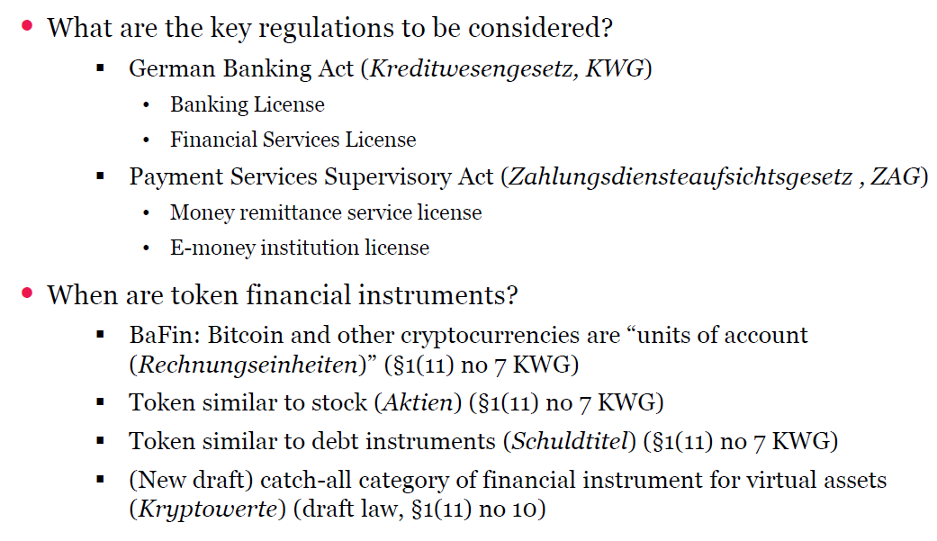
Process – Security Token Offering

Slide 13

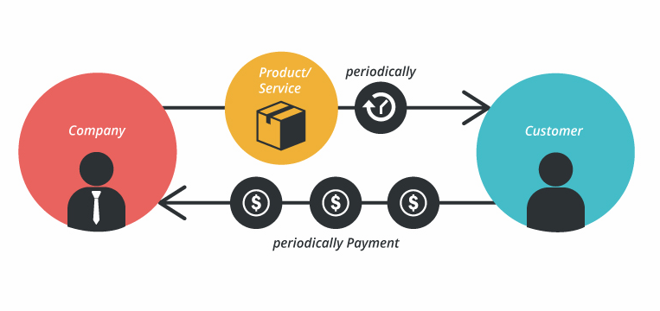
Blue Orion – Subscription
Problem
How can user subscribe to a service paying with xlm or assets:
a) without being online at the time of transaction
b) not providing their secret key to a third party (non custodian)
Solution
Transactions are presigned and submitted at the right time. Signing always happens on blueorion.cc to establish a trusted partner.
Technical Background
Transactions can be presigned on the Stellar ecosystem and submitted at the time demanded. Submissions need to be repeated in case of network failure!

Slide 14
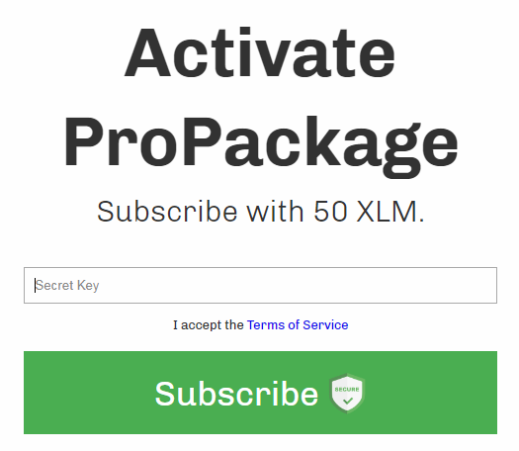
Subscription API Workflow – User View
Use Case: User subscribes on website on a service called „ProPackage“. The service costs 50 XLM per month. The XLM will be deducted every month from his public key.
Click on website-subscribe button
Enter your secret key on blueorion.cc interface (key is only used in browser!)
Click on subscribe
website.com
blueorion.cc
website.com
Website
Website
Subscription Successful!
Subscribe
Post Request:
see websnipplet
Post Request: client_id,
sub_id,
pubkey

Slide 15
Subscription API Workflow – User View
Use Case: Website owner wants to integrate the subscription service.
Copy web snipplet into website
Adjust parameters
Require client_id, subscription_id and password from blueorion.cc
Red Values: Defined by blueorion.cc
Green Values: Defined by yourself
<form id="form_subscribe" action="https://test2.artspirit.com/" method="POST" target="_blank">
<input type="hidden" name="p" value="subscription_subscribe">
<input type="hidden" name="client_id" value="id_testnet">
<input type="hidden" name="client_name" value="Stellar Expert">
<input type="hidden" name="client_servicename" value="ProPackage">
<input type="hidden" name="client_callback" value="https://test2.artspirit.com">
<input type="hidden" name="subscription_id" value="sub1">
<input type="hidden" name="asset_code" value="XLM">
<input type="hidden" name="asset_amount" value="3">
<input type="hidden" name="max_payments" value=„2"> <!-- number of month -->
<input type="hidden" name="memo" value="Test Subscription">
<input type="hidden" name="net" value=" testnet "> <!– testnet / publicnet -->
<input class="form_submit" type="submit" value="Subscribe">
</form>
The client_id id_testnet / sub1 is assigned to this key on testnet: GAPZ4PWWDEMSVJOVU46WQHRYVTDKXJQJ3MJ4VQ7YSZ4WEZ27VKMOGCLK

Slide 16
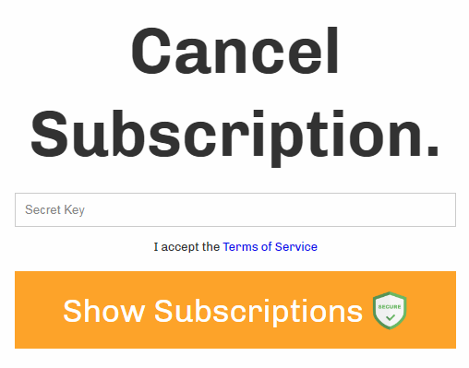
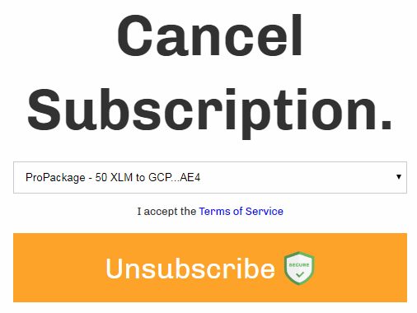
Subscription API Workflow – User View
Use Case: User wants to unsubscribe.
check which subscriptions are assigned to your account
select specific subscription and
unsubscribe
blueorion.cc
website.com
website.com
Website
Website
Subscription Canceled!
Unsubscribe

Slide 17
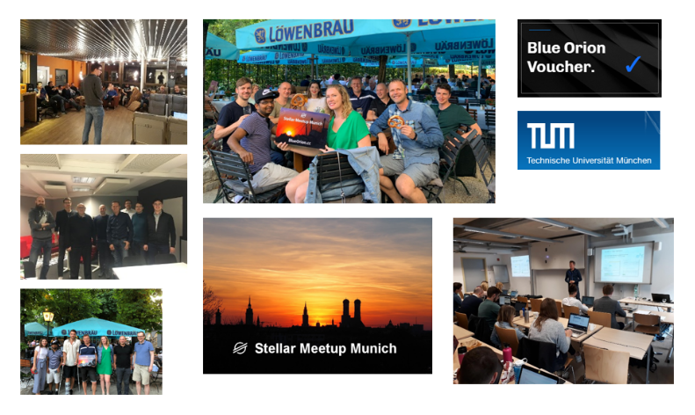
ANY
QUESTION?

