Slide 1

1. Meetup - AG Stellar 08.01.2020 München
Stellar Basics
UseCases + Roadmap
Your Projects + Discussion
Next Steps

Slide 2
What is special about Stellar?
Crypto
Features
Stellar is one of the fastest and scalable coins on the market. Transactions are done within 2-5 sec. and the network scales up to 1000 transactions per second. Stellar also has very low transaction fees which doesn’t depend on traffic like Bitcoin or Ethereum.
Tokens and Anchors
Stellar has an integrated asset platform which supports the creation of new tokens. New tokens can be traded immediately on the distributed Stellar exchanges like StellarX. Stellar also supports the creation of so called anchors. Anchors are entities in the Stellar network which can hold a deposit and issue credits as and when required.
Smart
Contracts
Stellar provides “Smart Contract” functionalities, like time-bound payments, multi signature accounts and weighted signatures. This enables a set of Smart Contracts which are sufficient for most token requirements. Also Smart Contracts do not require additional costs to be executed (unlike Ethereum).
Economy Partner
Stellar has a long list of successful partners: IBM, Deloitte, Stripe, and many more. See stellar.org/about/directory and also for IBM ibm.com/blogs/blockchain/2018/07/stable-coins-enabling-payments-on-blockchain-through-alternative-digital-currencies/
For more details see also: blockgeeks.com/guides/what-is-stellar-blockchain/

Slide 3
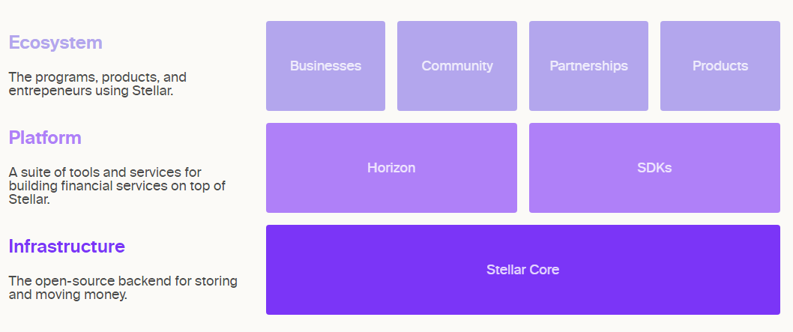
Stellar Infrastructure

Slide 4
First Layer Use Cases
Based on the existing Stellar Functions
Finacial services
Create Assets / Tokens
Second Layer Use Cases -> Smart Contracts
Combinations of basic Stellar Functions or adding functionality with “Smart Contracts”
Special payment functions with additional features like timed or reccurring payments
Building Smart Contracts by combining Stellar functions like voucher management
Blockchain/Ledger functions to enable “Proof of Existence”

Slide 5
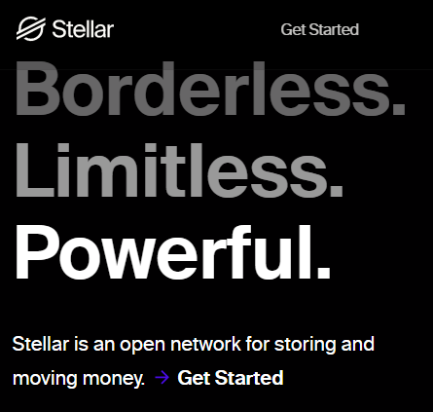
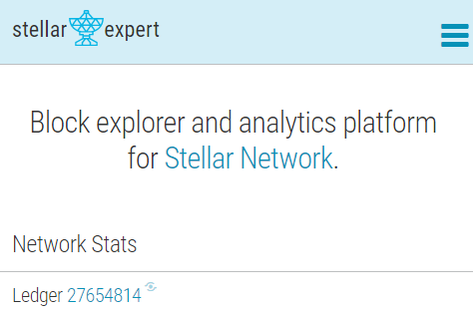
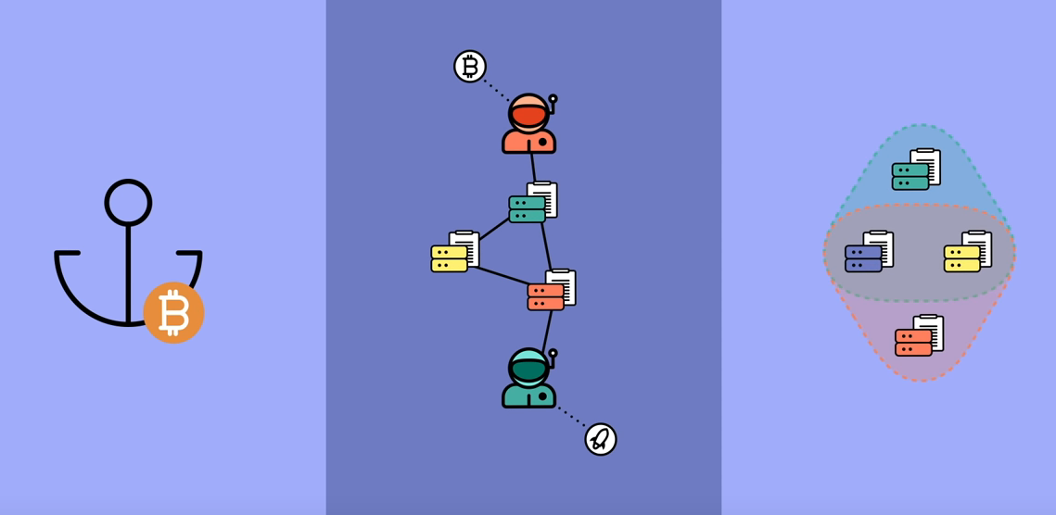
Information and Sources
stellar.org
stellar.expert
https://www.youtube.com/watch?v=ixerXWJrDr0

Slide 6





Companies using Stellar / Usecases
IBM Stellar is chosen by IBM as the public blockchain network. See details here: lumenauts.com/blog/how-the-partnership-between-ibm-and-stellar-works
coins.ph -> cross border payments Pay bills, buy load, buy digital currencies, and send money – even without a bank account! Access to more than 100,000 merchants!
tempo.eu.com -> cross border payments Money transfer in 55 countries.
bitbond.com -> funding of SMEs Business financing. Bridge liquidity gaps and try new product lines with instant financing from Bitbond.
satoshipay.io -> micropayments Global, fast and easy micropayment solutions
See also: stellar.org/about/directory for more companies!

Slide 7
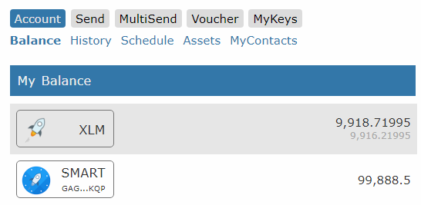

Blue Orion Services
Wallet https://blueorion.cc/signin
Timed and Recuring Payments
MultiSend Automated payout to multiple accounts.
Voucher Management Vouchers can be created on demand by SMART and redeemed by the user online.
MyKeys: An one page view with accounts of your interest
Subscription Service

Slide 8
Projects to be discussed
RegioCoin, Marco Zerjav Das Komplementärwährungs-Betriebssystem zur Aktivierung regionaler Wertschöpfung und Kreisläufe
???

Slide 9
Next Steps
???

Slide 10
ANY
QUESTION?

