Slide 1
2. Stellar Munich Meetup on 29.01.2019
Agenda
Introduction of all participants: Background, Knowhow, Interest -> Collecting Input (Flipchart/Whiteboard)
Goals of Stellar Munich a) Brainstorming to define goals b) Official Cluster supported by Stellar.org c) Networking + KnowHow Transfer -> workshops ? d) Cooperation with companies, organisations
Possibilities for Participation -> Support Meetup / Speaker at Meetup -> Organising Workshops -> Basis-Knowhow, Token-Creation -> Support on Products (Testing) -> What do you need / can offer?
Networking

Slide 2

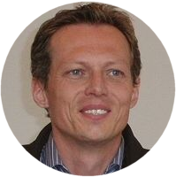

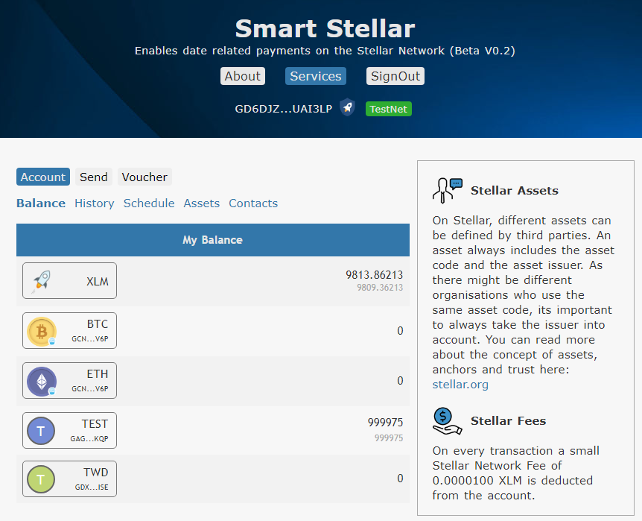
Stellar Munich Meetup
SmartStellar.org
Hans Woppmann
hw@smartstellar.org
Timed and Reccurring Payments
Crypto Voucher Creation
Currently on TestNet, Release on PublicNet in February 2019, Betatester are welcome ☺
Planned Features
Multipayments
Debit Authorisation

Slide 3

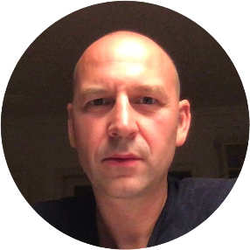
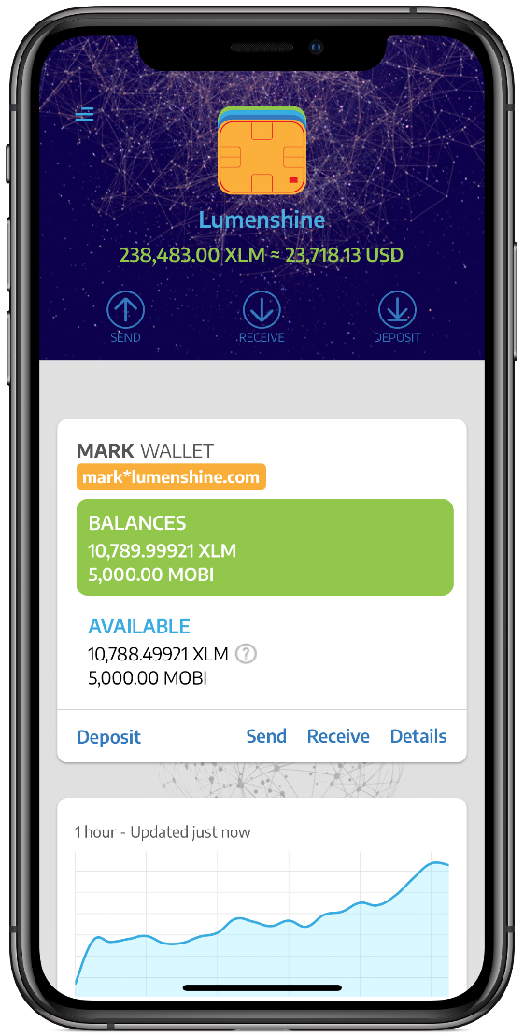
Stellar Munich Meetup
SONESO GmbH, Munich
www.soneso.com
Christian Rogobete
c.rogobete@soneso.com
Soneso iOS SDK for Stellar – winner of Stellar Build Challenge #6 – open source
Lumenshine wallet – Stellar wallet for web & iOS - lumenshine.com – open source
Blockchain consulting & development based on Stellar.

Slide 4
Stellar Munich Meetup
Introduction of participants:
Background, Knowhow, Interest

Slide 5
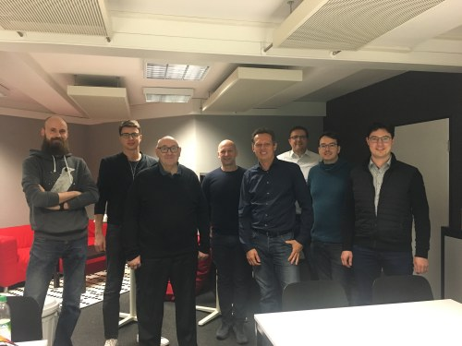
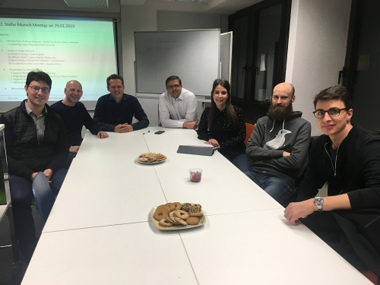
Stellar Munich Meetup
Thanks to everybody who joined the first Stellar Meetup in Munich. We had very interesting talks
Participants
Gyula Joseph Kuszli, Metal Trading
Alexander Hüsgen, Regulations, Startup-Consulting
Peter Pansegrau, IT-Consulting
Chris Rogobete, Soneso, lumenshine.com
Alexander Steinhoff, Trading Bot
Thomas Klemm, IT-Consulting
Udo Polder, IT Consulting, Development
Markus Dolio, IT Consulting, Development
Hans Woppmann, IT Consulting, SmartStellar.org
Melissa Tiedke, Organisation, Fotos

Slide 6
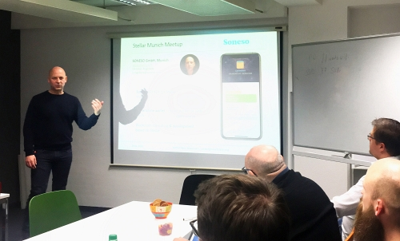
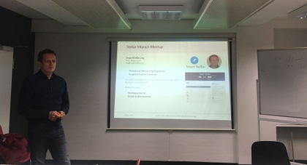
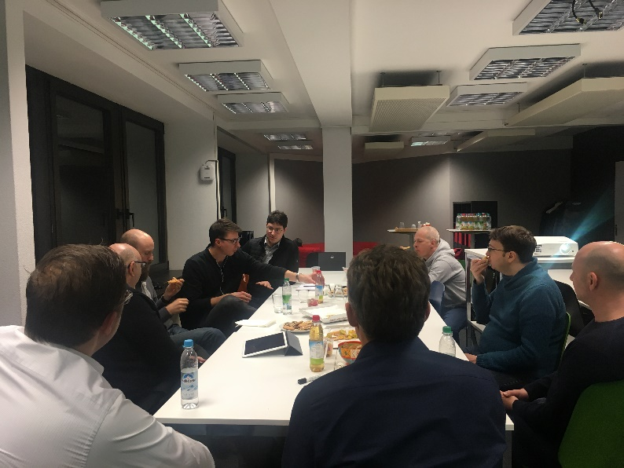
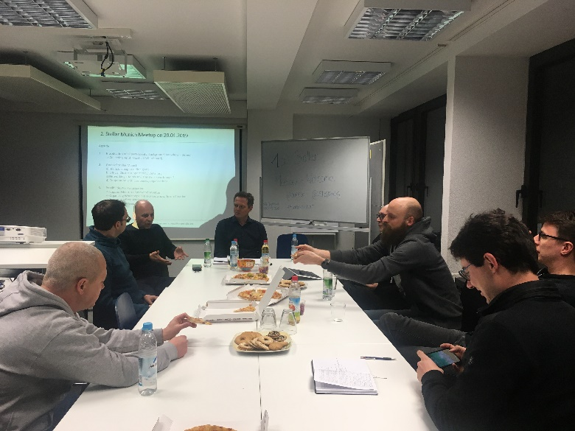
Stellar Munich Meetup

Slide 7
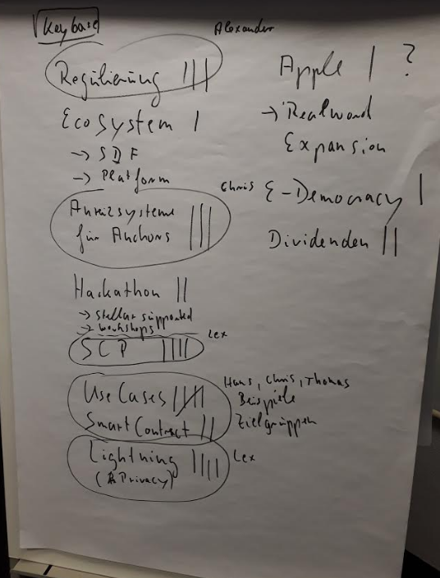
Stellar Munich Meetup
Meeting Minutes I
For the next meetup topics we made a interest rating:
Introduce Stellar Usecases and Challenges (Hans, Chris, Thomas)
Lightening, Privacy (Lex)
Consensus Protocol (Lex)
Reasons to create an Anchor (Chris)
Regulations (Alexander)
*Names are a suggestion as discussed in the meeting
Other topics: Ecosystem, Hackathlon, Workshops like „create your own token“, E-Democracy, Dividens, How can we convince Apple to use Stellar !?

Slide 8
Stellar Munich Meetup
Meeting Minutes II
Feedback for the next meetings
More in depth introduction of platforms/applications like the Lumenshine-Wallet or SmartStellar.org is welcome
Make clear beginners are also welcome
Beer was missing -> will be available next time ☺
Add blockchain or crypto to the meetup title -> gains more interest
Distribution of SmartStellar-Vouchers ☺
Provide a skype remote session for next meetup

Slide 9

Stellar Munich Meetup
Results
Next meetup will be in 2 month time: suggested day Tuesday 26.03.2019
Keybase-account for communication: stellar_munich (on keybase.io/) (done)
Topics for next meetup: 1) Use Cases 2) Lightning 3) Consensus -> Chris and Hans agreed to prepare something for Usecases.
Hans also might do a workshop for token creation. This will be a seperate meeting.
Thanks to everybody, I‘m looking forward to the next Meetup

