Slide 1

Smart Stellar – Crypto Services
Uses Cases based on Stellar
and
How to create Smart Contracts on Stellar

Slide 2
Smart Stellar – Crypto Services
Agenda
Intro
Stellar Features
Companies using Stellar + Use Cases
Types of Use Cases
First Layer and Second Layer Use Cases
8 Stellar features which support smart contracts
2-Party Multisignature Escrow Account
Smart Contracts and Architecture Models
Smart Stellar Services / Products
Multisend API-Service
About Us

Slide 3
Smart Stellar – Crypto Services
What kind of use cases are we looking for?
Use cases which bring value such as:
Financial services for the unbanked
Cross-border payments
Micropayments, which enable new business models
Proof of existence
We are not talking about:
Speculation
Trading

Slide 4
Smart Stellar – Crypto Services
What is special about Stellar?
Crypto
Features
Stellar is one of the fastest and scalable coins on the market. Transactions are done within 2-5 sec. and the network scales up to 1000 transactions per second. Stellar also has very low transaction fees which doesn’t depend on traffic like Bitcoin or Ethereum.
Tokens and Anchors
Stellar has an integrated asset platform which supports the creation of new tokens. New tokens can be traded immediately on the distributed Stellar exchanges like StellarX. Stellar also supports the creation of so called anchors. Anchors are entities in the Stellar network which can hold a deposit and issue credits as and when required.
Smart
Contracts
Stellar provides “Smart Contract” functionalities, like time-bound payments, multi signature accounts and weighted signatures. This enables a set of Smart Contracts which are sufficient for most token requirements. Also Smart Contracts do not require additional costs to be executed (unlike Ethereum).
Economy Partner
Stellar has a long list of successful partners: IBM, Deloitte, Stripe, and many more. See stellar.org/about/directory and also for IBM ibm.com/blogs/blockchain/2018/07/stable-coins-enabling-payments-on-blockchain-through-alternative-digital-currencies/
For more details see also: blockgeeks.com/guides/what-is-stellar-blockchain/

Slide 5





Smart Stellar – Crypto Services
Companies using Stellar / Usecases
IBM Stellar is chosen by IBM as the public blockchain network. See details here: lumenauts.com/blog/how-the-partnership-between-ibm-and-stellar-works
coins.ph -> cross border payments Pay bills, buy load, buy digital currencies, and send money – even without a bank account! Access to more than 100,000 merchants!
tempo.eu.com -> cross border payments Money transfer in 55 countries.
bitbond.com -> funding of SMEs Business financing. Bridge liquidity gaps and try new product lines with instant financing from Bitbond.
satoshipay.io -> micropayments Global, fast and easy micropayment solutions
See also: stellar.org/about/directory for more companies!

Slide 6
Smart Stellar – Crypto Services
Types of Use Cases
Cross Border
Payments*
Assets
& Tokens*
Vocher
Management*
Multi
Send*
Proof of Existence*
Micro-payments
Create Tokens*
Token Distribution*
Recurring
Payments*
Escrow Services
Timed
Payments*
* Services provided by Smart Stellar
Note: Financial service platforms, exchanges, and explorers are seen as tools to use the Stellar Network or to create new services, not as a use case on its own.

Slide 7
Smart Stellar – Crypto Services
First Layer Use Cases
Based on the existing Stellar Functions
Finacial services like simple payments
Create Assets / Tokens
Blockchain/Ledger functions to enable “Proof of Existence”
Second Layer Use Cases -> Smart Contracts
Combinations of basic Stellar Functions or adding functionality with “Smart Contracts”
Special payment functions with additional features like timed or reccurring payments
Building Smart Contracts by combining Stellar functions like voucher management

Slide 8
Smart Stellar – Crypto Services
8 Stellar features which support smart contracts
1. Pre-signed Transactions as Precondition for Non-Custodian Services
Related to: Transaction
Stellar transactions are stored in an XDR envelope and can be pre-signed by the signatures assigned to an account. The pre-signed transaction can be submitted at a certain event. Pre-signed transactions don’t reveal the secret key!

Slide 9

Smart Stellar – Crypto Services
2. Transaction Sequence Number
Related to: Stellar Account, Transaction
Each transaction needs to have the correct sequence number. If not, the transaction fails. After the transaction is done the number gets increased by one.
Can be used for: Canceling transactions. The sequence number can be increased by the account holder. By increasing the sequence the previous transaction can’t be executed any more.

Slide 10

Smart Stellar – Crypto Services
3. Memo
Related to: Stellar Account
Each transaction can have a message attached called “memo”. The message gets written into the ledger. There are four types of memos text, id, hash and return.
Can be used for: Memo_Hash can be 32 chars long. It can be used to write a document hash into the ledger. The service “Proof of Existence” can be realized this way.

Slide 11

Smart Stellar – Crypto Services
4. Time Bounds
Related to: Transaction
The submission time of each transaction can be limited by time bounds. There is a lower and a upper time bound.
Can be used for: Pre-signed transactions which only can be submitted at a certain time in the future. This can be used to define timed and recurring payments.

Slide 12
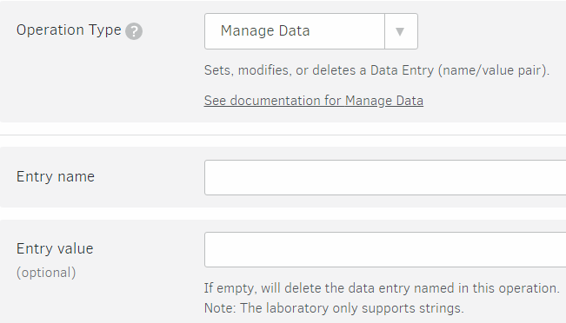
Smart Stellar – Crypto Services
5. Manage Data
Related to: Stellar Account
Allows you to set, modify or delete a Data Entry (name/value pair) that is attached to a particular account. An account can have an arbitrary amount of Data Entries attached to it. Each Data Entry increases the minimum balance needed to be held by the account.
Can be used for: Store strings up to 64 byte length for each entry. Useful for services like “Proof of Existence”
For each data set 0.5 base fee is reserved.

Slide 13
Smart Stellar – Crypto Services
6. Channel Accounts
Related to: Stellar Account, Transaction
A channel is simply another Stellar account that is used not to send the funds, but as the “source” account of the transaction.
Can be used for: To reach a high rate of transactions without getting problems with the correct sequence number as the sending order on the horizon server is not guaranteed.

Slide 14
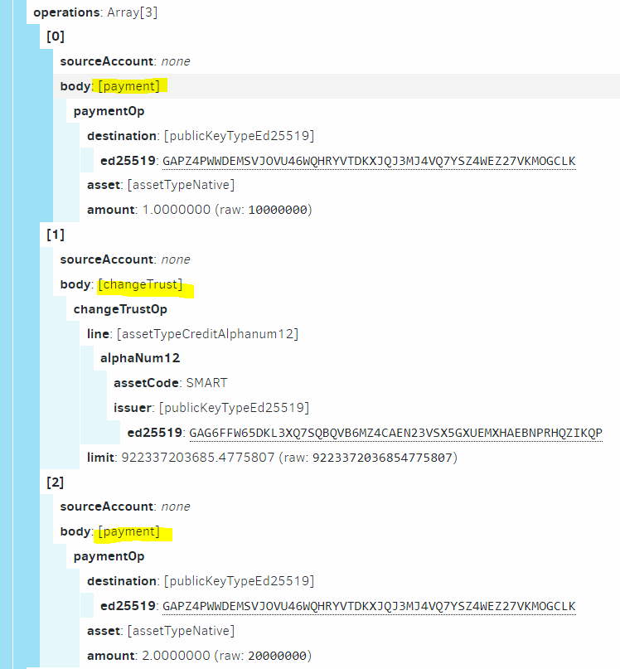
Smart Stellar – Crypto Services
7. Batching / Atomicity
Related to: Transaction
Batching is the concept of including multiple operations in one transaction. Atomicity is the guarantee that given a series of operations, upon submission to the network if one operation fails, all operation in the transaction fails.

Slide 15
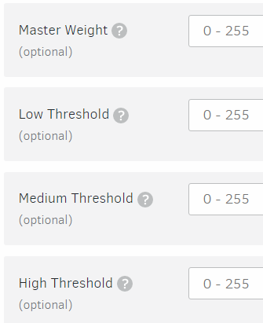
Smart Stellar – Crypto Services
8. Signatures, Thresholds and Weights (0-255)
Related to: Stellar Account Each account has one master key (=secret key). The weight of this key can be set between 0 to 255. An account can have additional signers with own keys and weights (0-255). Each account also has three different thresholds.
Can be used for: Multisignature accounts, for escrow accounts and also to block certain accounts. The last one is used to block token issuer accounts, so it is guaranteed that no further tokens can be issued.
Low Security: Transaction processing, Charging a fee or updating the sequence number for the source account, Allow Trust operation, Bump Sequence
Medium Security: All other operations
High Security: Set Options to change the signers or the thresholds, Allows you to create a set of signers that give or revoke access to the account, Account Merge to merge accounts

Slide 16
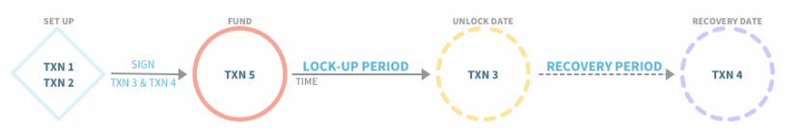
Smart Stellar – Crypto Services
2-Party Multisignature Escrow Account with Time Lock & Recovery
Ben Bitdiddle sells 50 CODE tokens to Alyssa P. Hacker, under the condition that Alyssa won’t resell the tokens until one year has passed.
Ben doesn’t completely trust Alyssa so he suggests that he holds the tokens for Alyssa for the year.
Alyssa protests. How will she know that Ben will still have the tokens after one year? How can she trust him to eventually deliver them?
Additionally, Alyssa is sometimes forgetful. There’s a chance she won’t remember to claim her tokens at the end of the year long waiting period. Ben would like to build in a recovery mechanism so that if Alyssa doesn’t claim the tokens, they can be recovered. This way, the tokens won’t be lost forever.
https://www.stellar.org/developers/guides/walkthroughs/stellar-smart-contracts.html

Slide 17
Smart Stellar – Crypto Services
Smart Contracts Architecture Models
Decentralized Apps
This is the classical approach most wallets follow. An app is installed as a mobile or desktop version on the users device.
+ This is relatively risk free regarding legal liability with usage of the Apache “AS IS” warranty. As the user takes full control and responsibility over the app.
+ Also it’s not so attractive to hackers as they “only” get access to one user compared with any centralized solution.
As the app only runs when the user is online, the possibilities regarding time related smart contracts is very limited.

Slide 18
Smart Stellar – Crypto Services
Smart Contracts Architecture Models
Apps with API to centralized server
+ The server can be used to store presigned transactions. This enables timed and recurring payments.
+ Complex work flows can be designed and realized.
- Legal aspects need to be considered: a) in case of a non-custodian wallet (no access to funds), it is less critical b) if the secret key is stored on server side (full access to funds), bank regulations apply
- Security Level a) in case of a non-custodian wallet (no access to funds), there is no incentive for hackers b) if the secret key is stored on server side (full access to funds), extra security precautions should be taken

Slide 19
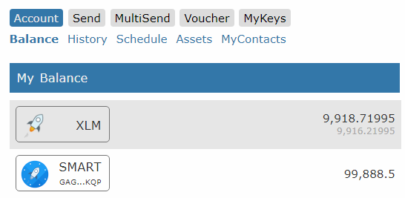
Smart Stellar – Crypto Services
Smart Stellar Services
Wallet
Timed and Recuring Payments
MultiSend Automated payout to multiple accounts.
Voucher Management Vouchers can be created on demand by SMART and redeemed by the user online.
MyKeys: An one page view with accounts of your interest

Slide 20
Workflow Multisend API-Service (Non-Custodian)
Client
App
Smart Stellar Server
App
1
Request
File
Upload
2
Create Transactions
Transactions
App
3
DB
Sign XDRs
Presigned Transactions
4
Submit Transactions
on Date
App
Pay Status
5
View Status
Send Pay Status
On Request
Note: Worflow without transfering or storing the secret key.

Slide 21
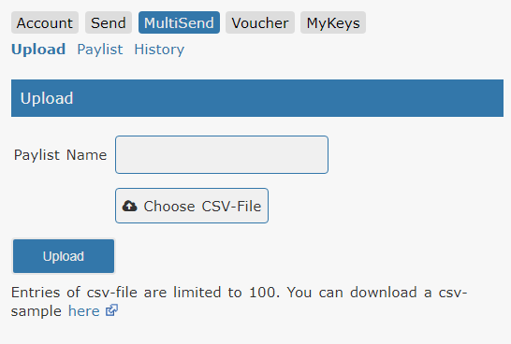
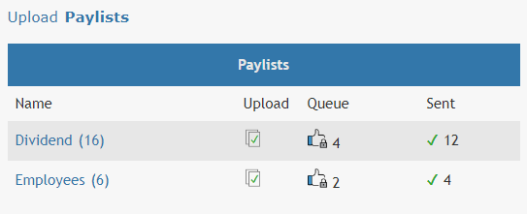
Smart Stellar – Crypto Services
MultiSend – 1) Upload
Enables multiple payments to specific destinations and dates.
Easy upload by CSV-File.
MultiSend – 2) Paylist
Manage your payments in paylists and always know which payments are already done or open.

Slide 22
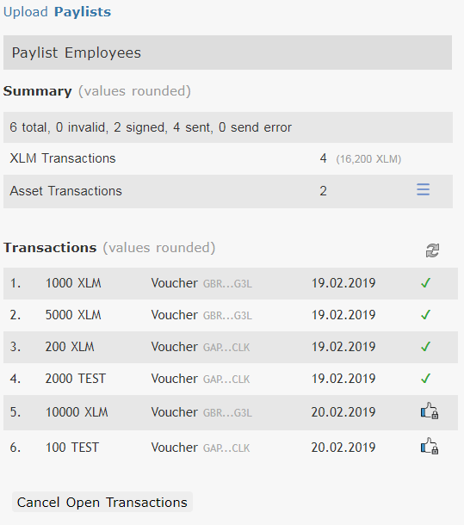
Smart Stellar – Crypto Services
MultiSend – 3) Detailed View
See the full payment plan. Also with a summary about the total amount of XLM and assets to be sent.
You also can cancel open payments, if you need to.

Slide 23


Smart Stellar – Crypto Services
Team
Hans Woppmann – Founder, CTO Senior IT-Consultant, Fullstack Developer and Teamlead in 50+ projects. Blockchain Developer since 2013, Founder SmartStellar.org. Worked at BMW, Atos, Altran
Peter Pansegrau – Co-Founder, Business Development, Quality Assurance Senior IT-Consultant, Testmanagement and Quality Engineering, Co-Founder SmartStellar.org. Worked at Atos, T-Systems
Luke Carriere – Co-Founder, Marketing & Sales CMO of B2B e-commerce technology startups, Co-Founder SmartStellar.org. Worked at Witbe, Cleeng, Piano

Slide 24
Smart Stellar – Crypto Services
Jobs at Smart Stellar
We are looking for crypto enthusiasts
Write to contact@smartsteller.org
or join our open monthly meetings 3rd Thursday at 19:00 CET

Slide 25
Smart Stellar – Crypto Services
Thank you for your time and interest!

Slide 26
Smart Stellar – Crypto Services
Appendix with Screenshots
The following pages show screenshots of the existing services available on smartstellar.org

Slide 27
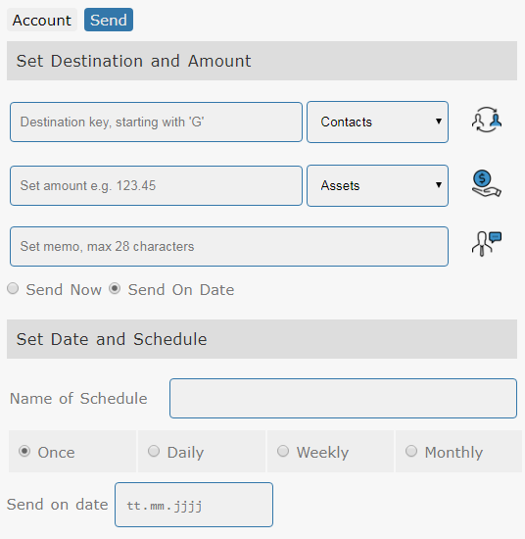
Smart Stellar – Crypto Services
Date Related Payments
First platform which enables date related payment on the Stellar Ecosystem.
To enable date related payments a smart contract is created which is presigned and time bound on a certain day.
See smartstellar.org for a live demo

Slide 28
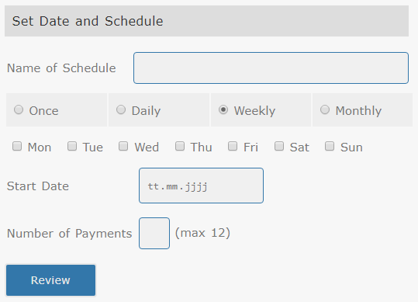
Smart Stellar – Crypto Services
Recurring Payments
As know from other applications like Outlook it is possible to set recurring payments.
See smartstellar.org for a live demo

Slide 29
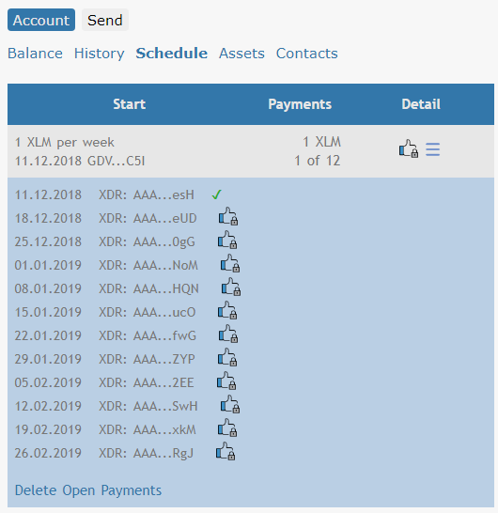
Smart Stellar – Crypto Services
Schedule Management
Recurring Payments are organized in schedules. State and time of submission is displayed in one view.

Slide 30
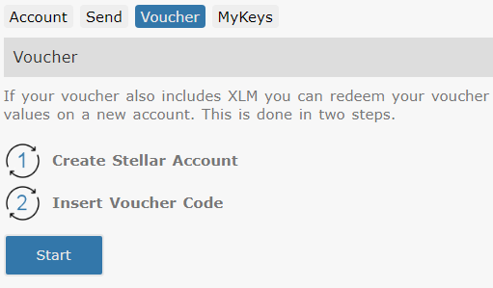
Smart Stellar – Crypto Services
Asset Vouchers
Vouchers on XLM or any other asset can be created and distributed by email. In case the user has no valid Stellar account, the account is created together with the redemption of the voucher.

Slide 31
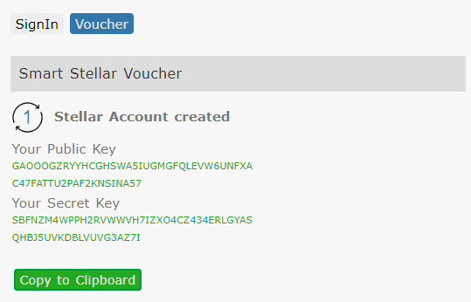
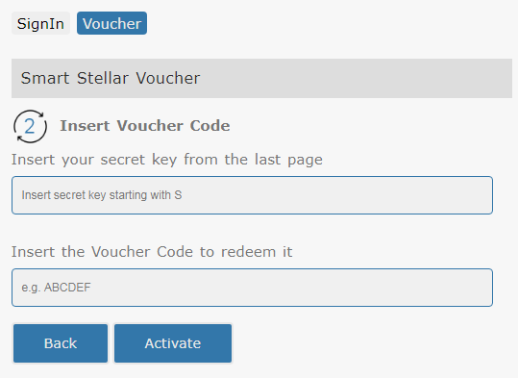
Smart Stellar – Crypto Services
Voucher Redemption in 2 Steps

Slide 32
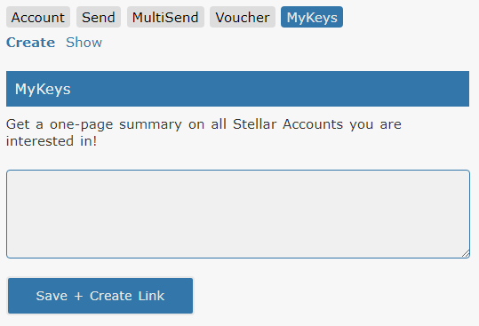
Smart Stellar – Crypto Services
MyKeys enables an one page view on all accounts of interest.
MyKeys – 1) Insert Keys
Name, key;
Name, key;
….

Slide 33
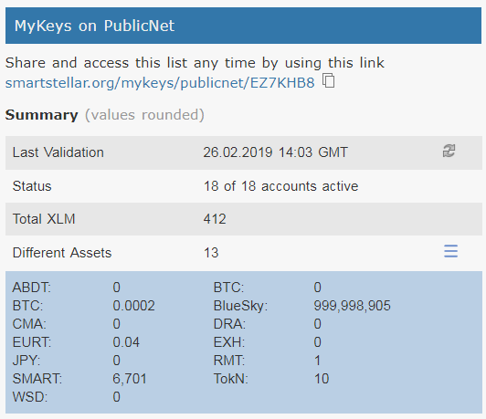
Smart Stellar – Crypto Services
MyKeys – 2) Account Summary
The summary shows
Last validation date
If accounts are active or not
Total XLM
Number of different assets and also total amount

