Slide 1
<<topic>>
<<level>>
OBJECTIVES: <<objectives>>

Slide 2
Inter-Act Online
By <<author>>

Slide 3
<<quote>>
—<<qperson>>

Slide 4
01
02
Review
INTRODUCTION
<<previoustopic>>
<<topic>>
03
04
ACTIVITY
TEST
Activity Set for <<topic>>
Test for <<topic>>

Slide 5
01.
Review
<<previoustopic>>
<<previousformula>>
<<previousex1>>
<<previousq1>>
<<previouswhq1>>
<<previouscommonq1>>

Slide 6
Introduction
<<intro>>
.02

Slide 7
<<picturetitle>>
<<picturecase>>

Slide 8
<<topic>>
<<formula>>
Auxiliary | Modal
Verb
Subject
Complement
<<aux>>
<<verbform>>
<<subjectexp>>
<<auxexp>>
<<verbformexp>>
<<complementexp>>

Slide 9
<<topic>>
<<formula>>
Auxiliary | Modal
Verb
Subject
Complement
<<aux>>
<<verbform>>
<<subjectexp>>
<<auxexp>>
<<verbformexp>>
<<complementexp>>
Nomarker just text
wtf
wtf2

Slide 10
<<topic>>
<<formula>>
<<uses>>
Examples:
<<ex1>>
<<ex2>>
<<ex3>>

Slide 11
03.
Activity Practice
Do your best!

Slide 12
HOW ABOUT THE PERCENTAGES?
Conversation
Grammar Comprehension
Spanish Connection
Vocabulary
True or False
Choose the correct
Fill in the blanks
Review this function in Spanish
Video Conversation
Practice Vocabulary and Pronunciation

Slide 13
True or False
Statement 1 | True | False
<<tf1>> | True | False
<<tf2>> | True | False
<<tf3>> | True | False

Slide 14
Choose the correct statement for <<topic>>
Statement 1 | Statement 2 | Statement 3 | Statement 4
<<tb1>> | <<tb2>> | <<tb3>> | <<tb4>>
<<tb5>> | <<tb6>> | <<tb7>> | <<tb8>>
<<tb9>> | <<tb10>> | <<tb11>> | <<tb12>>

Slide 15
Fill in the Blanks!
<<fb1>> [fb1a, fb1b]
<<fb2>> [fb1a, fb1b]
<<fb3>> [fb1a, fb1b]
<<fb4>> [fb1a, fb1b]
<<fb5>> [fb1a, fb1b]
<<fb6>> [fb1a, fb1b]
<<fb7>> [fb1a, fb1b]
<<fb8>> [fb1a, fb1b]
<<fb9>> [fb1a, fb1b]
<<fb10>> [fb1a, fb1b]

Slide 16
Spanish Connection
Learn the grammar in Spanish!

Slide 17
<<topic>>
<<formula>>
Auxiliary | Modal
Verb
Subject
Complement
<<aux>>
<<verbform>>
<<subjectexp>>
<<auxexp>>
<<verbformexp>>
<<complementexp>>
Sujeto
Complement
<<verbformsp>>
<<subjectexpsp>>
<<auxexpsp>>
<<verbformexpsp>>
<<complementexpsp>>

Slide 18

Video Conversation
<<videolink>>

Slide 19
TEST
Click on the following link to test your knowledge
<<testlink>>
Go to test link
See you soon!
“Always be ready to break away from convention” -InterAct

Slide 20
InterAct Speaking Center
Contact:
55-81-40-40
sales@interactmexico.com
https://www.Interactmexico.com

Slide 21
Types of Questions for <<topic>>
<<qformula>>
Yes/No Questions
Wh Questions
Common Questions
<<q1>>
<<q2>>
<<q3>>
<<whq1>>
<<whq2>>
<<whq3>>
<<commonq1>>
<<commonq2>>
<<commonq3>>

Slide 22
REINFORCE THE CONCEPT USING INFOGRAPHICS!
Despite being red, Mars is a cold place, not hot. It’s full of iron oxide dust
Venus has a beautiful name, but it’s terribly hot, even hotter than Mercury
Mercury is the closest planet to the Sun and is only a bit larger than our Moon

Slide 23

IF YOU WANT TO MODIFY THIS GRAPH, CLICK ON IT, FOLLOW THE LINK, CHANGE THE DATA AND REPLACE IT
MARS
MERCURY
Despite being red, Mars is a cold place, not hot
Mercury is the closest planet to the Sun
VENUS
NEPTUNE
Venus has a beautiful name, but it’s terribly hot
Neptune is the farthest planet from the Sun

Slide 24
INFOGRAPHICS MAKE YOUR IDEA UNDERSTANDABLE…
Saturn is the ringed one. It’s composed mostly of hydrogen and helium
Neptune is the farthest planet from the Sun and the fourth-largest by diameter
Venus has a beautiful name and is the second planet from the Sun. It’s very hot
Mercury is the closest planet to the Sun and the smallest one in our Solar System

Slide 25
A TIMELINE ALWAYS WORKS FINE
MARS
VENUS
Despite being red, Mars is a cold place, not hot. It’s full of iron oxide dust
Venus has a beautiful name and is the second planet from the Sun
Mercury is the closest planet to the Sun and is only a bit larger than our Moon
Neptune is the farthest planet from the Sun and the fourth-largest by diameter
Saturn is the ringed one. It’s composed mostly of hydrogen and helium
MERCURY
NEPTUNE
SATURN

Slide 26
DO YOU PREFER THIS GRAPH?
35%
32%
23%
10%

Slide 27
Summary for <<topic>>
Formula
Example
Question
<<formula>>
<<ex1>>
<<q1>>
Uses
<<aux>>
Conversation
<<uses>>
<<auxexp>>
<<videolink>>

Slide 28
OUR SERVICES
$35
You can explain your product or your service
Characteristic
Characteristic
$60
You can explain your product or your service
Characteristic
Characteristic
$85
You can explain your product or your service
Characteristic
Characteristic
BASIC
PRO
PREMIUM

Slide 29
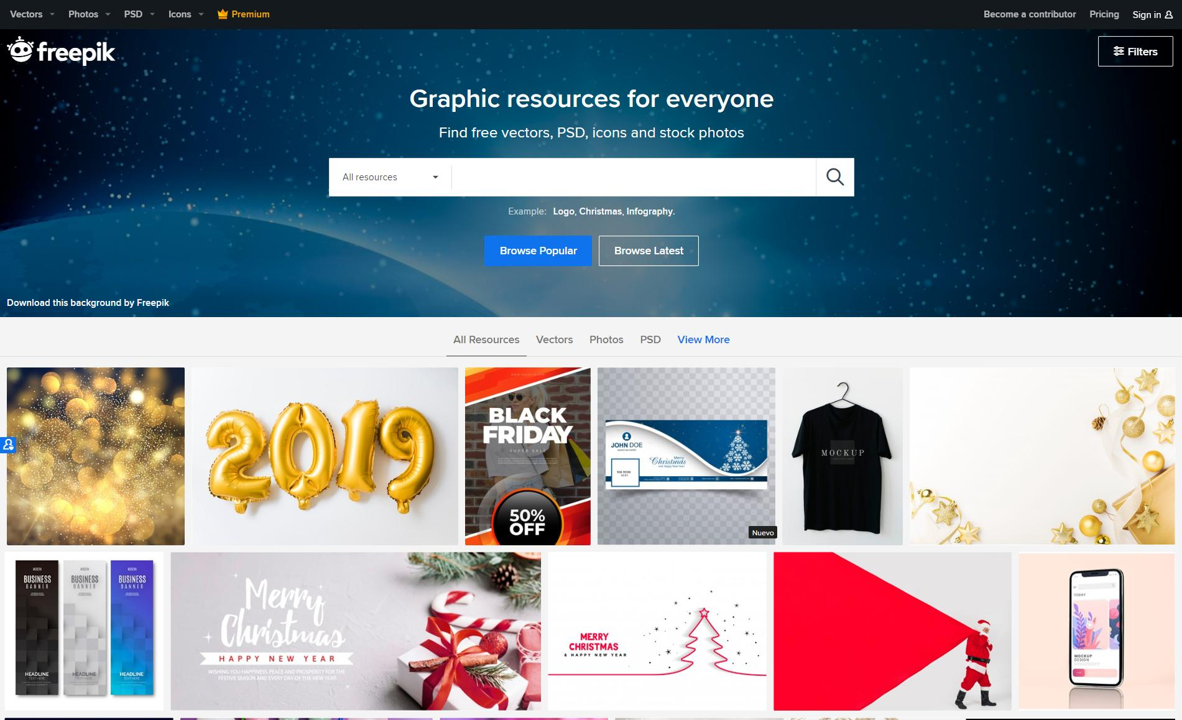
DESKTOP SOFTWARE
You can replace the image on the screen with your own work. Just delete this one, add yours and send it to the back

Slide 30
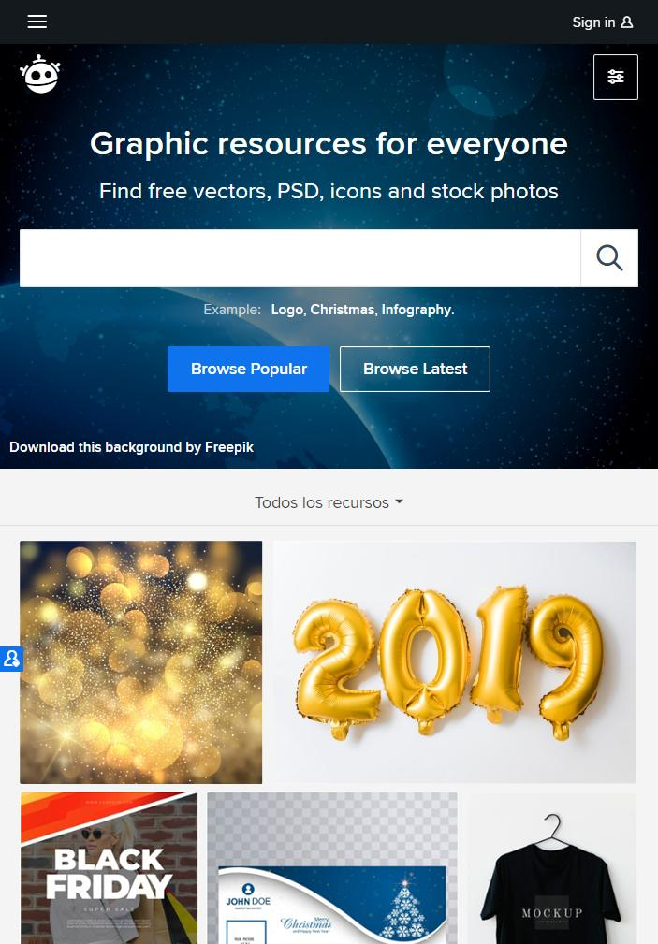
TABLET APP
You can replace the image on the screen with your own work. Just delete this one, add yours and send it to the back

Slide 31
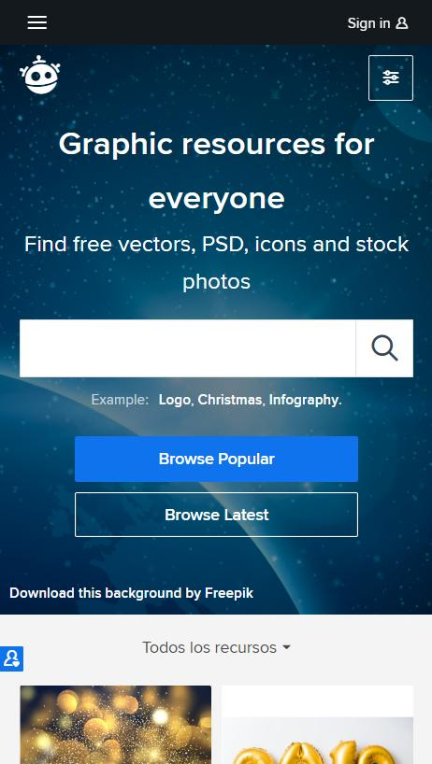
MOBILE WEB
You can replace the image on the screen with your own work. Just delete this one, add yours and send it to the back

Slide 32
OUR TEAM
JOHN DOE
You can replace the image on the screen with your own
JENNA DOE
You can replace the image on the screen with your own

Slide 33
CREDITS
This is where you give credit to the ones who are part of this project.
Presentation template by Slidesgo
Icons by Flaticon
Images & infographics by Freepik
Author introduction slide photo created by Freepik
Text & Image slide photo created by Freepik.com
Big image slide photo created by Freepik.com

