Slide 1
<<topic>>
<<level>>
<<objectives>>

Slide 2
Inter-Act Online
By <<author>>

Slide 3
<<quote>>
—<<qperson>>

Slide 4
01
02
INTRODUCTION
PRESENTATION
<<intro>>
<<case>>
03
04
ACTIVITY
CONCLUSION
<<activity>>
<<recap>>

Slide 5
01.
THIS IS A GREAT HEADLINE
And this is the subtitle that makes it comprehensible

Slide 6
<<function>>
<<uses>>
Examples:
<<ex1>>
<<ex2>>
<<ex3>>

Slide 7
MAYBE YOU NEED TO DIVIDE THE CONTENT
MERCURY
VENUS
Mercury is the closest planet to the Sun and the smallest one in the Solar System—it’s only a bit larger than our Moon. The planet’s name has nothing to do with the liquid metal, since it was named after the Roman messenger god, Mercury
Venus has a beautiful name and is the second planet from the Sun. It’s terribly hot—even hotter than Mercury—and its atmosphere is extremely poisonous. It’s the second-brightest natural object in the night sky after the Moon

Slide 8
YOU COULD USE THREE COLUMNS, WHY NOT?
MARS
JUPITER
MERCURY
Despite being red, Mars is a cold place, not hot. It’s full of iron oxide dust, which gives the planet its reddish cast
It’s a gas giant and also the biggest planet in our Solar System. Jupiter is the fourth-brightest object in the sky
Mercury is the closest planet to the Sun and the smallest one in the Solar System—it’s only a bit larger than our Moon

Slide 9
A PICTURE ALWAYS REINFORCES THE CONCEPT
Images reveal large amounts of data, so remember: use an image instead of long texts. Your audience will appreciate that

Slide 10
A PICTURE IS WORTH A THOUSAND WORDS

Slide 11
AWESOME WORDS
Key words are great for catching your audience’s attention

Slide 12
.02
SECTION TITLE
And this is the subtitle that makes it comprehensible

Slide 13
REINFORCE THE CONCEPT USING INFOGRAPHICS!
Despite being red, Mars is a cold place, not hot. It’s full of iron oxide dust
Venus has a beautiful name, but it’s terribly hot, even hotter than Mercury
Mercury is the closest planet to the Sun and is only a bit larger than our Moon

Slide 14

IF YOU WANT TO MODIFY THIS GRAPH, CLICK ON IT, FOLLOW THE LINK, CHANGE THE DATA AND REPLACE IT
MARS
MERCURY
Despite being red, Mars is a cold place, not hot
Mercury is the closest planet to the Sun
VENUS
NEPTUNE
Venus has a beautiful name, but it’s terribly hot
Neptune is the farthest planet from the Sun

Slide 15
INFOGRAPHICS MAKE YOUR IDEA UNDERSTANDABLE…
Saturn is the ringed one. It’s composed mostly of hydrogen and helium
Neptune is the farthest planet from the Sun and the fourth-largest by diameter
Venus has a beautiful name and is the second planet from the Sun. It’s very hot
Mercury is the closest planet to the Sun and the smallest one in our Solar System

Slide 16
… AND THE SAME GOES FOR TABLES
 | MASS (earths) | DIAMETER (earths) | SURFACE GRAVITY (earths)
MERCURY | 0,06 | 0,38 | 0,38
MARS | 0,11 | 0,53 | 0,38
SATURN | 95,2 | 9,4 | 1,16

Slide 17
THIS IS A MAP
MARS
MERCURY
Despite being red, Mars is a cold place, not hot
Mercury is the closest planet to the Sun
VENUS
NEPTUNE
Venus has a beautiful name, but it’s terribly hot
Neptune is the farthest planet from the Sun

Slide 18
A TIMELINE ALWAYS WORKS FINE
MARS
VENUS
Despite being red, Mars is a cold place, not hot. It’s full of iron oxide dust
Venus has a beautiful name and is the second planet from the Sun
Mercury is the closest planet to the Sun and is only a bit larger than our Moon
Neptune is the farthest planet from the Sun and the fourth-largest by diameter
Saturn is the ringed one. It’s composed mostly of hydrogen and helium
MERCURY
NEPTUNE
SATURN

Slide 19
DO YOU PREFER THIS GRAPH?
35%
32%
23%
10%

Slide 20
HOW ABOUT THE PERCENTAGES?
MARS
VENUS
NEPTUNE
MERCURY
Despite being red, Mars is a cold place, not hot
Venus has a beautiful name, but it’s terribly hot
Neptune is the farthest planet from the Sun
Mercury is the closest planet to the Sun

Slide 21
4,498,300,000
Big numbers catch your audience’s attention

Slide 22
333,000.00
earths is the Sun’s mass
24h 37m 23s
is Jupiter’s rotation period
386,000 km
is the distance between the Earth and the Moon

Slide 23
SOMETIMES, REVIEWING CONCEPTS IS A GOOD IDEA
MARS
VENUS
MERCURY
Despite being red, Mars is a cold place, not hot. It’s full of iron oxide dust
Venus has a beautiful name and is the second planet from the Sun
Mercury is the smallest planet in our Solar System
JUPITER
SATURN
NEPTUNE
Jupiter is a gas giant and the biggest planet in our Solar System
Saturn is a gas giant, composed mostly of hydrogen and helium
Neptune is the fourth-largest planet in oour Solar System

Slide 24
OUR SERVICES
$35
You can explain your product or your service
Characteristic
Characteristic
$60
You can explain your product or your service
Characteristic
Characteristic
$85
You can explain your product or your service
Characteristic
Characteristic
BASIC
PRO
PREMIUM

Slide 25
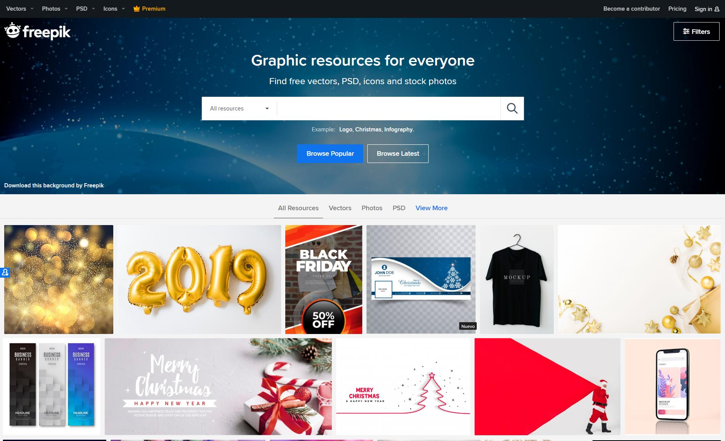
DESKTOP SOFTWARE
You can replace the image on the screen with your own work. Just delete this one, add yours and send it to the back

Slide 26
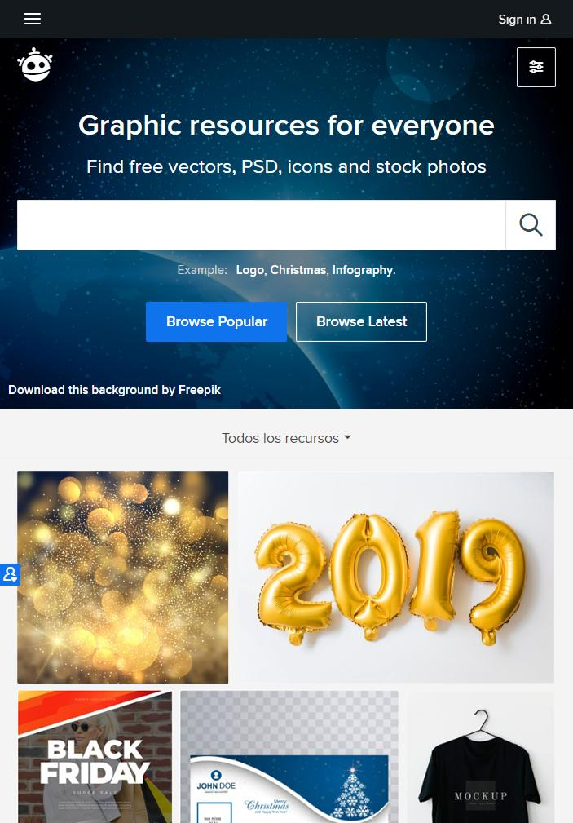
TABLET APP
You can replace the image on the screen with your own work. Just delete this one, add yours and send it to the back

Slide 27
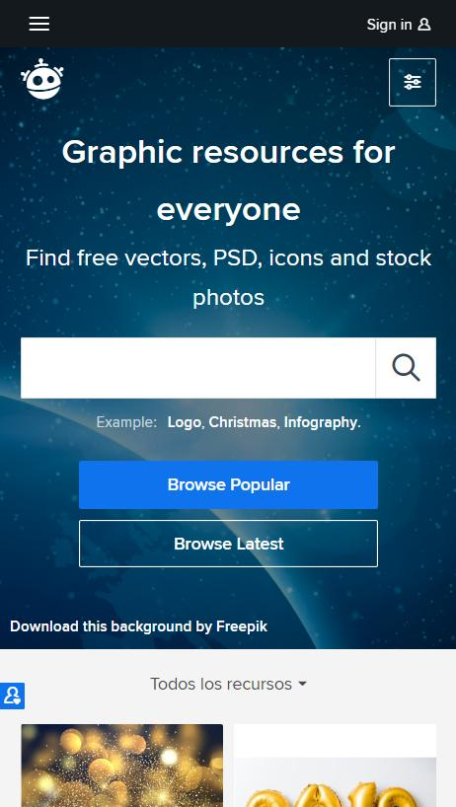
MOBILE WEB
You can replace the image on the screen with your own work. Just delete this one, add yours and send it to the back

Slide 28
OUR TEAM
JOHN DOE
You can replace the image on the screen with your own
JENNA DOE
You can replace the image on the screen with your own

Slide 29
THANKS!
Does anyone have any questions?
addyouremail@freepik.com
+91 620 421 838
yourcompany.com

Slide 30
CREDITS
This is where you give credit to the ones who are part of this project.
Presentation template by Slidesgo
Icons by Flaticon
Images & infographics by Freepik
Author introduction slide photo created by Freepik
Text & Image slide photo created by Freepik.com
Big image slide photo created by Freepik.com

Slide 31
RESOURCES
Did you like the resources on this template? Get them for free at our other websites.
Pack E-learning
Designer girl concept illustration
Social media
Documents
Statistics
Blogger post
At work
Business landing page
Business landing page
Business landing page
Resume

Slide 32
Instructions for use
In order to use this template, you must credit Slidesgo by keeping the Credits slide.
You are allowed to:
- Modify this template.
- Use it for both personal and commercial projects.
You are not allowed to:
- Sublicense, sell or rent any of Slidesgo Content (or a modified version of Slidesgo Content).
- Distribute Slidesgo Content unless it has been expressly authorized by Slidesgo.
- Include Slidesgo Content in an online or offline database or file.
- Offer Slidesgo templates (or modified versions of Slidesgo templates) for download.
- Acquire the copyright of Slidesgo Content.
For more information about editing slides, please read our FAQs:
https://slidesgo.com/faqs

Slide 33
Fonts & colors used
This presentation has been made using the following fonts:
Oswald
(https://fonts.google.com/specimen/Oswald)
Advent Pro
(https://fonts.google.com/specimen/Advent+Pro)
#434343
#999999
#f7965c
#ffc39f

Slide 35
Use our editable graphic resources...
You can easily resize these resources, keeping the quality. To change the color, just ungroup the resource and click on the object you want to change. Then, click on the paint bucket and select the color you want. Don’t forget to group the resource again when you’re done.

Slide 36
...and our set of editable icons
You can resize these icons, keeping the quality.
You can change the stroke and fill color; just select the icon and click on the paint-bucket/pen.
In Google Slides, you can also use Flaticon’s extension, allowing you to customize and add even more icons.

Slide 37
E-Learning Icons

Slide 38
Business Icons

Slide 39
Avatar Icons

Slide 40
Creative Process Icons

Slide 41
Educational Process Icons

Slide 42
Help & Support Icons

Slide 43
Medical Icons

Slide 44
Nature Icons

Slide 45
Performing Arts Icons

Slide 46
SEO & Marketing Icons

Slide 47
Teamwork Icons

Slide 48


