Slide 1
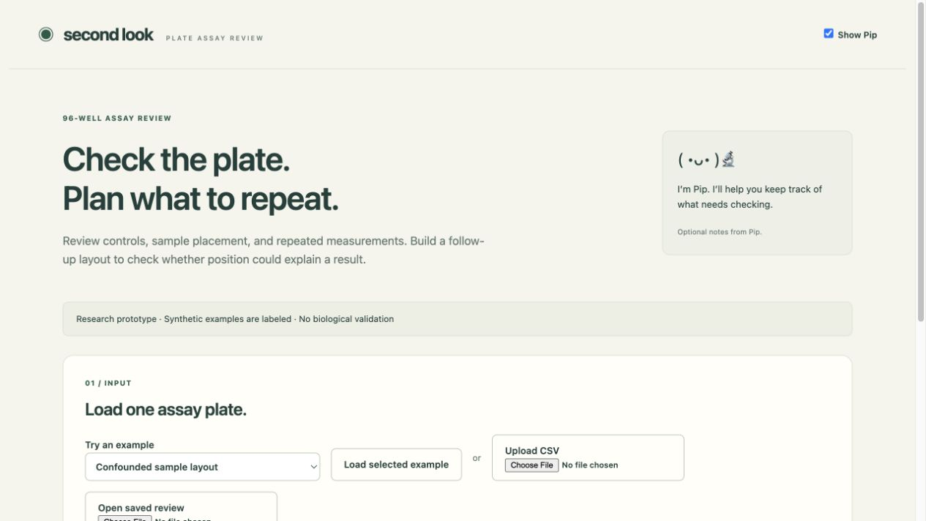
Second Look
A clearer reason to repeat an assay
Research prototype
Synthetic demonstration
Notes:
Opening, 0:00–0:15. Say: “Before spending another plate, what would you need to check? Second Look helps a researcher inspect a plate assay and plan a repeat when sample identity and position overlap.”
This is a research prototype. Use app footage for most of the video. Do not claim personal lab experience.

Slide 2
The position problem
Observed wells in the synthetic example
Sample | Edge wells | Interior wells
candidate_edge | 28 | 0
candidate_interior | 0 | 44
Sample identity and position overlap.
The app keeps that uncertainty visible.
Notes:
0:15–0:40. In the app, load Confounded sample layout, inspect it and open a measured well. Say: “This example is synthetic. One candidate appears only at the edge. The other appears only in the interior. A difference between them cannot tell us whether the sample, its position, or both contributed.”
Source: bundled synthetic confounded example seed 11. Counts verified in docs/screenshots/design-coverage.png and STATUS.md. Edge means row A/H or column 1/12. These descriptive counts do not establish an artifact.

Slide 3
Nemotron’s role
1 Researcher chooses the question and materials
2 Model requests limited analyses
3 Code computes evidence and validates references
4 Researcher reviews the suggested next step
NVIDIA Nemotron Nano on Nebius Token Factory
Notes:
0:40–1:15. Switch to the app. Choose selected sample IDs and Investigate selected samples by position. The browser live path has not yet completed successfully. Record a successful result only after separately verifying it. Otherwise use the failure narration in the companion script.
Say: “The optional AI review uses NVIDIA Nemotron Nano through Nebius. It requests limited analyses on materials I select. Code computes the results, and the model selects evidence references and a permitted next step. The researcher still decides what to repeat.”
Sources: agent_review.py, analysis_tools.py, server.py, docs/live-verification.json. Actual model: nvidia/NVIDIA-Nemotron-3-Nano-30B-A3B. One real two-stage structural success, followed by a local browser format failure. No claim of measured AI usefulness.

Slide 4
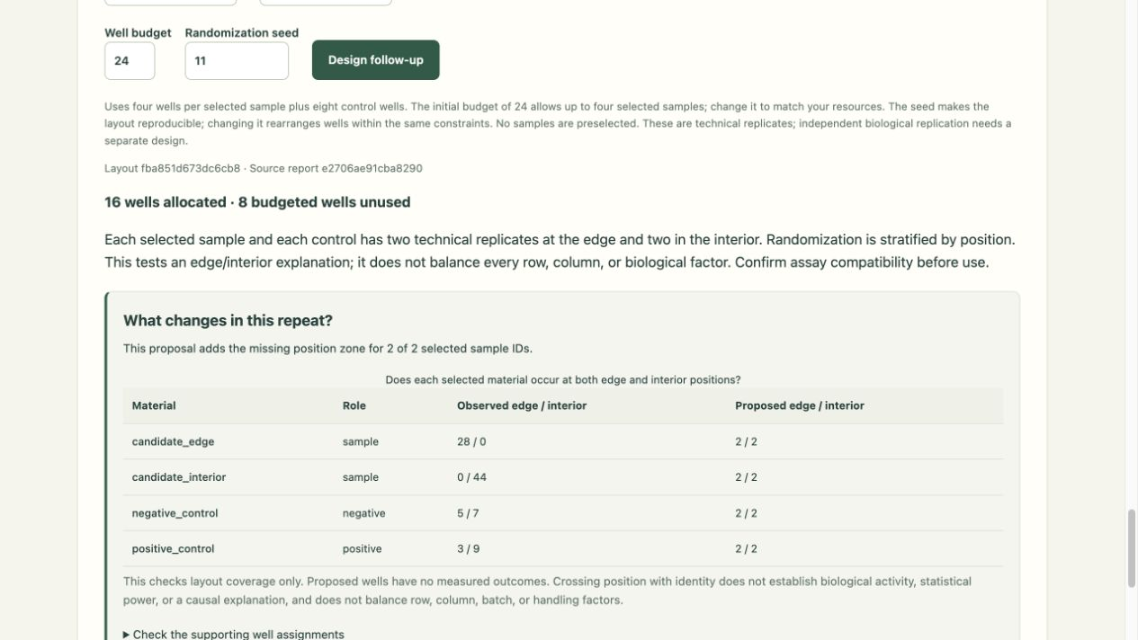
A repeat with an inspectable purpose
16 wells
allocated from
a budget of 24
Same materials
in both zones
Proposed wells have no measured outcomes.
Notes:
1:15–2:00. Show the app, both candidates selected, measured negative and positive controls, budget 24, seed 11. Design the follow-up. Say: “For these two candidates and two controls, the template allocates sixteen wells. Each material gets two edge and two interior wells. Eight budgeted wells remain unused. This table shows the missing position zone added for both candidates. It checks coverage, without predicting what the experiment will find.”
Source: actual app screenshot docs/screenshots/design-coverage.png, planner.py and design_coverage.py. Required wells = 4 × 2 samples + 8 controls = 16. Technical repeats do not establish biological replication, statistical power or causality.

Slide 5
Researcher review and current evidence
Compatibility review before layout export
Notes and source identifiers preserve context
103 Python checks
140 synthetic integrity cases
Live AI: one completed review
Later browser run: invalid output rejected
Biological validity and AI usefulness remain unestablished.
Notes:
2:00–2:30. Return to the app. Review compatibility, export a reviewed CSV and show report/layout identifiers. Add a short note if time permits.
Say: “Before export, the researcher checks compatibility. The handoff keeps notes and source identifiers with the proposal. The current checks cover calculation and layout integrity. They do not establish biological validity. One live AI review completed, and a later browser run rejected invalid output while keeping the local findings.”
Sources: docs/evaluation.json, tests/, STATUS.md, docs/live-verification.json. 103 Python checks, 3 Node note-draft checks, 140 synthetic integrity cases. These are development checks, not independent validation or model accuracy.

Slide 6
A decision the researcher can inspect
Try the synthetic examples
second-look-qz70.onrender.com
Read the implementation
github.com/BluePaper1122/second-look
Notes:
2:30–2:45. Closing. Say: “The goal is to make the reason for a repeat easier to inspect. You can try the examples and follow each proposal back to the measurements. The next step is assay-specific researcher review and a measured test of whether the AI adds value.”
Demo: https://second-look-qz70.onrender.com/
Code: https://github.com/BluePaper1122/second-look
The public demo currently has no model key. Do not imply publicly available live AI.
Presentation structure draws on the complete constrained workflow described in NVIDIA’s 2025 first-place Route Optimization Agent review and the specific human audience of Nomi, the AWS/NVIDIA grand-prize winner. This is an editorial inference, not a causal explanation of winning. Sources: https://developer.nvidia.com/blog/hackathon-winners-bring-agentic-ai-to-life-with-the-nvidia-nemo-agent-toolkit/ and https://nvidia-aws.devpost.com/updates/38660-and-the-winner-is . No winner code, images or claims copied.

Slide 7
Appendix: what the live test establishes
Verified
Still unresolved
Real Nebius runtime
Two-stage synthetic review
Validated computed references
Reliable live browser review
Public judge model access
Measured AI usefulness
Domain validation
The app rejected the later browser response and preserved local findings.
Notes:
Outside the timed video. Known integration evidence as of October 29, 2026 Chicago time. One successful two-stage CLI run does not show useful recommendations or a robust live UI. The failed browser run did not accept a model result. Up to four attempts were conservatively accounted for in that approved session. Public model activation was excluded from approval.
Source: docs/live-verification.json, STATUS.md at feca98e. No private data or credentials appear in this deck. This is a presentation, not evidence of an uploaded recording or completed submission.

