Slide 1
CS5200 Grind’n Coffee Company
By: Mitch, Noah and Stan

Slide 2
Motivation/Significance
Apply our knowledge of relational databases.
Apply knowledge of machine learning algorithms to build a recommendation engine.
To build a web application that could feasibly exist as an interesting product.
To learn how to work with DBAPI’s and Flask.
Notes:
We came into this project with a number of goals in mind. We wanted to apply our knowledge of relational database; we wanted to apply Noah’s experience with ml algorithms to build a recc engine; we wanted to build a web application that could reasibly exist an interesting product; and we wanted to take the opportunity to learn how to work with DBAPI’s and how to build web apps using Flask.

Slide 3
Problem Statement
Create a coffee distribution and subscription service that leverages machine learning techniques to recommend certain coffee products to consumers. This recommendation engine orders coffee products based on the ratings by consumers with similar tastes.
Notes:
Grind coffee is similar to the netflix of coffee. This type of service is different from many coffee websites, because as you and your peers buy and rate more coffee, our site improves recommendation by promoting popular coffee products and downvoting products that people don’t like as much

Slide 4
Application Architecture
SQLAlchemy
+
PyMySQL
MySQL
Python
Flask
Web App
Notes:
Backend: MySQL Server maintains our DBMS and Database
SQL Alchemy using PyMySQL DBAPI provides connectivity between Python and Flask. Both were well documented and reliable tools, which is why we ended up using them.
Functionality is mostly provided by code written in Python. Most queries and transactions are written in Python, and it acts as a staging area for transactions before commits.
The front-end application is provided by a Flask framework. When users try to interact with the app in a way that either queries or commits info, they do so through a front end built around the Flask framework.

Slide 5
Database Architecture
The architecture for this database is based around three main entities - Users, Orders, and Products.
Users - Personal Information, subscriptions, taste preferences
Orders - products being bought and by who
Products - Origin, roast, aroma
Notes:
Users make a profile when they buy coffee products or make a subscription. When they make a subscription, we know what their preferences are and how much they are alotted every month, so we can start automating orders
Orders tracks what people are buying and how much
Coffee products tracks name of products, how they smell, taste, origin, ets.

Slide 6
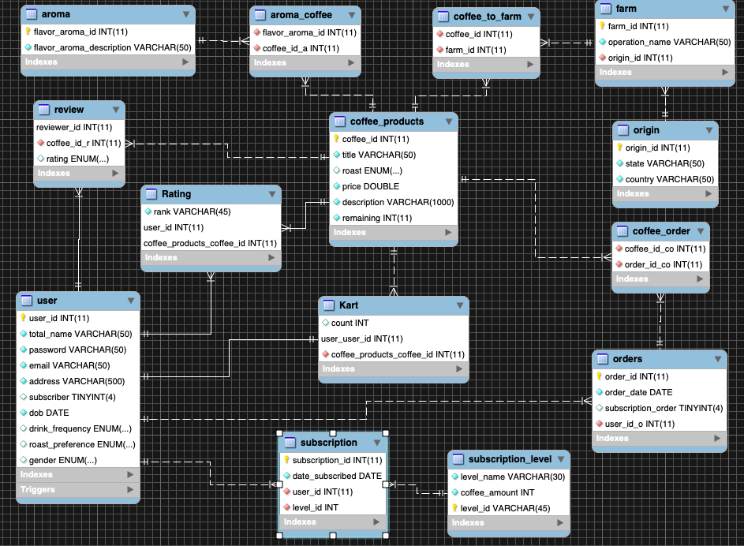
Notes:
Users and related join tables tell us what their preferences are and whether they have subscribed. The review join between user and products gives us what the popular opinion of the coffee products are. This data is then fed into a recommendation engine that gives recommendation rank for each product by user

Slide 7
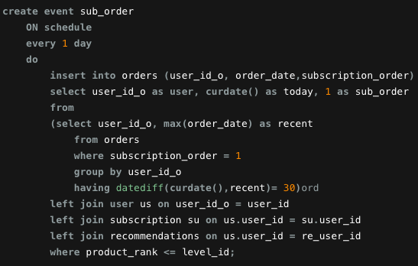
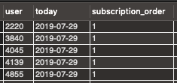
Automating Subscription Orders

Slide 8
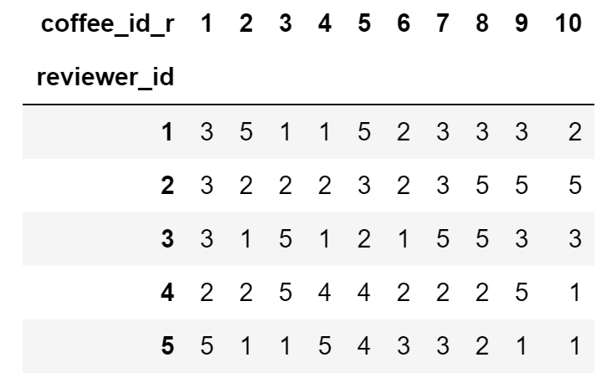
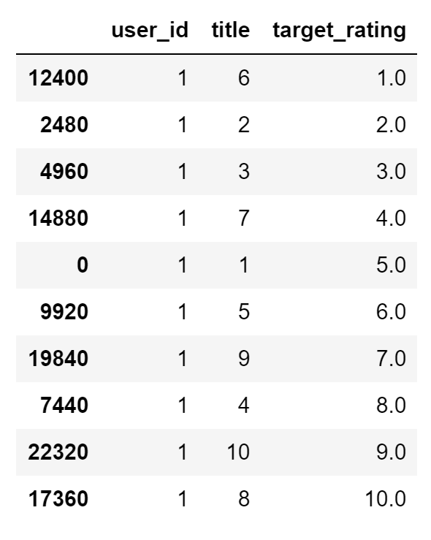
Recommendation
System

Slide 9
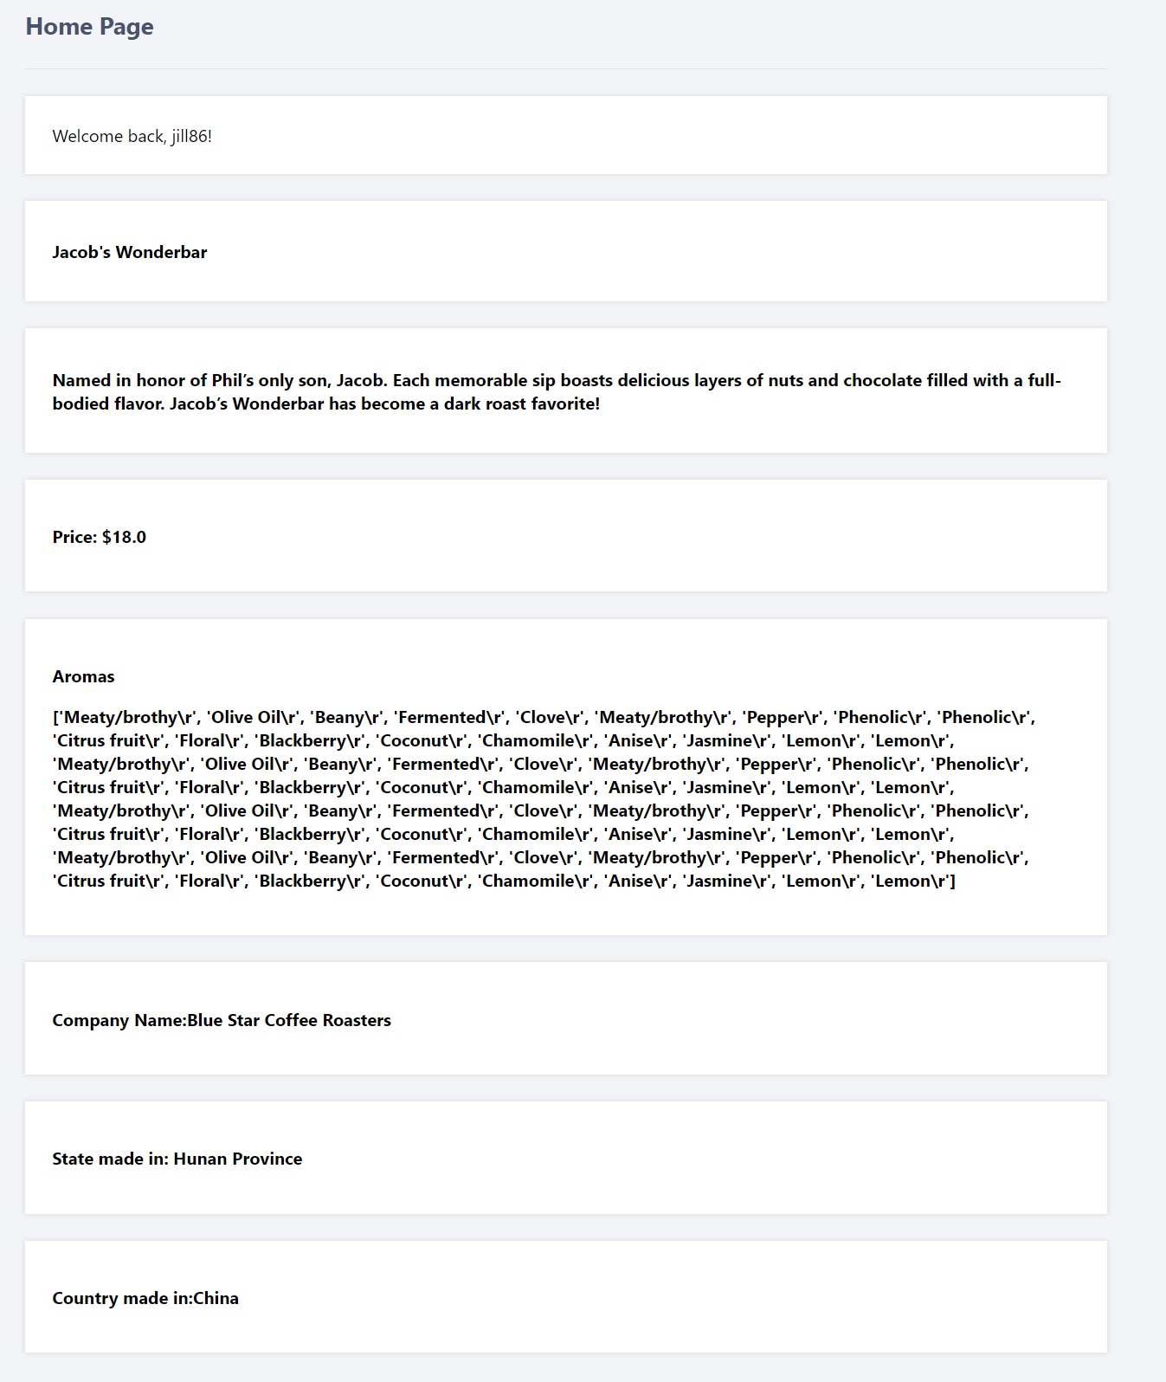
Use Case:
Product Description
Notes:
Backend: MySQL Server maintains our DBMS and Database
SQL Alchemy using PyMySQL DBAPI provides connectivity between Python and Flask. Both were well documented and reliable tools, which is why we ended up using them.
Functionality is mostly provided by code written in Python. Most queries and transactions are written in Python, and it acts as a staging area for transactions before commits.
The front-end application is provided by a Flask framework. When users try to interact with the app in a way that either queries or commits info, they do so through a front end built around the Flask framework.

Slide 10
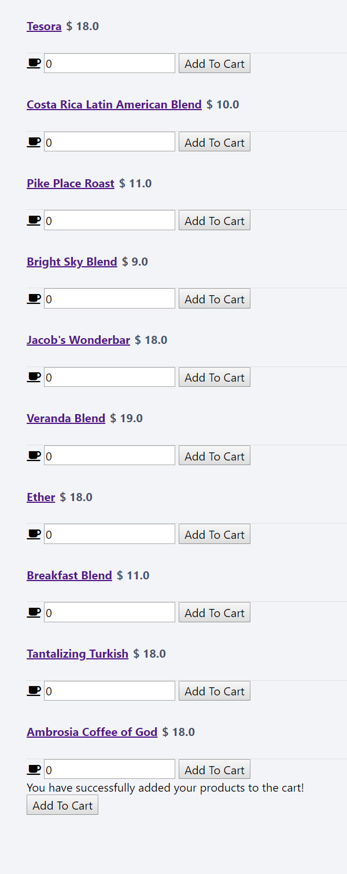
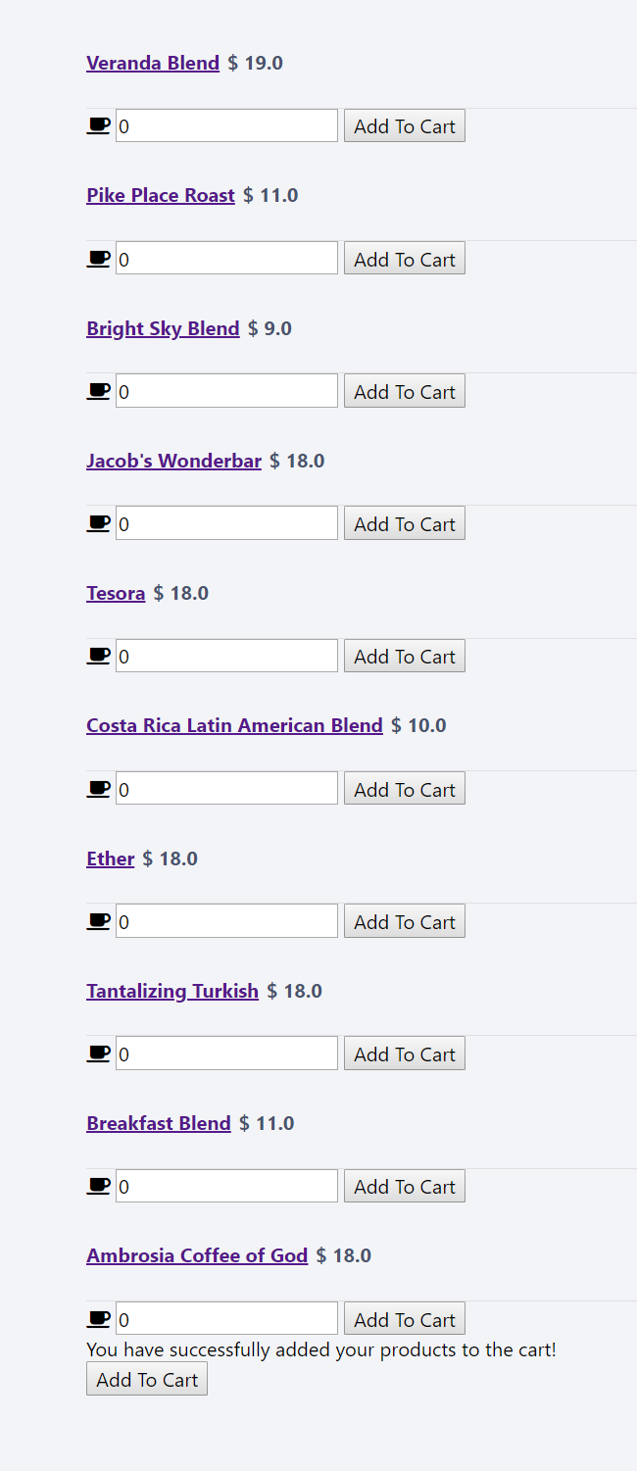
Use Cases: Product ordering by Recommendation
Jill86
Uriley

Slide 11

Use Case:
Login and
Registration

Slide 12
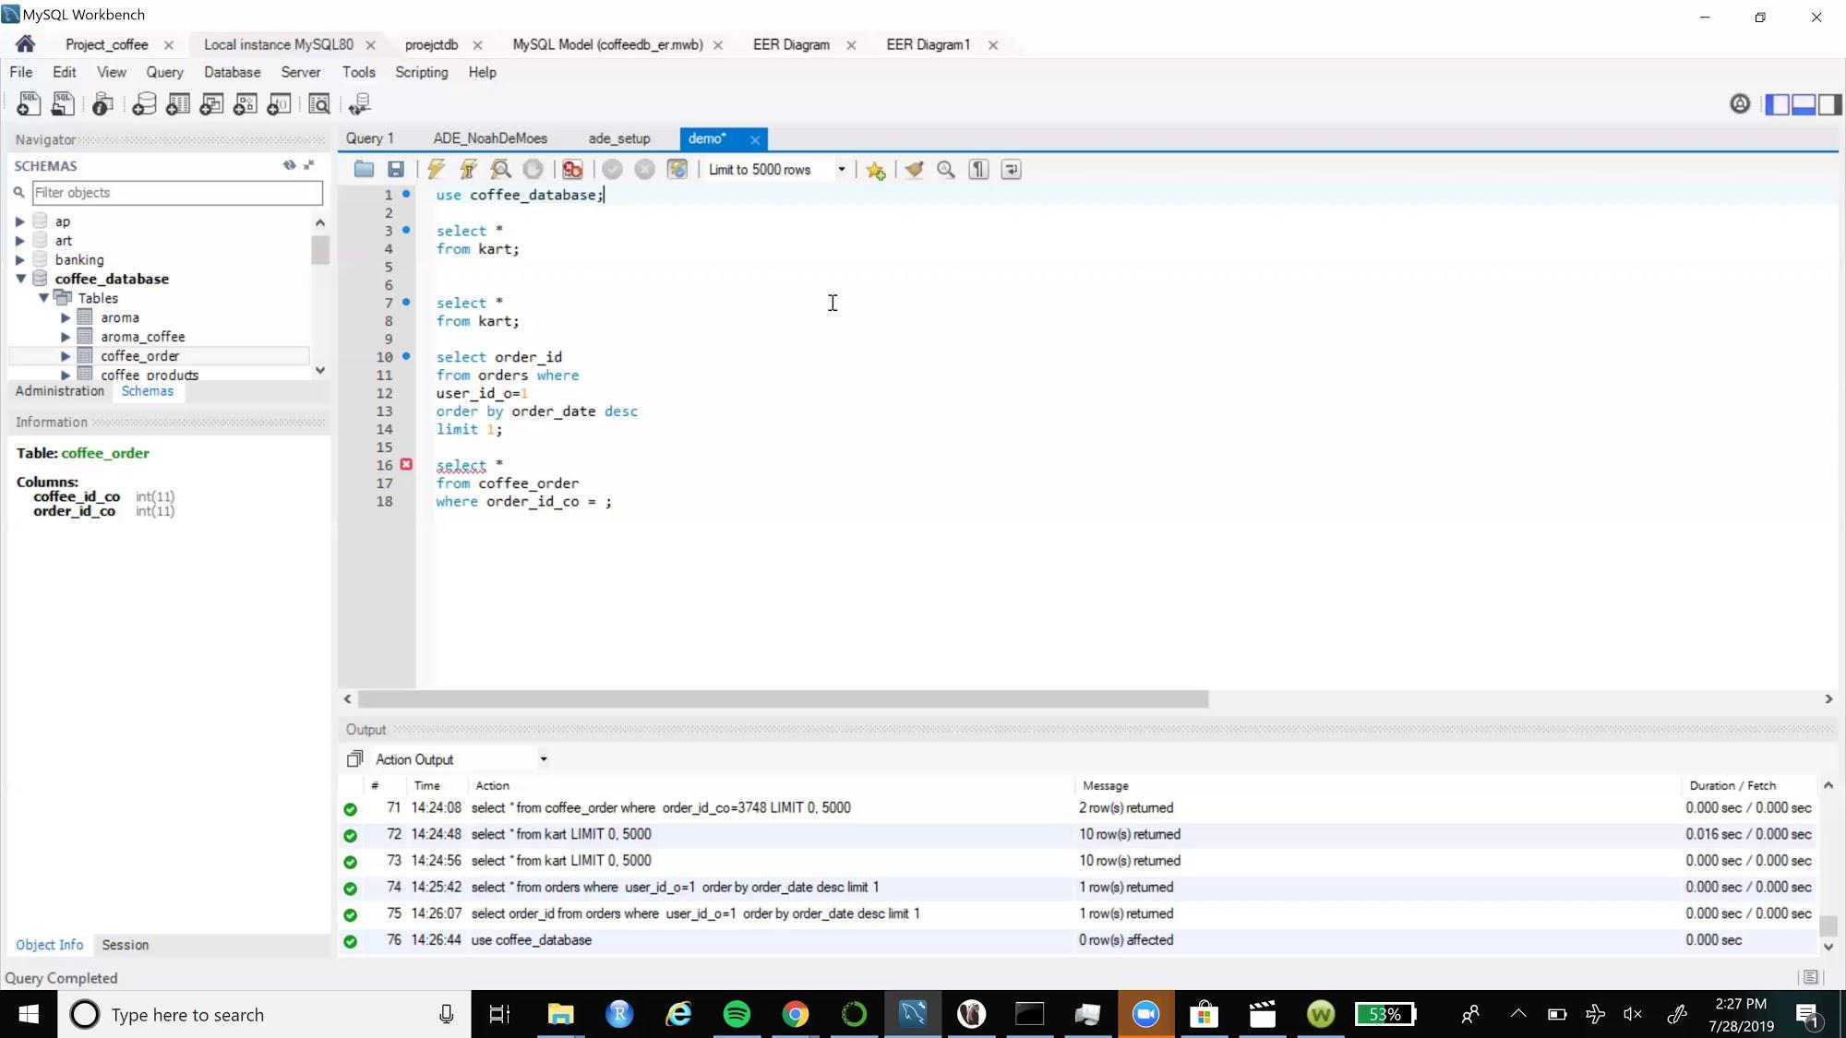
Use Case: Cart and
Checkout

