Slide 1
Congratulations !

Slide 2














Class
Building
class
Dog
class
Car
class
Object
The White House
instance of Building
Lassie
instance of Dog
Your car
instance of Car

Slide 3

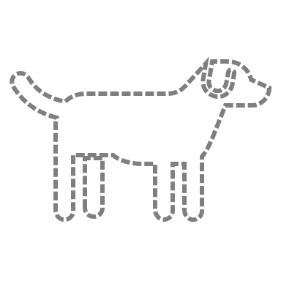

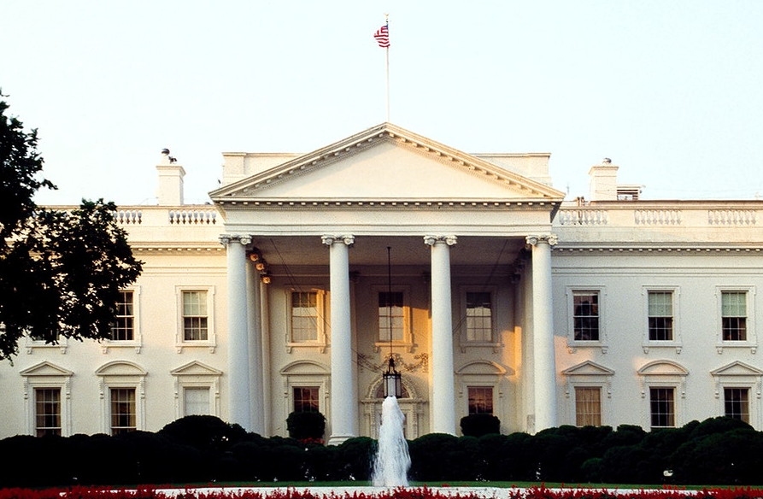
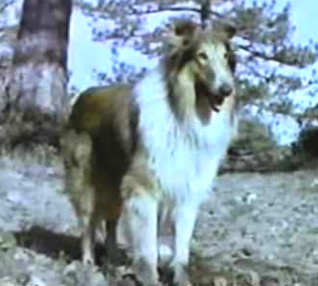
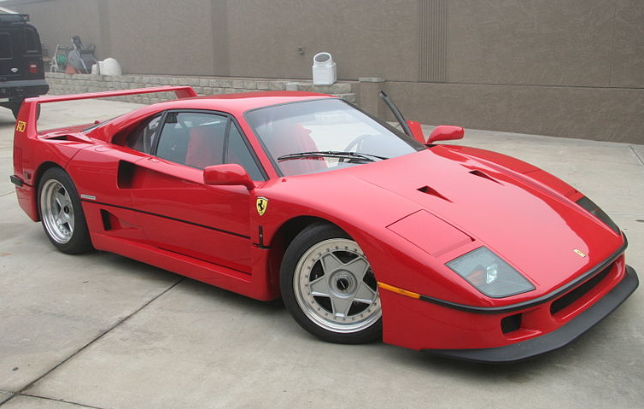
Class
House
class
Dog
class
Car
class
Object
The White House
instance of House
Lassie
instance of Dog
Your car
instance of Car

Slide 4
